Slide 1
Department of Environmental Quality
Air Quality Rules Readoption Stakeholder Meeting
December 2, 2016

Slide 2
Purpose of Today’s Meeting
Background
General Process
  Rule Groups
  Anticipated Timing
Group 1 Rules
  Stakeholder Feedback on Changes Needed
  Anticipated Timing
Questions?
Department of Environmental Quality

Slide 3
Background
G.S. 150B-21.3A requires agencies to review and update rules every 10 years
Following finalization of report classifying majority of air quality rules as necessary with substantive interest, Rules Review Commission (RRC) set readoption date for the air quality rules at its May 19, 2016 meeting
All 320 existing air quality rules are to be readopted by December 31, 2020
Department of Environmental Quality

Slide 4
General Process
Provide opportunity for Stakeholder dialogue/feedback on changes to existing rules that may be needed, then regular rulemaking process consistent with readoption provisions of the Administrative Procedures Act (APA)
Concept to Air Quality Committee (AQC)
Draft Rules to AQC
Request to Proceed to Comment and Hearing to Environmental Management Commission (EMC)
Public Comment Period and Hearing
Readoption by EMC
Rules Review Commission Approval
Department of Environmental Quality

Slide 5
Rule Groups &Anticipated General Timing
(subject to change)
Tentative General Timing (Subject to Change)
Group | Rules* | Target Stakeholder Meeting | Target EMC Adoption
1 | 02D .0100, .0200, .0300, .0400, .1300, .2000, .2200, .2300 | Early December 2016 | November 2017
2 | 02Q .0100, .0200, .0300, .0400, .0500, .0800, .0900 | Late January/February 2017 | Late 2017/Early 2018
3 | 02D .1100, .1200, .1700, 02Q .0700 | May/June 2017 | Summer 2018
4 | 02D .0540, .1800, .1900 | Late September 2017 | Fall 2018
5 | 02D .0600, .2100, .2600 | Late January/February 2018 | Late Spring/Summer 2019
6 | 02D .0500, .0900, .1000, .1400 | April/May 2018 | Summer/Fall 2019
*Some rules may shift groups as process progresses.
Department of Environmental Quality

Slide 6
Group 1 Rules Update Examples
  15A NCAC 02D
  SECTION .0100 ‑ DEFINITIONS AND REFERENCES
  SECTION .0200 ‑ AIR POLLUTION SOURCES
  SECTION .0300 ‑ AIR POLLUTION EMERGENCIES
  -administrative changes, e.g., update Department name, formatting, capitalization and punctuation; update who proclaims alerts at different levels to Secretary level
  SECTION .0400 ‑ AMBIENT AIR QUALITY STANDARDS
  -update .0405 to reflect 2015 Ozone NAAQS
  SECTION .1300 ‑ OXYGENATED GASOLINE STANDARD
  -formerly contingency measure for CO limited maintenance plan; appears no longer needed; reviewing further
  SECTION .2000 - TRANSPORTATION CONFORMITY
  -requirements set federally and reflected in rule; reviewing for any needed cross reference updates
  SECTION .2200 - SPECIAL ORDERS
  -requirements statutorily set; administrative process reflected in rule; no substantive changes identified
  SECTION .2300 - BANKING EMISSION REDUCTION CREDITS
  -update to reflect other federal trading programs in rule language
Department of Environmental Quality

Slide 7
Group 1 Rules Tentative Timing
(subject to change)
1/11/2017 - Concept to Air Quality Committee (AQC)
3/9/2017 - Draft Rules to AQC
5/11/2017 - Request to Proceed to Comment and Hearing to Environmental Management Commission (EMC)
6/15 through 8/14/2017 - Public Comment Period and Hearing
11/10/2017 - Readoption by EMC
12/21/2017 - Rules Review Commission Approval
Department of Environmental Quality

Slide 8
Group 1 Rules
Your turn…
Stakeholder comments on process, groupings or particular rules?
Department of Environmental Quality

Slide 9
Wrap Up
Next Group
  Group 2 Rules :
  15A NCAC 02Q - AIR QUALITY PERMIT PROCEDURES (excluding 02Q .0700)
  Stakeholder meeting tentatively late January 2017
Information to be available at
  http://deq.nc.gov/about/divisions/air-quality/air-quality-rules/periodic-review-existing-rules
Send comments to:
  daq.publiccomments@ncdenr.gov
  Type “Stakeholder Readoption Comment” in subject line
  Please submit comments by January 13, 2017
Questions/Feedback?
Department of Environmental Quality

Slide 10
Contact
Joelle Burleson, EIT, CPM
Rules Development Branch Supervisor
Division of Air Quality, Planning Section
North Carolina Department of Environmental Quality
919 707 8720 office
joelle.burleson@ncdenr.gov
Department of Environmental Quality

Slide 11
Thank you
Department of Environmental Quality

Slide 12
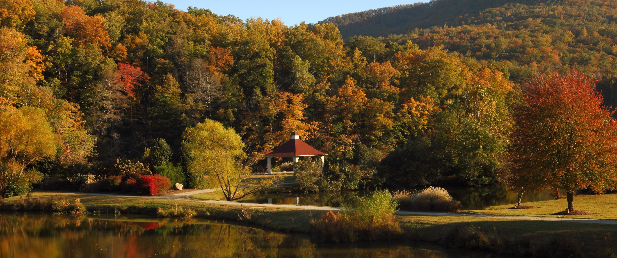
Department of Environmental Quality

