Slide 1
Department of Environmental Quality
Air Quality Rules Readoption Stakeholder Meeting
March 6, 2017

Slide 2
Purpose of Today’s Meeting
Background
General Process
  Rule Groups
  Anticipated Timing
Group 2 Rules
  Preliminary draft changes
  Stakeholder Feedback on Changes Needed
Group 1 Rules Update
  Comments Received
  Draft Rules Posted
  Next Steps
Questions?
Department of Environmental Quality

Slide 3
Background
G.S. 150B-21.3A requires agencies to review and update rules every 10 years
Following finalization of report classifying majority of air quality rules as necessary with substantive interest, Rules Review Commission (RRC) set readoption date for the air quality rules at its May 19, 2016 meeting
All 320 existing air quality rules are to be readopted by December 31, 2020
Department of Environmental Quality

Slide 4
General Process
Provide opportunity for Stakeholder dialogue/feedback on changes to existing rules that may be needed, then regular rulemaking process consistent with readoption provisions of the Administrative Procedures Act (APA)
Concept to Air Quality Committee (AQC)
Draft Rules to AQC
Request to Proceed to Comment and Hearing to Environmental Management Commission (EMC)
Public Comment Period and Hearing
Readoption by EMC
Rules Review Commission Approval
Department of Environmental Quality

Slide 5
Rule Groups &Anticipated General Timing
(subject to change)
Tentative General Timing (Subject to Change)
Group | Rules* | Target Stakeholder Meeting | Target EMC Adoption
1 | 02D .0100, .0200, .0300, .0400, .1300, .2000, .2200, .2300 | December 2, 2016^ | January 2018
2 | 02Q .0100, .0200, .0300, .0400, .0500, .0800, .0900 | March 6, 2017^ | Early 2018
3 | 02D .1100, .1200, .1700, 02Q .0700 | Summer 2017 | Summer 2018
4 | 02D .0540, .1800, .1900 | Fall 2017 | Fall 2018
5 | 02D .0600, .2100, .2600 | Early 2018 | Late Spring/Summer 2019
6 | 02D .0500, .0900, .1000, .1400 | Spring/Summer 2018 | Summer/Fall 2019
*Some rules may shift groups as process progresses
^Indicates date meeting held.
Department of Environmental Quality

Slide 6
Group 2 Rules
15A NCAC 02Q - AIR QUALITY PERMIT PROCEDURES (excluding 02Q .0700)
  SECTION .0100 – GENERAL PROVISIONS
  SECTION .0200 – PERMIT FEES
  SECTION .0300 – CONSTRUCTION AND OPERATION PERMITS
  SECTION .0400 – ACID RAIN PROCEDURES
  SECTION .0500 – TITLE V PROCEDURES
  SECTION .0800 – EXCLUSIONARY RULES
  SECTION .0900 – PERMIT EXEMPTIONS
3/6/2017 - Stakeholder Meeting
3/8/2017 - Concept to Air Quality Committee (AQC)
Department of Environmental Quality

Slide 7
Group 2 Rules
Title V
  SECTION .0400 – ACID RAIN PROCEDURES
  SECTION .0500 – TITLE V PROCEDURES
Non-Title V
  SECTION .0300 – CONSTRUCTION AND OPERATION PERMITS
  SECTION .0800 – EXCLUSIONARY RULES
  SECTION .0900 – PERMIT EXEMPTIONS
Other
  SECTION .0100 – GENERAL PROVISIONS
  SECTION .0200 – PERMIT FEES
Department of Environmental Quality

Slide 8
Group 2 Rules Preliminary Updates
Title V
  SECTION .0400 – ACID RAIN PROCEDURES
    Updates to format of references, cross reference correction, and update of Department name.
  SECTION .0500 – TITLE V PROCEDURES
    Updates to format of references, language clarification, removal of obsolete references related to initial implementation of Title V, update number of copies of applications needed per current business practice, update referenced web address, eliminate redundant language across rules, eliminate provisions not used, and make the language consistent with 40 CFR Part 70
Department of Environmental Quality

Slide 9
Group 2 Rules Preliminary Updates
Non-Title V
  SECTION .0300 – CONSTRUCTION AND OPERATION PERMITS
  Updates to format of references, addition of definition of authorized contact and deletion language “appropriate official” for consistency, clarifications of definitions of new and modified facilities, update number of copies of letters and applications needed per current business practice, elimination of outdated language related to timeframe prior to EPA initial approval of Title V program
Department of Environmental Quality

Slide 10
Group 2 Rules Preliminary Updates
Non-Title V
  SECTION .0800 – EXCLUSIONARY RULES
  Updates to format of references, various language clarifications, clarification regarding need to maintain records and submit reports per individual source category rule, proposed repeal of concrete batch plant rule as no longer needed based on potential emissions calculation under current methodology and recent updates to 02Q .0102
Department of Environmental Quality

Slide 11
Group 2 Rules Preliminary Updates
Non-Title V
SECTION .0900 – PERMIT EXEMPTIONS
  Updates to format of references, clarification regarding submittal of test report in temporary crusher rule, removal of unnecessary language related to Title II engines, various minor language clarifications, formatting updates, and typographical error corrections
Department of Environmental Quality

Slide 12
Group 2 Rules Preliminary Updates
Other
  SECTION .0100 – GENERAL PROVISIONS
  SECTION .0200 – PERMIT FEES
  Administrative format updates
  Considering potential removal of emissions reporting requirement for >25 tpy sources for portion of former 1997 8-hour ozone maintenance area to extent information is not needed for narrowing of area designations for subsequent standards
Department of Environmental Quality

Slide 13
Group 2 Rules Tentative Timing
(subject to change)
3/6/2017 Stakeholder Meeting
3/9/2017 Concept to Air Quality Committee (AQC)
5/10/2017 Draft Rules to AQC
7/13/2017 Request to Proceed to Comment and Hearing to Environmental Management Commission (EMC)
8/15/2017 - Public Comment Period and Hearing
10/16/2017
1/11/2018 Readoption by EMC
2/15/2018 Rules Review Commission Approval
3/1/2018 Tentatively Effective
Department of Environmental Quality

Slide 14
Group 2 Rules
Your turn…
Stakeholder comments on process, groupings or particular rules?
Department of Environmental Quality

Slide 15
Group 1 Rules Update
Stakeholder Comments/Response
  Comments received from National Waste and Recycling Association
  Focused on updating landfill and other terminology and related requirements
  Rule development ongoing to address updated Municipal Solid Waste Landfill Emissions Guidelines
  Comments to be considered further in conjunction with that effort and in broader context of other rules as continue readoption process
Next Steps
  Draft Rules posted on AQC/EMC website
  Request for Approval to Proceed to Hearing in May
  Section 02D .2300, Banking and Emission Reduction Credits, deferred for further consideration of potential changes needed and will be brought forward to AQC at a later time
Department of Environmental Quality

Slide 16
Wrap Up
Next Group…
  Group 3 Rules :
  15A NCAC 02D
  Section .1100 Control of Toxic Air Pollutants
  Section .1200 Control of Emissions from Incinerators
  Section .1700 Municipal Solid Waste Landfills
  15A NCAC 02Q
  Section .0700-Toxic Air Pollutant Procedures
  Stakeholder meeting tentatively Summer 2017
Questions/Feedback?
Department of Environmental Quality

Slide 17
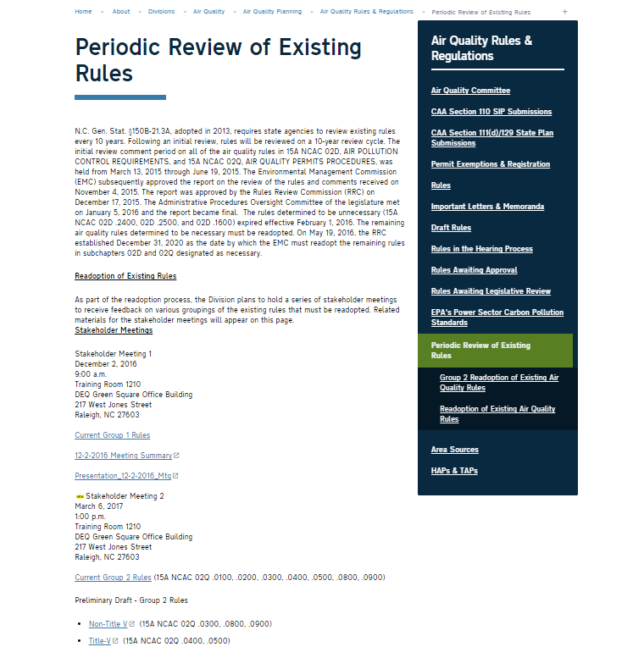

Slide 18
How to Get Involved
Information available at
  http://deq.nc.gov/about/divisions/air-quality/air-quality-rules/periodic-review-existing-rules
  Once in queue for action by AQC/EMC, refer to http://deq.nc.gov/about/divisions/air-quality/air-quality-rules
Send comments to:
  daq.publiccomments@ncdenr.gov
  Type “Stakeholder Readoption Comment” in subject line
  For Group 2, please submit comments by March 20, 2017
Department of Environmental Quality

Slide 19
Contact
Joelle Burleson, EIT, CPM
Rules Development Branch Supervisor
Division of Air Quality, Planning Section
North Carolina Department of Environmental Quality
919 707 8720 office
joelle.burleson@ncdenr.gov
Department of Environmental Quality

Slide 20
Thank you
Department of Environmental Quality

Slide 21

Department of Environmental Quality

