Slide 1
Funding Application Workshop
Division of Water Infrastructure
Fall 2025

Slide 2
Agenda
Introductions & program overview
SRF Helene Funding (western NC & RTP trainings only)
Application package completion
Priority Rating Systems (PRSs) for drinking water and wastewater construction projects (including Emerging Contaminants Studies)
CDBG-I programmatic specifics
Primer for viable utilities and study grant PRSs
Lead Service Line applications
Funding expectations primer
Wrap-Up
Notes:
Today, we’ll first start off with introductory information and then we want to give you a tour of our new website.
Note: For the western and RTP trainings, we’ll start out with the Hurricane Helene info, then move on to our other funding programs.
We’ll continue with a quick overview of our programs and then move into the application itself and associated forms.
We’ll then go through our study grant PRS.
After lunch, we’ll discuss a couple of items related to “At-risk” projects, then move on to our PRS for construction applications.
We’ll finish with ARPA Q&A.
If anyone wishes to stay around, we can discuss individual projects.

Slide 3
Training Handout Packet
Agenda
Presentation
NCDEQ DWI common application
NCDEQ DWI rolling application
Priority Rating Systems for all programs
VUR and SRP Eligibility forms
One-sheets for all funding programs and more
Guidance and other documents can be found on our website at: https://deq.nc.gov/about/divisions/water-infrastructure/i-need-funding/application-forms-and-additional-resources
Notes:
In your packet should be the following that you see up here. These are in the order we’ll be going in today.
One thing we would appreciate is for you to take some time before you leave and complete an evaluation form. It will help us to better serve you in the future.
Also, please note that the link to where we have our application information has changed. I’ll show you what that looks like in just a minute.
No VUR supplement anymore.

Slide 4
Introductions
Staff introductions
Audience introductions
  How many are representing local government units?
  How many are consultants or technical assistance providers?
  How many are new?
  How many are old hands at this?

Slide 5

Program Overviews

Slide 6
Know Before You Go: Funding Programs
Applications due Tuesday, September 30, 2025 by 5:00 p.m. (semi-annual applications only)
Electronic applications
  CDBG-I applications require 1 hard copy
One-sheets provide summary of each funding program
Rolling applications for
  Lead Service Line Replacement program
  Emerging Contaminants studies
  CWSRF onsite DWTS Pilot Program
  SRF Helene funding
  Cut-off dates
    August 1, 2025
    November 3, 2025
    January 9, 2026
    March 2, 2026
Notes:
For our semi-annual applications for the majority of our programs, the due date is 9/30/2025 at 5 PM.
All applications are submitted electronically via our LF portal. Note that for the CDBG-I program, which we’re offering this fall, we will nee done hard copy for our records.
We do have rolling applications for 4 of our programs now, as shown.
Note that with rolling applications, you can submit them any time, but we do have cutoff dates to allow our staff time to review the applications and to prepare recommendations for SWIA.

Slide 7
Funds Available
Fall 2025 Application Type | Approximate Amount Available in Fall 2025
Drinking Water Projects | DWSRF Loan: $50M (incl. $18 M in PF) | Emerging Contaminants (EC): $0 - $10M for construction (whatever is available from Study Reserve) (100% PF) | CDBG-I ~$19M | State Reserve Program $30M grants* + $30M loans * SRP grants prioritized for western NC / Helene projects per SL 2025-26 | Viable Utility Reserve $50M grants
Wastewater Projects (including stormwater quality, stream restoration) | CWSRF Loan: $90 M (incl. $13 M in PF) | Emerging Contaminants (EC): Up to $2M for construction (estimated) (100% PF)
Planning Projects
Total | ~$270M (not including SRF Helene funding)
Rolling Application Type | Approximate Amount Available Through 2025
Lead Service Line Inventories and Replacements | ~$19.6M (incl. ~$12.5M in PF) (more is available)
Evaluation/Assessment Studies to Address PFAS in Drinking Water and in Wastewater/Landfills | Drinking Water ~$10M (100% PF)
 | Wastewater ~$2M (100% PF)
SRF Helene Funding | See Slide 11
Total | ~$31.6M (not including SRF Helene funding)
Notes:
Here are our funding amounts available this round.
Note that we’re offering both SRP grants and loans, plus VUR.
For the VUR, we anticipate recommending $5M for planning grants and $45M for construction, but we’ll adjust that as we see the applications come in.
Also, note that the SRF Helene funding is not included in these numbers. We’ll deal with those in a few minutes.

Slide 8
Funding Types and Limits for Fall 2025 Round
Program | Funding Type and Limits
Drinking Water State Revolving Fund | Repayable loans (with principal forgiveness), up to $25 M per applicant per round, $200M total DWSRF loan per recipient $5M for IIJA EC construction Funds
Clean Water State Revolving Fund | Repayable loans (with principal forgiveness), up to $35 M per applicant per round, $200M total CWSRF loan per recipient No cap for IIJA EC funds
Viable Utility Reserve | 100% state grant up to $5M per construction project up to $400k per LGU for AIA, rate study, MRF VUR cap of $15M per Distressed LGU
State Reserve Program | Construction Grants: up to $3M per applicant every 3 fiscal years Loans: up to $3M per applicant every 3 fiscal years (targeted interest rate) Loans: up to $3M per applicant each fiscal year AIAs: $150,000* per applicant per project type every 3 years MRFs: $50,000* per applicant per project type every 3 years * legislation might change AIA/MRF limits
8
Notes:
Don’t need to spend much time on this one
Note our caps for many of our programs. We’ll talk about SRF Helene in a few minutes.

Slide 9
What’s New Since Spring 2025
New rolling application types
  SRF Helene funding
SRF Helene PRSs
  Drinking water/wastewater construction
  Decentralized Wastewater Treatment Systems (DWTS)
LGU indicators updated
New eligibility form for State Reserve Program grant funding
Notes:
A lot has happened since our last training, as you can see.
We’ve added 2 new funding types to our rolling applications.
We’re not going to talk about our CWSRF pilot program today, as it’s such a small amount of funding available. If you want to learn more about this program, please contact Logan.

Slide 10
What’s New This Round
Lead Service Line Replacement Projects
  More funds available!
  Initial funding caps can be increased in $500,000 increments if funds are available
    $5M for replacement of known lead
    $3M for find and replace
    $1M for inventory
Approx. Application Due Date | Approx. SWIA Meeting (Award Date) | Est. LSLR Funds Available (Includes PF) | Est. Principal Forgiveness (PF) Available
August 1, 2025 | September 17, 2025 | $17,009,394 | $12,446,164
November 3, 2025 | December 10, 2025 | FY2024 Remainder + TBD | FY2024 Remainder + TBD
*Dates TBD at September 2025 SWIA meeting.

Slide 11
What’s New This Round – SRF Helene
SRF Helene Funding*
  ~$253.7M available in CWSRF (for WW projects)
  ~$409.4M available in DWSRF (for DW projects)
  ~$22.5M available in CWSRF (for DWTS projects)
Cutoff dates for SRF Helene applications
  August 1, 2025 for September 17, 2025 awards
  November 3, 2025 for December 10, 2025 awards
  January 9, 2026 for February 18, 2026 awards*
  March 2, 2026 for April 15-16, 2026 awards*
More programmatic details to be discussed in SRF Helene module
*Minus up to 6% set-aside for administration and small systems assistance
Notes:
Here’s what a lot of you have been waiting for. Note that these are the funds we have available. We will be taking a 6% set-aside for admin and smally system assistance.
Please note the cutoff dates, which are the same as those listed on the previous slide.

Slide 12
Pop Quiz: Funding Programs Question #1
SRF Helene funding is offered on a rolling basis.
True
False
Notes:
True. We will be talking about this later on this afternoon.

Slide 13
Pop Quiz: Funding Programs Question #2
The following form(s) is(are) NEW this round:
Viable Utility Reserve eligibility form
Financial Information Form
SRP eligibility form
All of the above
Notes:
Just C. The rest have been around for at least one funding round.

Slide 14
Pop Quiz: Funding Programs Question #3
When are Fall 2025 (non-rolling) applications due?
Monday, September 29, 2025, 11:59 pm
Tuesday, September 30, 2025, 5:00 pm
Tuesday, September 30, 2025, 11:59 pm
Wednesday, October 1, 5:00 pm

Slide 15
SRF Helene Funding
Notes:
The sister study grant to the AIA is the Merger/Regionalization Feasibility Study which as also been around since 2016.

Slide 16
Supplemental Appropriation for Hurricanes Helene and Milton and Wildfires of Hawai'i (SA-HMW)
On December 21, 2024, Congress passed the “American Relief Act, 2025” providing one-time supplemental disaster relief funds. Included were supplemental funding for the State Revolving Funding (SRF) programs through US EPA for the states impacted by Hurricanes Helene and Milton and Hawai’i wildfires.
North Carolina’s allotments:
  $253,681,000 to the Clean Water State Revolving Fund $409,422,000 to the Drinking Water State Revolving Fund
  $22,510,000 to the CWSRF for decentralized wastewater treatment systems
“SRF SA-HMW” or “SRF Helene”
Notes:
West: Logan on DWTS/Kavitha DW-WW.

Slide 17
Purpose of the Supplemental Appropriations in the Act
DWSRF/CWSRF:
“… reduce flood or fire damage risk and vulnerability or to enhance resiliency to rapid hydrologic change or natural disaster ...”
CWSRF Decentralized:
“… improve the resilience of decentralized wastewater treatment systems to flooding, to assess the potential to connect homes … to centralized systems, and to fund such connections.”
In short:
“Improve flood resilience”

Slide 18
DWSRF/CWSRF Helene-Eligible Projects
Project must be:
SRF eligible, in Helene affected areas and
Either
  Reduce flood or fire damage risk and vulnerability at treatment works or eligible facilities, or
  Enhance resiliency to rapid hydrologic change or natural disaster at treatment works or eligible facilities
  Repair/recovery projects are eligible as long as they meet the criteria above.

Slide 19
SRF Helene Programmatic Specifics
Repayable Loan
  Terms – Typically 20 years
  LGC must approve loan portion
  0% interest rate for all applicants
Principal Forgiveness (PF)
  Varies for DW/WW projects (see Slide 21)
  100% PF for DWTS
Potential initial funding caps (subject to change)
  $5M per applicant for WW projects
  $10M per applicant for DW projects
  Initial caps for DWTS will be determined based on applications
  Capped awards may receive an increase after April 2026 based upon availability
Applicant SRF caps
  $200M debt to the DWSRF
  $200M debt to the CWSRF

Slide 20
SRF Helene Programmatic Specifics (cntd.)
SRF Helene Small Systems Reserve
  30% reserved for systems serving up to 10,000 people through April 2026
  Applies to both SRF Helene DWSRF & CWSRF
Loan fee – 2% closing fee
  Can be paid from the funding award
Federal cross cutters do apply
  E.g., ER/EID, Davis Bacon wages, AIS
  Build America, Buy America (BABA) does not apply
Earlier disbursements
  ≤ 15% of project awards may be disbursed for planning/design costs incurred before construction contract execution
  No repayable loan disbursed without LGC approval
No duplication of funding from other sources (e.g., funded via FEMA, USDA, EDA)

Slide 21
SRF Helene DW/WW Principal Forgiveness
Applicants designated as Distressed or Applicants with < 20,000 residential connections and with 2 or more LGU indicators worse than state benchmark ⇨ first $5M 100% PF, then remainder at 75% PF and 25% loan
Applicants with 20,001 – 40,000 residential connections and with 2 or more LGU indicators worse than state benchmark ⇨ 50% PF and 50% loan
Applicants with < 20,000 service population ⇨ first $5M 100% PF, then remainder at 30% PF and 70% loan
All other Applicants ⇨30% PF and 70% loan

Slide 22
SRF Helene DWTS Funding – Project Eligibility
Either improve resilience of DWTSs to flooding or assess the potential to connect homes served by DWTSs to centralized sewer systems and/or fund such connections
Project must be in a Helene-affected area
  FEMA disaster declared counties are automatically considered as Helene-affected area
Repair/replacement of DWTSs eligible so long as flood resilience improved
Notes:
Logan

Slide 23
SRF Helene DWTS – Applicant Eligibility
Eligible applicants allowed by statute
  Local government units (including counties and Districts)
  Non-profit wastewater utilities
  Community Development Finance Institutions or Nonprofits that provide financing assistance to homeowners to repair or replace DWTSs in North Carolina (NEW!)
Eligible applicants may contract with other organizations (e.g., COGs, TA providers) to administer funding and interact with homeowners

Slide 24
CWSRF Helene Decentralized – Examples of Eligible Projects
Protects DWTS from rising waters
Protects DWTS from power risks associated with flooding (backup power/power shutoffs)
Reduces the risk of DWTS failure associated with flooding (water tightening or elevating)
Increases DWTS capacity to handle flood risk (additional drain lines, larger tanks)
Consolidates DWTSs to reduce flood risk
Makes connections to centralized sewer & decommissions DWTSs
Assesses via planning the potential to connect to centralized sewer or other improved management

Slide 25
SRF Helene DWTS – Programmatic Specifics
All funds 100% PF
2% closing fee
  Can be paid from the funding award
Up to 7% can be budgeted for grant administration costs (excluding Engineering and permitting costs)
Residents may not be charged for funded work
Projects proposing connecting to sewer lines must identify where the connections will take place
Project proposing to remediate DWTSs must detail how the project team will ensure meeting 50% thresholds (for line items 1.A and 1.B)

Slide 26
SRF Helene DWTS – Programmatic Specifics (cntd.)
Funds must be expended in an expeditious and timely manner
All awarded projects must meet milestones
Costs associated with an executed funding offer must be incurred before requesting disbursements
All funds spent within 5 years or by December 2031 (whichever comes first)
Funds subject to all SRF conditions (except for BABA)

Slide 27
SRF Helene Application Process
Applications accepted on a rolling basis with cutoff dates
  August 1, 2025 ⇨ Awards at September 17, 2025 SWIA meeting
  November 3, 2025 ⇨ Awards at December 10, 2025 SWIA meeting
  January 9, 2026 ⇨ Awards at February 18, 2025 SWIA meeting*
  March 2, 2026 ⇨ Awards at April 15-16, 2026 SWIA meeting*
Applications not awarded funding in previous round will automatically receive consideration in the following round
  Applications reviewed as-is
  Revisions? Submit a new application
*Tentative

Slide 28
SRF Helene – Application Package
Division rolling application with appropriate SRF Helene boxes checked
Priority points sheet, narrative, and supporting documentation
  SRF Helene DW PRS
  SRF Helene WW PRS
  SRF Helene DWTS PRS
Affordability calculator
Resolution and Form for Certification by Recording Officer
Water and Sewer Financial Information Form (DW/WW projects only
Fund Transfer Certification Form
Rate sheets (if applicable)
Notes:
The packet you will send to the Division should contain these items regardless of the program to which you are applying.
We do require financial information, which is similar to 108C as well as the fund transfer certification form, which is now one sheet.
The packet you will send to the Division should contain these items regardless of the program to which you are applying.
A note about resolutions. They must be submitted at the time of application.
Regarding the priority points sheet and narrative, submit those for either wastewater or drinking water. If any of these are missing, the application will be considered incomplete.

Slide 29
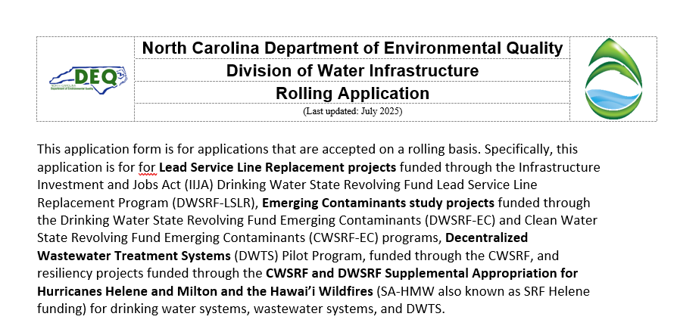
DWI Rolling Application
Use the rolling application
Notes:
This is rolling application. Please note this must be used. If it is not, your application will not be considered.
Please

Slide 30
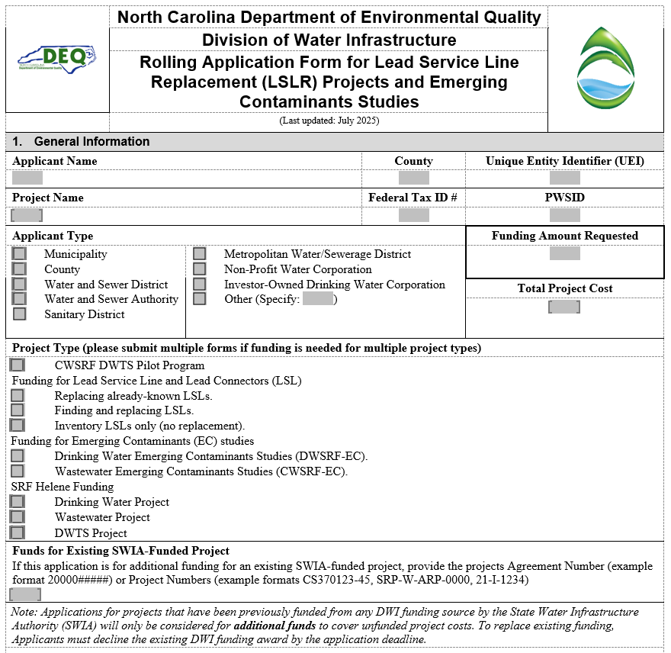
DWI Rolling Application
Main difference from semi-annual application is Project Type within Section 1
Notes:
Other items will be discussed and highlighted in the next module, so keep the rolling application with you as we go through the next module.
The big thing is to make sure that you check the appropriate SRF Helene project type you desire. Is your project DW? WW? DWTS? That tells us what pot of money you’re interested in.

Slide 31
Application Submittal – Electronic (New Link)
Electronic submittals only accepted
File size limit: 250 MB
Documents uploaded individually
https://edocs.deq.nc.gov/Forms/RollingApplication
Notes:
Then you are ready, submit here.

Slide 32
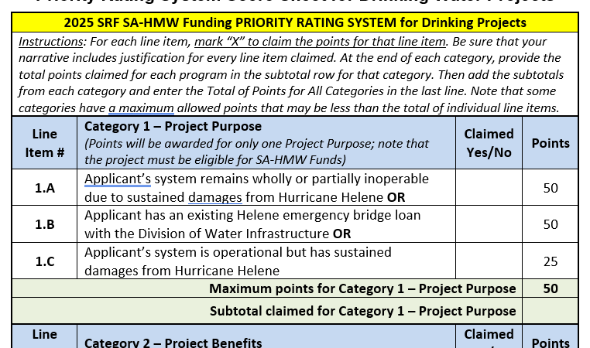
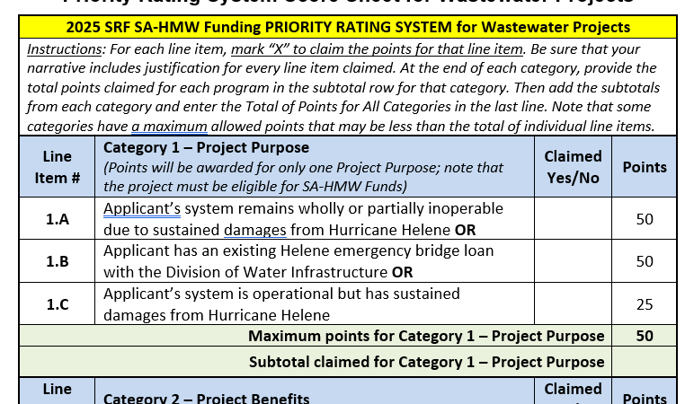
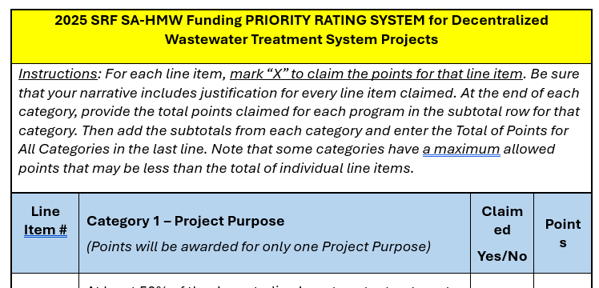
SRF Helene DW/WW Priority Rating Systems
Note: DW & WW PRSs are the same. DWTS PRS is different.

Slide 33
Priority Rating System (PRS) – General
Prioritizes projects for funding recommendations
  Projects funded in priority order
Claim all the points you can document
  You may claim more points than the priority point cap for each PRS Section
Include scoresheet along with narrative and supporting documentation
Provide ALL the required documentation listed in the PRS guidance
Only the information provided will be considered
Notes:
We have a priority system because we have more demand than funding. So we need to systematically prioritize projects. The priority system is a table of line items – descriptive phrases that might apply to the project such as “project provides backup power” and number of points (in this case, 3). If you claim and document that the line item applies (by for example noting that the project includes installing an emergency generator to a unit that has no current backup power), then you earn those three points.
We add up all the points for each project. Then we list all the projects from the most to the fewest points. Then, starting with the highest priority, we provide the best available funding to each project in priority order.
To get your project funded, do the following: Claim all the points you want to receive; we don’t apply unclaimed points. We don’t award unclaimed points, and we don’t ask for additional information. Send us all the information we ask for, and in the format we ask for it!

Slide 34
SRF Helene Priority Rating System Guidance
Read PRS Guidance carefully!
Provides lists and explanations of what is required to document the project is eligible for priority points
  Lists of what is required for each line item claimed
  Supporting information/documents needed for each requirement
Provides examples
Provides tips and examples
Two sets of guidance
  SRF Helene DW/WW
  SRF Helene DWTS
Questions? Call us!
Notes:
Read the guidance carefully and follow it. If you have alternative documentation that you think also documents the points, call us ahead of time. When we discuss these alternatives ahead of time, the answer is, “maybe’. If the first time we see the alternative documentation is reviewing the application, the answer is, “no’.
So CALL US with any questions.

Slide 35
SRF Helene Priority Rating Systems
SRF Helene DW/WW PRSs
  Categories
    Category 1 – Project Purpose
    Category 2 – Project Benefits
    Category 3 – System Management
    Category 4 – Affordability
  Use appropriate scoresheets for drinking water and wastewater programs
SRF Helene DWTS
  Use DWTS scoresheet
  Only 1 category – Project Purpose
Notes:
The priority line items are split into four categories:
Category 1 – Project Purpose -- the driving purpose of the project
Category 2 – Project Benefits – other good things that the project does
Category 3 – System Management -- good things that the system does (that we reward with priority pretty much independent of the project), and
Category 4 – Affordability - which is a measure of the neediness of the system
The scoring is the same for all the DW construction programs (whether SRP or DWSRF, etc.). Similarly it’s the same for all the wastewater programs. And finally, we’ve made the drinking water and wastewater programs as alike as we can given their inherent differences.
This presentation doesn’t go over every line item; that’s what the guidance is for. This presentation focuses on things that are new, or are frequent sources of error.

Slide 36
DW/WW SRF Helene Funding
Priority Rating System
Category 1 – Project Purpose
Notes:
West: Michael
East: Aisha/Jeanine/Kavitha

Slide 37
Category 1 Project Purpose
Maximum of 50 points
Claim 1 project purpose
Entire project must meet claimed Project Purpose
May “roll down” project purpose if need be
  Example: If 1.A not successfully claimed, will “roll down” to 1.C

Slide 38
1.A System Remains Wholly or Partially Inoperable – 50 points
Systems must remain wholly/partially inoperable due to damages from Hurricane Helene
Partially inoperable
  System does not meet permit requirements that it was meeting prior to Hurricane Helene OR
  Critical components of system damaged and not functioning OR
  System operational with temporary measures
Project must address non-functional component

Slide 39
1.A System Remains Wholly or Partially Inoperable – Required Documentation
Documentation showing initial system impact to point of inoperability
  Evaluation reports
  Assessment reports by other agencies
  Emails
  Pictures, Etc.
Most recent documentation to show system remains at least partially inoperable
  Phone logs
  Emails
  Letters
  Operator logs
  FEMA resource requests
  Pictures Etc.
All documentation must contain dates

Slide 40
1.B Applicant has Existing Emergency Bridge Loan with DWI – 50 points
For LGUs that have executed a Helene Emergency Bridge Loan with DWI
Documentation – Executed funding offer
Executed Funding Offer must be sent back to DWI before the application cutoff date
All available Bridge Loan funds have already been obligated

Slide 41
1.C System Operational But Sustained Damages– 25 points
For LGUs whose DW and/or WW system sustained at least some damage
Documentation
  General description of damage & proposed project, including resiliency elements
  Photos showing damage
  Power outage reports (if applicable)
  Assessment/evaluation reports prepared by other agencies (if applicable)
  Mapping showing damage

Slide 42
DW/WW SRF Helene Funding
Priority Rating System
Category 2 – Project Benefits
Notes:
West: Michael
East: Aisha/Jeanine/Kavitha

Slide 43
Category 2 – Project Benefits
Total of 40 points allowed
Only a portion of the project must relate to a specific benefit
Points only earned when the Applicant identifies direct connection between the project and type of expected benefit
Narratives must fully describe benefits of proposed project and how benefits arise from Project Purpose
Notes:
Every part of the project must serve the project purpose to earn those Category 1 Project Purpose Points. And if any part of the project doesn’t serve that purpose, the whole project loses those points. Category 2 is different.
Category 2 provides points as long as ANY part of the project genuinely confers that benefit. For example, a ten million dollar Water Treatment Plant Rehab can earn three points under Line Item 2.N.7 resiliency points for adding a fifty-thousand-dollar emergency generator.

Slide 44
2.A Infrastructure in Floodplains
2.A.1 – Relocates and/or Improves Infrastructure to Assure Continued Operation During a 500-year Flood Event – 12 points
2.A.2 – Relocates and/or Improves Infrastructure to Assure Continued Operation During a 100-year Flood Event – 10 points
Includes
  Relocation out of 500- and/or 100-year floodplain
  Fortification
    Replace equipment with new equipment not subject to damage by submersion
    Physical barriers
  Elevation

Slide 45
2.A Infrastructure in Floodplains – Documentation
Relocation
  Describe infrastructure being located
  Provide mapping
    FRIS or FEMA as source of data layer
    Show
      Location of existing and proposed infrastructure
      Floodplain boundaries
Fortification
  Determine base flood elevation (BFE)
  Mapping that shows
    Location of infrastructure
    BFEs at location of infrastructure
    Use FRIS or FEME as source of data layer
  Describe vulnerable components and how project will elevate/protect vulnerable components

Slide 46
2.B. Redundancy/Resiliency – 5 points
Requirements
Include redundant or resilient items in the project description
New or increased redundancy/resiliency = points
Replacing/repairing existing generator ≠ points
Retrofitting with backup power = points
New equipment with backup power ≠ points
Notes:
This is the general “redundancy /resiliency – not elsewhere classified”.
This is a “miscellaneous / not elsewhere classified” kind of item. Eligible Cybersecurity projects, for example, land here.
Requirements
Include redundant or resilient items in the project description
New or increased redundancy / resiliency = points
Replacing / repairing existing generator ≠ points b/c must be new/improved
Retrofitting with backup power = points
New equipment with backup power ≠ points - because backup power is the EXPECTATION for new equipment

Slide 47
2.C System Merger or Regionalization
2.C.1 – System merger (10 points)
  Physical consolidation into a single regional system
  Merger of ownership and operation without physical consolidation
  Interconnectivity alone does not qualify for 2.C.1
  Eligible up to two years after the date of merger
2.C.2 – System regionalization or partnership, still retaining separate ownership (5 points)
  Must include agreements/merger documents between the systems

Slide 48
2.D Reduction in Energy or Water Usage – 3 points
Eligible if
  Reduces energy usage by 20%
  Potable water usage at DW or WW facilities by 20%
Documentation
  Energy
    Describe & support expected energy reductions and/or energy production
    Show calculations to document 20% reduction in energy use
  Potable water
    Describe measures taken to reduce potable water usage
    Show potable water usage before & after project
    Provide calculations to show 20% reduction in potable water usage

Slide 49
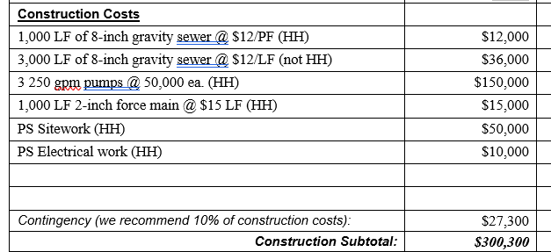
2.E 50% of Costs to Replace/Rehab/Improve Infrastructure Damaged by Helene (10 points)
> 50% of project construction costs go to infrastructure damaged by Helene
Intended to provide points for projects in Helene-impacted areas & sustained damage to infrastructure
Documentation
  Describe infrastructure damaged
  Differentiate line items in in project budget

Slide 50
DW/WW SRF Helene Funding
Priority Rating System
Category 3 – System Management
Notes:
West: Michael
East: Aisha/Jeanine/Kavitha

Slide 51
3.A. Flood Resiliency Action Plan – 5 points
Qualifies for points if applicant has created a flood resiliency action plan (FRAP)
Narrative should include:
  Inventory of assets exposed to flooding
  Prioritized actions for achieving flood resilience
  Consideration of future flood impacts
Review guidance
Provide mapping where required

Slide 52
3.B Emergency Preparedness, Response, or Recovery Plan – 5 points
May use Emergency Response Plan (ERP) or Hazard Mitigation Plan (HMP)
Documentation
  For ERP include
    Completion of risk & resilience assessment
    Discussion of resilience strategies
    Discussion of emergency plans & procedures
    Discussion of mitigation actions
    Discussion of detection strategies
  For HMP include
    Discussion of planning area
    Natural hazards description w/i planning area
    Probability of future events
    Mitigation strategies to protect water/wastewater infrastructure
Document that ERP or HMP is current to within 5 years
See guidance for more details

Slide 53
DW/WW SRF Helene Funding
Priority Rating System
Category 4 – Affordability
Notes:
West: Michael
East: Aisha/Jeanine/Kavitha

Slide 54
4.A Residential Connections – 2 to 8 points
Only claim one sub-category based on the number of connections
  Less than 10,000 residential connections, or
  Less than 5,000 residential connections, or
  Less than 1,000 residential connections
Use only number of sewer or water connections as of date of application
DWI staff will provide points based on connections provided in the application form. Applicant must explain any differences.

Slide 55
4.B Current Monthly Utility Bill at 5,000 Gallons – 2 to 8 points
Percentile Ranges | Spring 24 Combined Monthly Bills ($/5000 gallons) | Fall 2024 Combined Monthly Bills ($/5000 gallons) | Prioritization (Line Item 4.B)
>95 Percentile | $>129 - $148 | >$145 | 10
85 - 95 Percentile | $107 - $129 | $126 - $145 | 8
70 - 85 Percentile | $90 - $107 | $107 - $126 | 6
50 - 70 Percentile | $79 - $90 | $89 - $107 | 4
0 - 50 Percentile | $0 - $79 | $0 - $89 | 0

Slide 56
4.B Current Monthly Utility Bill at 5,000 Gallons – 2 to 8 points
Only claim one sub-category based on the current monthly utility combined bill for 5,000 gallons
Rates must match those on rate sheet(s) submitted
Use sewer bill and water bill
Use conversion factor for single-system utilities
  0.4 for water-only systems
  0.6 for sewer-only systems
Use lowest residential rate, “in-town rate”
Provide calculations
DWI staff will verify rates in application form match those in the rate sheet and provide points based on lowest value if staff cannot reconcile rate information

Slide 57
4.C.1 to 4.C.3 Local Government Unit (LGU) Indicators – 3 to 7 points
Only claim one sub-category
  3 out of 5 LGU indicators worse than state benchmark, or
  4 out of 5 LGU indicators worse than state benchmark, or
  5 out of 5 LGU indicators worse than state benchmark, or
  Project benefits a disadvantaged area
LGU Indicators are
  Property Valuation per Capita
  Percent Population Change
  Poverty Rate
  Median Household Income
  Unemployment Rate
DWI staff will provide points based on LGU data in the affordability calculator
Alternative population data – ACS or OSBM data may be used and may be chosen on affordability calculator
Notes:
Need to emphasize that projects claiming the points to benefit a disadvantaged area provides documentation to support that claim even if they are claiming 5 of 5 LGU indicators, since they won’t be guaranteed to get the principal forgiveness due to other circumstances unless they make and succeed in the argument about the disadvantaged area (app for section 6 to check the form and prompts them to put in documentation)

Slide 58
4.D. Loss of Water or Wastewater Volumetric Usage – 8 points
For when applicants can show a loss of volumetric water sales > 20%
Documentation
  Provide copies of volumetric water/wastewater sales for most recent 3 billing cycles
  Provide copies of volumetric water/wastewater sales for same 3 billing cycles prior to Hurricane Helene
  Provide calculations to show volumetric water loss

Slide 59
DWTS SRF Helene Funding
Priority Rating System
Category 1 – Project Purpose
Notes:
West: Michael
East: Aisha/Jeanine/Kavitha

Slide 60
1.A At Least 50% DTWSs Damaged by Hurricane Helene – 15 points
1.A: At Least 50% of the DWTS in the Project Area or to be Remedied by the Project were Damaged by Hurricane Helene
  Projects to Remedy DWTSs by Sewer Connections
    At least 50% or the DTWSs in the project area to be connected to the new sewer extension must have documented Helene damage
  Repair/Replacement Projects
    Applicant must explain implementation strategy (identifying, repairing, documenting, and administering) to find and fix DWTSs in the project area and maintain a ratio of at least 50% being Helene damaged

Slide 61
1.B At Least 50% of DWTSs Failed or Failing – 10 points
1.B: At Least 50% of the DWTS in the Project Area or to be Remedied by the Project are Failing or Failed
  Projects to Remedy DWTSs by Sewer Connections
    At least 50% or the DTWSs to be connected to the new sewer extension must be documented as failed or failing
  Repair/Replacement Projects
    Applicant must explain implementation strategy (identifying, repairing, documenting, and administering) to find and fix DWTSs in the project area and maintain a ratio of at least 50% being Helene damaged

Slide 62
1.C All Other Projects to Repair, Improve, or Repalce DWTSs
1.C: All Other Projects to Repair, Improve, or Replace DWTSs
  Projects to Remedy DWTSs by Sewer Connections
    A map must indicate the project area and the DWTS systems to be connected
  Repair/Replacement Projects
    Applicant must explain implementation strategy (identifying, repairing, documenting, and administering) to find and fix DWTSs in the project area

Slide 63
1.D DTWS Planning Project to Assess Options to Improve Resiliency– 2 points
1.D: Planning Project to Assess Options to Improve Resiliency Against Flood Damage
  Applicant must be able to describe how it will study DWTSs within a specified area to determine the best resilience strategies
  The proposed project must be reasonably expected to result in a capital project

Slide 64

Discussion Time
What questions do you have?

Slide 65
Application Package Completion
Notes:
We’re going to talk about the semi-annual application itself now. For the rolling application, when we get to the particular funding program where it applies, we’ll discuss it. So, the focus for this section is mainly on the semi-annual application packet

Slide 66
Semi-Annual Application Packet
Division application
Priority points sheet and narrative
  Wastewater, including IIJA-EC construction funding
  AIA/rate study and MRF funding (narrative only)
  Drinking water, including IIJA- EC construction funding
Affordability calculator
Resolution and Form for Certification by Recording Officer
Water and Sewer Financial Information Form, if applicable
Fund Transfer Certification Form
Rate sheets
Notes:
The packet you will send to the Division should contain these items regardless of the program to which you are applying.
We do require financial information, which is similar to 108C as well as the fund transfer certification form, which is now one sheet.
The packet you will send to the Division should contain these items regardless of the program to which you are applying.
A note about resolutions. They must be submitted at the time of application.
Regarding the priority points sheet and narrative, submit those for either wastewater or drinking water. If any of these are missing, the application will be considered incomplete.

Slide 67
Application Packages
Construction applications not funded in previous round (Spring 2025) considered in Fall 2025 No additional information allowed
  Application reconsidered as-is
  Adding information? ⇨ Submit completely new application
  Each application viewed as stand-alone
Notes:
Please note that if you had an application that was submitted last fall and not funded, it’ll be reviewed this round as well.
If you want your application reconsidered, please note that you are not allowed to submit any additional information; the application is considered as-is.
If you plan to add information, you will need to submit a completely new application.
Or, multiple applications come in that are missing pieces. Historically, we’ve had leeway with this. No more. Each application must stand on its own. In other words, we have sometimes received AIA applications from the same town for water AND sewer. The water has the FIF while the sewer does not. Historically, we gave leeway to this. No more. In this situation, of the sewer AIA was lacking the FIF and the water AIA application had it, the sewer AIA will be incomplete.
Also, all copies must have the same information. Real life example, one of our applications had a hard copy with the signature on the common application while the e-copy did not have that signature. We let it go for our past funding round but will not do so this point going forward. If the signature is lacking in the copy, then the application is incomplete.

Slide 68
Know Before You Go: Final Check Tips
All signatures present including electronic copies
All forms present and complete
  Application
  Fund Transfer Certification
  Rate sheet(s)
  Resolution
  VUR eligibility form (if applicable)
  SRP eligibility form (if applicable)
  Disadvantaged Area (DA) map (if applicable)
    Justice40 Climate and Economic Justice Screening Tool no longer eligible source for DA justification
Narratives & score sheets & supporting documentation
Notes:
This applies to whether or not you’re doing semi-annual or rolling applications
TIP: First, use your own internal QA/QC checklist to make sure all applications and copies have all pieces.
TIP2: Don’t scan anything to make a copy until the application is complete with all signatures.
Regarding QA/QC, we’ve created a checklist that you can use to make sure everything is in order before submittal. It’s available under the Additional Resources tab. It’s there for your use but not mandatory.

Slide 69
Division Application
Notes:
Please note that the majority of what I’m about to discuss will be for both rolling and semi-annual. I’ll point out here what’s for semi-annual only.
As I go through the Division Application, I’m not going to hit every single thing that needs to go into every single section. Most of us in here have been through this process before. Instead, I want to hit things that we consider to be crucial either to make a complete application or to ensure that you receive points for line items.
A lot of what I’m going to say is b
Some parts will have 3 stars after them. Those are critical to have a complete application.

Slide 70
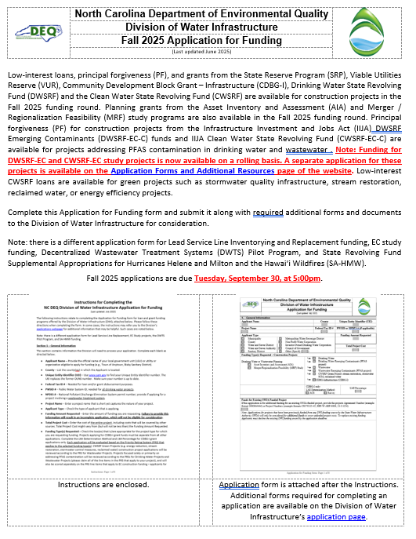
Division Application (Semi-Annual)
Revised in Summer 2025
  This application must be used
One application for app programs, except LSLR, EC study, CWSRF DWTS Pilot Program, and SRF Helene projects
Best funding available based on eligibility and prioritization
All sections completed
Note: Application comes with instructions
  Read the instructions
Notes:
Once you click on the links, you’ll select the one for the application. You should see the application with a header like this. Please use this one rather than an old one because this has been updated.
Make sure that you use this application. We will not consider applications submitted on the old form because there is too much information needed related to that.
Make sure you complete all sections within the application.
Please make sure that you take the time to read through the instructions. There are some pretty significant changes to the application, and I want to make sure you give yourself every chance at success. The best way to do that is to read these before you even start filling out the application.
I’m switching things up this year based upon the fact that first, most of you should be familiar with our forms. If not and you want me to discuss something, please do raise your hand. Instead, I want to focus on what we see as critical for the success of your application and where we typically saw people miss things that either hurt their chance for points or rendered the application not complete or ineligible.
If you see anywhere with three stars and dark red italics, that means that this item is critical for your application being considered complete.
Note that we’ll talk about the rolling application during our EC studies, LSLR and SRF Helene funding, so don’t think I’m leaving that out. Some aspects will be the same, but there are other critical differences, so stay tuned.

Slide 71
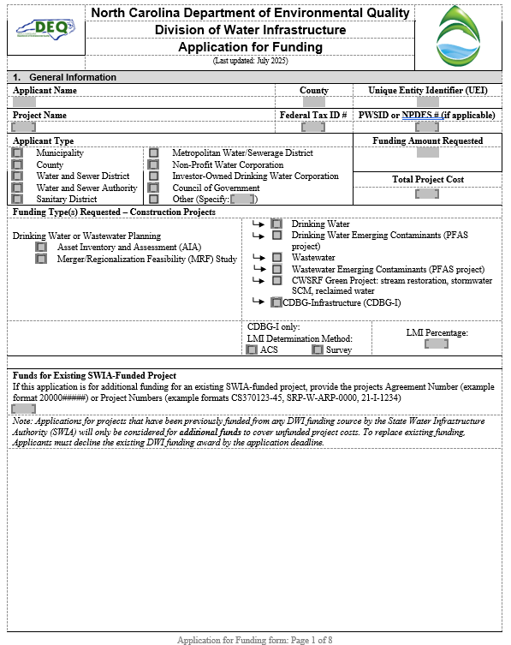
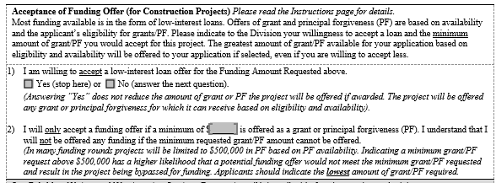
Section 1 – General Information
Notes:
Section 1 looks like this.

Slide 72
Division Application – Section 1 – Tips
Funding amount requested***
Total project cost
Funding Type Requested***
Previously (partially) funded project – Provide Agreement # (2000XXXX), project #(s) (New!)
  If you have a completely funded project and wish to reapply to get better terms, you must decline the original funding to be considered again
Minimal amount of grant/principal forgiveness needed (semi-annual only)
  Question 1 – Tell is if you’re willing to accept a low-interest loan offer for the full funding amount (Yes/No)
  If no, tell us in Question 2 the minimum amount of grant/PF you need to make the project move forward
Notes:
Please make sure that you put in the funding amount requested and the funding type requested.
If you’re applying for CDBG-I, we need to see your LMI information.
In Section 1, let us know how much your total project cost is and the minimal amount of grant/PF needed for your project.
In Section 2, provide information about your water/sewer connections and bills per 5,000 gallons.

Slide 73
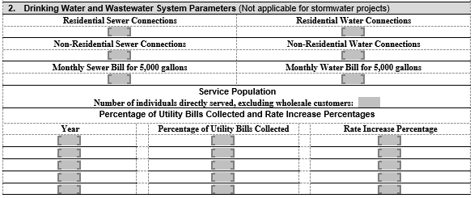
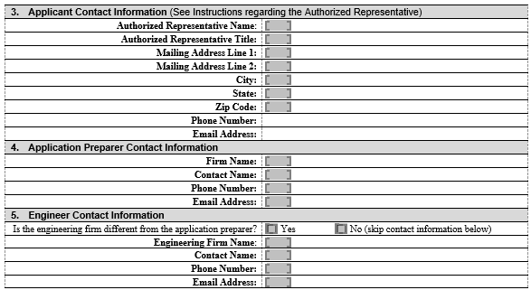
Sections 2-5 – System Parameters & Contact Information
Notes:
Section 2 has to do with connections and utility bills.
Sections 3-5 are all about contact information as shown.

Slide 74
Division Application – Sections 2, 3, 4, & 5 – Tips
Section 2
  Water/sewer connections (residential & non-residential)
  Water/sewer bills
  Service population
Section 3 – Authorized Representative***
  Top elected official
  Top administrative official (e.g., Town Manager)
  Person listed as Authorized Representative in Resolution
    Utility Director
    Finance Officer
    Council Member
Section 4 & 5 – Application Preparer and Engineer Contact
  Please make sure same contacts are listed as provided in the electronic application submittal form.
Notes:
In Section 3, the AR can be 1 of 3 people as shown here. The AR can be either the top elected official or the top administrative official. OR, the AR can be someone who’s listed as the AR in the Resolution. The big thing is that the AR must be the one to sign off on the application and other documents as noted.

Slide 75
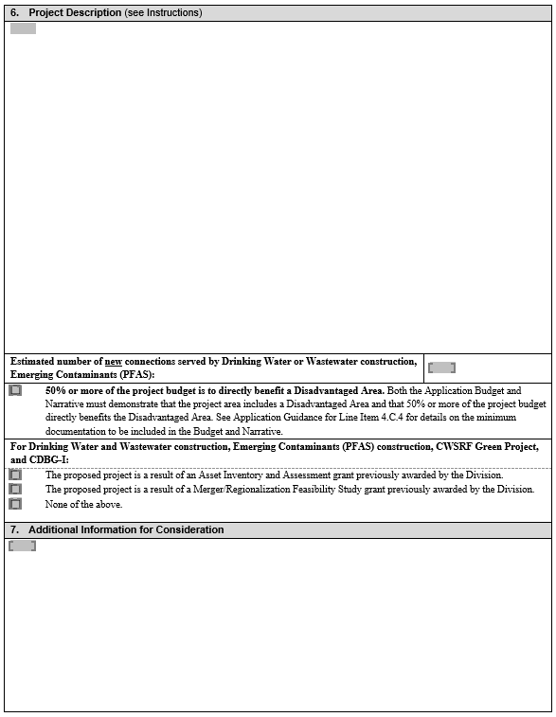
Sections 6-7 – Project Description & Additional Information
Notes:
Sections 6 and 7 are all about the project.

Slide 76
Division Application – Sections 6 & 7 – Tips
Section 6 –
  Project Description***
    Broad level of detail reflects major items in budget
    If adding connections, number of connections
    See Instructions for more detail
    For SRF Helene, make sure you discuss resiliency
  Identify if your project directly benefits a disadvantaged area
    Self identifies projects eligible for PF
    Supporting documentation provided as part of line item 4.C.4.
  Identify projects resulting from an AIA/MRF
Section 7 – Additional Information – Complete if needed (semi-annual applications only)
Notes:
For Section 6, give us a broad level of detail. We also want to know if this is the result of an AIA/MRF.
Section 7 isn’t required. Keep it limited to what’s not in the PRS, within the space provided.

Slide 77
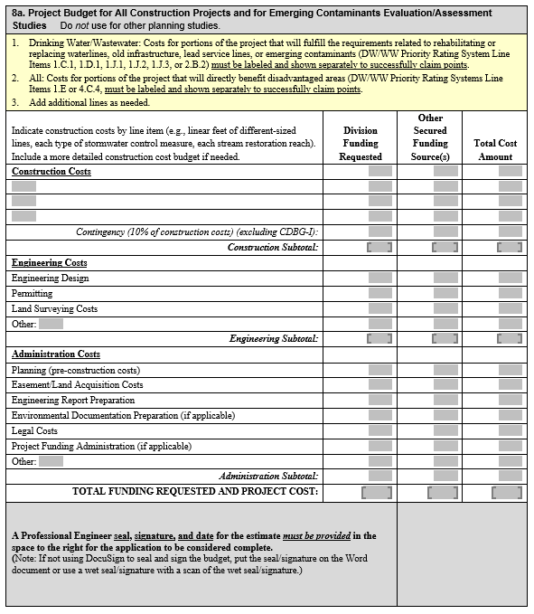
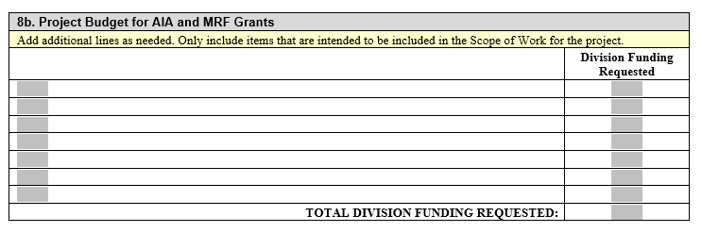
Sections 8a and 8b – Project Budgets
Notes:
Make sure to note that for the rolling application, this is Sections 7a and 7b.

Slide 78
Section 7 (rolling)/8 (semi-annual) – Tips
Budget funding requested must match funding requested in Section 1
Section 7a – Rolling Application
  For EC and LSLs, differentiate items for disadvantaged areas
  For SRF Helene DW/WW PRSs – Differentiate costs for Line Item 2.E (previously discussed)
Section 8a – DW/WW construction budget (semi-annual only)
  If claiming Line Items 1.C.1, 1.D.1, 1.E, 1.J.1, 1.J.2, 2.B.2 & 4.C.4, add lines as described in table instructions
  Affix PE seal, signature, and date***
Section 7b Rolling Application) – For DWTS planning only
Section 8b (Semi-annual) – Water and wastewater planning project budgets
Notes:
Make sure that the funding requested matches the budget.
And again, make sure if claiming the line items shown that we can discern that in the budget. Others will talk about this when we discuss these line items a bit later.
Make sure that you affix your seal/date/signature. This is one place where it’s really, really, really important to make sure that the seal/signature isn’t just overlaid on the PDF because Laserfiche can strip it out.

Slide 79
Certifications & Completeness– Tips
Certifications
  Authorized Representative must initial each certification***
  Not applicable? N/A
Completeness Checklist – Initialed by Authorized Representative or Preparer
Notes:
Make sure that AR does the certifications.

Slide 80
Signature – Tips
Must be signed by Authorized Representative
  Top elected official
  Top administrative official
  Person listed in Resolution as Authorized Representative
Original signature***
  Wet signature required for CDBG-I hardcopy
  Electronic signature (DocuSign preferred) okay for other programs and the official electronic
  CDBG-I application
Notes:
Again, the AR must sign off on this. Note the caveat for the AR for CDBG-I.
Make sure that for CDBG-I it’s a wet signature.
If you are planning on doing an electronic signature, it’s okay for other programs, but again, it should either be embedded in the application or signed with Docusign. Please do not just copy/paste a signature into a PDF—for a number of reasons, but Laserfiche may view it as a script and strip it out.

Slide 81
Additional Forms

Slide 82
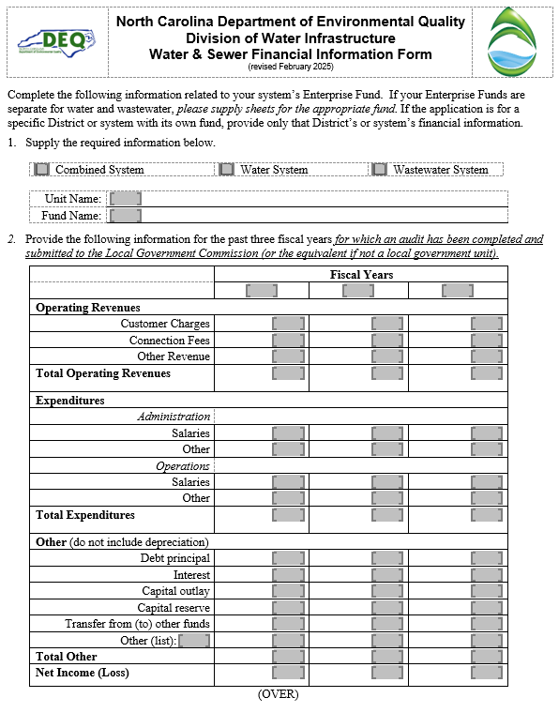
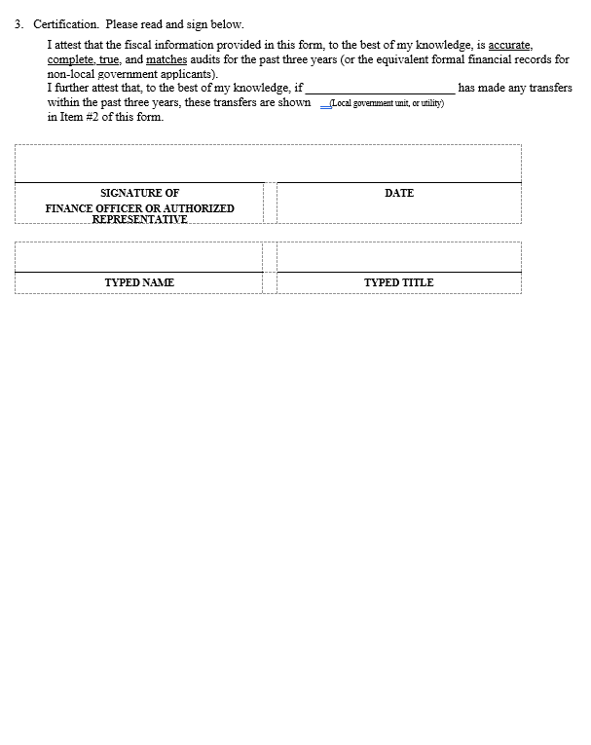
Financial Information Form

Slide 83
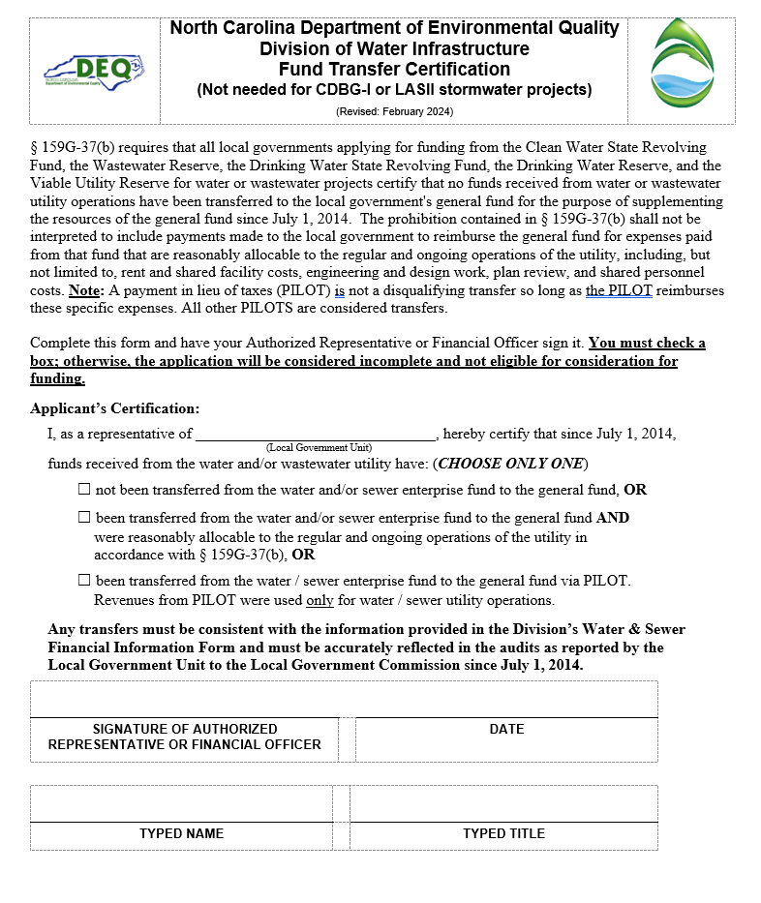
Fund Transfer Certification Form

Slide 84
Financial Information Form, Fund Transfer Certification & Rate Sheets – Tips
Financial Information Form
  Finance Officer or Authorized Representative signs
  3 years of information from most recently accepted, approved audits
  Absolute values in expenditures
  Remember transfers
  Do not modify form
  Not required for completeness BUT will impact points if not supplied (semi-annual application only)
Fund Transfer Certification
  Finance Officer or Authorized Representative signs***
  Go back to FY 2014
  1 of 3 checkboxes must be checked***
  Payment in lieu of taxes (PILOT) are not automatically considered reasonably allocable to operation of the utility
Rate sheets – Include
Notes:
For the FIF, make sure that you have 3 years of information and complete the information requested.
Expenditures need to be absolute values.
For the FTC, make sure the AR or CFO signs.
Check only 1 of 3 boxes.
With PILOT, it’s not a common situation (payment in lieu of taxes), and it’s really hard to explain. If you think you may have this issue, please check

Slide 85
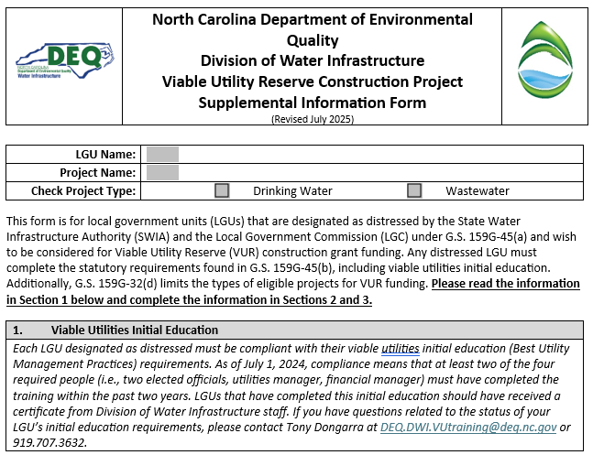
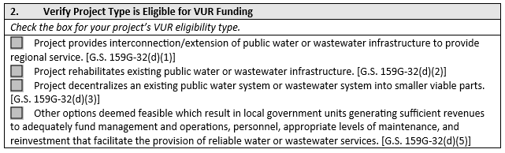
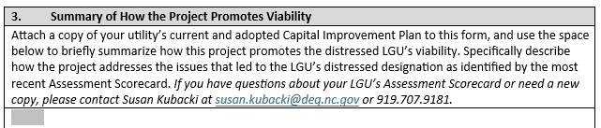
VUR Construction Eligibility Form
Required to be considered for project funding from the VUR
All distressed LGUs must complete form to be awarded VUR Construction Grant funding
Intent – VUR Construction grants promote viability
Notes:
For the VUR eligibility form, please make sure that you are compliant with your initial education requirements. There’s information about that here, so be sure to check it out. If you have questions, contact Tony Dongarra. He’ll be able to help you ascertain if you’re compliant or not.
Then on the second page, check your eligibility type.
On the back side, talk about how your project moves you closer to viability.

Slide 86
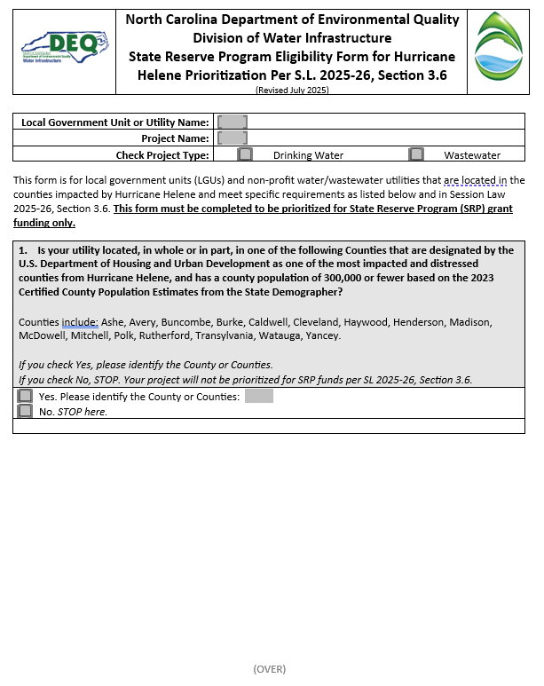
SRP Grant Form (SRP Projects only)
Project for repair, replacement, or construction of equipment, buildings, or natural features due to damage or effects from Hurricane Helene, including capacity-building
and
the amount of funds requested is the amount of unmet need above the amount paid by insurance and available federal aid.

Slide 87
SL 2025-26 SRP-Eligible Counties
Ashe
Avery
Buncombe
Burke
Caldwell
Cleveland
Haywood
Henderson
Madison
McDowell
Mitchell
Polk
Rutherford
Transylvania
Watauga
Yancey
Notes:
For the SRP-grant prioritization form, these counties were determined by HUD as the most impacted and distressed counties from Helene and also have a population of less than 300,000.
This is from SL 2025-26.

Slide 88
Resolutions – Tips
Recommend using supplied template
Due at time of application
1st Whereas clause
  List project***
  If submitting multiple projects, can list all projects
Authorized Representative
  CDBG-I: Name and title of Authorized Representative regardless
  List title of Authorized Representative***
Notes:
For resolutions, we do supply a template and recommend that you use it, though you may use your own, provided that you have the elements in red with stars within that resolution.

Slide 89
Resolutions – More Tips
Form for Certification by the Recording Officer – Must include***
  Use the template
  Date
  Recording officer title & signature
Attestations are acceptable – Must be from the Clerk of the Board
Both resolutions and attestations must include the seal/signature of the Clerk of the Board***
Notes:
You must provide the supplied template for the certification.
If you use an attestation, you still need to have that certification.

Slide 90
Application Submittal – Electronic (New Link)
Semi-annual application link only
Electronic submittals only accepted
File size limit: 250 MB
Documents uploaded individually
https://edocs.deq.nc.gov/Forms/Fall2025FundingApplication

Slide 91
Pop Quiz: Application Package – Question #1
The semi-annual application form is used for
Drinking water, wastewater, AIA, and MRF applications only
SRF Helene funding, Lead Service Lines, emerging contaminants, and the CWSRF DWTS Pilot Program
All of the above
None of the above
Notes:
A. Use it only for the programs shown. All other programs now fall under our rolling application.

Slide 92
Pop Quiz: Application Package – Question #2
How many boxes should be checked on the Fund Transfer Certification Form?
0
1
2
3
Notes:
No, but if any changes can be made to increase your points from what you received before, it would be recommended.

Slide 93
Pop Quiz: Application Package – Question #3
The SRP eligibility form is used to determine if your project will be prioritized for State Reserve Fund grants only
True
False
Notes:
This is true. The SRP loans we’re offering do not require the SRP eligibility form. My very strong suggestion is that you complete this form for your DW/WW project regardless.

Slide 94
Wastewater and Drinking Water Projects
Emerging Contaminant Funding Overview
Notes:
East: Trupti
West: Logan

Slide 95
IIJA SRF Emerging Contaminants (EC) Funding: Summary
North Carolina’s IIJA EC funding program limited to projects addressing PFAS contaminants
Must have documented PFAS contaminants in the drinking water or wastewater exceeding levels specified in the PRS and PRS guidance.
PFAS contaminants with a final MCL or HI get higher priority compared to other PFAS contaminants without proposed standards

Slide 96
IIJA-SRF-Emerging Contaminants Funding: Summary – Construction Projects (EC-C)
IIJA EC construction funding
  Availability for Fall 2025
    DW – Can be up to $10M in PF (whatever is not used from the Study Reserve)
    WW – ~$2M in PF
  Funding caps
    DW - $5M per applicant. All awards prior to today will count towards this cap (new)
    CW – No cap
  Check DW-EC or WW-EC as funding type on common application
Common application form used
Priority Rating Systems (PRSs)
  Claim all applicable line items, including EC-eligible line items
  EC projects will compete only with other EC projects for IIJA EC funds
DWI application review
  Only certain line items will be considered for prioritizing EC projects. EC projects will compete with all other projects for other funding programs.
Notes:
*Last year, funding cap for DW was $5M per applicant per ROUND (now it is per year). This change was effective beginning in the December 2024 SWIA meeting.
*The timeframe is based on the SWIA award date. (e.g., if awarded in Spring 2025 construction round, must wait until Spring 2026 to get a new award). DISCLAIMER – may change again in the future so only ONE award per applicant.
*ONE application submitted, and if it's eligible for EC (by getting 1.J. and 2.H.3./2.H.4. points), will receive 2 scores – a score for the base DWSRF and another score for the EC. Each "pot" of money is separate. The application is competing with applications eligible for base DWSRF fund, and is competing separately with other applications eligible for EC funds. Applicant may receive funding from one pot, both pots, or neither pot.

Slide 97
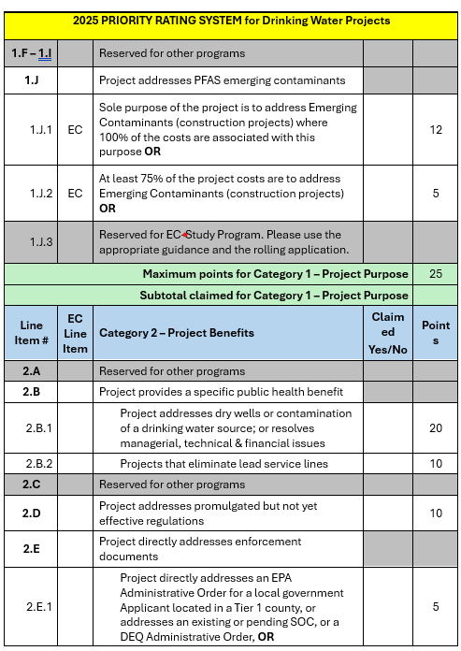
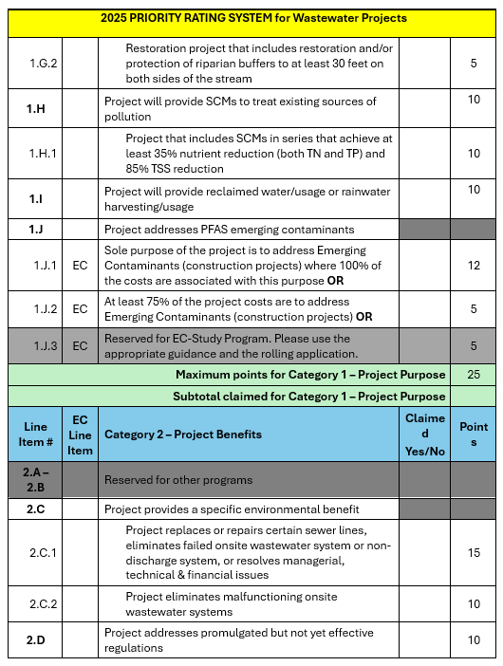
IIJA-SRF-Emerging Contaminants (EC) Funding: Summary – Construction Projects – PRS
Notes:
*Highlight where the EC points are on the PRS.
*Note on Project Purpose: Can claim BOTH a non-EC Project Purpose and an EC Project Purpose (e.g., 1.C. and 1.J.1). The 1.C points will only be added to the score for the base DWSRF. The 1.J.1. will only be added to the score for the EC funds. Both points will NOT be combined.

Slide 98
IIJA-SRF-Emerging Contaminants Funding: Summary – Study Projects (EC-S) (New)
EC studies
  Availability from FY 2025 (EC study reserve) after July 2025 SWIA awards
    DW – Up to $10M
    WW – Up to $2M
  Funding cap – $500,000 per applicant for DW/WW. All awards prior to today count towards this limit (new).
Application – Use rolling application form
Priority Rating System
  Only EC PRS used
  Separate PRS scoresheet at end of guidance
Guidance – Specific PRS for EC studies
EC-S Next Cutoff Date is August 1, 2025
Notes:
*EC PRS is the same as the Construction PRS, but simplified. It cuts out what is not applicable to the study projects.

Slide 99
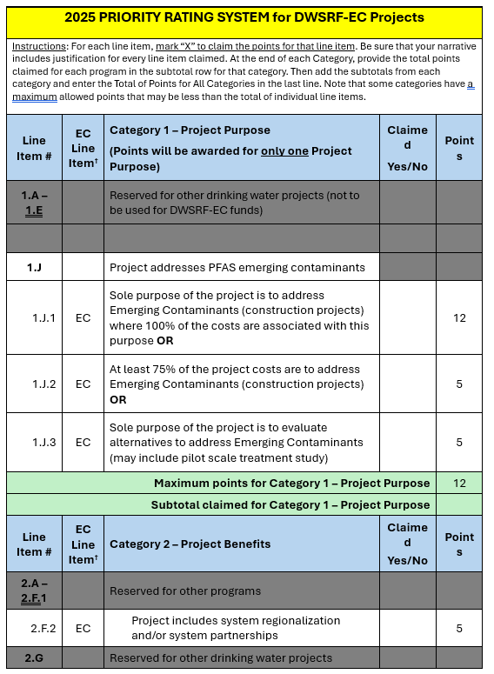
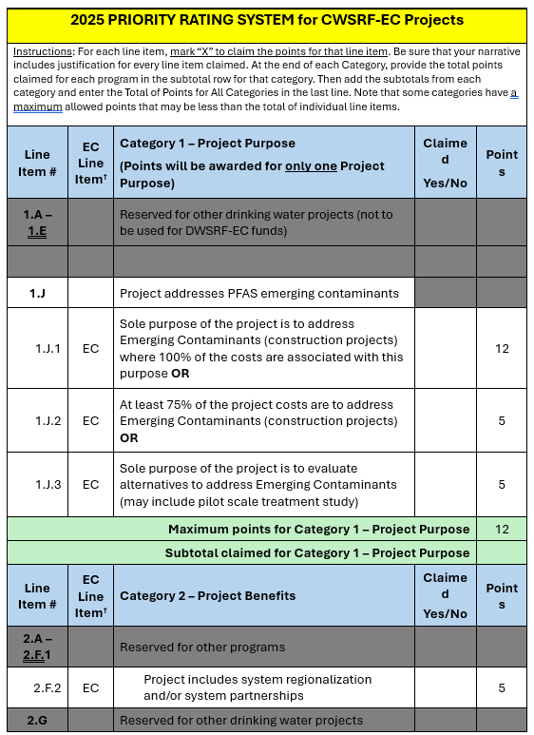
(New) IIJA SRF-Emerging Contaminants Funding: PRS – Study Projects (EC-S)
Notes:
*Grayed out the items not applicable to the EC program. Same as Construction PRS with the items removed that are not applicable to EC program.

Slide 100
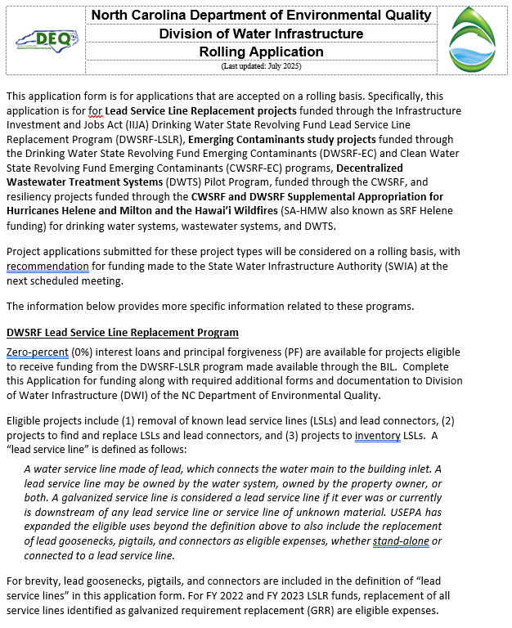
IIJA SRF-Emerging Contaminants Funding: Application – Study Projects (EC-S) (New)
Notes:
*This is the Rolling Application (for LSLR and EC Studies).

Slide 101
Rolling Application Expected Cutoff Dates for 2025 (for LSLR and EC-S)
Approximate Application Due Date | Approximate SWIA Meeting (Award Date)
August 1, 2025 | September 17, 2025
November 3, 2025 | December 10, 2025
January 9, 2026* | February 18, 2026*
March 2, 2026* | April 15-16, 2026*
*Dates to be finalized after September 2025 SWIA meeting

Slide 102
Wastewater and Drinking Water Projects
Project Priority Systems
Wastewater
Drinking Water
Notes:
Wastewater starts.

Slide 103
Priority Rating System (PRS)
Prioritizes projects for funding recommendations
  Projects funded in priority order
  Best funds available provided in priority order
Claim all the points you can document
  You may claim more points than the priority point cap for each PRS Section
Include scoresheet along with narrative and supporting documentation
Provide ALL the required documentation listed in the PRS guidance
Only the information provided will be considered
Notes:
We have a priority system because we have more demand than funding. So we need to systematically prioritize projects. The priority system is a table of line items – descriptive phrases that might apply to the project such as “project provides backup power” and number of points (in this case, 3). If you claim and document that the line item applies (by for example noting that the project includes installing an emergency generator to a unit that has no current backup power), then you earn those three points.
We add up all the points for each project. Then we list all the projects from the most to the fewest points. Then, starting with the highest priority, we provide the best available funding to each project in priority order.
To get your project funded, do the following: Claim all the points you want to receive; we don’t apply unclaimed points. We don’t award unclaimed points, and we don’t ask for additional information. Send us all the information we ask for, and in the format we ask for it!

Slide 104
Priority Rating System
Read PRS Guidance carefully!
Tables provided as handouts
Provides lists and explanations of what is required to document the project is eligible for priority points
  Lists of what is required for each line item claimed
  Supporting information/documents needed for each requirement
    Maps
    Non-compliance documents
    Etc.
Provides examples
Provides tips and recommendations
Notes:
Read the guidance carefully and follow it. If you have alternative documentation that you think also documents the points, call us ahead of time. When we discuss these alternatives ahead of time, the answer is, “maybe’. If the first time we see the alternative documentation is reviewing the application, the answer is, “no’.
So CALL US with any questions.

Slide 105
Priority Rating System
“Roll-downs” can happen in some situations
  Project Purpose examples
    Failed Infrastructure (1.B) to Rehabilitation/Replacement (1.C)
    Rehabilitation/Replacement (1.C and 1.C.1) to Expansion (1.D & 1.D.1)
  Resiliency (2.N)
  Capital Planning (3.A) to CIP (3.B)
If unsure, ask questions before submitting application
Notes:
“Roll downs” happen when you claim something at a higher category than the project is eligible for – for example, if you claim project purpose 1C points for rehabilitation but your project is actually an expansion, we will automatically consider you for 1D expansion points. This is not the case for every situation, however, so PLEASE ASK before submitting your application if you are unsure!

Slide 106
DW/WW/EC-C/EC-S Priority Rating Systems for Construction Projects
Categories
  Category 1 – Project Purpose
  Category 2 – Project Benefits
  Category 3 – System Management
  Category 4 – Affordability
Use appropriate scoresheets for drinking water and wastewater programs
Presentation focuses on problem areas, updated guidance clarifications, and EC-eligible line items
Presentation applies only to DW/WW, CDBG-I, EC construction, and EC studies only
Notes:
The priority line items are split into four categories:
Category 1 – Project Purpose -- the driving purpose of the project
Category 2 – Project Benefits – other good things that the project does
Category 3 – System Management -- good things that the system does (that we reward with priority pretty much independent of the project), and
Category 4 – Affordability - which is a measure of the neediness of the system
The scoring is the same for all the DW construction programs (whether SRP or DWSRF, etc.). Similarly it’s the same for all the wastewater programs. And finally, we’ve made the drinking water and wastewater programs as alike as we can given their inherent differences.
This presentation doesn’t go over every line item; that’s what the guidance is for. This presentation focuses on things that are new, or are frequent sources of error.

Slide 107
Priority Rating System – Category 1 – Project Purpose (25 points max)
The entire project must support the claimed purpose (except as specified in PRS guidance)
Staff will consider other project purpose points if there is insufficient documentation to award claimed Project Purpose
Projects not earning purpose points are still eligible for funding…
  …but do not qualify for PF
Notes:
A project probably serves multiple purposes. But it can only receive priority points for one purpose. So choose the highest priority purpose that every part of the project serves. If there is any part of the project that doesn’t support the claimed purpose, then the project will not earn those project purpose points (and this is where it may “roll down” to another purpose category)
Note that point spreads in the Project Purpose have changed slightly, mainly to more closely align between DW and WW projects.

Slide 108
1.A Consolidate Nonviable Systems (DW, CDBG-I, WW)
Points
  DW/WW – 25 points
  CDBG-I – 15 points
Consolidation of Nonviable Systems are the highest priority projects for funding
Two situations for becoming a nonviable system:
1. Nonviable due to system failing
  WW – Division of Water Resources has determined system is failing
  DW – Public Water Supply Section has determined system is failing
2. Nonviable as determined by DWI – Must meet with DWI 30 days prior to application
Notes:
West: Michael
East: Trupti
The best use of funds, so the most priority points, is to eliminate a failing or nonviable system by consolidating it a healthy system. There are three ways a system can be determined to be non-viable – for WW, WQROS has determined the system as being nonviable, for DW, PWSS has determined that the system is nonviable, and for the final category, you must present your case to DWI well before the application deadline (minimum of 30 days in advance). For all of these, please reach out to us before claiming! VUP unit can be a great resource for questions.
ALWAYS REFERENCE THE GUIDANCE and ASK QUESTIONS prior to submittal if unsure.

Slide 109
1.A Consolidate Nonviable Systems (DW, CDBG-I, WW)
1.A. eligible projects receive other Project Benefit points
1.A. eligible projects may consider rescuing system for claiming System Management points
1.A. eligible projects may consider the nonviable system for claiming Affordability points.
See guidance for narrative and documentation requirements
Notes:
There are additional “benefits” to being able to claim 1A points – there are other places in the priority points rating scale that may be claimed at higher points values depending on the systems involved. ALWAYS REFER TO GUIDANCE.

Slide 110
1.B Resolve Failed or Failing Infrastructure (DW, WW, CDBG-I)
Points
  WW – 20
  DW – 22
  CDBG-I – 15
100% of the cost must be to resolve failing infrastructure
Drinking water
  Physical extension of service to connect failed systems
  Contaminated wells with MCL exceedances
  Wells whose yield has declined by at least 50%
Notes:
The next best use of funding is to resolve failed infrastructure. Key here is 100% of cost must be to resolve the failing infrastructure (sole purpose).
This is a narrowly-defined category that focuses on either not having enough source water to put into your drinking water system, or not having any way to dispose of the effluent from your wastewater system. While we would all agree that a fallen down water tank is “failed infrastructure” – it does not earn these points.
DW: must provide physical interconnection to serve failed systems – two options – contaminated wells with MCL exceedances and “dry wells.” This is VERY NARROW so please REFER TO GUIDANCE.

Slide 111
1.B Resolve Failed or Failing Infrastructure (DW, WW, CDBG-I)
Wastewater
  Physical extension of service to connect
    Failed septic systems
    Failed non-discharge permitted disposal area
    Onsite systems with NOV issued as per 15A NCAC 18A.1961
Project must result in privately owned systems owned and operated by applicant
See guidance for narrative and documentation requirements
Notes:
WW: only three options count, listed here.
Reminder: No other infrastructure failure counts. The exact documentation depends on type of failure

Slide 112
1.C Rehabilitate/Replace Infrastructure (DW, WW, CDBG-I) 12 points
Points
  DW/WW – 12 points
  CDBG-I – 10 points
Rehabilitation or Replacement cannot “expand” capacity
Like-for-like water and sewer line replacements (can upsize to meet minimum design criteria)
  New pump station / treatment plant with same capacity as old system being decommissioned
  Looping that amounts to <10% of total project construction cost is allowed
  New treatment units that do not increase permitted capacity
New water supply intake structures and additional wells that are part of rehab and replacement of the water supply are not considered an expansion
Notes:
A majority of projects request this line item: rehab or replace (without expansion). It’s easy to document if you are replacing like-for-like!
As a side note, you can upsize smaller waterlines to six-inches or smaller sewer lines to eight inches to meet regulatory requirements, and it is still considered to be ‘without expansion’.
It’s more difficult –but just as important- to document that there is no expansion when a project uses an unlike unit – for example abandoning your WTP and buying a share in your regional WTP and building an interconnection. You must clearly show that there is not expansion! Replacement by regionalization – If equipment is being replaced as part of a regionalization effort. For instance, WWTP being replaced by PS and FM because a smaller system has regionalized with a larger system. See guidance for more detail.
Within a treatment plant, it includes adding new unit operations that don’t increase capacity to treat, such as EQ basin, UV disinfection, solids handling, SCADA, VFD, generator or clearwells. It also applies to source (intakes, well fields) as long as the capacity to provide TREATED water doesn’t increase. So you can drill a new well and send the water to the same treatment plant without triggering expansion.

Slide 113
1.C Rehab/Replace Infrastructure (DW, WW, CDBG-I)
Allows interconnection that replaces treatment or storage facility with no increase in capacity
  Capacity can be established or limited via interlocal agreement
Water meter replacement projects are not eligible 1.C. prioritization, unless the system is classified as “Distressed”
Water meter replacement associated with waterline rehab/replacement is eligible
If not eligible for 1.C, may “roll down”
to 1.D
Notes:
Here’s some examples of things said wrong:
We are replacing existing 10-inch gravity sewer. -- without saying what you're replacing it with
Here’s two different ways of saying we need a bigger unit:
We are increasing pumping capacity to meet current flows but not to provide any additional capacity. 0r
The 1 MGD unit we are replacing is under-sized, so we will replace it with a properly-sized 2 MGD unit.
The bigger unit is bigger! That makes it an expansion!
Missing supporting calculations when replacing a pump station with gravity sewer. – that’s one of those mix-and-match project for which it is difficult – but just as important – to show that there is no expansion.

Slide 114
1.C.1 Old Infrastructure – Age (DW, WW, CDBG-I)
Points
  DW/WW – 8 points
  CDBG-I – 5 points
Must earn 1.C points in order to get 1.C.1
Earn additional points for old infrastructure
  Treatment and pumping units – 20 years
  Distribution / collection lines – 40 years
  SCADA / process control / information technology – 10 years
  Obsolete pipe materials: ACP, VCP, galvanized iron, cast iron, Orangeburg, etc.
At least 50% of the construction cost is associated with replacing old infrastructure
Show clearly in budget
  What is older than threshold
  Whatever is not identified as old in the budget or narrative is assumed to be newer than threshold.
Notes:
Now that you’ve earned your 1.C points, if the infrastructure is older than certain thresholds shown in the table, you can earn additional ‘age’ points.
To document these points, your budget on page 4 of the application must clearly distinguish between things that are older than the threshold and things that are newer. And at least 50% of the construction cost must be for those things older than the threshold. And finally the narrative must explain how you know the age of the infrastructure. It can be a copy of the 1920 plans showing the waterline. It might be a statement that Old Joe says the waterline was never replaced in the 45 years he worked for the town.

Slide 115
1.C.1 Old Infrastructure Budget Example
Explain how you know the age
Line Item | Division Funding Requested
Replace 10,000 LF 8-inch pipe (older than 40 years) | $100,000
Replace 3,000 LF of 8-inch pipe (less than 40 years old) | $30,000
See guidance for narrative and documentation requirements
Notes:
Budget example – not only do you need to show it in the budget, but as I mentioned before, you MUST document how you know the age!

Slide 116
1.D. Expansion (DW, WW) – 2 points
Increase water/sewer line sizes or treatment capacity to meet current needs
Interconnection projects that add treatment or storage capacity (no new connections). Must also document and receive 2.K points
Additional wells, treatment plants, pump stations or storage tanks to meet current and justifiable future growth
New water lines solely to serve future development
  Not eligible for 1.D points
  Not eligible for DWSRF funding
Notes:
Note one difference between DWSRF and CWSRF funding – certain expansions are not eligible for DWSRF funding.

Slide 117
1.E. Service to Disadvantaged Areas (DW, WW) – 20 points
20 points for DW and CW
Qualification – 75% of construction costs to provide connection or alternative service
"Disadvantaged area" consideration not for projects that benefit entire LGU area or entire utility service area
Disadvantaged areas limited to less than half the number of total connections served by the applicant at the time of application
Notes:
Sole purpose of project needs to be to connect houses or areas/systems to disadvantaged areas – please READ THE GUIDANCE. Key thing is that you have to clear document that 75% of construction cost is for these connections.

Slide 118
1.E Service to Disadvantaged Areas (DW, WW)
A targeted project area considered a “disadvantaged area” based on at least 3 of the following factor compared to the state benchmark values
  Median household income (MHI)
  Poverty rate
  Property values per capita
  Unemployment rate
Additional factors such as socio-economic or existing contamination factors also considered (see Guidance)
When possible, compare project area data to LGU indicators

Slide 119
1.E. Service to Disadvantaged Areas – Documentation Requirements (DW, WW)
Narrative
  Justification of targeted project area as disadvantaged
  Project budget
    At least 75% construction cost to provide service to disadvantaged residences
    Budget line items necessary to provide service to disadvantaged areas must be clearly identified
    May include line items for private side connection and/or system development fees
Project map that
  Identifies disadvantaged area (must clearly show project area is in disadvantaged area)
  Identifies properties to be connected (must be clear that properties are in disadvantaged area)
Notes:
We’ve had applications attempt to claim these points and miss the documentation piece – please pay attention to all of the requirements in the guidance and ask questions if needed!

Slide 120
Budget Example – Disadvantaged Area – $4.7M Project
Line Item | Project Cost
Construction Costs
10-inch gravity sewer dis. area | $2,000,000
10-inch gravity sewer | $750,000
8-inch gravity sewer dis. area | $1,000,000
50 sewer laterals dis. area | $100,000
Subtotal: | $3,850,000 ($3.1M=80.51% d/u)
Contingency (10%) | $385,000 (80.51% d/u=$309,964 of cont.)
Total Construction – dis. area. | $3,409,964
Total Construction – Other | $825,036
Total Construction | $4,235,000
Engineering Costs | $100,000
Admin Costs | $100,000
Connection Fees | $250,000
Total Project Cost | =$4,685,000 (dis. area=$3,859,964)
Notes:
For disadvantaged communities, it’s critical that we’re able to discern how much of your budget relates to serving these communities.
This is only one way you can break it down. Start with construction costs and determine your percentage. Then use that with contingency, EC, and AC costs.
The key is that we need to be able to replicate your math, so make it very clear in the budget. You can add as many lines as you need, so do so if it helps to show your calculations.
Make sure as well that you include the cost of tap fees (connection fees)

Slide 121
Other Category 1 Points (CWSRF only)
Option for stormwater projects
  1.G Stream, Buffer, Wetland Restoration (15 points)
  1.H Stormwater Control Measures (10 points)
    Note change in terminology from BMP to SCM
  1.I Reclaimed water / rainwater harvesting (10 points)
See guidance for narrative and documentation requirements
Notes:
Several line items are grouped together here for the CWSRF and are categorized as “GREEN projects”: 1G, 1H, and 1I. For 1H – there must be SCMs and a stormwater quality component to it (REFER TO GUIDANCE FOR MORE INFO)

Slide 122
Category 1.J Points (EC-C, EC-S)
Only projects addressing PFAS compounds are eligible to receive EC funds
1.J: Project will address PFAS (must document and receive 2.H.3 or 2.H.4 to be eligible to receive 1.J points)
  1.J.1: 100% of the costs must be to address PFAS (12 points) (EC-C only)
  1.J.2: minimum 75% of the costs must be to address PFAS (5 points) (EC-C only)
  1.J.3: PFAS-related study/alternative analysis projects.
  100% of costs must be related to PFAS studies (5 points) (EC-S only)
    Once funded, Applicant will work with PWS to refine scope
Notes:
Note that BIL-EC funds are separate from regular DWSRF funds – even though they are also part of the SRF. ONLY PFAS compounds are eligible to receive BIL-EC funds!!
It’s very important that you document both 1J and the 2H3 or 2H4 points in order to receive 1J points! As with other project purpose categories, either 100% or 75% of the project cost must be documented to address PFAS. This I a new category.

Slide 123
Project Purpose Points Summary
Line Item # | Category 1 – Project Purpose | Prioritization Points | Notes
1.A | Consolidate a nonviable utility | 25 DW/WW 15 CDBG-I
1.B | Resolve failed or failing infrastructure issues | 20 WW 22 DW 15 CDBG-I
1.C | Rehab or replace infrastructure (no Expansion) | 12 DW/WW (+10 old) 10 CDBGi (+5 old)
1.D | Project will expand, or rehab or replace with expansion | 2 DW/WW (+10 old)
1.E | Provide service to disadvantaged areas | 20 DW/WW | N/A CDBG-I
1.F | Projects will extend service to LMI areas | 15-10 CDBG-I | CDBG-I Only
1.G | Stream/wetland/buffer restoration | 10 (15 for select restoration) | WW Only
1.H | SCMs to treat existing sources of pollution | 10
1.I | Reclaimed water or rainwater harvesting/usage | 10
1.J | PFAS emerging contaminants | 5 or 12 DW/WW | NA CDBG-I

Slide 124
Priority Rating System
Category 2 – Project Benefits
Notes:
West: Logan takes over
East: Jeanine/Aisha/Kavitha take over.
Vince takes over. -- As discussed, Every part of the project must serve the project purpose to earn those Category 1 Project Purpose Points. And if any part of the project doesn’t serve that purpose, the whole project loses those points. Category 2 is different.
Category 2 provides points as long as ANY part of the project genuinely confers that benefit. For example, a ten million dollar Water Treatment Plant Rehab can earn three points under Line Item 2.N.7 resiliency points for adding a fifty-thousand-dollar emergency generator.

Slide 125
Category 2 – Project Benefits
Only a portion of the project must relate to a specific benefit
Points only earned when the Applicant identifies direct connection between the project and type of expected benefit
Narratives must fully describe benefits of proposed project and how benefits arise from Project Purpose
In cases where a single application includes multiple project types, Project Benefit points must match Project Purpose that was claimed
Notes:
Every part of the project must serve the project purpose to earn those Category 1 Project Purpose Points. And if any part of the project doesn’t serve that purpose, the whole project loses those points. Category 2 is different.
Category 2 provides points as long as ANY part of the project genuinely confers that benefit. For example, a ten million dollar Water Treatment Plant Rehab can earn three points under Line Item 2.N.7 resiliency points for adding a fifty-thousand-dollar emergency generator.

Slide 126
2.A Provides Specific Environmental or Public Health Benefit (CDBG-I) – 15 points
Expanded to include additional environmental and public health benefits to list of projects that could receive these priority points:
Eliminating malfunctioning onsite wastewater systems and lead service lines (LSLs)
See guidance for required narrative discussion items and documentation
Notes:
West: Kavitha
East: Emily/Nikita/Eric
Colleen:
Projects also include:
1) Connect homes to a public sewer service that have a have failing septic systems;
2) connect homes to a public water service that has dry or contaminated wells;
3) Repair or replace sewer lines responsible for reported SSOs, or repair or replace equipment to resolve an upset, spill or bypass at treatment works that reach bodies of water or back up into homes; or
4) Replace failing public wells (failure due to contamination or significant yield reduction) with another well, or connection to another water system with excess capacity.

Slide 127
2.A Provides Specific Environmental or Public Health Benefit, continued (CDBG-I)
Common Errors
Narrative
  Not clear – does not link problem with project purpose or project area
  Does not include all discussion items as stated in guidance (e.g., size of existing and replacement infrastructure, addresses of all failed/failing private systems, etc.)
Documentation
  No documentation
  Did not match narrative
Maps – Not having anything guidance states is needed (e.g., project area boundary, location of private systems that have failed/failing/dried/contaminated, SSO locations, etc.)
SSO and Fire Flow
  No proof that at least one SSO reach a body of water because I/I in project area
  One spill does not convey a pattern of a problem
  Fire flow and pressure are not valid public health or specific environmental issues

Slide 128
2.A.1 Eliminates 20% or More (CDBG-I) –
5 points
Can claim an additional 5 points if project will eliminate 20% or more private systems that are failing, failed, dry or contaminated
Narrative and map must be complete (see guidance)
Will use the documentation in 2.A, in addition to the narrative and map in this line item to determine if points are earned

Slide 129
2.B.1 Specific Public Health Benefit (DW) – 20 points
Points are only for projects benefiting Public Water Systems
Project replaces dry wells (must also earn 1.B)
Addresses contamination of a public drinking water source (must also earn 2.H.1 or 2.H.2)
Project resolves managerial, technical and financial issues as documented by receiving 1.A points
2.B.1 is no longer an eligible Emerging Contaminant line item
Notes:
West: Logan
East: Aisha/Jeanine/Kavitha
This line item serves to stack points – to provide more Project Benefit points for DW rescue projects. DW rescue projects automatically get all the Project Purpose points under Line Item 1.A, and they get all the Project Benefit points under Line Item 2.B
Line Item 2B also provide points for failing wells under Line Item 1B. Wells can fail in two ways: they can go dry or become contaminated. Read the guidance carefully to document well failure or contamination.

Slide 130
2.B.2 Specific Public Health Benefit – Eliminates Lead Service Lines (DW) – 10 points
This is to prioritize lead service line replacements under DWSRF program
Applicable if at least 30% project cost is to eliminates lead service lines
Must provide map and addresses of known lead lines
Narrative must explain how the service lines were determined to be made of lead
These projects should consider applying for funding from the IIJA LSLR funding program when 100% of project is related to LSL replacement/identification

Slide 131
2.C. Provides Specific Environmental Benefit (WW)
2.C.1 – Project replaces or repairs certain sewer lines, eliminates failed onsite system or non-discharges systems, or resolves managerial, technical and financial issues (15 points)
2.C.2 – Project eliminates malfunctioning onsite wastewater systems (10 points)
Notes:
East: Trupti
Will go over each of these in a slide

Slide 132
2.C.1 Specific Environmental Benefit (WW)
Projects include
Providing public service to homes with failing septic systems
  Must include letter from a registered Sanitarian, a licensed Soil Scientist, or County Health Department
  Includes failed single-family residence spray/drip irrigation systems
Repairing or replacing sewers with reported SSOs that
  Reach bodies of water, or
  Document backup into homes
Project resolves managerial, technical and financial issues documented by receiving 1.A points
Notes:
Similar to Line Item 2.B, points for Line Item 2.C are automatically earned if you also claim and earn points under Line Item 1.A. In addition to the project types eligible for Line Item 1.A, the only other projects eligible for these points are connecting homes with failing septic system to public sewer service and repairing or replacing sewers with reported SSOs that either reached bodies of water or backed up into homes. The project must directly address the SSOs, and the SSO’s must have occurred within 5 years of the application deadline. Again, these points are automatically earned given the proper documentation for Line Item 1.A. Sometimes we will see projects where SSOs happen in one part of town, but they are doing the work in another – this is how projects lose points here.
Applies to 2A for CDBG-I projects

Slide 133
2.C.2 Elimination of Malfunctioning Onsite Wastewater Systems (WW) – 10 points
Failing ⇨ Authorized agent issues Notice of Violation per 15A NCAC 18A .1961
Majority of homes (>50%) being connected must have documented failing systems
Provide list of addresses where septic systems are malfunctioning
Map requirements
  Street names and house numbers of malfunctioning systems
  New sewer lines
  All systems to be connected to public sewer system
  Copies of NOVs for any malfunctioning systems
Notes:
Common errors when claiming these points are insufficient documentation linking the failed septic system or SSO to the project. Potential or likely failures are not eligible for points under Line Item 2.C. Other errors include a lack of mapping to show the locations of the failing septic systems or SSOs.

Slide 134
2.E Addresses Enforcement Documents (DW, WW, CDBG-I)
2.E.1 - Addresses Administrative Orders or Special Orders by Consent (5 points)
2.E.2 - Resolves Notice of Violation or Deficiency (3 points)
Must clearly establish how proposed project will lead to compliance and address that specific regulatory requirement
Enforcement documents must be no more than 3 years old
Notes:
West: Logan
East: Aisha/Jeanine/Kavitha
Orders can be issued by EPA or DWR – but must demonstrate direct correlation between how the project will resolve the issue – i.e., once the project is done the issue is gone. Often there are multiple issues covered by an SOC or an NOV – so project needs to solve at least one of them. Document, document, document!

Slide 135
2.F System Merger or Regionalization (DW, WW, CDBG-I, EC-C [2.F.2 only], EC-S [2.F.2 only])
2.F.1 – System merger (10 points)
  Physical consolidation into a single regional system
  Merger of ownership and operation without physical consolidation
  Interconnectivity alone does not qualify for 2.F.1
  Eligible up to two years after the date of merger
2.F.2 – System regionalization or partnership, still retaining separate ownership (5 points)
  Must include agreements/merger documents between the systems
  EC PRSs will consider these points if partnership help address PFAS contamination for one or more partners
  Must also receive 2.H.3. or 2.H.4

Slide 136
2.H Project Addresses Contamination – (DW, WW, CDBG-I, EC)
2.H.1 Acute Contamination (15 points)
  Primary Contaminants covered in Drinking Water Regulations
    Have established MCLs
2.H.2 (5 points) Other-Than-Acute Contamination
  Secondary contaminants covered in drinking water regulations
  Contaminant has established SMCL and/or action level (iron, manganese, copper, lead, corrosivity, etc.), and 1,4 Dioxane
2.H.3 PFAS compounds exceeding 10 ppt or State-established regulatory standards or limits (2 points) (EC-C and EC-S eligible)
2.H.4 PFAS exceeding proposed or promulgated MCL or Hazard Index(HI) (5 points) (EC-C and EC-S eligible)
  PFOA, PFOS, GenX, PFBs, PFNA, PFHXs
Notes:
Vince continues:
We don’t see this very often – so I’ll just say, compare MONITORED levels to Legally Enforceable Limits.

Slide 137
2.H.3 & 2.H.4 Emerging Contaminants Sampling requirements
Use EPA-validated testing method for PFAS
Public systems – At least one sample within last 12 months must exceed the threshold levels
Private drinking water wells – At least one sample within last three years must exceed the threshold
  All wells proposed to be connected must have PFAS levels exceeding threshold levels (to receive 1.J.1)
  If contaminant is GenX and wells are located within 50 miles of Chemours with 25% wells exceeding threshold values will get 1.J.1
  1.J.2 – Minimum of 50% wells must have data exceeding thresholds and 75% of total cost must be to address PFAS

Slide 138
2.H.3 and 2.H.4 Emerging Contaminants
Must replace or provide new treatment to a wastewater treatment or drinking water supply system affected by emerging contaminants
Document how the project will reduce PFAS contaminants to below proposed MCL/HI or below 10 ppt for other unregulated PFAS
See Guidance for detailed documentation requirements

Slide 139
2.K.1 & 2.K.2 Interconnection (DW, CDBG-I)
Prioritization for providing interconnections.
  2.K.1 – New potable water system interconnections
    DW – 10 points
    CDBG-I – 5 points
  2.K.2 – Addition of larger potable water systems interconnections
    DW – 10 points
    CDBG-I – 3 points
  2.K.3 – Other interconnections (not limited to potable water system)
    DW – 5 points
    CDBG-I – N/A
Must provide documentation of both partners’ willingness to interconnect (see guidance)

Slide 140
2.N Infrastructure in Floodplains (DW, WW, CDBG-I)
Newly restructured!
2.N.1 – Relocates and/or Improves Infrastructure to Assure Continued Operation During a 500-year Flood Event – 8 Points
2.N.2 – Relocates and/or Improves Infrastructure to Assure Continued Operation During a 100-year Flood Event – 5 points
No more 2.N.3 through 2.N.6
2.N.7 now 2.T (see Slide 145)
Notes:
Review CDBG PRS/Guidance carefully – documentation is slightly different to account for new Floodplain rules

Slide 141
2.N Infrastructure in Floodplains
2.N.1 – Relocates and/or Improves Infrastructure to Assure Continued Operation During a 500-year Flood Event – 8 points
2.N.2 – Relocates and/or Improves Infrastructure to Assure Continued Operation During a 100-year Flood Event – 5 points
Includes
  Relocation out of 500- and/or 100-year floodlpain
  Fortification
    Replace equipment with new equipment not subject to damage by submersion
    Physical barriers
  Elevation

Slide 142
2.N Infrastructure in Floodplains -- Documentation
Relocation
  Describe infrastructure being located
  Provide mapping
    FRIS or FEMA as source of data layer
    Show
      Location of existing and proposed infrastructure
      Floodplain boundaries
Fortification
  Determine base flood elevation (BFE)
  Mapping that shows
    Location of infrastructure
    BFEs at location of infrastructure
    Use FRIS or FEMA as source of data layer
  Describe vulnerable components and how project will elevate/protect vulnerable components
  How 2 feet above BFE will be achieved OR how infrastructure will be replaced with that not vulnerable to flooding

Slide 143
2.O Impaired Waters (WW) – 20 points
Project will directly benefit impaired waters
Provide
  Stream name and impairment(s) as documented in the Integrated Report
  Discussion of impairment and connect the dots to show the project will directly benefit the impairment
  Map(s) with project location, stream location and impaired segment
Common errors
  Project does not address impairment
  Map does not adequately show location of project and impairment
Notes:
Points under Line Item 2.O are earned when a project directly benefits an impaired waterway as documented in the most recent Integrated Report by the Division of Water Resources. Refer to the guidance to ensure you have all documentation needed – particularly for project claiming points due to SSOs (which must be accompanied by SSO reports identifying spill locations and show SSOs on map – just having a sewer in proximity to impaired waters is not enough). Note the common errors.

Slide 144
2.P. Special Water Classifications (WW) – 10 points
More classifications (UWL, PNA, AFSA, SAV)
Show direct connection of projects to their impact on these waters
Provide mapping
  Project location
  Location of special waters
  SSO reports (for project claiming points due to SSO impacts)
See Guidance for more information
Notes:
If project is in close proximity to certain classifications of waters, you may be able to claim 2P points.

Slide 145
2.T. Redundancy/Resiliency (DW, WW, CDBG-I) – 3 points
Requirements
Include redundant or resilient items in the project description
New or increased redundancy/resiliency = points
Replacing/repairing existing generator ≠ points
Retrofitting with backup power = points
New equipment with backup power ≠ points
Notes:
This is the general “redundancy /resiliency – not elsewhere classified”.
This is a “miscellaneous / not elsewhere classified” kind of item. Eligible Cybersecurity projects, for example, land here.
Requirements
Include redundant or resilient items in the project description
New or increased redundancy / resiliency = points
Replacing / repairing existing generator ≠ points b/c must be new/improved
Retrofitting with backup power = points
New equipment with backup power ≠ points - because backup power is the EXPECTATION for new equipment

Slide 146
Priority Rating System
Category 3 – System Management
Notes:
West: Michael
East: Trupti
The next category for points, Category 3 – system management, pertains to your applicant’s financial and managerial capacities.

Slide 147
3.A Capital Planning Activities (DW, WW, CDBG-I, EC-C, EC-S)
Can only receive points for either 3.A.1 or 3.A 2
3.A.1 - Asset Management Plan (10 points)
  Narrative describes 4 key AMP areas (see Guidance)
  AMP must be fully implemented
  Must qualify for 3.A.2 points
  For CDBG-I only, must provide complete AMP with both applications
3.A.2 - Capital Improvement Plan – (2 points for DW/WW, 3 points for CDBG-I)
  CIP must be adopted within 2 years of application
  CIP must span 10 years from the adoption date
  For the first 5 years, list projects with cost by year
  Next 5 years, list projects and total costs, including year planned or priority of those projects not required
  Project is clearly highlighted in the priority matrix
  Planning grant eligible if project related to
  Capital Project.
Notes:
Line Item 3.A is for Capital Planning Activities. Under this line item, you can only receive points for one of the following subcategories; 3.A.1 Asset Management Plan or 3.A.2 Capital Improvement Plan. Note the requirements for both line items – specific AMP key areas and 10 year CIP FROM ADOPTION DATE

Slide 148
3.A.2 Capital Improvement Plan (DW, WW, CDBG-I, EC-C, EC-S)
Common Errors
More than 2 years old
Spans less than 10 years
Lacks minutes showing adoption (certification not sufficient)
Project applied-for not evident and unambiguous on CIP
Includes only O&M expenses and/or a single project (project applied for)
Large cost difference between CIP and Application not clearly explained
No explanation of change in CIP priority
Not providing application narrative

Slide 149
3.F Flood Resiliency Action Plan (DW, WW, CDBG-I) – 3 points (NEW!)
Qualifies for points if applicant has created a flood resiliency action plan
Narrative required – Hits 3 points
  Inventory of assets exposed to flooding
  Prioritized actions for achieving flood resilience
  Consideration of future flood impacts
Review guidance
Provide mapping where required

Slide 150
Priority Rating System
Category 4 – Affordability
Notes:
West: Michael
East: Aisha/Jeanine/Kavitha

Slide 151
4.A Residential Connections (DW, WW, EC-C, EC-S) – 2 to 4 points
Only claim one sub-category based on the number of connections
  Less than 10,000 residential connections, or
  Less than 5,000 residential connections, or
  Less than 1,000 residential connections
Use only number of sewer or water connections as of date of application
DWI staff will provide points based on connections provided in the application form. Applicant must explain any differences.

Slide 152
4.B Current Monthly Utility Bill at 5,000 Gallons (DW, WW, CDBG-I, EC-C, EC-S) – 4 to 10 points
Percentile Ranges | Spring 24 Combined Monthly Bills ($/5000 gallons) | Fall 2024 Combined Monthly Bills ($/5000 gallons) | Prioritization (Line Item 4.B)
>95 Percentile | $>129 - $148 | >$145 | 10
85 - 95 Percentile | $107 - $129 | $126 - $145 | 8
70 - 85 Percentile | $90 - $107 | $107 - $126 | 6
50 - 70 Percentile | $79 - $90 | $89 - $107 | 4
0 - 50 Percentile | $0 - $79 | $0 - $89 | 0

Slide 153
4.B Current Monthly Utility Bill at 5,000 Gallons (DW, WW, CDBG-I, EC-C, EC-S) – 4 to 10 points
Only claim one sub-category based on the current monthly utility combined bill for 5,000 gallons
Rates must match those on rate sheet(s) submitted
Use sewer bill and water bill
Use conversion factor for single-system utilities
  0.4 for water-only systems
  0.6 for sewer-only systems
Use lowest residential rate, “in-town rate”
Provide calculations
DWI staff will verify rates in application form match those in the rate sheet and provide points based on lowest value if staff cannot reconcile rate information

Slide 154
4.C.1 to 4.C.3 Local Government Unit (LGU) Indicators (DW, WW, EC-C, EC-S) – 3 to 7 points
Only claim one sub-category
  3 out of 5 LGU indicators worse than state benchmark, or
  4 out of 5 LGU indicators worse than state benchmark, or
  5 out of 5 LGU indicators worse than state benchmark, or
  Project benefits a disadvantaged area
LGU Indicators are
  Property Valuation per Capita
  Percent Population Change
  Poverty Rate
  Median Household Income
  Unemployment Rate
DWI staff will provide points based on LGU data in the affordability calculator
Alternative population data – ACS or OSBM data may be used and may be chosen on affordability calculator
Notes:
Need to emphasize that projects claiming the points to benefit a disadvantaged area provides documentation to support that claim even if they are claiming 5 of 5 LGU indicators, since they won’t be guaranteed to get the principal forgiveness due to other circumstances unless they make and succeed in the argument about the disadvantaged area (app for section 6 to check the form and prompts them to put in documentation)

Slide 155
4.C.4 Benefit to Disadvantaged Areas (DW, WW, EC-C, EC-S) – 5 points
Used to be Line Item 4.D
4.C.4: 5 points - Requirements updated for Fall 2023
Additional priority to projects benefiting disadvantaged areas
Disadvantaged Area definition – Same definition for Line Item 1.E
Benefit related to public health and the environment (not financial)
Qualification: 50% of construction costs ⇨benefit disadvantaged area – Cost for treatment plant upgrades or distribution/collection systems must be divided equitably over service area
Notes:
Document, document, document!

Slide 156
4.C.4 Benefit to Disadvantaged Areas – 5 points
Documentation
See Guidance for more details
Projects receiving 1.E points will receive 4.C.4 points without additional documentation
Justification Narrative (similar to Line Item 1.E)
Map (same sources as Line Item 1.E)
Public health or environmental benefit to disadvantaged area
Project budget (similar to Line Item 1.E)
    When project benefits customers outside of a DA, the infrastructure cost should be pro-rated based on % of DA’s population, service connections, or other documented approach
    Include calculations!

Slide 157
4.C.4 Benefit to Disadvantaged Areas – 5 points
Projects documenting 4.C.4 points are also eligible for 50% PF (up to $500,000 initial cap)
Projects benefiting disadvantaged areas must provide documentation in 4.C.4 to be eligible for PF even if you are claiming other 4.C points.

Slide 158
4.E - 4F (CDBG-I)
4.E. Poverty Rate of Local Government
  Pull down poverty rate from local (LGC) indicators table on Division website
  Higher the rate, more points received up to 15 points
  Include a copy of the LGC table with applicant information highlighted
4.F. Low-and Mod-Income Percentage
  Use the LMI percentage claimed in LMI documentation
  Higher the LMI, more points received up to 25 points
  Ensure all required LMI documentation is provided in both the official (digital/electronic) and hardcopy application
Notes:
West: Kavitha
East: Nikita/Emily/Eric

Slide 159


CDBG-I Programmatic Specifics
Notes:
West: Kavitha
East: Nikita/Emily/Eric

Slide 160
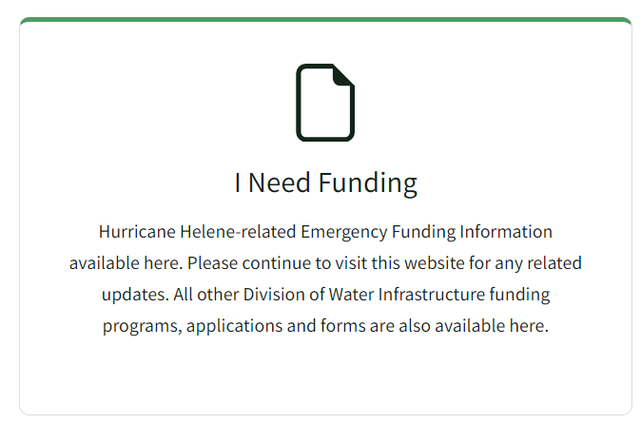
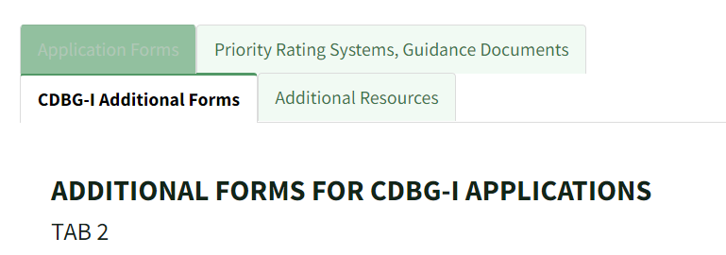
CDBG-I Application Resources, and Templates
Priority Rating System (PRS) Guidance ​
Fall 2025 Interactive Scorecard​
Appendix A – Determining LMI​
Appendix B – Public Hearings ​
Appendix C – HUD Forms and Instructions ​
HUD CPD 17-12 Floodway Notice​
HUD CPD 24-04 LMI Summary Data Updates
HUD 2025 Income Limits
HUD Area-Benefit LMI Census Data
Income Survey Templates & Instructions
  English & Spanish​
Public Hearing Notice and Templates​
Federal Certificates and Forms
Go To: 'I Need Funding'

Slide 161
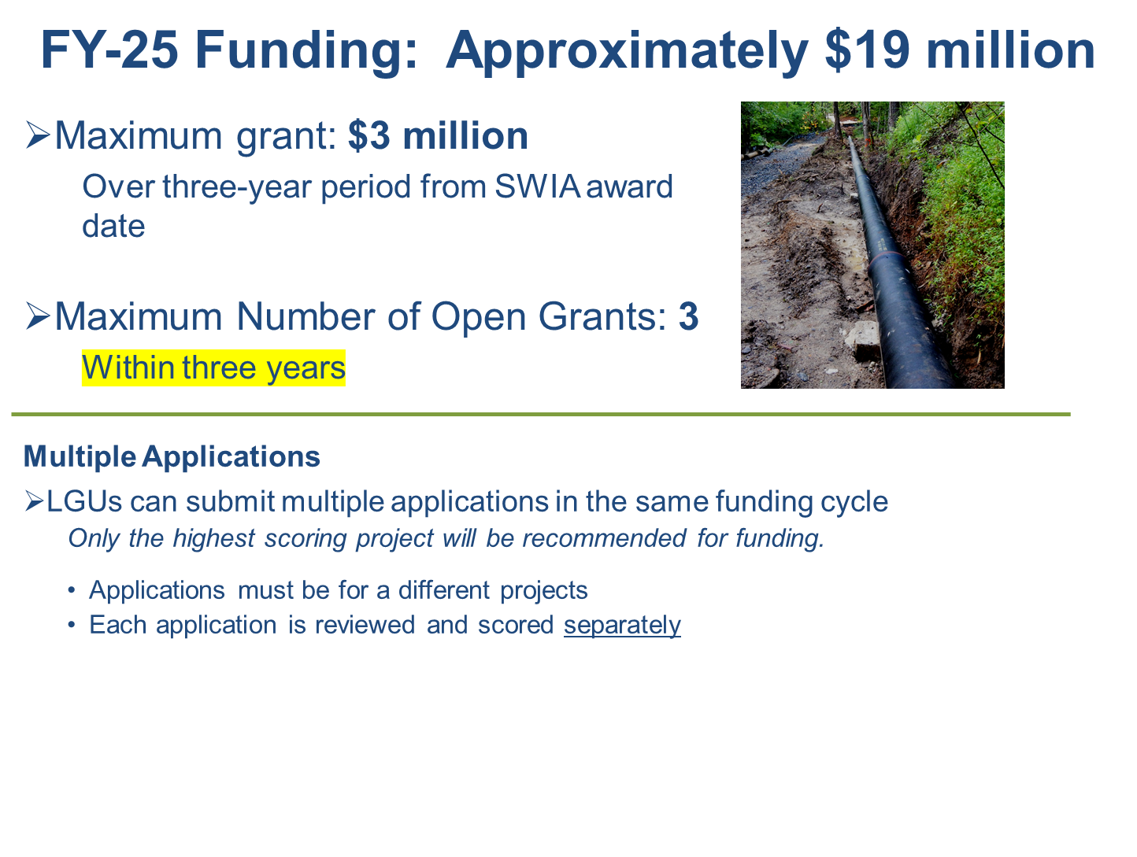
CDBG-I: Allocation and Maximum Grant Amount

Slide 162
CDBG-I Program Focus on Low-to-Moderate Income
Program Focus
Create healthy living environments through public water and sewer infrastructure financing
Mitigate public and environmental health problems in areas with a LMI percentage of at least 51%
Grant Application Eligibility
Be a non-entitlement municipality or county
Must benefit at least 51% LMI persons or households
  new connections
LMI Person Defined
Someone whose household income is at or below 80% of the area's median income (AMI)

Slide 163
CDBG-I: Project Restrictions and Limitations
  Project Limitations:
  Projects are restricted to residential areas only
    No funding benefits for business districts or for economic development
  Can fund private water/sewer connections to LMI homes
    Requires additional documentation
  Project Restrictions for Flood Areas:
Floodway (or Regulatory Floodway)
  HUD financial assistance is prohibited in floodways,
    with limited exceptions found in 24 CFR 55.8 and 24 CFR 55.21, HUD Notice CPD-17-013)
  Will allow CIPP, if completely underground and access is done outside floodway
Floodplain (must comply with 24 CFR Part 55)
  Can fund projects in the floodplain
    (1% Annual Chance or 100-Year and 0.2% Annual Chance or 500-year)
  Must follow new floodplain regulations

Slide 164
CDBG-I: Applicants Eligible to Apply (Slide 1 of 2)
Small Cities Funding is eligible for all municipalities and counties who are eligible to receive State CDBG funds, except for entitlement communities and counties.
Entitlement communities receive funds directly from HUD.
  North Carolina's 24 entitlement municipalities are:
Entitlement counties receive funds directly from HUD.
Neither the counties nor their municipalities are eligible
    Except for the Towns of Holly Springs and Linden.
Ashville | Burlington | Cary | Chapel Hill | Charlotte | Concord
Durham | Fayetteville | Gastonia | Goldsboro | Greensboro | Greenville
Hickory | High Point | Jacksonville | Kannapolis | Lenoir | Morganton
New Bern | Raleigh | Rocky Mount | Salisbury | Wilmington | Winston-Salem
Mecklenburg | Wake | Union | Cumberland

Slide 165




CDBG-I: Applicants Eligible to Apply (Slide 2 of 2)
Water and Sewer Authorities
Single purpose unit of government that own infrastructure
Must work with local governments to apply for funding
Are considered subrecipients

Slide 166
CDBG-I Project Area Map & Description
Project area must serve the entire project area!
If there are multiple project areas, each must have 51% LMI
Project Description Must List:
Streets
Municipal Information
Natural features: creeks, hills
Location of project area
Project Area Map Must Have:
Clear boundaries
Streets served
Houses served
Clear location
Project Area and Description MUST MATCH!
Make map
Legible!
See Appendix A:
Determining the LMI Percentage of the Project Area

Slide 167
CDBG-I: Determining LMI % For a Project
There are two ways to determine LMI percentage for project area.
*Note that this is not the same as the disadvantaged community definition.
Census Data (area wide), must use LMI summary data from HUD (2016-2020 ACS)
Income Surveys
Use 2025 HUD income limits
Older surveys must be completed within 18 months of application deadline
English and Spanish templates are available
A survey form is required for each occupied, vacant, above income, and nonresponsive household.
Four Survey Methods: ​
    Door-to-door
    mail
    online
    telephone
See Appendix A: ​
Determining the LMI Percentage of the Project Area

Slide 168
CDBG-I: Determining Data Type used for LMI %
  The project purpose, and type of project, determines which LMI data is used.
  Census Data – Area wide
    Water/sewer treatment plant work, major outfalls, major water mains, major pump stations, etc.
    Things that benefit the whole community/area
  Income surveys
    Line rehab/replacement, private failing or failed infrastructure, etc.
    Calculate the LMI percentage of the project area, using the number of people served.
  If project is connecting households to a public system, income survey with a 100% LMI, and if awarded income verification is required.
DO NOT round calculations, include last two decimal points (i.e., 76.26%)

Slide 169
CDBG-I: Using Census Data to Determine LMI %
Must use American Community Survey (ACS):
5-year 2016-2020 Low-Moderate Income Summary Data (LMISD)
(ACS 2020) - Effective August 1, 2024
Use the data set for Local Governments or All Block Groups
Filter data set for North Carolina
When using Census Tract or Block Data:
Project must serve the entire tract or block
The project area shall not be intentionally drawn to include LMI persons or exclude non-LMI persons
Refer to HUD CPD-24-04 (issued June 6, 2024)
Notes:
Note that I did have to filter data to North Carolina, and some location information has been hidden.
It is better to survey – most water and sewer systems are not designed to serve a census tract or block

Slide 170
CDBG-I: Using LMI Surveys to Determine LMI%
Best Practices
Start as early as possible.
  Surveys can be conducted up to 18 months before the application is submitted.
Engage the community.
  Let them know why they are being asked these questions.
  Utilize community leaders to help with surveys
    Mayors, managers, clergy, town councilmen – people that the community recognizes and trusts.
Assure the interviewees of the confidentiality of their answers.
Use our Spanish language survey or translate survey into another language, if necessary.
Notes:
If the project includes direct sewer connections, they need to know they will pick up a sewer bill! It should be obvious the project is needed and wanted by recipients in the application

Slide 171
CDBG-I: Documenting LMI % in Application Submission
  The electronic and hardcopy must include:
      Methodology
      LMI Project Area Map
      Documentation of Data Used
      Documentation of Data Used
      For area-wide ACS 2020 data: provide a copy of the data
      For income surveys: submit copies of surveys & a tabulation spreadsheet
        Include
            Completed surveys
            Surveys with No Reponses (marked as such)
            Vacant Properties (marked as such)
All surveys need to be signed and dated!
See Appendix A and PRS/Guidance
Notes:
Surveys not done correctly will NOT be counted and will lower your LMI percentage.

Slide 172

CDBG-I: Common Mistakes in LMI% Documentation
  Overall Documentation:
    LMI methodology is missing
    One side of the surveys is provided, not both
    Outdated surveys (older than 18 months)
    Missing income surveys
  Survey Forms:
    Used wrong income limits
    Surveys were not signed by appropriate parties
    Marked/circled household size and income limits do not match
    Survey corrections were not initialed or dated all appropriate parties
  Tabulation Summary Table:
    Data on tabulation summary table does not match survey data
    Wrong average household size to calculate no responses
  Map:
    LMI map does not convey all homes surveyed or more than what was surveyed
Could prevent application from moving forward!

Slide 173

CDBG-I: Project Description
Project description must include:
All major components of water or sewer lines
Location(s) of any work
Work on a Street or Within a Right-of-Way
List all streets
Include intersections
Include identifiable landmarks
Work “Off-Road”, or Outside of the Right-of-Way
Include a clear description of work location
Incidentals, such as backfill, rock, asphalt patching, etc., only need to be included in the budget!

Slide 174
CDBG-I: Project Budget – Paving Costs
  Paving Eligibility:
  Existing pavement disturbed by project
    Based on the pipe diameter and length of pipe for installation in road - referred as Pipe Trench.
    NCDOT PAVEMENT REPAIRS 654.01
  Paving Costs Not Eligible:
    Mechanical overlay of entire road surface regardless of NCDOT requirements.
    Roads that are currently in poor and unpaved conditions.
    Using contingency funds to pave beyond pipe trench.
    Paving costs exceeding 5% of project budget without Pipe Trench documentation
      Recommendation to SWIA will include reducing the budget line-item for paving to 5% of the total project budget prior to award
    What needs to be in application:
    Include cost in the Construction Budget.
    Provide map and initial cost estimate calculations for paving.
New Info!

Slide 175

CDBG-I: Build America, Buy America (BABA)
CDBG-I BABA requirements flow down to local governments (grant recipients) and contractors.
FY 2025 round of applications going forward:
  Iron and Steel
  Specifically Listed Construction Materials
  All Other Construction Materials and Manufactured Products
Notes:
HUD BABA phased implementation

Slide 176
CDBG-I Required Federal Compliance Documents
  Compliance Statements and Certifications
    Signed and dated in same calendar year as application
    Local Government Certification of Understanding….
    Certification of Debarment….
    Conflict-of-Interest Certification
    Federal Performance & Procurement Certification
    Disclosure of Other Federal Income….
  HUD Required Forms
    See Appendix C: HUD Forms and Instructions
      Economic Need – Infrastructure National Objective Form
      Project Source and Use Form
      IDIS Accomplishments and Beneficiaries Forms
Notes:
Full names of … compliance statements
Local Government Certification of Understanding of the Roles and Responsibilities Under HUD State CDBG Program
Certification Regarding Debarment, Suspension, and Other Responsibility Matters
Conflict-of-Interest Certification
Federal Performance & Procurement Requirements Certification
Disclosure of Other Federal Income and Any Financial Interest by Persons Involved with the Project.

Slide 177
CDBG-I Federal Application Requirements
  Documentation of the following must be provided:
  Sam.gov activity registration
      Local governments must have active registration with federal government
  Applicant’s Capacity Letter
    Applicant letterhead – see PRS & Guidance
  Applicant’s Latest Audit
    Must be current with audits - FY24
Floodplain / Floodway Map
    With project area and project description
  See PRS Guidance for requirements
Notes:
Also required manadary training with attendance by local government if awarded

Slide 178

CDBG-I: Required Public Hearing
A Public Hearing is a Citizen Participation Requirement.
Held within same calendar year of application
Certified public hearing minutes required
  See Appendix B: Public Hearing & PRS/Guidance
  Information to pay attention to:
    Public Hearing Notice
      Cannot be published in the legal notice section
      Notice Window
        At least 10 days before, no more than 25 days
    Required public hearing content
Could prevent application from moving forward!

Slide 179
CDBG-I: Application Submission - Hardcopy
CDBG-I REQUIRES HARD COPY APPLICATION with ELECTRONIC SUBMISSION.
Due by the Application Deadline in the Raleigh Office.
Electronic Submission
  Done via Laserfiche
  Is the official application
Hard Copy Submission
  Must include original signatures
  Submitted in a three-ring binder
  See PRS & Guidance for FedEx and UPS address
Could prevent application from moving forward!
  Both applications MUST be complete and match!

Slide 180
Discussion Time
What questions do you have?

Slide 181
Viable Utilities Program
(VUP)
Notes:
West: Matthew
East: Linda/Catherine/Tony
Before diving into the AIA and MRF applications, we wanted to give you a quick overview of the Viable Utility Program. By show of hands, who here is representing a Designated Distressed Local Government Unit?
[[[For the presenter, spend more/less time through this section depending on how many people are representing a distressed LGU or supporting a distressed LGU’s applications]]]

Slide 182

Master Plan – Definition of Viability
2017 State Water Infrastructure Authority Master Plan
A viable system is one that functions as a long-term, self-sufficient business enterprise, establishes organizational excellence, and provides appropriate levels of infrastructure maintenance, operation, and reinvestment that allow the utility to provide reliable water services now and in the future.
https://www.deq.nc.gov/about/divisions/water-infrastructure/viable-utilities
Notes:
In 2017 DWI and SWIA devised and created North Carolina’s Statewide water and wastewater infrastructure master plan: the road to viability. The goals and vision of the master plan are that all water and wastewater systems in North Carolina can become and remain viable utilities. The Division and SWIA are currently updating the Master Plan to reflect the progress made and lessons learned since 2017, and the updated plan is anticipated to be complete by the end of 2025.

Slide 183
Viable Utility Program (VUP)
Signed into law on July 1, 2020 (Reform of Water and Wastewater Public Enterprises, S.L. 2020-79)
  Updates to G.S. 159G “Water Infrastructure”
  $15M per Distressed system, $30M for merger
Foster the viability of water and wastewater operations across the state by:
  Identifying and designating distressed local government units (LGUs)
  Providing a process to develop viable water/sewer utilities.
  Coordinating approval by both SWIA and Local Government Commission (LGC)
Created Viable Utility Reserve (VUR)
  Fall 2025 to include $50 million for AIA, Rate Study,
  MRF, and construction projects
    Goal: $5M for planning and $45M for construction
Notes:
In 2020, the General Assembly updated the “Water Infrastructure” statutes in GS 159G to codify the goals outlined in the Statewide Infrastructure Master Plan.
The statute updates also created the Viable Utility Reserve. For this Fall 2025 funding round, $50 million is being offered from the VUR with goals of $5M for planning and $45M for construction. The actual amounts for planning and construction will be determined based on the applications we receive, but all $50M is expected to be awarded during this Fall 2025 funding round.
[[[If there are questions about where this funding is coming from, please ask them to contact Shadi Eskaf.]]]

Slide 184
“Distressed Unit” Statutory Definition
“Distressed unit. – A public water system or wastewater system operated by a local government unit exhibiting signs of failure to identify or address those financial or operating needs necessary to enable that system to become or to remain a local government unit generating sufficient revenues to adequately fund management and operations, personnel, appropriate levels of maintenance, and reinvestment that facilitate the provision of reliable water or wastewater services.”
Notes:
This is the statutory definition of a distressed system. Please note that there is no mention of “viability” in this definition, and becoming “designated as distressed” is only an indicator that the system may become non-viable. Conversely, just because a system has not been designated as distressed does not mean the system is and can continue being viable.
Still all viable water and wastewater systems have common features that enable the utility to provide reliable services now and into the future.

Slide 185
Viable Utility Program (VUP) Objectives
Assist Distressed utilities
  Establish clear expectation to meet statutory requirements
  Support utility condition assessment and capital improvement planning
  Encourage local leaders to be engaged, committed, and accountable for utility management
  Assist in developing short-term and long-term plans for viability
Support efforts and projects that promote viability
  Coordinate with other funding programs to develop partnerships and share prioritization
  Coordinate and strengthen relationship with other resource agencies
  Develop a program that supports all utilities
Notes:
The Viable Utility Program has two primary objectives that advance the statewide master plan’s mission. They are
1) Directly assisting distressed units as they identify their short and long terms needs, and
2) Supporting any available effort that promotes the viability of all water and wastewater systems in North Carolina, even if not directly funded or led by DWI.
So, how does a system become designated as distressed? [[[next slide]]]

Slide 186
VUP – LGU Assessment Process
Fifth annual assessment underway
  Approximately 500 publicly-owned DW/WW utilities
  151 LGUs designated as distressed currently
Schedule
  Designation by SWIA and LGC in September and October 2025, respectively
  Designation letters after formal designation
  "First Year" notifications issued for 2025 assessment
  “First Year” designation requests must be submitted by December SWIA meeting
Notes:
Every year, the Division in assesses approximately 500 publicly-owned water and wastewater utilities. Currently 151 systems are formally designated as distressed, which is roughly a third of all public water/sewer systems in the state.
After the Division completes the assessment process, we present our findings to both SWIA and the LGC who then must approve the distressed designations. Compared to previous years, we pushed our assessment cycle to late summer/early fall to coincide with the LGC’s updated Audit dates, so first year notifications and formal designation letters will be issued in late October/early November.
Utilities that receive a first year notice this year are not designated distressed at this point, but formal designation will occur if their assessment score is above the score threshold after next year’s assessment. [[[next slide]]]

Slide 187
VUP – LGU Assessment Criteria
# | Criterion | Type | Points/Weight | Source Data
1 | Service Population | Statutory | 1 | Varied
2 | Transfers Out | Statutory | 1 | Calculated from LGC data
3 | Transfers In | Statutory | 1 | Calculated from LGC data
4 | Debt Service Coverage Ratio (DSCR) | Statutory | 1 | Calculated from LGC data
5 | DW Compliance | Infrastructure/Organizational | 1 | NC DEQ-DWR
6 | WW / CS Compliance | Infrastructure/Organizational | 1 | NC DEQ-DWR
7 | Flow Moratorium | Infrastructure/Organizational | 4 | NC DEQ-DWR
8 | Revenue Outlook | Infrastructure/Organizational | 4 | EFC rates; source of population varies
9 | Affordability | Infrastructure/Organizational | 1 | Developed by DWI/SWIA
10 | Rates | Infrastructure/Organizational | 1 | EFC
11 | UAL Control Issues - W/S only | Infrastructure/Organizational | 3 | NC DEQ-DWR
Notes:
These two slides are the 18 assessment criteria. These criteria are used to designate LGUs as distressed – it’s a combination of service population, financial indicators such as operating margins, rates, affordability, and debt service coverage, and compliance indicators such as sewer moratoriums and water/wastewater violations.
Note that 1-4 are statutorily required to be assessed, 5-11 were developed based on technical and organizational aspects of systems, and….[[[next slide]]]

Slide 188
VUP – LGU Assessment Criteria (cont’d)
# | Criterion | Type | Points/Weight | Source Data
12 | UAL Missing Audit | Financial | 3 | LGC
13 | Surplus (deficit) w/ Debt | Financial | 2 | Calculated from LGC data
14 | No Debt DSCR Test | Financial | 1 | Calculated from LGC data
15 | % Depreciated | Financial | 1 | Calculated from LGC data
16 | Operating Margin | Financial | 1 | Calculated from LGC data
17 | Quick Ratio | Financial | 1 | Calculated from LGC data
18 | Receivables Ratio | Financial | 1 | Calculated from LGC data
Notes:
….criteria 12-18 are under the purview of the LGC, who provide the financial piece of the assessment through the required annual audit process.
As mentioned, we assess all publicly-owned water and sewer utilities in North Carolina every year, so please reach out to anyone in the Viable Utility Unit if you are curious about your current or prior years’ score. You can find a complete list of LGUs and their assessment scores on the “Viable Utility Program” page on the Division’s website.

Slide 189
VUP – Distressed Designation
Distressed criteria were created to help identify LGUs most likely in need of assistance for maintaining utility viability.
Approved criteria:
  D1. LGC has formally taken financial control of LGU.
  D2. No annual audit submitted in the past 2 years.
  D3. Total Assessment Criteria score (18 separate parameters with values ranging from 1-4).
    9 for LGUs regardless of one or both DW/WW utilities
  D4. Other information has become available.
Notes:
The assessment criteria is just one means of becoming designated distressed. There are other factors such as whether the LGC has taken financial control of the LGU, the utility has not submitted audits for two consecutive years, and if there is other information that is not captured in the assessment criteria.
If you believe your utility should be designated under the D4 “other information” category, please reach out to anyone in the Viable Utility Unit and we will gladly meet with you to help determine if the D4 route is appropriate for your situation.
Upon formal designation, each Distressed LGU has a series of statutory requirements provided in NCGS 159G-45(b) that must be fulfilled prior to no longer being designated as distressed. [[[next slide]]]

Slide 190



Distressed LGU – Statutory Requirements
Statutory Requirement | Available Resources
Perform an Asset Inventory and Assessment that results in a Capital Improvement Plan (10-year minimum) to inform a Rate Study. May lead to a Merger and Regionalization Feasibility (MRF) study. | VUR Study Grants can fund a study of any one or more of the following: Rates (Rate Study) Asset inventory and assessment (AIA) Merger and regionalization options (MRF)
Participate in a training and educational program for governing board, utility managers, finance directors, and operating staff. a.k.a. Best Utility Management Practices (BUMP) Training Completion of BUMP Training is required to access VUR Construction funding. | BUMP Training: (A) Free in-person training by DWI in the spring and fall. Upcoming dates: First couple of weeks in September 2025 (B) On-demand training ($72+tax) via NCLM. VUR Training Grants for distressed units cover registration fees and mileage to/from utility-specific training coordinated/offered by DWI, DST (LGC), and RAPWU partners.
Develop (and iterate on) a Short-term Action Plan (STAP) to identify and outline immediate steps necessary for the LGU to address technical, managerial, and financial (TMF) issues and reasons for being designated distressed. | Direct DWI assistance via comprehensive Status Report to facilitate the generation of a STAP.
AIA and Rate Study
Training
Short-Term Action Plan
Notes:
These two slides provide both the statutory requirements of distressed systems AND the funding options or resources that are available for distressed systems.
You can see that some statutory requirements can be fulfilled through division funding, but other requirements will be fulfilled through on-the-ground case management by Viable Utility Unit staff. Please note that distressed LGUs are not obligated to use DWI funding to fulfill their statutory requirements, however all distressed LGUs must adhere to the guidance documents and minimum criteria for AIAs and Rate Studies as approved by SWIA and the LGC. Two of the key minimum criteria for all distressed systems’ planning efforts are 1) developing a minimum 10-year CIP based on the Asset Management Plan, and 2) developing at least a full-cost pricing rate scenario as part of the required rate study.
For example, the required AIA and rate study efforts can be fulfilled through AIA and/or rate study grants funded by the Division.
The Division’s BUMP training is also a statutory requirement for all distressed systems, and it is a gateway to being eligible to receive VUR construction funding (more on that later). The Division puts on 5-6 BUMP trainings around the state each Spring and Fall, and the next round is expected to be the first few weeks of September. Upon being designated, each distressed LGU is allotted up to $2,000 to pay for the initial BUMP training requirement and to allow new staff to access the League of Municipality’s training resources.
For requirements such as the Short-Term Action Plan and [[[next slide]]]

Slide 191



Distressed LGU – Statutory Requirements (cont’d)
Statutory Requirement | Available Resources
Develop an Action Plan, considering: Short- and long-term infrastructure repair, maintenance, and management (STAP and LTAP) Continuing education of governing board and operating staff including how to send new staff to initial BUMP training Long-term financial management that facilitates reliable water or wastewater services Any other matters identified by DWI or the LGC | Long-term plan (i.e., “Long-Term Viability Plan” or LTVP) combines the long-term action and financial management plans into a single document and is developed through the Rate Study, AIA, MRF, and other plans such as CIPs and Master Plans. Includes budgeting for continued education, establishes the frequency and reasons for updating the AIA and rate study, and effectively ties together the utility’s planning efforts into a road map for improving and maintaining viability. Direct DWI and resource partner technical assistance available.
Long-term financial management to ensure sufficient revenue for O&M, personnel, maintenance, and reinvestment. | VUR Construction Grants for eligible projects.
Long-Term Action Plan
Continuing Education
Long-Term Financial Mgmt.
Notes:
This slide provides both the statutory requirements of distressed systems AND the Division’s resources that are available for distressed systems.
…and the Long-Term Action and Financial Management Plans, the Division is developing documents and tools that, in conjunction with the existing Emergency Operating, AIA/rate study, MRF, and training grants, will provide the means and methods through which distressed systems will meet their statutory requirements.
Some publicly accessible tools are being developed under contract with DWI by UNC’s School of Government’s Environmental Finance Center and other contracted entities which will be made available in the coming months. Continue to check our website for the latest announcements.

Slide 192
VUP – Funding Opportunities
Asset Inventory and Assessment Grant (AIA) &
Rate Study
  Required for all Distressed LGUs
  Goal: Asset Management Plan, Capital Improvement Plan, and Rate Study
Merger/Regionalization Feasibility Study (MRF)
  Encouraged for some Distressed LGUs
  Goal: Investigate partnerships for viability as needed
Emergency Operating Grants (EOG)
  D1 LGUs only
Construction Project Grants
  Applications must include VUR Supplemental Form
Notes:
As mentioned above, DWI has several funding opportunities available, but distressed systems are not obligated to utilize DWI funding to fulfill the statutory requirements. Regardless, all distressed systems’ AIA projects and Rate Studies must include the minimum criteria that SWIA and the LGC approved for these efforts. You can find the guidance documents that contain the approved minimum criteria for AIA projects and for Rate Studies on the “Viable Utility Program” page on the Division’s website.
Broadly speaking, the AIA and rate study allows a system to get a solid picture of the utility by determine what condition it’s in, what are the most critical assets, and what level of revenue is required to meet system needs. As SWIA and the LGC have approved, the AIA effort (whether in one project or a series of projects) must result in a minimum 10-year Capital Improvement Plan. This CIP as well as the ongoing operation and maintenance costs identified during the AIA project will subsequently feed into the rate study.
MRFs, while not required for Distressed systems, may be a necessary path for the utility when going-alone is neither feasible nor affordable. MRFs can include multiple partners who may be distressed and non-distressed and must include a full cost and affordability analysis of the potential merger or regionalization options.
VUR funds can also be used for Emergency Operating Grants for D1 systems, and these are in part managed by the Local Government Commission.
Lastly, VUR funds can of course be used for construction project grants which must meet certain Viable Utility eligibilities which is documented on the VUR Construction Supplemental Form.
[[[next slide]]]

Slide 193
VUR Eligibility Form
Required to be considered for project funding from the VUR
All distressed LGUs must complete form to be awarded VUR Construction Grant funding
Intent – VUR Construction grants promote viability
Notes:
We are offering approximately $45 million in VUR construction funding for this round, and any distressed LGU who wishes to be considered for this funding must complete this form and include it as part of the submitted construction application. If you anticipate your system will be designated Distressed by the time SWIA awards this round of funding in February 2026, go ahead and provide this form with each of your construction project applications.
Please make sure that you are compliant with your initial education requirements. There’s information about that here, so be sure to check it out. If you have questions, contact Tony Dongarra. He’ll be able to help you ascertain if you’re compliant or not.
Then on the second page, check your project eligibility type.
On the back side, provide a brief description of the project and how it promotes viability for your utility specifically related to your LGU’s assessment scorecard. “For example: This meter replacement project will improve the utility’s revenue generation by replacing the existing 30 year-old meters in the system; the meter replacement project will also ensure billing is performed more regularly and consistently through automatic meter reading software that will be integrated into the utility’s existing billing software.” Also, please attach a copy of your utility’s current and adopted CIP. If you lack a CIP, your application will not be excluded from consideration for VUR construction funds, but it will provide Division staff sufficient context for how the project resulted from and fits within the utility’s planning efforts.

Slide 194
Other Statutory Requirements – STAP/LTAP/LTFP
NCGS 159G-45(b)(3) – Develop an Action Plan, considering:
  Short-term (STAP) and Long-term plan for infrastructure repair, maintenance, and management
    Status Reports for STAP are underway
  Continuing education of governing board and staff
  Long-term financial management plan to ensure sufficient revenue to adequately fund, e.g. “Long-Term Viability Plan” or “LTVP”:
    Management and operations
    Personnel
    Appropriate levels of maintenance
    Reinvestment to provide reliable services
    Key Performance Indicators for Technical, Managerial, and Financial aspects of utility
  Other matters to achieve permit/regulatory compliance and as identified by SWIA and LGC
DWI’s Long-Term Viability Plan (LTVP) Guidance
available by end of 2025
Notes:
(KEEP IT GENERAL)
Beyond the types of projects DWI can fund, Distressed systems are also required to develop an Action Plan that includes short- and long-term action plans, continuing education plans, long-term financial management plans, and other matters identified by SWIA and LGC.
The focus of these plans is to establish specific actions, goals, KPIs, etc. to address the specific reasons for being distressed. Viable Utility staff along with SWIA and LGC are developing a guidance document to assist in the development of these plans.
The Short-term action plan was approved by SWIA and LGC in 2023, and the Long-term Viability Plan will be developed by the end of 2025.

Slide 195
VUP – AIA/MRF Project Timeline
SWIA approves funding = DWI issues Letter of Intent to Fund (LOIF)
Recipient submits Preliminary Scope
(90 days after LOIF)
    Scope must be consistent with the costs, challenges, and benefits presented in the application
Scope Approved by DWI = Funding Offer Issued
(150 days after LOIF)
    First payment items
    Must complete project within 2 years of LOIF date
    During the project, DWI requires regular project updates at least every two months, and draft and final deliverable/report
    Draft Deliverables provided to LGU and DWI
    (20 months after LOIF)
    Final Deliverable Approved = Final Payment
    (24 months after LOIF)
Notes:
This is the project timeline for all Division-funded AIAs, rate studies, and MRFs. Please note that this is the same project timeline for all Division-funded AIA and MRF projects, the goal being to complete your planning project within 2 years of the Letter of Intent to Fund.
Some key highlights are that DWI can start issuing disbursements for incurred costs after the scope has been approved and you submit the first payment items including the executed funding offer.
Also, DWI will withhold the final 5% of the funding until the Final Deliverable and Last Payment Items have been completed and approved by the Division.
This is the same process for all DWI-funded projects, and we will cover these processes in detail in later sections of the presentation.

Slide 196
VUP – Construction Project Timeline
VUP construction projects follow the same schedule/timeline as other DWI construction projects:
SWIA approves funding = DWI issues Letter of Intent to Fund (LOIF)
Engineering Report submittal/approval
    For distressed LGUs, there are additional requirements for the ER submittal related to viability.
    Include these responses for review in the first submittal!
    https://www.deq.nc.gov/water-infrastructure/supplemental-er-guidance-distressed-lgus/download?attachment
Plans and Specifications submittal/approval
    Project under Construction (two years after LOIF)
    Project Closeout
Notes:
Similarly, construction projects funded from the Viable Utility Reserve are subject to the same timeline as all other DWI-funded construction projects.
Here, we want to call your attention to the VUP’s additional Engineering Report requirements for distressed systems. Regardless of how much planning went in to develop the construction project, all engineering reports for distressed systems’ construction projects must include a discussion and brief analysis of how the system is addressing their viability needs during and beyond this project. These questions should look similar to the VUR Application Eligibility Form we previously discussed.
The main date to keep in mind is funding recipients have two years from the LOIF date to execute all contracts for the project.
For disbursements, construction disbursements will begin after the project has bid and awarded all contracts for the projects, and the funding recipient has executed the funding offer and provided all first payment items to the Division.

Slide 197
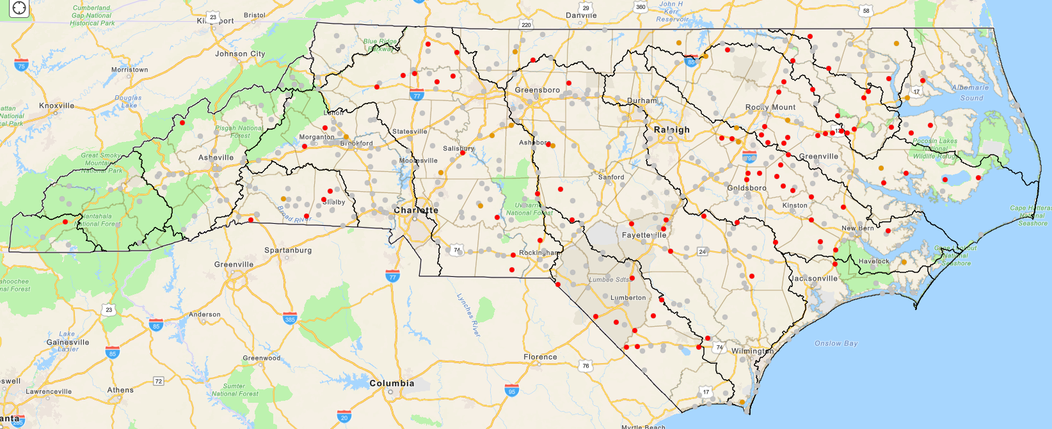
DWI/VUP – Existing and Emerging Partnerships
Martin County (MCRWASA)
Wayne County (Goldsboro)
Fairmont (Lumber River COG)
Cleveland County (CCW)
Others potential partnerships emerging (Jones County)
Bethel/Greenville Utility Commission
Pilot Mountain/Mount Airy
Tuckaseigee WSA
Gastonia/TRU/McAdenville
Western Intake Partnership (Chatham, Durham, Orange)
Notes:
[[[Talk about what you know]]]
We have several ongoing and potential partnerships around the state. Some efforts commenced before the VUR was created via the existing AIA and MRF grants.
Cleveland County Water – several small systems, already under central management, studying feasibility of more interconnections and/or actual merging
LRCOG – 10+ systems investigating a myriad of interconnections, consolidations, and interlocal agreements to provide reliable water and wastewater services
Wayne County – Goldsboro is a large utility among several smaller systems, so the Division has been working with surrounding utilities in their efforts to position themselves for potential utility mergers/consolidations among themselves and/or with Goldsboro
Martin County – Martin County contains a regional water and sewer authority and several small municipal systems; the Division has funded several AIA and MRF grants in this county even prior to the creation of the VUP, and current funding is allowing each system to investigate the best paths forward for each system and the county-wide authority.

Slide 198
VUP – Additional Initiatives
  COG rate study support through Raftelis Contract
    Goal to enable Distressed LGU rate studies with COG support
  Closing America’s Wastewater Access Gap
    EPA and USDA-RD program to help communities with problematic onsite systems pursue federal funding
    Can include engineering, planning, mapping, etc.
    https://www.epa.gov/water-infrastructure/closing-americas-wastewater-access-gap
  Voluntary energy optimization training and support
    DWI collaboration with State Energy Office
    Next training in Wallace, September 16, 23, and 30, 2025
    https://www.deq.nc.gov/about/divisions/water-infrastructure/fall-2025-application-training-ebs-training-and-water-wastewater-energy-efficiency-training-etc
  Cybersecurity audits – EPA and NC National Guard
  https://www.epa.gov/waterresilience/cybersecurity-assessments and
  https://www.csrf.nc.gov/
Notes:
(TALK ABOUT WHAT YOU KNOW!)
This slide is an overview of other initiatives the Viable Utility Program is participating in and collaborating with.
DEQ’s contract with Raftelis was recently reworked to support COGs’ capacities to help Distress LGUs develop rate studies.
Energy optimization training and support, next training is in Wallace in September. Please see the Division’s website for more information including how to register to attend. Space is filling up quickly to please register as soon as possible!
Lastly but certainly not least, Cybersecurity is a hot-topic especially with the recent proliferation of artificial intelligence/AI, and Viable Utilities is working with the EPA and NC National Guard to provide cybersecurity resources including risk and vulnerability assessments. Please see the EPA’s and North Carolina’s Cybersecurity Response Force’s website for resources and additional information.

Slide 199

VUP – Technical Support and Assistance
Resource Agency Partners for Water and Wastewater Utilities (RAPWU)
  Have well-established relationships with LGUs
  Provide technical and managerial expertise to LGUs
  Are often seen a neutral arbiters for partnerships (e.g., COGs)
  Share information and collaborate on many VUP elements
Notes:
Lastly, the Viable Utility Program supports and coordinates quarterly RAPWU meetings with most of the water/sewer technical assistance providers in North Carolina. The next meeting will be in September or October of this year, so please follow our website for that announcement.
[[[Talk about any services you’re aware of such as….
EFC’s rates dashboard, and their rate check-up and interlocal agreement tools
NC Department of State Treasurer’s coach team
NC Rural Water and SERCAP assist with system mapping, rate studies, and operational support
Etc….]]]]

Slide 200
Discussion Time
What questions do you have?

Slide 201
Asset Inventory & Assessment Grants
(AIA)
Notes:
This next section covers everything about Asset Inventory and Assessment Grants, or AIAs.
How many people here are interested in applying for AIA funding?

Slide 202
Asset Inventory and Assessment Grants (AIA)
Inventory existing water and/or sewer system and document the condition of inventoried infrastructure
For Fall 2025, VUR funding for AIAs is available
$400,000 limit per LGU, 1.5% Fee
No match requirement for VUR-funded AIA grants
Eligible activities can include:
  Identifying and GIS-locating system components
  Performing a risk analysis to determine critical components
  Determining the condition of critical components
  Establishing capital and O&M costs
  Creating a prioritized list of projects
  Preparing a realistic Capital Improvement Plan (CIP)
  Conducting a rate study
VU funding must be used to help address Distressed LGU’s statutory requirements
VU funding must be awarded directly to Distressed LGUs, their public partners or COG.
https://www.deq.nc.gov/about/divisions/water-infrastructure/i-need-funding/asset-inventory-and-assessment-grants
Notes:
AIA grants can be funded through the Viable Utility Reserve and the Drinking Water or Wastewater State Reserves. In all cases, AIA grants must include inventory and condition assessments of the existing system, but may also include other features of asset management programming.
Specifically for VUR-funded AIAs, eligible applicants are either Distressed LGUs, their public partners, and Councils of Governments or COGs.
For this Fall 2025 cycle, the $400,000 limit pertains to the maximum VUR funding available to a distressed LGU for any combination of AIA, rate study, and MRF projects.
Unlike the State Reserve AIAs (which we will talk about on the next slide), there is no match requirement for VUR-funded AIA grants, but all DWI grants require a 1.5% Fee regardless of their funding source. This fee can be paid by directly by the LGU or reimbursed through the grant. Either way, the fee must be paid by the funding recipient and should be factored into the overall project budget.
This list of eligible activities effectively covers the key components of what the EPA and industry standards recommend for utilities’ asset management plans. For distressed systems, these are also the minimum criteria SWIA and the LGC approved through the Division’s Water and Wastewater Utility Asset Assessment Guidance and Rate Study Guidance documents which can be found on the Division’s website on the asset inventory and assessment grants page.
Lastly, a unique feature of all VUR-funded planning grants including AIAs, rate studies, and MRFs is that a single project can include both drinking water and wastewater utilities owned by the applicant or benefitting LGU. For example, you can apply for $325,000 for an AIA and rate study covering both drinking water and wastewater systems, and $75,000 for an MRF covering the drinking water system alone.

Slide 203
Asset Inventory and Assessment Grants (AIA)
Inventory existing water and/or sewer system and document the condition of inventoried infrastructure
For Fall 2025, SRP funding for AIAs may be available
$150,000 limit per LGU’s utility (may change by legislation), 1.5% Fee
Match requirement for non-distressed recipients
Limited to utilities with 10,000 or fewer residential connections and once every 3 years per utility
Eligible activities can include:
  Identifying and GIS-locating system components
  Performing a risk analysis to determine critical components
  Determining the condition of critical components
  Establishing capital and O&M costs
  Creating a prioritized list of projects
  Preparing a realistic Capital Improvement Plan (CIP)
  Conducting a rate study
https://www.deq.nc.gov/about/divisions/water-infrastructure/i-need-funding/asset-inventory-and-assessment-grants
Session Law 2025-26
For FY 2025-2026, all grants awarded by SWIA from the State Drinking Water and Wastewater Reserves must be prioritized for Helene projects in counties designated by US HUD and have 300,000 or fewer population.
Notes:
[[[do not click again until the end]]]
This slide covers AIA grants funded out of the state reserve, or SRP, and these have their own set of limits and application restrictions. As you see the set of eligible activities is identical as the VUR-funded AIAs, but the State Reserve AIAs have a different set of applicant restrictions.
State Reserve AIA funding is limited to $150,000 per drinking water and wastewater system every three years, and eligible applicants must have 10,000 or fewer residential connections. As for the “every three years” limit, this is based on when SWIA awards the funding, so you can apply for another round of AIA funding is your last State Reserve AIA was awarded during or before the Fall 2022 funding cycle. Also, the limit applies to both utilities, so if you own both drinking water and wastewater systems, you can apply for and receive up to $150,000 for each system.. For example, the applicant may have a drinking water system with 11,000 connections and a wastewater system with 7,000 connections.
In this case, the LGU is eligible to apply for a wastewater AIA if their last wastewater AIA was funded during or before the Fall 2022 funding cycle, but they are not eligible for a drinking water AIA because they exceed the residential connections limit.
Specific to state reserve AIAs, there is a local match requirements for non-distressed funding recipients. The match is a percentage of the grant funding that the recipient must contribute toward the project either in local funds or in-kind, staff contributions to the AIA project. The match is attributed in 5% increments based on the number of LGU indicators at the time of applying that are worse than the state benchmarks, so an LGU with 5 of 5 indicators that are worse than the state benchmarks will be required to match 5% of the grant, 4/5 indicators requires 10%, and 3/5 requires 15%, and less than 3 requires 20%.
Lastly, we have heard that the general assembly may change the funding limits for AIA grants, but we will not know what that entails until the changes become law. To that end, we advise that you request a funding amount that you know is available to you when you apply, and be sure to include a total project cost on the application if your AIA project requires more than the Division can fund at the time you submit your application. If the funding limits change, the Division will honor the increased funding limits if you show in your application that your AIA project requires more than the current $150,000 funding limit.
[[[click again to bring up Green banner]]]
Before we proceed the last caveat for state reserve grants which fund AIAs is that Session Law 2025-26 requires all State Reserve grants to be prioritized to the 16 counties US Department of HUD deemed most affected by Hurricane Helene and have populations of 300,000 or fewer for the 2025-2026 fiscal year; please refer to slide 87 for the list of eligible counties. This means SWIA must award as much of the available $30 million in state reserve grants for Helene-related construction projects before they can consider funding AIAs. Still, we encourage everyone interested in AIA funding to apply this round, and your application may be able to receive funding if it is available. As always, we consider all Division applications for two funding rounds when funding for the project is available (for AIAs and MRFs this is typically each Fall round), so you will have saved yourself some time for the Fall 2026 funding round, plus your application will get the full review treatment meaning you will have sufficient time to improve it and resubmit if you so choose.

Slide 204
AIA – Distressed Systems
AIA and Rate Study required for all Distressed systems
Distressed System AIA’s scope must include:
  Identifying and locating system components
  Performing a risk analysis to determine critical components
  Determining the condition of critical components (at a minimum)
  Establishing capital and O&M costs
  Creating a prioritized list of projects
  Preparing a realistic Capital Improvement Plan (CIP), 10-year minimum
  Conducting a rate study
    https://www.deq.nc.gov/about/divisions/water-infrastructure/viable-utilities
A new AIA is not required if a sufficient AIA has recently been conducted (i.e., within past 5 years)
An AIA Grant may be used to further the results of
previous AIA activities
Must follow the Division’s “Water and Wastewater Utility
Asset Assessment Guidance” Document
Notes:
Moving on to specific requirements of Distressed systems. AIAs and rate studies are required for all Distressed systems if a sufficient study has not been completed within the last 5 years.
As always, AIAs may be used to further the results of past asset management activities, particularly when Distressed systems lack key components of a complete Asset Management Plan, or the current Capital Improvement Plan was developed before or without regard to the Asset Management Plan.
Similarly, rate studies should account for the costs of operating and maintaining the system, rehabilitation and replacement costs, and other necessary capital investments included in the CIP. The rate studies should also include building capital or debt reserves, and at least one scenario that provides a full-cost pricing rate structure as if the utility’s enterprise fund was able to completely self-fund all costs with no reliance on grant funding. Other scenarios should certainly be developed, but this full-cost pricing rate structure is a key criteria that SWIA and the LGC approved for all distressed systems. You can find out more including the Division’s rate study guidance for Distressed systems on the Viable Utilities page of the website.
Additionally and not just for Distressed LGUs, all Division-funded AIA projects whether through the State Reserve or VUR must adhere to the Division’s Water and Wastewater Utility Asset Assessment Guidance Document which can be found online as well.

Slide 205
AIA – Application Components
  Required for Completeness:
  Application forms
  Fund Transfer Certification Form
  Resolution
  Narrative question responses
    Including supporting documentation with specific references in narrative
    Required for scoring certain points:
  Financial Information Form – Operating Ratio
  Applicable rate sheets – DW/WW bill per 5,000gal
Notes:
When applying for either a State Reserve AIA or a VUR AIA, the same set of documents are required for a complete application.
The top group of documents are the required forms and documents needed for a complete application. In order to even be considered for scoring, you must submit a complete application form (the semi-annual version), a Fundin Transfer Certification Form, a Resolution authorizing the application, and a narrative response to the questions in the Priority Rating System Guidance plus supporting documentation. With these forms, your application will be reviewed and provided a score.
In order to score well, we also require the Financial Information Form (this will be used to determine the Operating Ration points), and the LGU’s current water/sewer rate sheets (these will be used to determine the points for the water and/or sewer bill per 5,000 gallons). If your LGU owns both drinking water and wastewater utilities, please provide financial information and rate sheets for both utilities even if you are applying for an AIA for just one of your utilities.

Slide 206
AIA – Priority Rating System (PRS)
SRP and VUR Asset Inventory and Assessment Grant Priority Rating System
Line Item # | Category | Points
1. | Project Benefits | 0 - 8
1.A | The LGU has been identified as “distressed” by the Authority and Commission per NCGS 159G-45(b). | 2
2. | System Management
2.A | Knowledge base of utility’s internal asset management team | 0 - 4
2.B | Current and past rate setting practices, CIPs, etc. | 0, 1, or 2
2.C | Management of asset inventory data | 0 - 4
2.D | Operating Ratio (OR) is greater than or equal to 1.00 based on a current audit, or is less than 1.00 and water/sewer rates are greater than $107/month | 0, 1, or 2
3. | Affordability
3.A | Current Monthly Utility Rate at 5,000 gallons usage | 0, 1, or 2
3.B | Local Government Unit (LGU) Indicators
3.B.1 | 3 out of 5 LGU indicators are worse than the state benchmark OR | 0
3.B.2 | 4 out of 5 LGU indicators are worse than the state benchmark OR | 1
3.B.3 | 5 out of 5 LGU indicators are worse than the state benchmark | 2
Total Points |  | 24 Max
Notes:
This is the Priority Rating System for all AIA applications. Category 1 Project Benefits has a maximum 8 points, Category 2 System Management has a max 12 points, and Category 3 Affordability is a max 4 points.
Note that half of the 24 available points pertain to system management. AIA applications that receive the highest funding priority are typically those whose challenges are most likely addressed by an AIA and whose asset management teams are most likely to use and manage the data in ways that promote proactive asset management practices.

Slide 207
AIA – Application Narrative
3 categories with 8 questions and 4 calculations
  Respond in same order as the Guidance
Category 1: Project Benefits
  Challenges, past asset management efforts, distressed status
Category 2: System Management
  Asset management team, how data will be used, how data will be managed, operating ratio
Category 3: Affordability
  Water/Sewer rates, LGU Indicators
Notes:
These next four slides outline the AIA priority rating system which consists of 8 questions and 4 calculations.
There were only minor tweaks to the guidance since the last AIA funding round in Fall 2024, so it will read nearly identical to prior applicants.

Slide 208
AIA – Category 1: Project Benefits
Discuss the top 3 challenges your system faces in the next 5 years and how an AIA will benefit these challenges.
  Challenges must directly relate to benefits of an AIA
  Consider (provide documentation as applicable)
    Permits, enforcement actions, and required and approved plans
Discuss steps already taken/underway to meet statutory requirements of Distressed system
Discuss past asset management and capital planning efforts and how they were financed
Notes:
Category 1 project benefits is for discussing the top 3 challenges your system faces in the next 5 years, your LGU’s distressed status and steps taken to meet the distressed requirements, and past asset management and capital planning efforts.

Slide 209
AIA – Category 2: System Management
Discuss the internal Asset Management Team, including for each member:
Discuss rate setting practices and whether an adopted CIP is used to inform that process
Discuss how the Team will use and manage the data to address the system challenges
  Consider external/contracted partners (public and/or private)
Calculate and discuss the last 3 years’ Operating Ratios
  Consider rate increases and bill collection percentages
  Name
  Position title
  Experience
  Trainings/certifications
  Current and future duties
  Responsibilities on the team
Notes:
Category 2 system management is for discussing the internal and external members of the Asset Management Team who will lead the AIA project now and continue to lead the system’s asset management efforts after the project. At a minimum the team must consist of utility staff who cover each of the 3 realms of your utility: Technical, Managerial, and Financial.
Also, discuss how the Team will use and manage the data into perpetuity.
For the operating ratio, please include discussion when the system’s ORs do not fit neatly into the scoring rationale. Lack of discussion in this section may result in staff awarding fewer points than if a discussion was provided for why the ORs fluctuated or changed drastically.

Slide 210
AIA – Category 3: Affordability
Calculate and discuss the system’s water and/or sewer rates per 5,000 gallons
Using DWI’s Affordability Calculator, determine the system’s number of LGU Indicators that are worse than the state benchmarks
  AIA grant eligibility is not based on the Affordability Calculator.
Notes:
Category 3 affordability is the same as it’s always been and is consistent with the other funding programs.
Please note you do not have to submit the Affordability Calculator with your AIA application because statutorily all AIAs are 100% grant funded.

Slide 211
AIA – Funded Projects
Milestones
  Letter of Intent to Fund (LOIF)
  Preliminary Scope Submittal and Approval
  Executed Grant Agreement and Contract(s)
  Draft Report then Final Deliverables
Disbursements for incurred project costs will be made upon request after the Grant Agreement, First Payment Items, and Contract(s) are executed
VUR-AIA Funding Requirements:
Grant period → 2 years from LOIF date
1.5% Fee for all
No Local Match Requirement
Up to 10% of funding can be used for software or equipment
Final Deliverable Requirements
  Executive Summary
  Meeting minutes/resolution of action(s) taken
  Final Report
  GIS layers (when applicable) to define service area
  boundaries including service gaps
Notes:
This slide covers the project timeline and requirements for AIAs funded by VUR.
Once SWIA approves an AIA for funding, the project is subject to the following schedule.
Again, all AIAs must be complete within 2 years of the LOIF date.
VUR-funded AIAs have a 1.5% grant fee for all recipients but there is no local match requirement for AIAs funded by the VUR.
Software and equipment that supports a system’s asset management program, specifically the benefits of an AIA as discussed in the application, must not exceed 10% of the funding amount. If you are setting up a new subscription-based service as part of your AIA grant, only the first year fees are eligible, and recurring fees must be factored into future budget planning.
At the end of the AIA project, the AIA deliverables include an executive summary, the final report, proof the project’s findings were presented to the benefiting LGUs governing body through either board minutes or a resolution accepting and/or any resulting plans. Additionally, if the AIA project creates new GIS layers or modifies existing GIS layers, the Division also requires submission GIS file types that sufficiently define the utility’s service area boundary including any gaps or donut holes in service coverage.

Slide 212
AIA – Funded Projects
Milestones
  Letter of Intent to Fund (LOIF)
  Preliminary Scope Submittal and Approval
  Executed Grant Agreement and Contract(s)
  Draft Report then Final Deliverables
Disbursements for incurred project costs will be made upon request after the Grant Agreement, First Payment Items, and Contract(s) are executed
SRP-AIA Funding Requirements
Grant period → 2 years from LOIF date
1.5% Fee for all
Local match requirement for non-distressed LGUs (waived for distressed)
Up to 10% of funding can be used for software or equipment
Final Deliverable Requirements
  Executive Summary
  Meeting minutes/resolution of action(s) taken
  Final Report
  GIS layers (when applicable) to define service area
  boundaries including service gaps
Notes:
This slide covers the project timeline and requirements for AIAs funded by the State Reserve.
The only difference is the local match requirement for non-distressed LGUs, otherwise the same set of eligibilities and requirements we discussed on the previous slide for VUR AIAs applies here to State Reserve AIAs.
Are there any questions?
If so, please reach out to Matthew Rushing or anyone in the Viable Utility Unit if you are interested in applying for AIA funding this Fall.

Slide 213
Discussion Time
What questions do you have?

Slide 214
Merger / Regionalization Feasibility Study Grants
(MRF)
Notes:
This next section covers everything about Merger/Regionalization Feasibility Study Grants, or MRFs.
How many people here are interested in applying for MRF funding?
[[[take more/less time through this section depending on how many folks are interested]]]

Slide 215
Merger/Regionalization Feasibility Study Grants (MRF)
To determine the feasibility of potential partnerships.
For Fall 2025, VUR funding for MRFs is available
  $400,000 limit per LGU (combined AIA and MRF funding)
  1.5% Fee
Merger – partial or complete consolidation
  Two or more utilities
  Organizational, Financial, and/or Operational
Regionalization – physical interconnection
  Water supply or wastewater collection
  Regional treatment
VU funding must be used to help address Distressed LGU’s statutory requirements
VU funding must be awarded directly to Distressed LGUs,
their public partners or COGs
https://www.deq.nc.gov/about/divisions/water-infrastructure/i-need-funding/mergerregionalization-feasibility-grants
Notes:
MRF grants can be funded through Viable Utility Reserve and the Drinking Water or Wastewater State Reserves. In all cases, MRF grants must investigate the feasibility of improving economies of scale among the applicant and partnering systems across their technical, managerial, and financial needs and obligations.
The definitions of merger and regionalization you see here reflect what is in General Statute 159G. Mergers can be either partial, so creating an interlocal agreement for shared operations while the two systems have separate managerial oversight and financial control, or complete which means either a direct acquisition of one system by another or multiple systems coming together to form a new authority or regional system
Short of merging, regionalization can mean either physical interconnections for shared treatment, collection, or distribution, creating an interlocal agreement for staff or other resource sharing, so hiring one ORC to oversee multiple treatment plants or entering into joint-purchase agreements to save costs on equipment, chemicals, or to improve buying-power for the systems.
Same as for AIA grants funded out of the Viable Utility Reserve, the MRF funding limit must fit within the overall $400,000 limit for any combination of AIA, rate study, and MRF grant funded by the Viable Utility Reserve. Also, eligible applicants are either Distressed LGUs, their public partners, and Councils of Governments or COGs. Also,

Slide 216
Merger/Regionalization Feasibility Study Grants (MRF)
To determine the feasibility of potential partnerships to improve economies of scale
For Fall 2025, SRP funding for MRFs may be available
  $50,000 limit per LGU’s utility (may change by legislation), 1.5% Fee
  Limited to once every 3 years per utility
Merger – partial or complete consolidation
  Two or more utilities
  Organizational, Financial, and/or Operational
Regionalization – physical interconnection
  Water supply or wastewater collection
  Regional treatment
https://www.deq.nc.gov/about/divisions/water-infrastructure/i-need-funding/mergerregionalization-feasibility-grants
Session Law 2025-26
For FY 2025-2026, all grants awarded by SWIA from the State Drinking Water and Wastewater Reserves must be prioritized for Helene projects in counties designated by US HUD and have 300,000 or fewer population.
Notes:
[[[do not click again until the end]]]
MRF grants funded by the State Reserve are identical to MRFs funded by the VUR, with a couple exceptions to the funding limits. Currently, State Reserve MRFs are limited to $50,000 per utility every 3 years. Same as for AIAs, you can apply for and received two $50,000 MRFs for your drinking water and wastewater systems.
Lastly, we have heard that the general assembly may change the funding limits for MRF grants, but we will not know what that entails until the changes become law. To that end, we advise that you request a funding amount that you know is available to you when you apply, and be sure to include a total project cost on the application if your MRF project requires more than the Division can fund at the time you submit your application. If the funding limits change, the Division will honor the increased funding limits if you show in your application that your MRF project requires more than the current $50,000 funding limit.
[[[click again to bring up Green banner]]]
Just as we discussed for State Reserve AIA grants, MRF grants funded by the State Reserve for fiscal year 2025-2026 are subject to the same provisions in Session Law 2025-26. Slide 87 in this presentation lists the counties that will be prioritized above all others, but we certainly encourage everyone to apply if you are interested in MRF funding. Your application will of course receive a full review and score, and we will reconsider your application again the next time State Reserve funding is available for MRF grants.

Slide 217
MRF – Distressed Systems
NOT required for all distressed systems
At least one applicant + one partner
  May include multiple partners
Non-distressed partner may apply on behalf of distressed system(s)
Distressed System MRF scopes must:
  Include at least 3 alternative + No-Action
  Identify new options that were not addressed in a previous study, or build upon and advance past efforts
  Consider reasons for being distressed and how merging/regionalizing will lead to viability
  May include decentralization alternatives
An MRF Grant may be used to further the results
of previous MRF activities
Notes:
MRFs for distressed systems are not a statutory requirement, but may be the best path to viability for your utility.
If you are distressed, we have a few explicit project requirements to ensure you are looking at a variety of alternatives for the service you provide, but we will meet with you after SWIA awards funding for your project to help determine what options will be investigated. The one caveat is that VUR-funded MRF projects can include investigating decentralized alternatives, whether that is actual on-site treatment alternatives or breaking up a larger system into distinct, more viable pieces. MRFs funded by the State Reserve, however, must focus on centralized options based on how the statute is currently written.

Slide 218
MRF – Application Components
  Required for Completeness:
  Application forms
Fund Transfer Certification Form
  Resolution from Applicant
  Narrative question responses
    Including supporting documentation with specific references in narrative
  Letter(s) from potential partner(s)
      Acknowledge the application and commit to participate
      Non-binding to act on the study’s recommendations
      Required for scoring certain points:
  Financial Information Form – Operating Ratio
  Applicable rate sheets – DW/WW bill per 5,000 gal
Notes:
MRF applications have the same application forms and documentation requirements as AIA grants with the one addition of the required partner letters or resolutions.
We have language in the MRF priority rating system guidance document that you can copy and paste onto the partner’s letterhead and have it signed by their chief elected official or equivalent manager, director, or administrator. The letters acknowledge their participation in the MRF project, declare their commitment to participate in the study, and specify that the findings from the MRF project are non-binding. Existing MOUs or other interlocal agreements also satisfy this requirement.

Slide 219
MRF – Priority Rating System (PRS)
SRP and VUR Merger/Regionalization Feasibility Priority Rating System
Line Item # | Category | Points
1 | Project Benefits
1.A | Top 3 Challenges and Compliance History | 0, 1, 2, or 3
1.B | Past Collaboration and/or Proximity | 0, 1, 2, or 3
2 | System Management
2.A | Size and Capabilities | 0, 1, or 2
2.B | The LGU has been identified as “distressed” by the Authority and Commission per NCGS 159G-45(b). | 3
2.C | Operating Ratio < 1.00 | 1
3 | Affordability
3.A | Current Monthly Utility Bill for 5,000 gallons usage | 0, 2, or 4
3.B | Local Government Unit (LGU) Indicators
3.B.1 | 3 out of 5 LGU indicators are worse than the state benchmark OR | 0
3.B.2 | 4 out of 5 LGU indicators are worse that the state benchmark OR | 2
3.B.3 | 5 out of 5 LGU indicators are worse that the state benchmark | 4
 | Total Points | 20 Max
Notes:
Here is the priority rating system for all MRF grants whether funded through the State Reserves or VUR.
Broadly speaking, MRF applications that receive the highest funding priority are those that demonstrate have the most endemic long-term challenges that will be addressed by an MRF and the highest likelihood of successfully carrying out the most feasible conclusions of the study.
There is a maximum of 20 points available. Category 1 project benefit has a maximum of 6 points, category 2 system management has a maximum of 6 points, and category 3 affordability has a maximum of 8 points. Points in categories 1 and 2 are awarded based on comparing with the other MRF applications received that round, and we roughly adhere to a standard distribution of points for the line item. For an example of the 1A points, an MRF application that documents the most severe NOVs will most often receive 3 points, an MRF application that demonstrates having the fewest NOVs will most often receive 0 points, and 1 or 2 points are assigned accordingly. Similarly for item 2.A, the application that includes a system with the smallest number of full-time positions most often receives 2 points, and 0 points are often awarded for MRF applications where the applicant and partner are robustly and appropriately staffed.
That said, SWIA has historically funded every complete and eligible MRF application, but our experience is that the best MRF project stem from well conceived and well written MRF applications.
For Division staff to get a sense of all the challenges faced by the applicant and partnering systems, please do not write the narrative responses solely focused on one system. For example, the applicant may be challenged in hiring and retaining qualified personnel, and the partner system may have the greatest barriers to providing affordable service. In this case, we would expect Category 2 System Management to focus on the applicant while Category 3 Affordability focuses primarily on the partnerning system.

Slide 220
MRF – Application Narrative
3 categories with 9 questions and 4 calculations
  Respond in same order as the Guidance
Category 1: Project Benefits
  Challenges, past studies, compliance history, past collaboration, proximity, and unallocated capacity
Category 2: System Management
  Organizational size and capabilities, desired level of service, distressed status, and operating ratio
Category 3: Affordability
  Water/Sewer rates, LGU Indicators
Notes:
[[[spend more or less time on this and the next 3 slides based on the number of folks interested in MRF funding]]]
The MRF priority rating system narrative consists of 9 questions and 4 items/calculations.
The next 3 slides provide a brief overview of each Category.

Slide 221
MRF – Category 1: Project Benefits
Discuss the top 3 challenges your system faces in the next 5 years and how an MRF will benefit these challenges.
  Challenges must directly relate to benefits of an MRF
  Consider (provide documentation as applicable)
    Technical ability, Organization structure, and Financial health
Discuss steps already taken/underway to meet statutory requirements of Distressed system
Discuss previous MRF or similar studies, proximity to, and past collaboration with partners
Confirm that at least one system has adequate unallocated capacity to expand
Notes:
Category 1 project benefits is for discussing the top 3 challenges your system faces in the next 5 years, distressed status and steps taken to meet the distressed requirements, and past merger/regionalization efforts.
Additionally, one of the systems in the application must document that they have adequate unallocated capacity to expand.

Slide 222
MRF – Category 2: System Management
Discuss the system size and capabilities, considering
  Number, position descriptions, and actual duties of utility staff
  Consider any contracted operation and management agreements with private and other public entities
Define or start to define the system’s desire level of service for its customers
Calculate and discuss the most recent fiscal year’s Operating Ratio
  Consider rate increases and bill collection percentages
Notes:
Category 2 system management is for discussing the size and capabilities of the least viable partner.
Also discuss your desired level of service and the barriers you face that limit your ability to meet those goals.
For the operating ratio, we just look at the most recent audited year, and one point is awarded if the most recent operating ratio is less than 1.

Slide 223
MRF – Category 3: Affordability
Calculate and discuss the system’s water and/or sewer rates per 5,000 gallons
Using DWI’s Affordability Calculator, determine the system’s number of LGU Indicators that are worse than the state benchmarks
  MRF grant eligibility is not based on the Affordability Calculator.
Notes:
Category 3 affordability is the same as it’s always been and is consistent with the other funding programs.

Slide 224
MRF – Funded Projects
      Milestones
        Letter of Intent to Fund (LOIF)
        Preliminary Scope Submittal and Approval
        Executed Grant Agreement and Contract(s)
        Deliverable and Closeout
      Disbursements for incurred project costs will be made upon request after the Grant Agreement, First Payment Items, and Contract(s) are executed
      SRP-MRF Funding Requirements
      Grant period → 2 years from LOIF date
      1.5% Fee for all, no local match requirement
      Deliverable contents
          Report containing alternatives evaluation, analysis of each alternative including financial implications, and conclusions/recommendations
          Meeting minutes/resolution of action(s) taken
          Executive Summary
Notes:
Once SWIA approves an MRF for funding, the project is subject to the following schedule.
Similar to AIA, all MRFs must be complete within 2 years of the letter of intent to fund, and the milestone schedule in your LOIF outlines the Division’s desired project schedule.
All MRFs have a 1.5% grant fee.
Lastly, MRF deliverable includes an executive summary, report/deliverable including conclusions/recommendations, and board minutes/resolution accepting and approving the final report.

Slide 225
Pop Quiz: AIA & MRF Applications – Question #1
In AIAs for system management, Line Item 2.A discusses the applicant’s internal asset management team.
Q: Which characteristics of a team member should be included in the narrative?
Position within LGU
Duties on asset management team
Experience
Training/certifications/licensure
A, B and C
All of the above (A-D)
Notes:
F. All of the above (A-D)

Slide 226
Pop Quiz: AIA & MRF Applications – Question #2
For MRF applications, the highest capacity partner should be the applicant.
Q: True or False?
True
False
Answer: The narrative should address both the applicant’s and partners’ challenges and benefits of performing an MRF project.
Notes:
B. False
[[[click again an read the answer in italics]]]

Slide 227
Pop Quiz: AIA & MRF PRSs – Question #3
To get full credit for Line Item 1.A of the AIA project, the narrative must...
Include the inventory of known assets and installation dates.
Address how the proposed project will generally address most of the listed challenges.
Draw direct connections between the top 3 challenges faced by the applicant and how the AIA will address and benefit those challenges.
List only one or two challenges faced by the applicant.
Notes:
C. Direct connections must be drawn between challenges and the benefit line item.

Slide 228
Discussion Time
What questions do you have?

Slide 229
IIJA - Lead Service Lines Replacement Program
Notes:
West and East: David.

Slide 230
IIJA – LSLR Allotments
NC's DWSRF-LSLR Allotments
Cap Grant Year | North Carolina's Allotment | 49% Principal Forgiveness | Total Available for Projects
2022 | $87,062,000 | $42,660,380 | $67,037,740
2023 | $87,290,000 | $42,772,100 | $64,594,600
2024 | $76,201,000 | $37,338,490 | ~$56M
  Portion of the state’s allotment will be used for set-aside activities:
    LSL inventory support and technical assistance
    Program management
    2024 Set asides are pending approval of 2024 LSLR Intended Use Plan
FY2025-2026 allotments to be determined by US EPA

Slide 231
Current and Estimated Funding Amounts per Funding Round
Funds Available | PF | 0% Loan | Total
FY 2024 funds available for projects | $37,338,490 | $19,050,250 | $56,388,740
Awarded Feb. 2025 | $5,360,560 | $0 | $5,360,560
Awarded Apr. 2025 | $1,129,110 | $9,000,000 | $10,129,110
Awarded Jul. 2025 | $12,374,300 | $2,000,000 | $14,374,300
Estimated min. available for Sept. 2025 awards | $12,446,162 | $4,563,230 | $17,009,392
Estimated min. available for Dec. 2025 awards* | Remaining FY2024 funds + TBD* | Remaining FY2024 funds + TBD* | Remaining FY2024 funds + TBD*
(*) Any unobligated FY 2024 amount, plus additional funds may be available from the FY 2025 IIJA DWSRF-LSLR capitalization grant to meet demand

Slide 232
IIJA – LSLR Funding Program
Eligible funding recipients
  Local government units
  Non-profit water utilities
  Investor-owned water utilities
Eligible projects or activities must be
  Lead service line replacement (LSLR) projects or
  Activities directly connected to the identification, planning, design, and replacement of lead service lines
Regular DWSRF is available for projects addressing lead in water mains/distribution systems, and other non-LSL replacement projects
Notes:
This round only, we’ll have two types of SRF funds available: ASADRA and SRF funding through our regular program. We’ll get into some basic details of ASADRA in just a few slides.
The CWSRF is a low-interest loan program where the rate is set at ½ the 20-year bond index. Currently, it’s at about 1.27% and will be set at the end of April
A couple of notes:
Note that 0% interest rates have changed more to targeted interest rates. We’ll cover that in a few minutes.
Loan terms are a 20-year maximum for the base rate and may be up to 30 years for reduced targeted interest rates.
Debt must be approved by the LGC.
Applications are due on April 30th

Slide 233
IIJA – LSLR Funding Program
Replacement projects must replace the entire lead service line
Service line connects the water main to the building inlet
  Includes lead connectors (goosenecks, pigtails, etc.)
  Includes galvanized service lines downstream of a lead service line
    starting with 2024 LSLR funds, replacement of GRR service lines downstream of "lead status unknown" lines no longer eligible for funding
No need to replace portions previously replaced
Funds cannot be used for in-house “premise” plumbing
Notes:
This round only, we’ll have two types of SRF funds available: ASADRA and SRF funding through our regular program. We’ll get into some basic details of ASADRA in just a few slides.
The CWSRF is a low-interest loan program where the rate is set at ½ the 20-year bond index. Currently, it’s at about 1.27% and will be set at the end of April
A couple of notes:
Note that 0% interest rates have changed more to targeted interest rates. We’ll cover that in a few minutes.
Loan terms are a 20-year maximum for the base rate and may be up to 30 years for reduced targeted interest rates.
Debt must be approved by the LGC.
Applications are due on April 30th

Slide 234
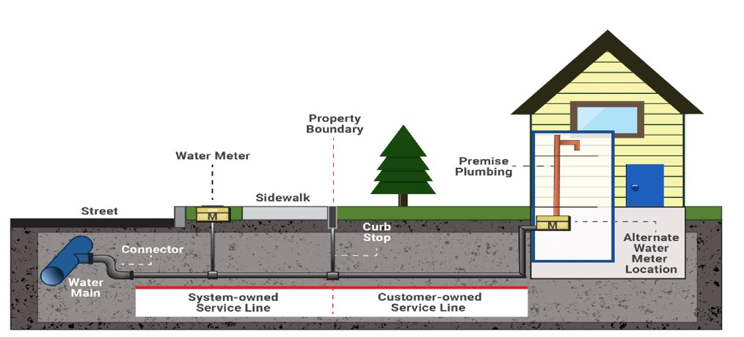
IIJA – LSLR Private Side Work

Slide 235
IIJA – LSLR Private Side Work
You must replace entire lead portions of the service line for any of the work to be eligible for funds
Homeowners are not required to replace their lines
Utility not required to pay for the private-side portion of the work (but if you don’t... you can’t get LSLR funds for that work!)
Must document that the entire known lead portions have been replaced

Slide 236
IIJA – LSLR Private Side Work
Flexibility to find solution that work best for your system
Utility performs work (in house or contract)
Homeowner hires “approved” service provider
  Utility reimbursement to homeowners
  Utility direct payment to service provider (plumber)
  Utility uses force accounts

Slide 237
IIJA– LSLR Loan Terms
>50% of funds available for projects are non-repayable loans (PF)
Repayable loan will be at 0% interest rate
Loan terms cannot exceed expected life of the project:
  20-year term loan for replacement projects
  5-year term loan for inventory-only projects
Notes:
This round only, we’ll have two types of SRF funds available: ASADRA and SRF funding through our regular program. We’ll get into some basic details of ASADRA in just a few slides.
The CWSRF is a low-interest loan program where the rate is set at ½ the 20-year bond index. Currently, it’s at about 1.27% and will be set at the end of April
A couple of notes:
Note that 0% interest rates have changed more to targeted interest rates. We’ll cover that in a few minutes.
Loan terms are a 20-year maximum for the base rate and may be up to 30 years for reduced targeted interest rates.
Debt must be approved by the LGC.
Applications are due on April 30th

Slide 238
IIJA– LSLR Principal Forgiveness (PF)
Portion of the loan that is not repayable
Determined at time of award based on application:
  Affordability Criteria – evaluates entire community/utility
    Considers community size, water/sewer rates, and economic indicators
    Eligibility ranges from 0% - 100% (in 25% increments)
  Disadvantaged Area – evaluates residents benefiting from the project, eligible for 50% PF
Initial cap of $1,000,000 or eligibility percentage of project cost (whichever is lower)
Caps and percentages can be exceeded if additional PF funds are available in a funding round
  Anticipate being able to provide PF up to % eligibility or more
Notes:
This round only, we’ll have two types of SRF funds available: ASADRA and SRF funding through our regular program. We’ll get into some basic details of ASADRA in just a few slides.
The CWSRF is a low-interest loan program where the rate is set at ½ the 20-year bond index. Currently, it’s at about 1.27% and will be set at the end of April
A couple of notes:
Note that 0% interest rates have changed more to targeted interest rates. We’ll cover that in a few minutes.
Loan terms are a 20-year maximum for the base rate and may be up to 30 years for reduced targeted interest rates.
Debt must be approved by the LGC.
Applications are due on April 30th

Slide 239
IIJA – LSLR Conditions
Funds are provided after costs have been incurred, not upfront
Drinking Water State Revolving Fund (DWSRF) conditions apply and must be documented:
  Davis-Bacon Prevailing Wage Rates
  American Iron and Steel (AIS)
  Build America, Buy America (BABA)

Slide 240
IIJA – LSLR Funding Types and Caps per Round
Replacing known lead service lines
  $5 million
  LSLs already known to be lead and you are ready to replace them
Verifying materials and replacing lead service lines
  $2 million of which $1 million max. can be used for material verification
  Already done inventory and identified lines and areas likely to be lead. Ready to verify materials and replace lines
Inventory only
  $1 million
  Identifying areas as known lead, known not lead, or unknown
  Further investigation and verification on unknown areas
Funding Caps can be exceeded in priority order by $500,000 increments when funds are available

Slide 241
IIJA – LSLR Funding Types and Caps
50% of available funds each round reserved for inventory projects
  may use reserve for other project types if there is not sufficient demand
DWI will reassess inventory reserves and caps for each FY LSLR allotments
Applicants may apply for multiple project types each round

Slide 242
IIJA – LSLR Priority Rating System
Projects will be recommended for funding based on approved priority rating system
Project purpose
Project benefits
System Management (not used)
Affordability

Slide 243
IIJA – LSLR Priority Rating System – Project Purpose
Category 1 – Project Purpose
Project Purpose Points
Line Item # | Category 1 – Project Purpose (Points will be awarded for only one Project Purpose) | Claimed Yes/No | Points
1.A | Project eliminates lead service lines (100% of project is to replace known lead service lines) |  | 20
1.B | Project establishes and implements a program to find and replace lead service lines in areas suspect to have lead lines. |  | 15
1.C | Project inventories lead service lines (no replacement as part of project) |  | 10
Maximum points for Category 1 – Project Purpose |  |  | 20
Notes:
This round only, we’ll have two types of SRF funds available: ASADRA and SRF funding through our regular program. We’ll get into some basic details of ASADRA in just a few slides.
The CWSRF is a low-interest loan program where the rate is set at ½ the 20-year bond index. Currently, it’s at about 1.27% and will be set at the end of April
A couple of notes:
Note that 0% interest rates have changed more to targeted interest rates. We’ll cover that in a few minutes.
Loan terms are a 20-year maximum for the base rate and may be up to 30 years for reduced targeted interest rates.
Debt must be approved by the LGC.
Applications are due on April 30th

Slide 244
IIJA – LSLR Priority Rating System – Project Benefit
Category 2 – Project Benefits
Project Benefits Points
Line Item # | Category 2 – Project Benefits | Claimed Yes/No | Points
2.A | Project directly addresses/resolves Lead Action Level Exceedance |  | 5
2.B | Project benefits area has documented Lead Action Level Exceedance |  | 2
Maximum points for Category 2 – Project Benefits |  |  | 5
Notes:
This round only, we’ll have two types of SRF funds available: ASADRA and SRF funding through our regular program. We’ll get into some basic details of ASADRA in just a few slides.
The CWSRF is a low-interest loan program where the rate is set at ½ the 20-year bond index. Currently, it’s at about 1.27% and will be set at the end of April
A couple of notes:
Note that 0% interest rates have changed more to targeted interest rates. We’ll cover that in a few minutes.
Loan terms are a 20-year maximum for the base rate and may be up to 30 years for reduced targeted interest rates.
Debt must be approved by the LGC.
Applications are due on April 30th

Slide 245
IIJA – LSLR Priority rating System – Affordability
Category 4 - Affordability
Affordability Points
Line Item # | Category 4 – Affordability | Claimed Yes/No | Points
4.A | Residential Connections
4.A.1 | Less than 10,000 residential connections OR |  | 2
4.A.2 | Less than 5,000 residential connections OR |  | 4
4.A.3 | Less than 1,000 residential connections |  | 8
4.B | Current Monthly Combined Utility Rates at 5,000 gal Usage
4.B.1 | Greater than $89 OR |  | 4
4.B.2 | Greater than $107 OR |  | 6
4.B.3 | Greater than $126 OR |  | 8
4.B.4 | Greater than $145 |  | 10
4.C | Local Government Unit (LGU) Indicators
4.C.1 | 3 out of 5 LGU indicators worse than state benchmark OR |  | 3
4.C.2 | 4 out of 5 LGU indicators worse than state benchmark OR |  | 5
4.C.3 | 5 out of 5 LGU indicators worse than state benchmark OR |  | 7
4.C.4 | Project benefits disadvantaged areas |  | 5
Maximum points for Category 4 – Affordability |  |  | 25
Notes:
This round only, we’ll have two types of SRF funds available: ASADRA and SRF funding through our regular program. We’ll get into some basic details of ASADRA in just a few slides.
The CWSRF is a low-interest loan program where the rate is set at ½ the 20-year bond index. Currently, it’s at about 1.27% and will be set at the end of April
A couple of notes:
Note that 0% interest rates have changed more to targeted interest rates. We’ll cover that in a few minutes.
Loan terms are a 20-year maximum for the base rate and may be up to 30 years for reduced targeted interest rates.
Debt must be approved by the LGC.
Applications are due on April 30th

Slide 246

IIJA – Lead Service Line Replacement Project Application Form
Part of the new LSLR/EC-S rolling application
Available on Division’s “Application Forms and Additional Resources” webpage
https://deq.nc.gov/about/divisions/water-infrastructure/i-need-funding/application-forms-and-additional-resources

Slide 247
When (and how) do I get
the money?
Notes:
West: Matthew
East:

Slide 248
Construction Project Funding Schedule
24 Month Schedule
Application | 0
ER Prep |  | 1 | 2 | 3 | 4
ER Review |  |  |  |  |  | 5 | 6 | 7 | 8 | 9
Design |  |  |  |  |  |  |  |  |  |  | 10 | 11 | 12 | 13 | 14 | 15
Plan Review |  |  |  |  |  |  |  |  |  |  |  |  |  |  |  |  | 16 | 17 | 18 | 19
Bid |  |  |  |  |  |  |  |  |  |  |  |  |  |  |  |  |  |  |  |  | 20 | 21 | 22
ATA |  |  |  |  |  |  |  |  |  |  |  |  |  |  |  |  |  |  |  |  |  |  |  | 23
Contract |  |  |  |  |  |  |  |  |  |  |  |  |  |  |  |  |  |  |  |  |  |  |  |  | 24
Disbursement for documented expenditures after signing construction contract
Notes:
This is the funding schedule for construction projects. Once a muni has applied for funding is approved, this is the construction project funding schedule.
The LOIF goes out shortly after awards are made. The project is automatically put on a two-year schedule, applicable to all projects. Some projects can move a lot quicker than that though!
4-5 months from LOIF for the ER to be sent in. Some munis might already have gone through the RFQ (qualification based selection) process to contract with a consultant, but others may not have – this time period allows for the muni to have time to get a contract set and get the ER in to the Division. Sometimes we may need to push deadlines back to allow munis time to select consultant or to prepare docs, but muni needs to request an extension from us if that is needed.
5 months or so for ER to be reviewed and approved. Keep in mind that there are new VUR requirements for the ERs, so to keep a tighter schedule make sure to include those in your first submittal.
Then we move into plans & specs design, also known as the bid and design package, which needs to be approved before the project can go out to bid.
At the end, after the authorization to awards and contracting is typically when we can start issuing disbursements for work done on the project.

Slide 249
Construction Project Schedule
GS 159G-41
  2 years to get under construction contract from LOIF
  1 year to get under contract after award (signing offer agreement)
  Unless there is an approved extension.
Offer and Acceptance
  Signed by Recipient and DWI
  Board approved agreement and Resolution
Engineering Report Approval ~9 Months from LOIF
  Alternatives Analysis
  Environmental Review (if required), more time for FONSI
Plans and Specifications Approval ~19 Months from LOIF
Project Bid
Construction/Contract Start ≤ 24 Months from LOIF
Notes:
In the LOIF, the P&S is referred to as the Bid and Design package
Point out the two years to get under contract – hard and fast statutory requirement.

Slide 250
When do I get my money?
Loan Recipients
  LGC approval of all debt
    Get annual financial audits in order
    Construction projects must have bids in hand!
DWI Fees – NCGS 159G-24
  2% of the loan (includes principal forgiveness)
  1.5% of the grant
  Due after award and prior to first payment
Disbursement of funds – NCGS 159G-42
  Disburse based on the progress of the project
  Recipient must document expenditures
  Funds for approved costs only
Notes:
When you receive your ER approval, the Division requests the LGC to approve any debt associated with the project. Upon the LGC’s approval or for projects funded by 100% grant, the Division will issue the formal Offer and Acceptance document.
Closing fees are 2% for loans and 1.5% for grants. ARPA-funded projects are not subject to the closing fees; this slide is in reference to all non-ARPA projects, including BIL funding which we will discuss in the next section.
The CWSRF/DWSRF is a low-interest loan program where the rate is set at ½ the 20-year bond index.
Note that 0% interest rates have changed more to targeted interest rates. Loan terms are a 20-year maximum for the base rate and may be up to 30 years for reduced targeted interest rates.
Debt must be approved by the LGC.

Slide 251
When do I start getting my money?
First payment checklist (all projects)
  Executed Funding Offer and Acceptance Resolution
  Federal ID/UEID Form
  Sales Tax Certification
  Executed and Approved Agreements/Contracts
    including Notice to Proceed for construction only
Construction Only (plus the above)
  Capital Project or Annual Budget Ordinance
  Site Certification
  Engineering Procurement Certification (ARPA, LSLR, EC and CWSRF)
  DWI’s Authority to Award
Notes:
This is all out on the website as well. First payment items are due prior to the DWI processing the first reimbursement request. Required forms are sent with the Offer and Acceptance package (after the Engineering Report is approved), and the above list of documents must be submitted as they are executed and issued.
Note that we only pay out on a reimbursement basis – no lump sums or money paid without an invoice!

Slide 252
When do I get the rest of my money?
Construction only last payment checklist (key items)
  Closeout Checklist (signed by recipient)
  Owner’s Certification of Completion
  Engineer’s Certification
  DWI’s Final Change Order Eligibility Determination
  DWI’s Final Inspection Report
Notes:
Final payment items are project-specific (depending on the permits required for construction), but templates should be included in the construction contract as part of the formal closeout process. The final reimbursement request will be processed upon receipt of the closeout document.
Note that this slide is primarily for construction projects. AIAs/MRFs need to submit the final deliverables, board minutes approving/accepting final deliverables, and have those approved by PM before final disbursement

Slide 253
When do I get the rest of my money?
Planning only last payment checklist (key items)
  Final Report
  Executive Summary
  Proof the project’s findings were presented to LGU’s governing body via either minutes or resolution
  GIS shape-files to determine service area boundary including gaps (AIA only)
Notes:
Final payment items are project-specific (depending on the permits required for construction), but templates should be included in the construction contract as part of the formal closeout process. The final reimbursement request will be processed upon receipt of the closeout document.
Note that this slide is primarily for construction projects. AIAs/MRFs need to submit the final deliverables, board minutes approving/accepting final deliverables, and have those approved by PM before final disbursement

Slide 254
State Revolving Fund (SRF) Conditions
SRF
  Offer and Acceptance Package
    Conditions and Assurances
  Davis-Bacon Wage Rates
  American Iron and Steel
  Build America, Buy America (in place of AIS!)
Read your Letter of Intent to Fund (LOIF)
Read your offer and acceptance letter
Notes:
If your project is subject to BABA, the LOIF will mention it.
By executing the offer package, make sure you know what you are agreeing to – read all the conditions!
IIJA money is subject to BABA (not AIS) – but Davis Bacon and AIS apply to all other SRF funding sources.

Slide 255
State Revolving Fund (SRF)
Build America, Buy America (BABA) Act
  Beginning May 2022, BABA applies to equivalency SRF projects every funding round, and to all projects funded with IIJA money.
    All iron and steel are produced in the United States.
    All manufactured products are produced in the United States.
    All construction materials are manufactured in the United States.
  EPA website: Build America, Buy America (BABA) | US EPA

Slide 256
BABA – Approved Waivers
EPA De Minimis General Applicability Waiver
  Waive requirements for products that cumulatively comprise no more than five percent of the total project cost.
  This waiver is not additive with the existing American Iron and Steel national de minimis waiver.
EPA Small Project General Applicability Waiver
  Waiver for small projects, where assistance agreements or subawards under assistance agreements are less than $250,000
Notes:
There are a few waivers for BABA, which is good. EPA has three categories of waivers – public interest waiver, where by following BABA you are going against the public interest. The second is the product is not available through BABA manufacturers, and the third is that the entire project cost will be increased by 25% (not the individual component cost but total project cost). The pre-approved waivers are listed here, including the de minimus and he small project waivers.

Slide 257
BABA – Approved Waivers
Adjustment Period Waiver for SRF Projects thathave Initiated Design Planning
  This one is complicated
  Waive BABA requirements on projects that initiated project design planning prior to May 14, 2022
  Does not waive AIS requirements
  May not cover re-design
  DWI has already identified affected projects and is in contact with the relevant fund recipients.
  Waiver does not apply for new projects that got funded after December 2023.

Slide 258
Timely and Expeditious Use of Funds (NEW)
EPA issued a memo (January 31, 2024) to all states requiring a statement in Intended Use Plan confirming that the funds will be expended in a timely and expeditious manner
Each cap grant will expire in four years once the drawdown begins
Hence it is extremely important for projects to finish on time as indicated in the Letter of Intend to Fund (LOIF)
Projects not following these milestone dates risks loss of committed SRF funds

Slide 259
Funds Available
Fall 2025 Application Type | Approximate Amount Available in Fall 2025
Drinking Water Projects | DWSRF Loan: $50M (incl. $18 M in PF) | Emerging Contaminants (EC): $0 - $10M for construction (whatever is available from Study Reserve) (100% PF) | CDBG-I ~$18M | State Reserve Program $30M grants* + $30M loans * SRP grants prioritized for western NC / Helene projects per SL 2025-26 | Viable Utility Reserve $50M grants
Wastewater Projects (including stormwater quality, stream restoration) | CWSRF Loan: $90 M (incl. $13 M in PF) | Emerging Contaminants (EC): Up to $2M for construction (estimated) (100% PF)
Planning Projects
Total | ~$270M (not including SRF Helene funding)
Rolling Application Type | Approximate Amount Available Through 2025
Lead Service Line Inventories and Replacements | ~$19.6M (incl. ~$12.5M in PF) (more is available)
Evaluation/Assessment Studies to Address PFAS in Drinking Water and in Wastewater/Landfills | Drinking Water ~$10M (100% PF)
 | Wastewater ~$2M (100% PF)
SRF Helene Funding | See Slide 11
Total | ~$31.6M (not including SRF Helene funding)
Notes:
Here are our funding amounts available this round.
Note that we’re offering both SRP grants and loans, plus VUR.
For the VUR, we anticipate recommending $5M for planning grants and $45M for construction, but we’ll adjust that as we see the applications come in.
Also, note that the SRF Helene funding is not included in these numbers. We’ll deal with those in a few minutes.

Slide 260
Discussion Time
What questions do you have?

Slide 261
Thank you!
See our website for contact information.
https://www.deq.nc.gov/water-infrastructure-contacts

