Slide 1
Application Workshop
Division of Water Infrastructure
Fall 2022

Slide 2
Agenda
Introductions
Program overview
Application package completion
Priority Rating Systems for drinking water and wastewater construction projects
Community Development Block Grant – Infrastructure (CDBG-I) programmatic specifics
Priority Rating Systems for planning grants (except for stormwater)
Local Assistance for Stormwater Infrastructure Investment (LASII) program
Wrap-Up
Notes:
Today, we’ll first start off with introductory information and then we want to give you a tour of our new website.
We’ll continue with a quick overview of our programs and then move into the application itself and associated forms.
We’ll then go through our study grant PRS.
After lunch, we’ll discuss a couple of items related to “At-risk” projects, then move on to our PRS for construction applications.
We’ll finish with ARPA Q&A.
If anyone wishes to stay around, we can discuss individual projects.

Slide 3
Training Handout Packet
Agenda
NCDEQ Division application packet
  Application
  Additional consideration guidance
  Project Financial Information
  Fund Transfer Certification Form
  Project resolutions
  LASII stormwater eligibility form
Priority Rating Systems and guidance
  Study grants for water/wastewater projects
    Asset Inventory and Assessment Grants
    Merger/Regionalization Feasibility Grants
  Construction projects for drinking water and wastewater, including CDBG-I
  LASII stormwater construction projects & planning grants
Evaluation form
Guidance and other documents can be found on our website at: https://deq.nc.gov/about/divisions/water-infrastructure/i-need-funding/application-forms-and-additional-resources
Notes:
In your packet should be the following that you see up here. These are in the order we’ll be going in today.
One thing we would appreciate is for you to take some time before you leave and complete an evaluation form. It will help us to better serve you in the future.
Also, please note that the link to where we have our application information has changed. I’ll show you what that looks like in just a minute.
No VUR supplement anymore.

Slide 4
New and Changing Items
Adjustment of points in Project Purpose
New line items in Drinking Water and Wastewater Priority Rating Systems
  Disadvantaged / underserved areas
  Failing infrastructure
  Regionalization
  Lead service lines
Local Assistance for Stormwater Infrastructure Investment (LASII)

Slide 5

Program Overviews

Slide 6
Funding Overview
American Rescue Plan Act (ARPA)
  State Reserve Program
  Viable Utility Reserve
State Revolving Fund (SRF)
  Loan and Principal Forgiveness
  Construction projects
  Bipartisan Infrastructure Law
Community Development Block Grant – Infrastructure (CDBG-I)
  Federal Grants from HUD with conditions
  Construction Projects
Notes:
This round only, we’ll have two types of SRF funds available: ASADRA and SRF funding through our regular program. We’ll get into some basic details of ASADRA in just a few slides.
The CWSRF is a low-interest loan program where the rate is set at ½ the 20-year bond index. Currently, it’s at about 1.27% and will be set at the end of April
A couple of notes:
Note that 0% interest rates have changed more to targeted interest rates. We’ll cover that in a few minutes.
Loan terms are a 20-year maximum for the base rate and may be up to 30 years for reduced targeted interest rates.
Debt must be approved by the LGC.
Applications are due on April 30th

Slide 7
Viable Utility Reserve – ARPA Important Facts
Funding Available – $119 million
Funds likely available only this round
Funding limits
  $15 million per applicant OR $30 million total for utilities merging
    Construction grants
    Study grants
Applications due on September 30, 2022
Funds must be expended by December 31, 2026
Notes:
Note that any previously awarded VUR funding will count toward these limits.
Funding limits are as shown for construction and training grants. Note that for study grants, there is no limit.
DWI intends to partially hold back some funds for the distressed LGUs for use in the Fall 2022 funding round. We do expect to fully expend funds allotted to the other category. If any remains, it’ll be disbursed in the Fall 2022 funding round.

Slide 8
Viable Utility Reserve – ARPA – Eligibilities
Utilities designated as distressed by State Water Infrastructure Authority (SWIA) and Local Government Commission (LGC) and partners
SRF-Eligible
Additional VUR eligibilities
  Physical interconnection
  Rehabilitation
  Decentralization
  Study grants
  Other feasible options leading to viability
  Training grants
Notes:
For ARPA coming from the VUR, there are eligibility requirements.
First, LGUs must be designated as distressed by SWIA and the LGC. Those who were designated as distressed should have received a letter from DWI.
All projects must be SRF-eligible.
All projects must fit what is eligible within the VUR, which is seen here.

Slide 9
State Reserve Program – ARPA – Important Facts
Funding available
  “At-Risk” utilities – $42.5 million
  Study and training grants – $28.3 million
  2022 Budget (SL 2022-74) – $7.5 million
  Funds likely available this round only)
Funding limits
  Construction projects
    “At-Risk” utilities – $15 million per applicant
  Study and training grants –
    $400,000 per recipient (including training grants) in the 2021-2023 biennium
    Training grants – $2,000 per recipient – Must be used within 2 years of award
Applications due on September 30, 2022
Funds must be expended by December 31, 2026
Notes:
For the SRP, funding available depends on where LGUs fall. As shown, there is much more funding for construction projects for “at-risk” LGUs than other LGUs. There’s also funding available for study grants.
Note that funding limits are different depending on whether you’re “at-risk” or other. For “At-risk” LGUs, DWI intends to hold back a small amount of funds until the Fall 2022 funding round. The DWI decided not to offer that option for other LGUs due to the small amount of funding available. Additionally, fund limits for Other LGUs is lower.

Slide 10
State Reserve – ARPA – Eligibilities
SRF-eligible projects
“At-Risk” utilities
  Eligibilities
    Not designated as distressed
    Systems eligible for “at risk” funds:
      6 or higher on Assessment Criteria score AND 3 of 5 LGU indicators worse than state benchmark OR
      Serves ≤ 1,000 residential service connections AND 3 of 5 LGU indicators worse than state benchmark
Notes:
If not “at-risk” in the original assessment but is “at-risk” due to April 2022 assessment, will be considered “at-risk.” “Worst” assessment score of the two evaluations will be considered.
Projects must be SRF-eligible.
Here are the requirements to be “at-risk”. We’ll talk more about how to determine that shortly after lunch.
Not that LGUs that fall into “Other” category may access the “at-risk” funding. We’ll talk about how on the next slide.

Slide 11
State Reserve – ARPA – Accessing “At-Risk” Funds
Other projects eligible for “At-Risk” ARPA funding
  Requirements
    75% of construction cost must connect existing disadvantaged, under-served areas within or adjacent to utilities
    Replace on-site services
    Connection is voluntary
    Connection fees covered by grant (may not be charged to residents)
  Demonstration of underserved areas
    Determined by DEQ
    DEQ Community Mapping System – https://deq.nc.gov/outreach-education/environmental-justice/deq-north-carolina-community-mapping-system
Notes:
We know that funding is very limited in the Other category, and we wanted to allow LGUs in that category to have a chance to access the “at-risk” funding.
Projects must meet the requirements shown here.
Mention that we’ll have an EJ map demo later in the training.

Slide 12
State Revolving Fund (SRF)
Clean Water State Revolving Fund (CWSRF)
Drinking Water State Revolving Fund (DWSRF)
Low-interest loan programs
  Rate set at ½ market (20-Year Bond Index)
  Current base interest rate is approximately 1.13% (will be set at application due date)
  20-year maximum term for base rate
  30-year maximum term possible for targeted interest rates
  Debt approved by Local Government Commission
Notes:
This round only, we’ll have two types of SRF funds available: ASADRA and SRF funding through our regular program. We’ll get into some basic details of ASADRA in just a few slides.
The CWSRF is a low-interest loan program where the rate is set at ½ the 20-year bond index. Currently, it’s at about 1.27% and will be set at the end of April
A couple of notes:
Note that 0% interest rates have changed more to targeted interest rates. We’ll cover that in a few minutes.
Loan terms are a 20-year maximum for the base rate and may be up to 30 years for reduced targeted interest rates.
Debt must be approved by the LGC.
Applications are due on April 30th

Slide 13
SRF & CDBG-I Funding Availability
CWSRF – Approximately $85 million available
DWSRF – Approximately $50 million available
Loan Maximums
  CWSRF – $35 million per Applicant
  DWSRF – $25 million per Applicant
  Can exceed if funds are available
CDBG-Infrastructure
  Approximately $20 million available
  $2 million per applicant every 3 years
Notes:
This spring, we’re offering SRF loans for both drinking water and wastewater under our regular program. Here are the approximate availability numbers for the SRFs. Our loan maximums are also shown. I do want to point out that if funds are available, we can exceed those maximum amounts to ensure that we use all of the funds.

Slide 14
State Revolving Fund (SRF)
Bipartisan Infrastructure Fund
Funds appropriate for next 5 years
Supplemental SRF funds
Approx. 50% to be available this Fall
  $16.7 million CWSRF
    $7.8 million as PF
  $21.8 million DWSRF
    $13.5 million as PF
Remaining funds available Spring 2023
Some BIL Funds not yet Available
  Lead Service Line Replacement
  Emerging Contaminants
Notes:
This round only, we’ll have two types of SRF funds available: ASADRA and SRF funding through our regular program. We’ll get into some basic details of ASADRA in just a few slides.
The CWSRF is a low-interest loan program where the rate is set at ½ the 20-year bond index. Currently, it’s at about 1.27% and will be set at the end of April
A couple of notes:
Note that 0% interest rates have changed more to targeted interest rates. We’ll cover that in a few minutes.
Loan terms are a 20-year maximum for the base rate and may be up to 30 years for reduced targeted interest rates.
Debt must be approved by the LGC.
Applications are due on April 30th

Slide 15
State Revolving Fund (SRF)
Build America, Buy America Act
  Applies to SRF and BIL funds awarded to States after May 2022.
    All iron and steel are produced in the United States.
    All manufactured products are produced in the United States.
    All construction materials are manufactured in the United States.
  EPA website: Build America, Buy America (BABA) | US EPA
Notes:
This round only, we’ll have two types of SRF funds available: ASADRA and SRF funding through our regular program. We’ll get into some basic details of ASADRA in just a few slides.
The CWSRF is a low-interest loan program where the rate is set at ½ the 20-year bond index. Currently, it’s at about 1.27% and will be set at the end of April
A couple of notes:
Note that 0% interest rates have changed more to targeted interest rates. We’ll cover that in a few minutes.
Loan terms are a 20-year maximum for the base rate and may be up to 30 years for reduced targeted interest rates.
Debt must be approved by the LGC.
Applications are due on April 30th

Slide 16
Funding Hierarchy – Drinking Water and Wastewater Projects
Grants (VUR or SRP)
100% PF-based (% based on affordability criteria)
CDBG-I grants
Less than 100% PF
SRF loans

Slide 17
CWSRF & DWSRF Targeted Funding
Principal forgiveness (PF)
  PF percentage based on affordability criteria
  Must receive priority points for Category 1 - Project Purpose
  PF limits can be exceeded if funds are available
Up to 100% PF for nonviable utility consolidation and failing drinking water and wastewater systems
Targeted interest rates for PF-qualified applicants
  PF eligibility ≥ 75% ⇨ 0%
  PF eligibility < 75% ⇨ 1% less than base rate
CWSRF only – 1% less than base rate for green projects
Notes:
The DWSRF and CWSRF have targeted interest rates as shown here.
We have PF, which is “grant-like.”
Limits are ½ the loan amount up to $500,000 per applicant. So if you have a $700k project, $350k will be PF. Or, if you have a $2M project, $500k is available in PF.
I do want to highlight that we’ve changed the qualification requirements for PF to be what you see here. These are based upon the affordability criteria, and the project must receive project purpose points.
Due to changes in our project priority systems, we now have 100% PF available for nonviable utilities and also for failing water systems. This is new.
Note that if you qualify for PF but don’t receive any, we’ve changed our interest rate structure. If you come out to 75% on the grant percentage matrix or greater, your interest rate will continue to be 0%. If you’d qualify for 50% grant or 25% grant, then it’ll be 1% less than the base rate. So if the base rate is 1.27%, your rate would be 0.27%.
We also have a green project reserve, which will be highlighted as we go through the project priority systems. One big thing to note here is that we’ve changed the way interest rates are determined for the GPR. Rather than 0%, we’re now using 1% off the base rate. So if the base rate is 1.27% at the end of April, the GPR interest rate would be 0.27%.

Slide 18
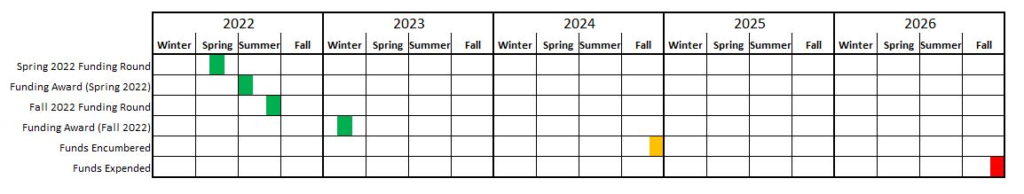
ARPA Spending Project Schedule

Slide 19
LASII – Important Facts – Grants Available
Construction grants
  Development and implementation of new stormwater utility
  Development and implementation of new stormwater control measure (SCM)
  Restoration of streams, wetlands, buffers and estuaries
  Retrofitting existing stormwater conveyances to provide for quantity and quality control
  Installation of innovative technologies or nature-based solutions
Planning grants
  Research or investigative studies
  Alternatives analyses
  Preparation of engineering concept plans or engineering designs
  Similar activities to determine best solutions to stormwater quantity or quality issues and to engineer / permit solutions
Notes:
Mention - Development and implementation of new stormwater utility is paid out of Construction Grants PRS but scored under the Planning Grants PRS

Slide 20
LASII – Important Facts – Funds / Funding Limits
What’s available
  ~$82 million overall
    ~$57.4 million for construction
    ~24.6 million for planning grants
  SWIA may award all in February 2023 or split funding into two rounds
Funding limits
  Construction Grants
    $5 million per applicant per cycle for construction projects
    $7.5 million per grant per cycle IF two or more units of local government work together on the same project
  Planning Grants
    $400,000 per applicant per grant cycle
    $500,000 per grant per cycle IF two or more units of local government work together on the same project

Slide 21
LASII – Important Facts – Funding Limits Cont.
Stormwater Utility Grants
  Grant amounts dependent upon number of LGU indicators worse than the state benchmark
  0, 1, or 2 LGU indicators worse than state benchmarks ⇨ $400,000
  3, 4, or 5 LGU indicators worse than state benchmarks ⇨ $500,000

Slide 22
LASII – Important Facts – Eligibility
Who is eligible to apply
  Cities
  Counties
  Councils of government or non-profit entity partnering with City or County on LASII stormwater project
Other eligibility requirements
  Must document a stormwater quality or quantity issue
  Must demonstrate significant hardship raising revenue to finance stormwater management activities
Notes:
Cities are analogous to municipalities in the final rule and therefore eligibility also includes towns

Slide 23
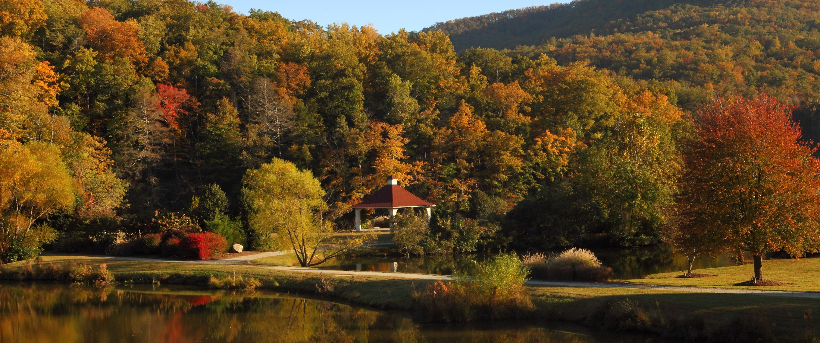
Questions?

Slide 24
Application Package Completion
Notes:
We’re going to talk about the application itself now.

Slide 25
Application Packet
Division application
Project Financial Information Form
Fund Transfer Certification Form
Resolution
Affordability calculator
Environmental Justice (EJ) map, if applicable
Rate sheets
LASII stormwater eligibility form (if applicable)
Priority points sheet and narrative
  Wastewater
  Drinking water
  Study grants
  LASII grants
Notes:
The packet you will send to the Division should contain these items regardless of the program to which you are applying.
We do require financial information, which is similar to 108C as well as the fund transfer certification form, which is now one sheet.
The packet you will send to the Division should contain these items regardless of the program to which you are applying.
A note about resolutions. They must be submitted at the time of application.
Regarding the priority points sheet and narrative, submit those for either wastewater or drinking water. If any of these are missing, the application will be considered incomplete.

Slide 26
Application Packages
Construction project applications not funded in previous round (Spring 2022) considered in Fall 2022 reconsideration
  No additional information allowed
  Application reconsidered as-is
  Adding information? ⇨ Submit completely new application
Each application viewed as stand-alone
Notes:
Please note that if you had an application that was submitted last fall and not funded, it’ll be reviewed this round as well.
If you want your application reconsidered, please note that you are not allowed to submit any additional information; the application is considered as-is.
If you plan to add information, you will need to submit a completely new application.
Or, multiple applications come in that are missing pieces. Historically, we’ve had leeway with this. No more. Each application must stand on its own. In other words, we have sometimes received AIA applications from the same town for water AND sewer. The water has the FIF while the sewer does not. Historically, we gave leeway to this. No more. In this situation, of the sewer AIA was lacking the FIF and the water AIA application had it, the sewer AIA will be incomplete.
Also, all copies must have the same information. Real life example, one of our applications had a hard copy with the signature on the common application while the e-copy did not have that signature. We let it go for our past funding round but will not do so this point going forward. If the signature is lacking in the copy, then the application is incomplete.

Slide 27
Final Check Tips
All signatures present including electronic copies
All forms present and complete
  Application
  Fund Transfer Certification
  Rate sheet(s)
  Resolution(s) as needed
  LASII stormwater eligibility form (if applicable)
  Affordability calculations
  EJ map (if applicable)
Narratives & score sheets & supporting documentation
Notes:
TIP: First, use your own internal QA/QC checklist to make sure all applications and copies have all pieces.
TIP2: Don’t scan anything to make a copy until the application is complete with all signatures.

Slide 28
Division Application

Slide 29

Division Application
Revised in Summer 2022
This application must be used
One application for all programs
Best funding fit
All sections completed
Note: Application comes with instructions
Read the instructions
Notes:
Once you click on the links, you’ll select the one for the application. You should see the application with a header like this. Please use this one rather than an old one because this has been updated.
Make sure that you use this application. We will not consider applications submitted on the old form because there is too much information needed related to that.
Make sure you complete all sections within the application.
Please make sure that you take the time to read through the instructions. There are some pretty significant changes to the application, and I want to make sure you give yourself every chance at success. The best way to do that is to read these before you even start filling out the application.

Slide 30
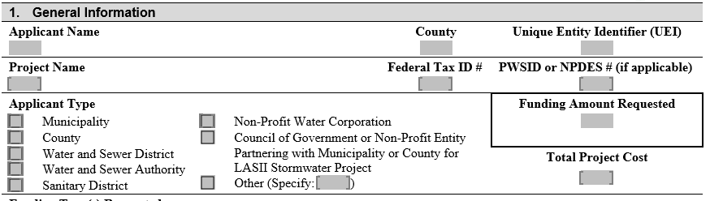
Division Application – Section 1
Notes:
This section has changed some, so I want to break it down. The first part up here is similar to what you know.
The Total Project Cost may very but may not be less than the Funding Amount Requested.
You must complete the Funding Amount Requested. We’ve been generous in the past related to people leaving this blank and did have at least one application leave it blank this past round. Due to the amount of funding available, you must complete this item. Else, the application will be incomplete.

Slide 31
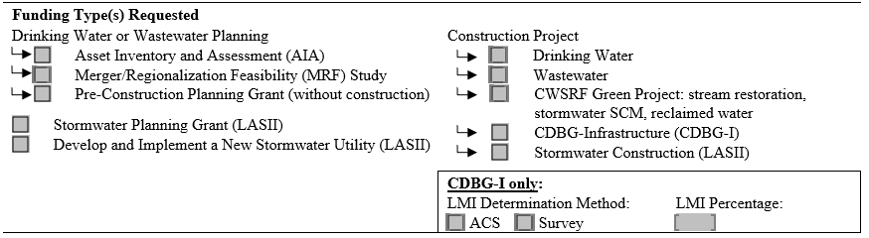
Division Application – Section 1
Notes:
The Funding Type Requested has changed somewhat. We’ve temporarily removed the CDBG-I portion.
Listen carefully. Things are different since ARPA is in the mix. The first thing is that if you plan to do an AIA and MRF application, check the appropriate box. One AIA/MRF type per application. For example, if the Town of Buxton wishes to apply for an AIA and an MRF, they’ll need to do 2 applications.
If you’re planning a construction project, tell us that by checking this box and talking about what type of project. Note that we do not have a stormwater fund through ARPA yet. This stormwater fund is for CWSRF only. Very important.
Now here’s where things change somewhat. We do have training and study grants (beside AIA/MRF) available that can be part of the AIA, MRF, or construction projects. For example. You can apply for a construction project and training grant at the same time. If that’s the case, check the appropriate boxes for your construction project and then in the other box, add training grant and check it. Or maybe you want to do training alongside an AIA project. Same thing. Check AIA and add training. Or maybe you want to do a pre-construction grant only. Check the box.

Slide 32
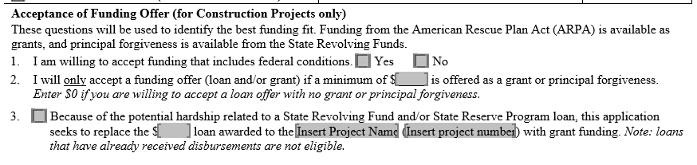
Division Application – Section 1
Notes:
We shifted our funding questions up to this section, and they’re shown here.
Question 1. For this round of applications, please check yes. Checking no will remove you from any funding possibility because ARPA does have Federal conditions.
Question 2. This is very important, especially if you or your client happens to fall into the Other category where we simply don’t have a lot of funding. However, it’s also important because if we do run out of ARPA money, we want to know about your willingness to accept SRF funding. In this question, tell us how much grant money you would have to have to make the project go. As it says, it’s okay to be $0 if you know you could take a loan. Something to keep in mind as you strategize: Your project may rank out when we’re getting ready to run out of ARPA or PF funds. If that’s the case, say if you have a $2M and you say you need at least $1M to make the project go and we have only $800K left, we’ll skip you. This is similar to the way we’ve previously done it, just expressed more directly with dollar values.
Question 3. Something we are offering this round is the ability for you as a LGU or your client to swap out an existing SRF or SRP loan for ARPA funds. There are some catches. If you decide to do that, we still need to see your full application because you’re applying for funding this round along with every other totally new project. The big thing is to make sure that sure that you have not received any disbursements for that particular project. If you do have an SRF or SRP loan with no disbursements received and you want to swap it out, check the box. Then let us know how much the loan is, what its project name is, and what it’s project loan is. We will verify it’s status. What you’ll want to do is check this box if you want to do a swap-out. Keep in mind that any loan swapped out goes toward your overall funding amount. So say if you’re an at-risk project and want your $3,000,000 SRF loan swapped out, you’ll still have $12M in ARPA eligibility left.

Slide 33
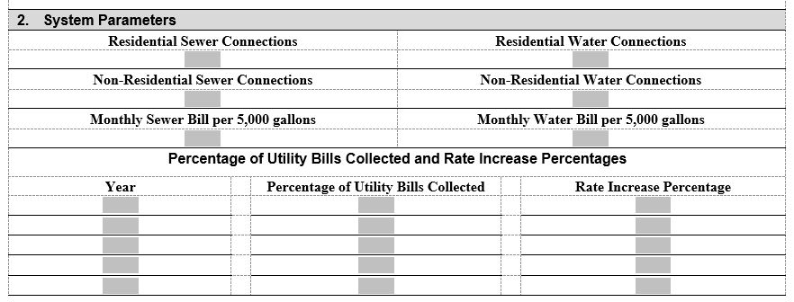
Division Application – Section 2
Notes:
Section 2 is a place where you will provide information that is also used in the affordability calculator and helps us determine your ARPA at-risk eligibility. Please put in the number of residential water and sewer connections. If you’re a single utility provider, that’s okay. Put what you have.
Also provide us with the monthly water and sewer bill. This is important for Priority Points as well as for PF eligibility.
Then provide us with the bill collection and rate increase information as shown.

Slide 34
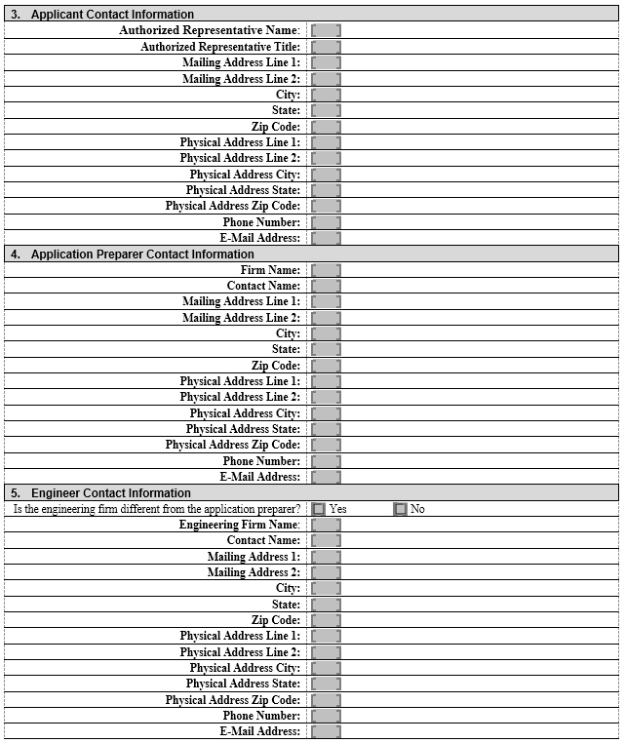
Division Application – Sections 3, 4, and 5
Notes:
Sections 3 through 5 are now all contact information and all on the same page. Complete these. If your application preparer is different than the engineer, just check “Yes” and complete the information.
One would think this is self-explanatory, but apparently, we had a lot of people put in wrong addresses/contact information.
Elementary, I know, but it happened. It’s critical that this is correct because this is how we base our correspondence.
For mailing address, put where you receive your mail. For example, if you receive your mail at a PO box, put the PO box and not the street address. We simply need to know where your mail goes so that we can send you information.

Slide 35
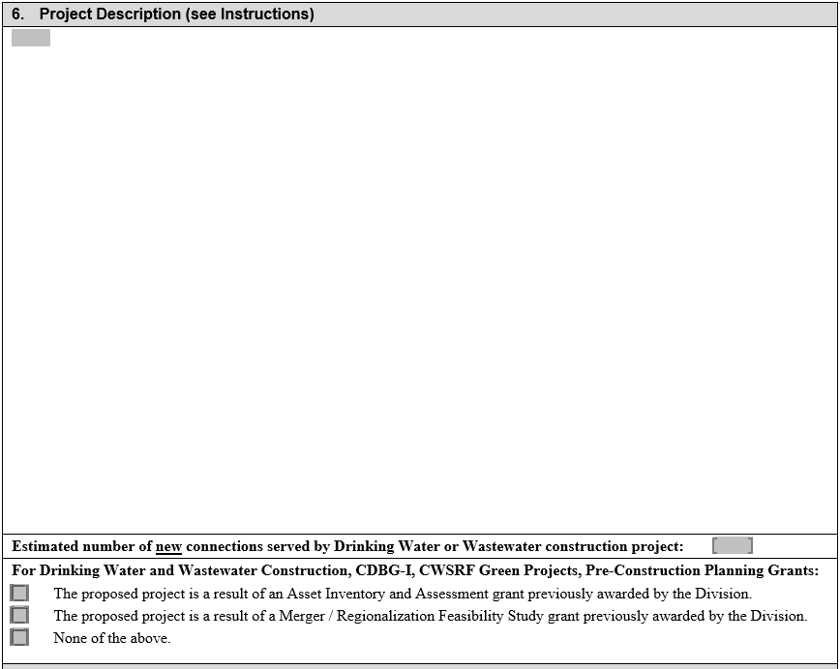
Division Application – Section 6
Notes:
This is really, really important. Regardless of what type of project you’re applying for, be it a construction or study grant project, please take the time to read through the instructions for what we ask because this is the section where the requirements have changed. I’ll outline them for you.
Give a good, broad description. For construction projects, keep in mind that our application reviewers match the description to the budget.
If you’re applying for training or study grants such as a rate study or pre-construction, AIA, or MRF, describe what these studies will entail. For example, you have a wastewater construction project but also want to send your utility staff to training to learn how to do condition assessment. You’d describe the construction project, then discuss what the training is for. Another example would be if you’re a distressed LGU who is applying for an AIA and a training grant, you might want to generate an AIA, then send the LGU’s staff to GIS training so they can learn how to use the system.
For those of you who may be in the Other category for ARPA funding, this is the place where you can tell us why you think you should have access to the “At-risk” ARPA funding. Tell us that your project will enable you to access the “At-Risk” funding and where it will be. Be detailed in where your project will occur. You can either use the DEQ Community Mapping System or provide a paragraph (keep to a paragraph) to describe why you think the community is disadvantaged or underserved. Keep in mind that d/u communities must be within the boundaries of the applicant or adjacent to the boundaries. Also, keep in mind that 75% of the project must go to that and that connection must be voluntary. We’ll do a demo of the map after lunch.
In the line below for construction projects and pre-construction grants only, tell us if that project is coming out of a previously awarded AIA or MRF by us. This does not influence points. It’s an information collection mechanism for us.
Finally, if your project will add new connections, please report this information here.
The one thing I can say, especially if you’re looking for funds for d/u communities is to read Section 6 very, very carefully, including the footnotes.

Slide 36
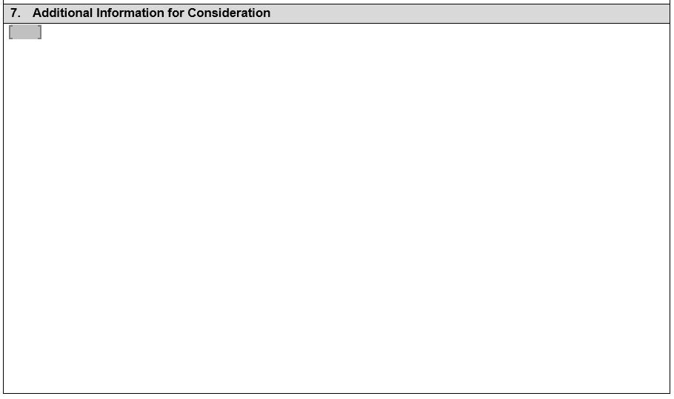
Division Application – Section 7
For use with information to add beyond the priority points system
Use supplementary guidance
Must fit into the space provided
Notes:
You also have the chance for additional consideration, something that the Authority approved last year.
The purpose of this information is to provide for the opportunity to be considered for things that don’t fall within the priority points system. For example, if you live in a town that suddenly loses its one industry, you could put that in here.
Complete this section of the application only if you have information that doesn’t fall within the priority points system that you would like for the Authority to consider.
Check out the supplementary guidance that is in your packet. This has information related to this section as well as examples.
If you choose to add additional information, it must fit into that space. No exceptions.

Slide 37
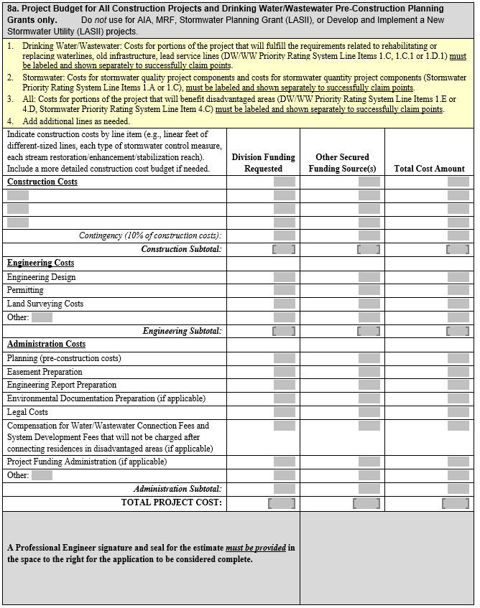
Division Application – Section 8a – Construction Projects
Notes:
When you fill this out, make sure that you hit the major items that are in the project description.
For construction projects, pre-construction is wrapped in with the construction budget, so no need for requesting a separate pre-construction grant.
If you are doing a pre-construction grant only, just fill out the EC and AC portions.
Fill in the lines, total, and drop the total to the bottom Make sure that the total funding requested and total project cost match what you put in Section 1.
Make sure you stamp the PE seal on this budget. The application won’t be complete without it.

Slide 38
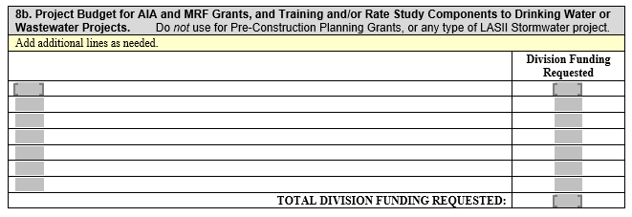
Division Application – Section 8b – Planning-Type Grants (DW & WW Projects Only)
Can add rate studies or training grants to construction, AIA, and MRF applications for DW/WW projects
No PE seal is required for this budget
Notes:
Section 8b’s budget is very simple. Give us a broad-brush.
Say, if you’re applying for an AIA and training grant, give a basic budget for the AIA and how much the training grant will be for.

Slide 39
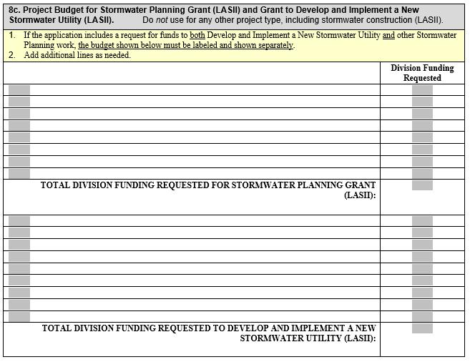
Division Application – Section 8c – Develop & Implement New Stormwater Utility (LASII Only)

Slide 40
Certifications
11 items
Read each
Initial each
Not applicable? N/A

Slide 41
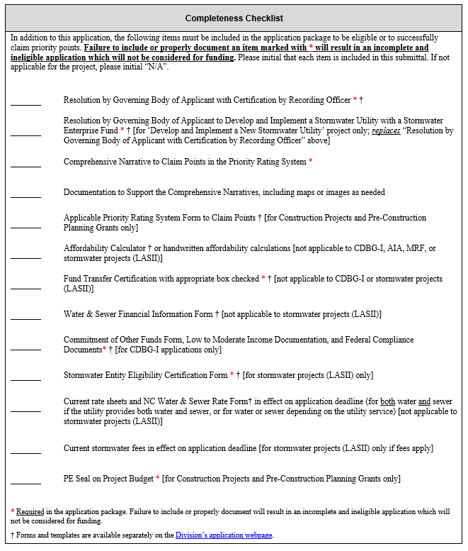
Application – Completeness Checklist
Notes:
Initial to show complete package

Slide 42
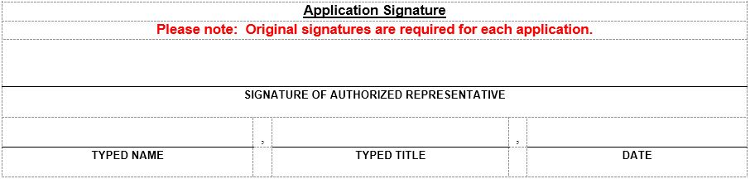
Application – Signature
Application must be signed
Authorized Representative
Notes:
Make sure your application is signed. If it isn’t, then the application will be considered to be incomplete.
The signature must be from the person with signature authority, either the elected official or the Authorized Representative
Remember that the Authorized Rep must be listed in the resolution.
If you are going to get your resolution in later than your application, make sure that you make a note of that on the signature page of the application.

Slide 43
Additional Forms

Slide 44
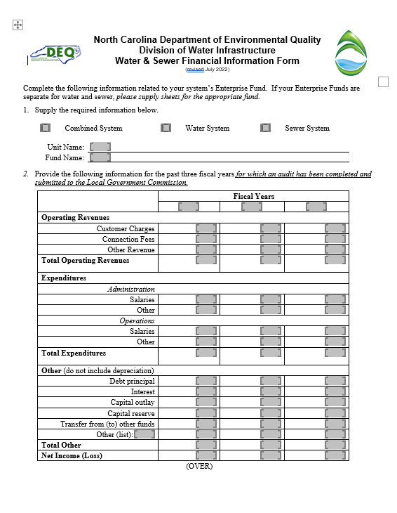
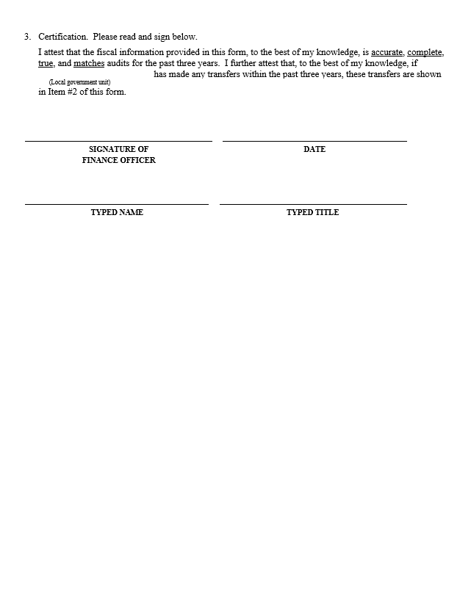
Financial Information Form
Notes:
This is the first page of the form and is similar to what we’ve had for the past few years.
List your revenues and expenditures.
In Other is where we want to see debt principal, interest, capital outlay, and transfers.
For transfers, if your audit shows them, especially going out of the fund, then please list the total transfer amount. This is important, and it could impact your eligibility.
What’s happened is that people would not show transfers. Then we had enough reason this time to go back and verify via audit information, and we’ve discovered that many transfers out of the Enterprise Fund were made but not listed on this table.
If you have questions about transfers, please contact the LGC.

Slide 45
Additional Forms – Financial Information Form
Three years of information
Absolute values for expenditures
Remember transfers
Do not modify form
Notes:
After the Spring 2019 application review, we’ve come to realize that we’ve had issues with transfers. As a result, we’ve broken out the single forms back into two forms.
It requests information similar to the LGC-108C except that we ask for three rather than one year’s worth.
One of the big things is to remember to record transfers. This is because the issue we’ve had are transfers that show up on audits yet weren’t listed on the Financial information form.
Most people have combined systems in their accounting. If you track them separately, please complete a form for each.
All transfers need to be correct and to match.

Slide 46
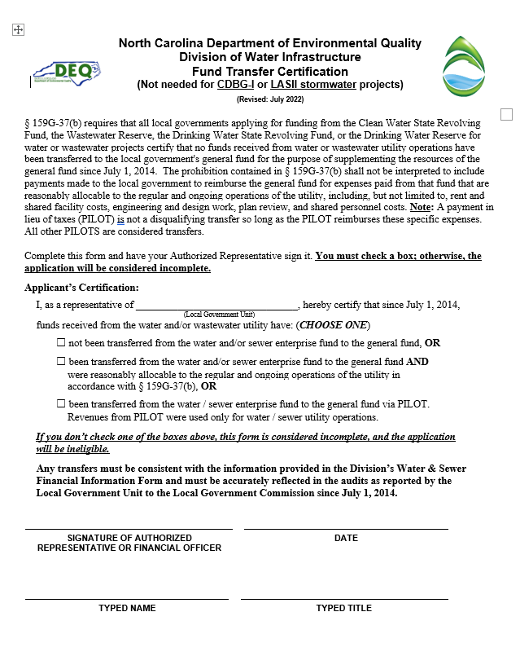
Additional Forms – Fund Transfer Certification
Must be completed and signed
Go back to FY 2014
Payment in lieu of taxes (PILOT) are not automatically considered reasonably allocable to operation of the utility.

Slide 47
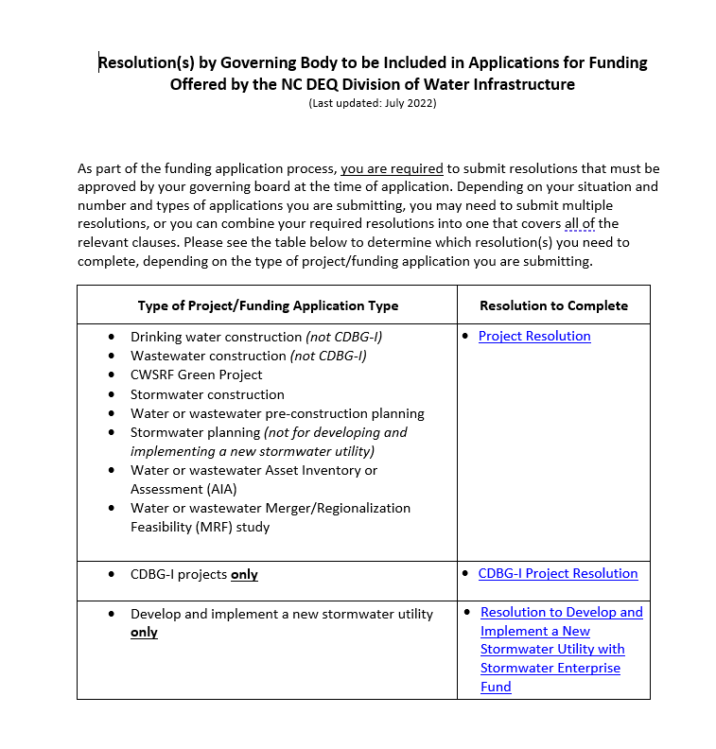
Additional Forms – Resolutions
Notes:
Resolutions will now be due at the time of application. If needed, a template is available on the website.
Keep in mind that there are 2 resolutions now, one for distressed systems and one for non-distressed. We have a copy of the one for distressed systems in the packet you got.
Make sure that the resolution lists the Authorized Representative, as we do check that information against any documentation where the Authorized Representative’s signature is required.
Make sure that you include the LGC rate sheets. We use these rate sheets to verify rates. If we do not have the rate sheets, we are not able to do so and will not provide credit for those points. Additionally, no rate sheet means an incomplete application.

Slide 48
Additional Forms – Resolutions
Types of resolutions
  Project resolution – Complete for all applications
  Stormwater utility resolution (if needed) (New!)
Template available in one file (New!)
Viable Utility resolution(s) no longer needed
List Authorized Representative
Due at time of application
Resolutions from Spring round can be used this Fall
  Make sure your application was eligible.
  Make sure your project has stayed the same
Notes:
Resolutions will now be due at the time of application. If needed, a template is available on the website.
Keep in mind that there are 2 resolutions now, one for distressed systems and one for non-distressed. We have a copy of the one for distressed systems in the packet you got.
Make sure that the resolution lists the Authorized Representative, as we do check that information against any documentation where the Authorized Representative’s signature is required.
Make sure that you include the LGC rate sheets. We use these rate sheets to verify rates. If we do not have the rate sheets, we are not able to do so and will not provide credit for those points. Additionally, no rate sheet means an incomplete application.

Slide 49
Additional Forms – Resolutions and Rate Sheets
Rate sheets – Be sure to include utility rate sheets
Affordability calculator
Disadvantaged / underserved map (if applicable)
LASII stormwater eligibility form (if applicable)
Notes:
Resolutions will now be due at the time of application. If needed, a template is available on the website.
Keep in mind that there are 2 resolutions now, one for distressed systems and one for non-distressed. We have a copy of the one for distressed systems in the packet you got.
Make sure that the resolution lists the Authorized Representative, as we do check that information against any documentation where the Authorized Representative’s signature is required.
Make sure that you include the LGC rate sheets. We use these rate sheets to verify rates. If we do not have the rate sheets, we are not able to do so and will not provide credit for those points. Additionally, no rate sheet means an incomplete application.

Slide 50
Application Submittal – Electronic (New!)
Electronic submittals only accepted
Website: https://edocs.deq.nc.gov/Forms/OPA-ARPA
File size limit: 250 MB
Documents uploaded individually

Slide 51
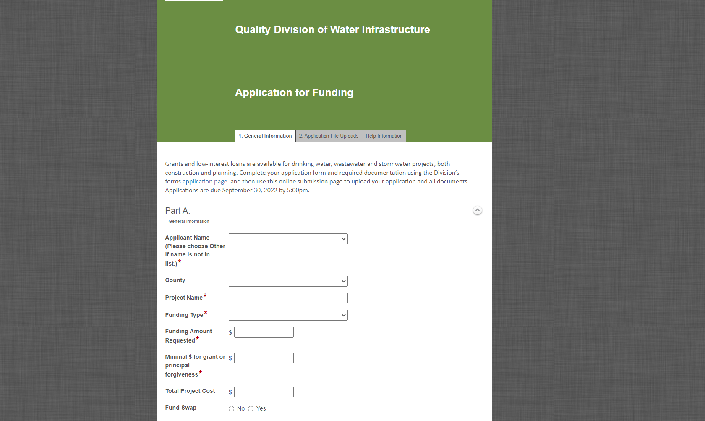
General Information
Notes:
Do demo rather than go through slides (if possible)
This is what the opening page looks like. This is information that we have normally logged in as staff in the past. On the first page, enter in all of the information shown. Red asterisks show what must be completed to move forward.
What you enter may open new fields, so please make sure to complete them..

Slide 52
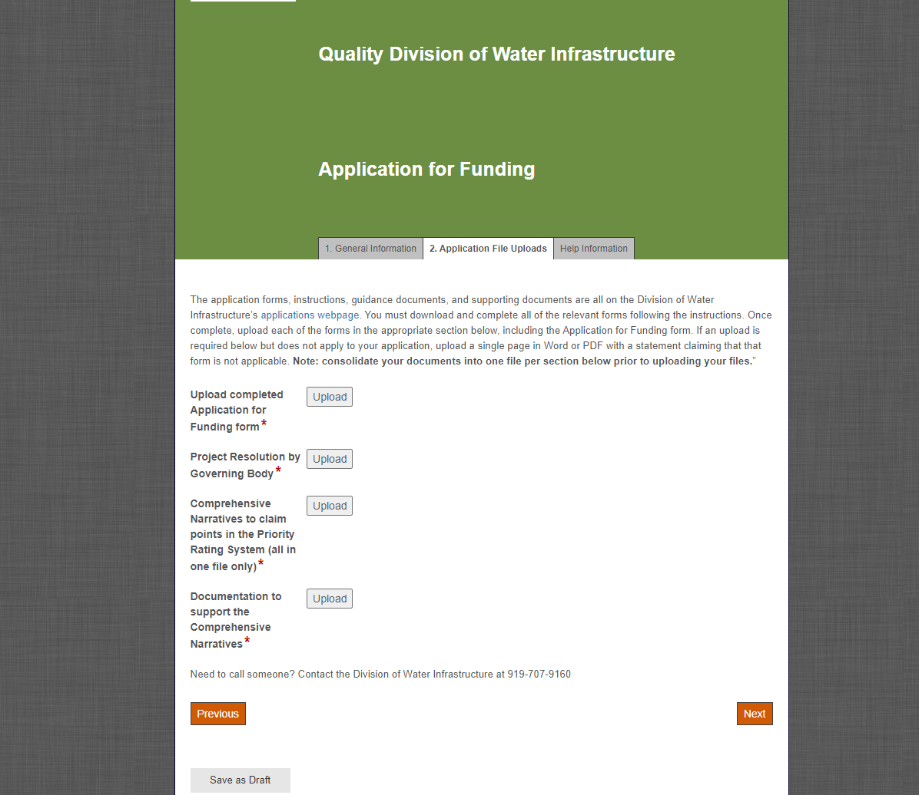
Application File Uploads
Notes:
The second tab is where you’ll upload the application pieces.
Again, these will change according to what’s upfront, so make sure that you pay close attention to what’s needed.
Red asterisks indicate what must be submitted.

Slide 53
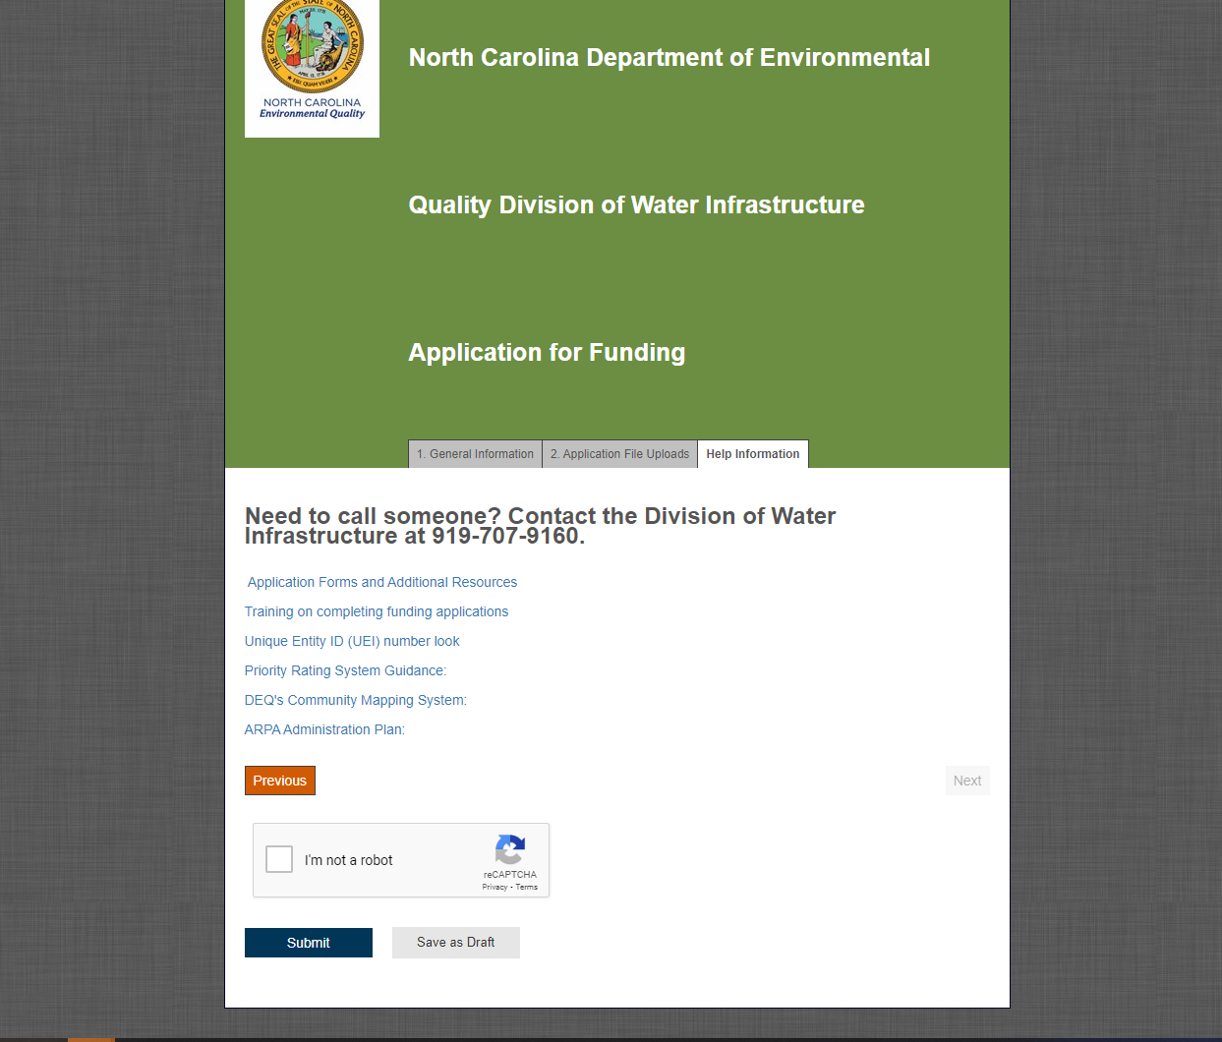
Completing Online Submittal
53

Slide 54
Questions?

Slide 55
Wastewater and Drinking Water Projects
Project Priority Systems
Wastewater
Drinking Water
CDBG-I
Notes:
VInce

Slide 56
Priority Rating System
Used to rank projects for funding
Read guidance carefully – describes the required narratives, maps, and documentation
Claim the points you can document
Provide ALL the required documentation
Additional information will NOT be requested
Include scoresheet along with narrative and supporting documentation
“Roll-downs” can happen in some situations
Ask questions if unsure
Notes:
We have a priority system because we have more demand than funding. So we need to systematically prioritize projects. The priority system is a table of line items – descriptive phrases that might apply to the project such as “project provides backup power” and number of points (in this case, 3). If you claim and document that the line item applies (by for example noting that the project includes installing an emergency generator to a unit that has no current backup power), then you earn those three points.
We add up all the points for each project. Then we list all the projects from the most to the fewest points. Then, starting with the highest priority, we provide the best available funding to each project in priority order.
To get your project funded, do the following: Claim all the points you want to receive; we don’t apply unclaimed points. In fall 2020 had a project leave five Operating Ratio points unclaimed – that would have been the difference in funding.
We don’t award unclaimed points, and we don’t ask for additional information.
So send us all the information we ask for, and in the form we ask for it.
Read the guidance carefully and follow it. If you have alternative documentation that you think also documents the points, call us ahead of time. When we discuss these alternatives ahead of time, the answer is, “maybe’. If the first time we see the alternative documentation is reviewing the application, the answer is, “no’.
So CALL US with any questions.

Slide 57
DW / WW / CDBG-I Priority Rating Systems for Construction Projects
Categories
  Category 1 – Project Purpose
  Category 2 – Project Benefits
  Category 3 – System Management
  Category 4 – Affordability
Scoring same regardless of program (one column only)
Presentation focuses on problem areas and new line items
Notes:
The priority line items are split into four categories:
Category 1 – Project Purpose -- the driving purpose of the project
Category 2 – Project Benefits – other good things that the project does
Category 3 – System Management -- good things that the system does (that we reward with priority pretty much independent of the project), and
Category 4 – Affordability - which is a measure of the neediness of the system
The scoring is the same for all the DW construction programs (whether SRP or DWSRF, etc.). Similarly it’s the same for all the wastewater programs. And finally, we’ve made the drinking water and wastewater programs as alike as we can given their inherent differences.
This presentation doesn’t go over every line item; that’s what the guidance is for. This presentation focuses on things that are new, or are frequent sources of error.

Slide 58
Priority Rating System
Category 1 – Project Purpose
Notes:
A project probably serves multiple purposes. But it can only receive priority points for one purpose. So choose the highest priority purpose that every part of the project serves. If there is any part of the project that doesn’t support the claimed purpose, then the project will not earn those project purpose points.
Note that point spreads in the Project Purpose have changed slightly, mainly to more closely align between DW and WW projects.

Slide 59
1.A Consolidate Nonviable Systems (DW, WW, CDBG-I)
Two situations
Failing
  WW – Division of Water Resources has determined system is failing
  DW – Public Water Supply Section has determined system is failing
  See guidance for details
Nonviable
  DWI has determined system is nonviable
  Must be currently designated as distressed or requested designation as distressed
  See guidance for details
Notes:
The best use of funds, so the most priority points, is to eliminate a failing or nonviable system by consolidating it a healthy system. This is split four ways: Drinking Water or Wastewater, and failing vs other non-viable. We’ll go over each in turn

Slide 60
1.B Resolve Failed or Failing Infrastructure (DW, WW, CDBG-I)
Note change in points
  WW now 20, DW now 22, CDBG-I 15
Failed infrastructure
  Narrow definition of failed infrastructure – See guidance
  No other infrastructure failure counts
  Documentation depends on type of failure
Failing infrastructure (New!)
  Limited to onsite systems
    An onsite system is failing when a NOV from an authorized agent has been issued per 15A NCAC 18A .1961.
Result in privately owned systems owned and operated by applicant
Notes:
JMH Added from slide:
Failed Septic Systems or DWR-permitted single-family spray/drip irrigation system
Failed non-discharge permitted disposal area, such as a failed spray/drip irrigation field or infiltration basin
Failed (dry or contaminated) well
Matthew/Ken takes over.
The next best use of funds (after a rescuing a failing system) is addressing failed infrastructure, which is captured in Line item 1.B.
This is a narrowly-defined category that focuses on either not having enough source water to put into your drinking water system, or not having any way to dispose of the effluent from your wastewater system. While we would all agree that a fallen down water tank is “failed infrastructure” – but it does not earn these points. The only infrastructure failures that count for this line item are
Failed Septic Systems or DWR-permitted single-family spray/drip irrigation system
Failed non-discharge permitted disposal area, such as a failed spray/drip irrigation field or infiltration basin
Failed (dry or contaminated) well
No other infrastructure failure counts
The exact documentation depends on type of failure

Slide 61
1.B Resolve Failed or Failing Infrastructure (DW, WW, CDBG-I)
Includes wells with documented exceedance of Health Advisory Limits (HAL)
  Limited to:
    PFOA
    PFOS
    GenX
    PFBS
  Projects addressing GenX are eligible provided that:
    Wells are within 50 miles of the Chemours facility
    25% or more of facilities to be connected in this project have documented exceedance of the HAL for GenX.
Notes:
JMH Added from slide:
Failed Septic Systems or DWR-permitted single-family spray/drip irrigation system
Failed non-discharge permitted disposal area, such as a failed spray/drip irrigation field or infiltration basin
Failed (dry or contaminated) well
Matthew/Ken takes over.
The next best use of funds (after a rescuing a failing system) is addressing failed infrastructure, which is captured in Line item 1.B.
This is a narrowly-defined category that focuses on either not having enough source water to put into your drinking water system, or not having any way to dispose of the effluent from your wastewater system. While we would all agree that a fallen down water tank is “failed infrastructure” – but it does not earn these points. The only infrastructure failures that count for this line item are
Failed Septic Systems or DWR-permitted single-family spray/drip irrigation system
Failed non-discharge permitted disposal area, such as a failed spray/drip irrigation field or infiltration basin
Failed (dry or contaminated) well
No other infrastructure failure counts
The exact documentation depends on type of failure

Slide 62
1.C Rehabilitate/Replace Infrastructure (WW, DW, CDBG-I)
If not eligible for 1.C points may “roll down” to 1.D
Includes replacement by regionalization projects (New!)
Less than 50% of total meters outside of the service line replacements can be included. (New!)
Rehab or Replace cannot expand capacity
  New pump station / treatment plant with same capacity as old being decommissioned
  Like-for-like replacement
  Includes new unit operations that don’t increase capacity to treat
    EQ basin, UV disinfection, solids handling, SCADA, VFD, generator
    Applies to source (intakes, well fields)
Notes:
JMH: Replacement by regionalization – If equipment is being replaced as part of a regionalization effort. For instance, WWTP being replaced by PS and FM because a smaller system has regionalized with a larger system. See guidance for more detail.
Vince takes over the majority of project request this line item: rehab or replace (without expansion). It’s easy to documents if you are replacing like-for-like.
As a side note, you can upsize smaller waterlines to six-inches or smaller sewer lines to eight inches, and it is still considered to be ‘without expansion’.
It’s more difficult –but just as important- to document that there is no expansion when a project uses an unlike unit – for example abandoning your SWTP and buying a share in your regional SWTP and building an interconnection. You must clearly show that there is not expansion .
Within a treatment plant, it includes adding new unit operations that don’t increase capacity to treat, such as EQ basin, UV disinfection, solids handling, SCADA, VFD, generator or clearwells. It also applies to source (intakes, well fields) as long as the capacity to provide TREATED water doesn’t increase. So you can drill a new well and send the water to the same treatment plant without triggering expansion.

Slide 63
1.C Rehab/Replace Infrastructure – Common Errors
We are replacing existing 10-inch gravity sewer.
We are increasing pumping capacity to meet current flows but not to provide any additional capacity.
The 1 MGD unit we are replacing is under-sized, so we will replace it with a properly-sized 2 MGD unit.
Missing supporting calculations when replacing a pump station with gravity sewer.
Narrative does not clearly state what is getting rehab/replaced (size, linear footage, etc.).
Support documentation is not clear.
No connection between stated project and proposed project.
Notes:
Here’s some examples of things said wrong:
We are replacing existing 10-inch gravity sewer. -- without saying what your’e replacing it with
Here’s two different ways of saying we need a bigger unit:
We are increasing pumping capacity to meet current flows but not to provide any additional capacity. 0r
The 1 MGD unit we are replacing is under-sized, so we will replace it with a properly-sized 2 MGD unit.
The bigger unit is bigger! That makes it an expansion!
Missing supporting calculations when replacing a pump station with gravity sewer. – that’s one of those mix-and-match project for which it is difficult – but just as important – to show that there is no expansion.

Slide 64
1.C.1 Old Infrastructure – Age
If not eligible for 1.C.1 points, may “roll down” to 1.D.1
Can earn additional points for old infrastructure
  Treatment and pumping units – 20 years
  Distribution / collection lines – 40 years
  SCADA / process control / information technology – 10 years
  Certain pipe materials: ACP, VCP, galvanized iron, cast iron, Orangeburg
At least 50% of the construction cost is associated with replacing old infrastructure
Show clearly in budget
  What is older than threshold?
  What is younger than threshold
Explain how you know the age
Notes:
Now that you’ve earned your 1.C points, if the infrastructure is older than certain thresholds shown in the table, you can earn additional ‘age’ points.
To document these points, your budget on page 4 of the application must clearly distinguish between things that are older than the threshold and things that are newer. And at least 50% of the construction cost must be for those things older than the threshold. And finally the narrative must explain how you know the age of the infrastructure. It can be a copy of the 1920 plans showing the waterline. It might be a statement that Old Joe says the waterline was never replaced in the 45 years he worked for the town.

Slide 65
1.C.1 Old Infrastructure Budget Example
10,000 l.f. 8-inch pipe (60% old)
Line Item | Division Funding Requested
OLD 6,000 l.f. 8-inch pipe | AAAAAAA
4,000 l.f. 8-inch pipe | BBBBBBB
Notes:
There are a couple of examples I want to hit hard.
First, for old infrastructure. As Vince will discuss later, you can claim priority points for having old infrastructure. Part of what has to happen to get these points happens in the budget as shown.

Slide 66
1.C.1 Old Infrastructure – Lead Service Lines (New!)
For drinking water projects only
Replacing lead service lines or goosenecks = claim points
Required
  Identified lead service lines and explanation of how you know they are lead.
  50% of construction costs going to replace lead service lines
  Map showing location of lines to be replaced

Slide 67
1.E. Service to Disadvantaged Areas (New Line Item!) (DW/WW)
20 points for DW and CW
Qualification: 75% of construction costs ⇨Provide connection or alternative service
“Disadvantaged area” based on
  Affordability of water and / or sewer rates relative to income levels of residents
  Median household income
  Poverty rates
  Additional factors (see guidance)
Compare project area data to LGU Indicators, when possible

Slide 68
1.E. Service to Disadvantaged Areas (New Line Item) (DW / WW)
Requirements
Narrative
  Justification of targeted project area as disadvantaged
  Project budget
    75% construction cost to provide services to residences
    Line item for connection or system development fees
    Specification of line items necessary to provide service to disadvantaged areas
Project map
  Identification of disadvantaged area
  Properties within project area inside / outside disadvantaged area
  Properties to be connected services

Slide 69
Budget Example – Disadvantaged Area – $4.7M Project
Line Item | Project Cost
Construction Costs
10-inch gravity sewer dis. area | $2,000,000
10-inch gravity sewer | $750,000
8-inch gravity sewer dis. area | $1,000,000
50 sewer laterals dis. area | $100,000
Subtotal: | $3,850,000 ($3.1M=80.51% d/u)
Contingency (10%) | $385,000 (80.51% d/u=$309,964 of cont.)
Total Construction – dis. area. | $3,409,964
Total Construction – Other | $825,036
Total Construction | $4,235,000
Engineering Costs | $100,000
Admin Costs | $100,000
Connection Fees | $250,000
Total Project Cost | =$4,685,000 (dis. area=$3,859,964)
Notes:
For d/u communities, it’s critical that we’re able to discern how much of your budget relates to serving these communities.
This is only one way you can break it down. Start with construction costs and determine your percentage. Then use that with contingency, EC, and AC costs.
The key is that we need to be able to replicate your math, so make it very clear in the budget. You can add as many lines as you need, so do so if it helps to show your calculations.
Make sure as well that you include the cost of tap fees. Those can be 100% d/u.

Slide 70
Category 1 Points (CWSRF only)
One option for stormwater
1.G Stream, Buffer, Wetland Restoration now 15 points
1.H Stormwater Stormwater Control Measure (SCM)
  Now 10 points
  Note change in terminology from BMP to SCM
1.I Reclaimed water / rainwater harvesting now 10 points
Notes:
JMH: Moved from slide Green projects scored only for CWSRF
Matthew/Ken takes over. Break after slide.
Lastly for Category 1 – Project Purpose, points are also available for Green Projects under the CWSRF. These projects address Stream, Buffer, and/or Wetland Restoration under Line Item 1.F and Stormwater BMPs under Line Item 1.G. A little later in this presentation we will discuss the funding implications for projects that receive Green Funding Please note in the guidance that there have been minor changes in these points.

Slide 71
Priority Rating System
Category 2 – Project Benefits
Notes:
Vince takes over. -- As discussed, Every part of the project must serve the project purpose to earn those Category 1 Project Purpose Points. And if any part of the project doesn’t serve that purpose, the whole project loses those points. Category 2 is different.
Category 2 provides points as long as ANY part of the project genuinely confers that benefit. For example, a ten million dollar Water Treatment Plant Rehab can earn three points under Line Item 2.N.7 resiliency points for adding a fifty-thousand-dollar emergency generator.

Slide 72
2.A Provides Specific Environmental or Public Health Benefit (CDBG-I)
Expanded to include additional environmental and public health benefits to list of projects that could receive these priority points:
  Eliminating malfunctioning onsite wastewater systems
  Eliminating lead service lines
    Must document that at least 50% of the construction cost is to replace lead service lines
Notes:
Colleen:
Projects also include:
1) Connect homes to a public sewer service that have a have failing septic systems;
2) connect homes to a public water service that has dry or contaminated wells;
3) Repair or replace sewer lines responsible for reported SSOs, or repair or replace equipment to resolve an upset, spill or bypass at treatment works that reach bodies of water or back up into homes; or
4) Replace failing public wells (failure due to contamination or significant yield reduction) with another well, or connection to another water system with excess capacity.

Slide 73
2.A Provides Specific Environmental or Public Health Benefit (CDBG-I), continued
Common Errors
  Maps did not show spill locations
  No documentation
  One spill report that does not convey a pattern of a problem
  Narrative was not clear – does not link problem with project area
  No proof that at least one SSO reach a body of water due to I/I in project area
  Project area not shown on map
  Backup documentation did not match narrative

Slide 74
2.A.1 Eliminates 20% or More (CDBG-I)
Expanded to include eliminating malfunctioning (failing) onsite wastewater systems and lead service lines
For projects that eliminate malfunctioning onsite wastewater systems, applicants must provide copies of the notice of violations documenting system is malfunctioning per 15A NCAC 18A.1961

Slide 75
2.B Specific Public Health Benefit (DW)
Line item split out (New!)
2.B.1 – Project addresses dry wells or contamination of a public drinking water source; or resolves managerial, technical and financial issues (20 points)
2.B.2 – Project eliminates lead service lines (10 points)
Line Item 2.H. will provide prioritization for privately owned wells
Notes:
Vince:
This line item serves to stack points – to provide more Project Benefit points for DW rescue projects. DW rescue projects automatically get all the Project Purpose points under Line Item 1.A, and they get all the Project Benefit points under Line Item 2.B
Line Item 2A also provide points for failing wells under Line Item 1B. Wells can fail in two ways: they can go dry or become contaminated. Read the guidance carefully to document well failure or contamination. The Analogous Wastewater Line Item is 2.B – Over to Matthew!

Slide 76
2.B.1 Addresses Dry Wells, Contamination, or TMF Issues (DW)
Provides points for
  Dry or contaminated wells
  Specific project types that also earn other points
For failed / nonviability claimed under Line Item 1.A.
For Failed wells under Line Item 1.B.
Notes:
Vince:
This line item serves to stack points – to provide more Project Benefit points for DW rescue projects. DW rescue projects automatically get all the Project Purpose points under Line Item 1.A, and they get all the Project Benefit points under Line Item 2.B
Line Item 2A also provide points for failing wells under Line Item 1B. Wells can fail in two ways: they can go dry or become contaminated. Read the guidance carefully to document well failure or contamination. The Analogous Wastewater Line Item is 2.B – Over to Matthew!

Slide 77
2.B.2 Eliminates Lead Service Lines (DW)
New Line Item
Applicable if a portion or all of project eliminates lead service lines
Describe location of lines
Show location of lines to be replaced

Slide 78
2.C. Provides Specific Environmental Benefit (WW)
Line Item split out (New!)
2.C.1 – Project Replaces or repairs certain sewer lines, eliminates failed onsite system or non-discharges systems, or resolves managerial, technical and financial issues (15 points)
2.C.2 – Project eliminates malfunctioning onsite wastewater systems (10 points)

Slide 79
2.C.1 Specific Environmental Benefit (WW)
Projects include:
Connecting homes with failing septic systems to public sewer service
  Must include letter from a registered sanitarian, a licensed soil scientist, or County Health Department documenting existing failures
  Includes failed single-family residence spray/drip irrigation system
Repairing or replacing sewers with reported SSOs that
  Reach bodies of water, or
  Document backup into homes
Automatic for nonviability claimed under
Line Item 1.A.
Notes:
Matthew/Ken takes over.
2.C (white) is the WW SRF Program, 2.A (yellow) in the CDBG Program
Similar to Line Item 2.B, points for Line Item 2.C are automatically earned if you also claim and earn points under Line Item 1.A. In addition to the project types eligible for Line Item 1.A, the only other projects eligible for these points are connecting homes with failing septic system to public sewer service and repairing or replacing sewers with reported SSOs that either reached bodies of water or backed up into homes. The project must directly address the SSOs, and the SSO’s must have occurred within 5 years of the application deadline. Again, these points are automatically earned given the proper documentation for Line Item 1.A.
Applies to 2A for CDBG-I projects

Slide 80
2.C.2 Elimination of Malfunctioning Onsite Wastewater Systems (WW)
New line item
Failing ⇨ Authorized agent issues Notice of Violation per 15A NCAC 18A .1961
Majority of homes (>50%) with failing systems must be connected
To claim
  List of addresses where septic systems are malfunctioning
  Map that shows
    Street names and house numbers of malfunctioning systems
    New sewer lines
    All systems to be connected to public sewer system
    Copies of NOVs for any malfunctioning systems

Slide 81
2.C Specific Environmental Benefit (WW)
Common errors
Center Avenue area soils are unsuitable and septic system failure is likely
SSOs not resolved by project
No map showing location of failing systems
No map showing SSOs
Notes:
Common errors when claiming these points are insufficient documentation linking the failed septic system or SSO to the project. Potential or likely failures are not eligible for points under Line Item 2.C. Other errors include a lack of mapping to show the locations of the failing septic systems or SSOs.

Slide 82
2.F System Merger or Regionalization (DW/ WW/ CDBG-I)
Line Item split out (New!)
2.F.1 – Includes system merger (old 2.F) (10 points) OR
2.F.2 – Includes system regionalization or partnership (5 points)

Slide 83
2.F.1 Includes System Regionalization
New line item
Earn points
  Regionalize as defined by G.S. 159G-20(16) OR
  Result in a partnership
Documentation
  Identify systems forming partnership or regionalizing
  Describe type of partnership / regionalization
  Describe how project will result in partnership / regionalization
  See guidance for more detail

Slide 84
2.H Project Addresses Contamination (DW & CDBG-I)
2.H.1 Acute Contamination
  Refer to the guidance and separate sampling protocol
2.H.2 Other-Than-Acute Contamination
  Refer to the guidance and separate sampling protocol
2.H.3 Emerging Contaminants
  Now 10 points
  Note - 1,4-Dioxane (HAL = 35 ug/l - some guidance handouts may have wrong HAL)
Notes:
Vince continues:
We don’t see this very often – so I’ll just say, compare MONITORED levels to Legally Enforceable Limits.

Slide 85
2.H.3 Emerging Contaminants (DW & CDBG-I)
Must replace or provide new treatment to a drinking water supply system that produces water containing emerging contaminants
See guidance for what drinking water health advisory level means
Documentation (see guidance)
  Describe contaminated source Describe how project will address contamination
  Map showing
  Project location
  Service area of impacted community (including PWSID #)
  Location of contaminated source

Slide 86
2.N Resiliency
New for CDBG-I projects
Points range from 3 points to 8 points
Points can “roll down”

Slide 87
2.N.1 – 2.N.3 Movement from the Floodplain
Describe infrastructure being located out of floodplain
Provide a map that shows where existing and relocated infrastructure will be
  Location of existing and proposed infrastructure
  Clearly show floodplain boundaries
  Clearly show existing infrastructure in higher-hazard floodplain
Use FRIS or FEMA map as source of data layer or flood elevations (www.fris.nc.gov)
Any alternative mapping source must be pre-approved
Notes:
The documentation is the same for N.N.1 to 2.N.3.

Slide 88
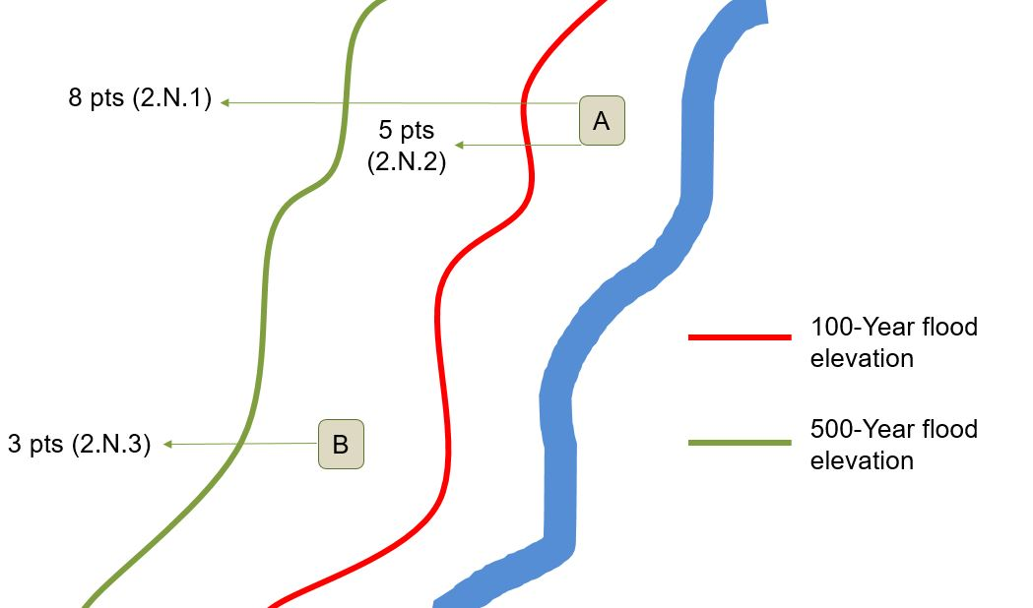
2.N.1. –2.N.3 Movement from the Floodplain
Notes:
Vince or Ken:
A project can receive priority for moving infrastructure from a higher hazard to a lower hazard area. In this example graphic, vulnerable infrastructure sits inside the 100-year (red) flood plain at location A.
A project that moves the infrastructure from inside the 100-year floodplain to outside the 100-year flood plain can earn 5 points. If the project only moved from inside the 100-yer flood plain all the way to outside the 500-year flood plain, it can earn additional 3 points, for a total of 8 points.
An alternative project that starts at location B (between the 500-year floodplain and the 100-year flood plain earn 3 points And 3 plus 5 = 8.

Slide 89
2.N.7. Redundancy / Resiliency
Expanded for Fall 2020 round to include wastewater
Includes eligible cybersecurity
Requirements
  Include redundant or resilient items in the project description
  New or increased redundancy / resiliency = points
  Replacing / repairing existing generator ≠ points
  Retrofitting with backup power = points
  New equipment with backup power ≠ points
Notes:
This is the general “redundancy /resiliency – not elsewhere classified”.
Historically, this was only available for drinking water
Expanded for Fall 2020 round to include wastewater
This is a “miscellaneous / not elsewhere classified” kind of item. Eligible Cybersecurity projects, for example, land here.
Requirements
Include redundant or resilient items in the project description
New or increased redundancy / resiliency = points
Replacing / repairing existing generator ≠ points
Retrofitting with backup power = points
New equipment with backup power ≠ points -- because backup power is the EXPECTATION for new equipment

Slide 90
2.O Impaired Waters (WW)
Project will directly benefit impaired waters
Provide:
  Stream name and impairment(s) as documented in the Integrated Report
  Discussion of impairment and connect the dots to show the project will directly benefit the impairment
  Map(s) with project location, stream location and impaired segment
Common errors
  Project does not address impairment
  Map does not adequately show location of project and impairment
Notes:
Ken takes over.
Points under Line Item 2.O are earned when a project directly benefits an impaired waterway as documented in the most recent Integrated Report by the Division of Water Resources. The narrative must include the stream name and the documented impairment(s), how the project will directly benefit the impairment, and maps showing the location of the project and the impaired stream segment. Common errors are that there is not direct connection between the project and the impairment, or the map does not adequately show the location of the project and impairment.

Slide 91
2.P. Special Water Classifications (WW)
More classifications (UWL, PNA, AFSA, SAV)
Show direct connection of projects to their impact on these waters
Provide mapping
  Project location
  Location of special waters
  SSO reports (for project claiming points due to SSO impacts)
See guidance for more information

Slide 92
Priority Rating System
Category 3 – System Management
Notes:
Ken:
Any questions about Category 2 – Project Purpose?
The next category for points, Category 3 – system management, pertains to your applicant’s financial and managerial capacities.

Slide 93
3.A Capital Planning Activities
Can only receive points for ONE of the following:
3.A.1 – Asset Management Plan OR
3.A.2 – Capital Improvement Plan
If applicable, points can “roll down”
Notes:
Line Item 3.A is for Capital Planning Activities. Under this line item, you can only receive points for one of the following subcategories; 3.A.1 Asset Management Plan or 3.A.2 Capital Improvement Plan.

Slide 94
3.A.1 Asset Management Plan
Applicant has implemented AMP before application
Common errors
  No narrative provided
  AMP has not been implemented
  Does not meet CIP requirements
  Does not have all assets for the utility seeking funding
  None "poor" assets in project not explained.
  Not adopted within 2 yrs from date of application deadline
See guidance for more information on what must be in narrative
Notes:
For 3.A.1 asset management plan, the application must show that the applicant has implemented an asset management plan prior to the application deadline. Discuss the makeup and contents of the AMP in the narrative, and provide proof that the AMP has been implemented by the system. Under our guidelines, a simple list of assets does not qualify as an AMP.
CDBG-I AMP is 3.A.1

Slide 95
3.A.2 Capital Improvement Plan
Must clearly show the project applied-for
Must span 10 years, be less than 2 years old
  State years covered by the CIP
  Years 1 through 5: show projects and their costs
  Years 5 through 10:
    Show projects - not necessarily their cost
    Show some capital expenditure - not necessarily linked to specific projects
Resolution or certified minutes showing adoption of CIP
  A certification is inadequate
Notes:
To claim points under Line item 3.A.1, the applicant’s CIP must span 10 years and be less than 2 years old from the application deadline. The CIP must clearly show the project being applied-for and the anticipated capital cost; highlighting it in your CIP is the best way to show us your project. For years 1 through 5, you must show specific projects and their costs. For years 6-10, you must show some capital expenditures, but they do not have to be linked to specific projects. Also, and equally important, you must provide a resolution or certified minutes showing the adoption of the CIP which must have occurred within 2 years of the application deadline.
CDBG-I CIP is 3.A.2

Slide 96
3.A.2 Capital Improvement Plan
Common Errors
More than 2 years old
Spans less than 10 years
Lacks minutes showing adoption (certification not sufficient)
Project applied-for not obvious and unambiguous on CIP
Includes only O&M expenses and/or a single project (project applied for)
Large cost differentiation not clearly explained
No explanation of change in CIP priority
No application narrative

Slide 97
Priority Rating System
Category 4 – Affordability
Notes:
Jon or Ken takes over.

Slide 98
4.A Residential Connections (DW / WW)
Only claim ONE sub-category based on the number of connections
  Less than 10,000 residential connections, or
  Less than 5,000 residential connections, or
  Less than 1,000 residential connections
Use only sewer connections or drinking water connections as of date of application

Slide 99
4.B Current Monthly Utility Bill at 5,000 Gallons
New for CDBG-I
Ranges from 4 points to 10 points
Only claim ONE sub-category based on the current monthly utility combined bill for 5,000 gallons or for single-use utilities, use conversion factors.
Rates must match those on rate sheet(s) submitted
Use sewer bill and drinking water bill
Use conversion factor for single-system utilities
  0.4 for water-only systems
  0.6 for sewer-only systems
Use lowest residential rate, “in-town rate”
Provide calculations

Slide 100
4.C Local Government Unit (LGU) Indicators (DW / WW)
Only claim ONE sub-category
  3 out of 5 LGU indicators worse than state benchmark, or
  4 out of 5 LGU indicators worse than state benchmark, or
  5 out of 5 LGU indicators worse than state benchmark
  Note change in points for specific line items
LGU Indicators are
  Property Valuation per Capita is less than $125,015
  Percent Population Change is less than 4.48%
  Poverty Rate is greater than 14.0%
  Median Household Income is less than $56,642
  Unemployment rate is greater than 7.1%

Slide 101
4.D Benefit to Disadvantaged Areas (DW / WW)
New line item (5 points)
Projects receiving 1.E points will receive these points without additional documentation
Qualification: 50% of construction costs ⇨Provide connection or alternative service
Disadvantaged Area definition – Similar to definition for Line Item 1.E
Documentation - See guidance for more details
  Justification Narrative (similar to Line Item 1.E)
  Map (similar to Line Item 1.E)
  Benefit narrative
  Project budget (similar to Line Item 1.E)

Slide 102
4.E and 4.F Poverty Rate and LMI (CDBG-I)
4.E – Now is poverty line item, points did not change
4.F – Points adjustment to a maximum of 25 points instead of 20

Slide 103
Questions?

Slide 104
CDBG-I Programmatic Specifics

Slide 105
CDBG-I: Applicants Eligible to Apply
Non-entitlement communities only
  Incorporated municipalities under 50,000 in population
  Counties under 200,000 in population
Single purpose units of governments (e.g., water/sewer authorities) must work with local governments on projects and are considered subrecipients.
  If a local government is served by a single purpose unit of government, they may apply for a grant to replace, repair, or up-date or extend infrastructure owned by the single purpose unit of government.
All proposed projects must show they benefit at least 51% low-to-moderate income (LMI) persons and/or households.

Slide 106
CDBG-I: Project Area and LMI Eligibility
Appendix A: Determining the LMI Percentage of the Project Area – Updated Online
The project area must first be established before LMI is determined.
  The project must serve the entire project area.
  LMI % in application must represent the project area.
  Project map – details needed
LMI Determination
  Census Data (area wide)
    Must use most recent LMI summary data from HUD
  Income Surveys
    Valid for 18 months
    2021 or 2022 income limits only

Slide 107
CDBG-I: Multiple Applications
• Local governments can submit multiple applications for different projects; however:
  Each application is reviewed and scored separately.
  If one application scores within funding range and the other does not; the local government cannot request switching it with the lower scoring application.
  If more than one application scores within the funding range, the highest scoring application will be recommended for funding.

Slide 108
CDBG-I Projects and Floodway
We can fund projects in the floodplain and only certain ones in the floodway (per HUD Notice CPD-17-013).
  Found online under Application Forms and Additional Resources.
"the construction, installation, or repair of linear infrastructure located entirely below ground level or entirely above base flood elevation may comply with Part 55..."
No new construction, manhole repair/replacement or ground disturbance within the floodway.
Will allow CIPP, if completely underground and
access is done outside floodway.
Flood maps with project area and proposed
project is required.

Slide 109
CDBG-I Federal Compliance Documents
Tab 8 of Application
  See CDBG-I Program Priority Rating System Guidance
Public Hearing
  See Appendix B: Public Hearing
Compliance Statements and Certifications
HUD Required Forms
  See Appendix C: HUD Forms and Instructions
Sam.gov
Applicant’s Capacity
Applicant’s Audit (must be current on audits)
If awarded, there are two mandatory trainings local government representatives must attend
Notes:
Also required manadary training with attendance by local government if awared

Slide 110
CDBG-I: Common Errors
Common Errors with Income Surveys
  Door-to-door surveys were not signed by both parties
  Data transfer from surveys to tabulation summary sheet
  Household size and income limits do not match
  Corrections made on survey are not initialed nor dated
  The use of wrong average household size to calculate no responses
Commons Errors on Federal Compliance Documents
  Forms are not signed or dated
  Forms not filled out correctly or completely
  Project descriptions and project area do not match
  Old forms are resubmitted instead of new ones

Slide 111
Asset Inventory & Assessment Grants

Slide 112
Asset Inventory and Assessment Grants
To inventory existing water and/or sewer system and document the condition of inventoried infrastructure
Eligible activities can include:
  Identifying and locating system components
  Performing a risk analysis to determine critical components
  Determining the condition of critical components
  Establishing capital and O&M costs
  Creating a prioritized list of projects
  Preparing a realistic Capital Improvement Plan (CIP)
See DWI’s “Water and Wastewater Utility Asset Assessment Guidance” for more information
on typical AIA tasks

Slide 113
Asset Inventory and Assessment Grants
Distressed System AIA’s scope must include :
  Identifying and locating system components
  Performing a risk analysis to determine critical components
  Determining the condition of critical components
  Establishing capital and O&M costs
  Creating a prioritized list of projects
  Preparing a realistic Capital Improvement Plan (CIP)
  Conducting a rate study
A new AIA is not required if a sufficient AIA has recently been conducted (i.e., within past 5 years)
An AIA Grant may be used to further the results of previous AIA activities

Slide 114
Statutory Requirements of Distressed Units
If a unit has been designated distressed, required process is established by legislation
  Conduct an asset assessment and rate study
  Participate in a training and education program
  Develop an action plan, taking into consideration the following:
    A short-term and a long-term plan for
      infrastructure repair, maintenance, and management;
    Continuing education; and
    Long-term financial management to ensure sufficient revenue to fund:
        Management and Operations,
        Personnel, and
        Maintenance.
114
Notes:
If a system is distressed, the legislation lays out the process:
A system will have to conduct AIA and a Rate Study (can be part of the AIA). Funding may either be from the LGU itself, from the VUR, or from other sources.
EOs and utility staff will have to attend training. This isn’t voluntary. It’s mandatory and will focus on the basics of utility management.
Look for in-person and online options starting around September.
The LGUs will have to develop both STAPs and LTAPs. The STAP focuses on infrastructure repair, maintenance, and management. The LTAP will focus on the same but also include financial plans for management.
AIA/RS will inform both
MRF/RS will inform mostly the LTAP

Slide 115
Viable Utility Program – Distressed Criteria
Four approved Identification Criteria
  LGC has taken fiscal control of LGU (D1)
  No annual audit submitted in the past 2 years (D2)
  Total Assessment Criteria score (D3)
    20 separate parameters with values ranging from 1-4 points
    Threshold of 9 pts for LGUs with both water & wastewater systems
    Threshold of 8 pts for LGUs with only one service (DW or WW)
  Other available information (D4)
115
Notes:
So…who is distressed?
There are four potential ways to be identified: 1&2 are “automatic”, 3 is based on a scorecard (won’t go into details now) and requires designation by SWIA and LGC, 4 is a catch-all for unique circumstances
There has been some distress about the word “distress” – we can’t change the wording. Designation allows for grant funding, but does have some requirements of the units.

Slide 116
Application Components
  Application forms
  Financial Information Form
  Fund Transfer Certification Form
  Resolution
  Applicable rate sheets
  Narrative question responses
    Supporting documentation with specific references in narrative
Notes:
When applying, these are the required forms and documents needed for a complete application. You must submit separate forms, resolutions, and narratives.

Slide 117
Priority Rating System (AIA)
Asset Inventory and Assessment Grant Priority Rating System
Line Item # | Category | Points
1. | Project Benefits | 0 - 8
1.A | The LGU has been identified as “distressed” by the Authority and Commission per NCGS 159G-45(b). | 2
2. | System Management
2.A | Knowledge base of utility’s internal asset management team | 0 - 4
2.B | Current and past rate setting practices, CIPs, etc. | 0, 1, or 2
2.C | Management of asset inventory data | 0 - 4
2.D | Operating Ratio (OR) is greater than or equal to 1.00 based on a current audit, or is less than 1.00 and water/sewer rates are greater than $107/month | 0, 1, or 2
3. | Affordability
3.A | Current Monthly Utility Rate at 5,000 gallons usage | 0, 1, or 2
3.B | Local Government Unit (LGU) Indicators
3.B.1 | 3 out of 5 LGU indicators are worse than the state benchmark OR | 0
3.B.2 | 4 out of 5 LGU indicators are worse than the state benchmark OR | 1
3.B.3 | 5 out of 5 LGU indicators are worse than the state benchmark | 2
Total Points |  | 24 Max
Notes:
This is the Priority Rating System, as approved by SWIA for Fall 2021. The maximum 8 project Benefit points will be determined by the 8 narrative questions and the applicant’s distressed designation.

Slide 118
VUR Priority Rating System (AIA and MRF)
Prioritization based on:
Designation criterion
  D1 = Unit under control of LGC = Highest Priority
  D2-D4 = Other designated units (typically based on assessment score)
Assessment score
  >13 = Highest Priority
  11-12
  8-10
  If funding is limited and not all LGUs in the subgroup can be funded, priority further prioritized:
    Revenue Outlook: 15 points
    Moratorium: 15 points
    Service Population <1,000: 10 points
    Ability to address multiple distressed units: 5 points
Priority
118
Notes:
Let’s talk about Prioritization
Three levels:
Designation status/criterion
Assessment score
Tie-break criteria

Slide 119
Category 1 – Project Benefits
Narrative discussion, Questions 1-8
Top 3 challenges in next 5 years AND
How will this AIA grant address the challenges?
Line Item 1.A → 2 points
  Only for systems designated as distressed per §159G-45(b)
  Discuss steps already taken
  Do not need to submit the designation letter

Slide 120
Narrative Question No. 1 (Line Item 1)
Discuss the top 3 challenges your system faces in the next 5 years and how an AIA will benefit these challenges.
Challenges must directly relate to benefits of an AIA
Consider (provide documentation as applicable)
  NOVs
  SSO Reports
  Approved Supply Plans (voluntary and mandatory)
  Current Discharge/Supply Limits
  Water Audits
  I/I evaluations
  Boil water notices
  Work order summaries
See Scoring Rationale
Notes:
Project Benefits (8 points max)
Questions associated with this category provide information on the utility’s understanding of what they want to get out of the project

Slide 121
Narrative Question No. 2 (Line Item 1)
Discuss completed or ongoing asset management, capital planning, and/or mapping efforts by the utility.
Discuss examples of any changes in practices due to past efforts
Realized benefits by having this information
Provide electronic copy of past efforts
See Scoring Rationale
Notes:
Give specific examples (i.e., immediate operational changes or longer-term changes in business practices) of how the system has benefited by having this information
Provide a copy (hard copy or USB/CD) of any existing asset inventory map, smoke testing results or other condition assessment report, flow monitoring results, asset management plan or capital improvement plan

Slide 122
Narrative Question No. 3 (Line Item 2.A)
Identify (by title) the utility’s internal asset management team, and
Describe the role of each team member both during AND after completion of the project
Consider
  Experience and professional training
  External partners during the project (permanent and temporary)
  Long-term partners after completion of the project
  (e.g., for data storage)
See Scoring Rationale
Notes:
Identify (by title) the utility’s internal asset management team
Describe any asset management and/or capital planning experience or training for each
Include any external partners (consultants, county, COG, or nonprofit staff, etc.) and describe role during project
Differentiate between external members that are temporary (e.g., surveying companies) and those that will be continuously assisting in asset management planning (e.g., company providing long-term data management, or ongoing operation and maintenance)
Describe the role of each team member in the future after completion of the project

Slide 123
Narrative Question No. 4 (Line Item 2.B)
Describe the process used to set rates.
Consider
  Capital planning
  Rate history and process changes (when? and why?)
  Rate studies
Provide a copy of the CIP, if utilized, and discuss completed projects
Provide a copy of rate study recommendations, if applicable
See Scoring Rationale
Notes:
Project Benefits (8 points max)
Questions associated with this category provide information on the utility’s understanding of what they want to get out of the project

Slide 124
Narrative Question No. 5 (Line Item 2.C)
Discuss how the utility will utilize the information developed through this project to develop and prioritize future infrastructure.
Discuss how will these projects be incorporated into the CIP planning process in the future, and how funding sources will be determined
Consider
  Your level of service required to maintain/achieve viability
  Coordination among your internal AIA team members
  Team members should include technical, managerial, and financial
Avoid discussing general condition assessment methods
See Scoring Rationale
Notes:
Project Benefits (8 points max)
Questions associated with this category provide information on the utility’s understanding of what they want to get out of the project

Slide 125
Narrative Question No. 6 (Line Item 2.C)
Discuss the anticipated ongoing efforts to maintain and build upon the results of this project.
Consider
  External partnerships (e.g., COGs, County GIS departments, contract operators)
  Costs, frequency and triggers for updates and reviews, procedures, milestones, etc.
  Data ownership and accessibility
See Scoring Rationale
Notes:
Project Benefits (8 points max)
Questions associated with this category provide information on the utility’s understanding of what they want to get out of the project

Slide 126
Narrative Question No. 7 (Line Item 2.D)
Provide the System Operating Ratio each year for the past three (3) years of audited statements
Calculate a single combined OR for both water and sewer enterprise funds
Same calculation as other funding programs
Explain any discrepancies in the Operating Ratio
from year to year
Show calculations with all values
Calculate to the hundredths
See scoring rationale
Notes:
I will explain this item further in a few minutes.

Slide 127
Category 2 – System Management
Line Item 2.D – Past 3 Years’ Operating Ratios
All values are same as those entered on Financial Information form
“Capital Outlay” = funded from enterprise fund
Do not use “non-operating” revenues or future revenues
Calculate to hundredths
Discuss discrepancies/inconsistencies
Operating Revenues
OR =
Total Expenditures + Debt Principal + Interest + Capital Outlay

Slide 128
Narrative Question No. 8
Describe any additional benefits to the utility of receiving this Asset Inventory & Assessment grant that have not been previously mentioned
  Distressed status (beyond statutory obligations)
  Flood/storm vulnerability
  Energy/Water efficiency measures
  Regulatory changes (e.g. permit limits, emerging contaminants, lead and copper rules)
See Scoring Rationale
Notes:
Project Benefits (8 points max)
Questions associated with this category provide information on the utility’s understanding of what they want to get out of the project

Slide 129
Category 3 – Affordability
Line Item 3.A - Current Monthly Utility Rate at 5,000 Gallons
(Same method for all funding programs)
Show calculation of the current monthly utility combined bill for 5,000 gallons.
  Less than or equal to $79 = 0 points, or
  Greater than $79 and less than or equal to $107 = 1 point, or
  Greater than $107 = 2 points
Provide rate sheets
Rates must match those on rate sheet(s) submitted
Use sewer rates and drinking water rates
Use conversion factor for single-system utilities
  0.4 for water-only systems
  0.6 for sewer-only systems
Use lowest residential rate, “in-town rate”
Show calculations

Slide 130
Category 3 – Affordability
Line Item 3.B – Local Government Unit (LGU) Indicators
**same criteria as with all other funding programs**
Only receive points for ONE sub-category
  3 out of 5 LGU indicators worse than state benchmark = 0 points
  4 out of 5 LGU indicators worse than state benchmark = 1 point
  5 out of 5 LGU indicators worse than state benchmark = 2 points
LGU Indicators are:
  Property Valuation per Capita is less than $119,594
  Percent Population Change is less than 4.26%
  Poverty Rate is greater than 14.7%
  Median Household Income is less than $54,602
  Unemployment rate is greater than 3.9%

Slide 131
Funded Projects
Milestones
  Letter of Intent to Fund (LOIF)
  Preliminary Scope and Budget
  Grant Agreement
  Reimbursements
  Deliverable and Closeout
Grant period → 2 years
Requires inventory & assessment – likely other components
Only a small percentage of funding can be used for software or equipment

Slide 132
Questions?

Slide 133
Merger / Regionalization Feasibility Study Grants
Notes:
We’re going to talk about the application itself now.

Slide 134
Merger/Regionalization Feasibility Grants
NCGS 159G-20
Merger – partial or complete consolidation
  Two or more utilities
  Organizational, Financial, and/or Operational
Regionalization – physical interconnection
  Water supply or wastewater collection
  Regional treatment
Public and private, not-for-profit systems are eligible as applicants AND partners

Slide 135
Application Components
  Application forms
  Financial Information Form
Fund Transfer Certification Form
  Resolution from Applicant
  Applicable rate sheets
  Narrative question responses
    Supporting documentation with specific references in narrative
  Letter(s) from potential partners
      Acknowledge the application and commit to participate
      Non-binding to act on the study’s
      recommendations
Notes:
Submit the appropriate application resolution depending on the applicant’s distressed status. If the applicant is not distressed and applying on behalf of a single or group of distressed systems, all parties must submit the appropriate application resolution to be eligible for consideration.
Potential partners can include publicly-owned systems and private, not-for-profit systems.

Slide 136
Priority Rating System (MRF)
Merger/Regionalization Feasibility Priority Rating System
Line Item # | Category | Points
1 | Project Benefits
1.A | Top 3 Challenges and Compliance History | 0, 1, 2, or 3
1.B | Past Collaboration and /or Proximity | 0, 1, 2, or 3
2 | System Management
2.A | Size and Capabilities | 0, 1, or 2
2.B | The LGU has been identified as “distressed” by the Authority and Commission per NCGS 159G-45(b). | 3
2.C | Operating Ratio < 1.00 | 1
3 | Affordability
3.A | Current Monthly Utility Bill for 5,000 gallons usage | 0, 2, or 4
3.B | Local Government Unit (LGU) Indicators
3.B.1 | 3 out of 5 LGU indicators are worse than the state benchmark OR | 0
3.B.2 | 4 out of 5 LGU indicators are worse that the state benchmark OR | 2
3.B.3 | 5 out of 5 LGU indicators are worse that the state benchmark | 4
 | Total Points | 20 Max
Notes:
Here is the MRF priority rating system for Fall 2021. The State Water Infrastructure Authority approved three changes to this rating system at their July 14 meeting. Two changes are the titles for categories 1 and 2. The third change is replacement of the recently defunct LGC unit letter with the distressed system designation per NCGS 159G-45(b).
Category 1 project benefits captures the applicant’s or partnering systems’ compliance history, past collaboration, and proximity.
n general have fewer connections, more compliance issues, smaller staffs, greater financial barriers, or any combination of the above that may hinder system viability and the ability to self-fund or conduct a feasibility study
Project Benefits (6 points max)
Items in this category address compliance issues, collaboration history, and physical proximity to other systems
System Management (6 points max)
Items in this category address the organizational structure, challenges, and fiscal concerns of the applicant
Affordability (8 points max)
Used to prioritize applications with the greatest financial need

Slide 137
Narrative Questions – General Discussion
Has the feasibility of a merger or regionalization been studied before?
If so, how will this study differ?
  What were previous findings/conclusions?
If not, was a similar study previously considered?
  Why now/why not previously?
Discuss the top 3 challenges your system faces
in the next 5 years
  Consider technical, organizational, and financial
Notes:
Project Benefits (8 points max)
Questions associated with this category provide information on the utility’s understanding of what they want to get out of the project

Slide 138
Narrative Questions – General Discussion
What does the system hope to benefit from receiving a MRF grant?
Discuss how the top 3 challenges will be addressed through receiving a MRF grant
  Technical and operational obstacles
  Organizational issues
  Financial limitations
Notes:
Project Benefits (8 points max)
Questions associated with this category provide information on the utility’s understanding of what they want to get out of the project

Slide 139
Category 1 – Project Benefits
Line Item 1.A – Top 3 Challenges and Compliance History
Describe any ongoing environmental protection and public health issues, such as impaired watersheds, contaminated sources, failing infrastructure, etc.
Discuss how the top 3 challenges affect the technical and operational goals of the utility
Provide copies of enforcement actions from past 5 years
Discuss whether any actions were addressed
Notes:
Project Benefits (8 points max)
Questions associated with this category provide information on the utility’s understanding of what they want to get out of the project

Slide 140
Category 1 – Project Benefits
Line Item 1.B - Proximity and Past Collaboration
Discuss whether the applicant or potential partner(s) appears to have adequate unallocated capacity to accommodate the needs of the other systems in this study.
Specifically confirm that one of the applying systems has adequate unallocated capacity to expand
Provide a map showing
  Geographic proximity of all applying systems
  Locations of known collection/distribution lines,
  pump stations, storage, and treatment plants
Notes:
Project Benefits (8 points max)
Questions associated with this category provide information on the utility’s understanding of what they want to get out of the project

Slide 141
Category 1 – Project Benefits
Line Item 1.B - Proximity and Past Collaboration (cont’d)
Discuss any previous or on-going collaborative efforts among the applicant and partner system(s).
Consider
  Current Inter Local Cooperation agreements
  Staff/resource sharing agreements
  Operation and management contracts
  Projects/partnerships beyond the water/sewer utilities
Notes:
Project Benefits (8 points max)
Questions associated with this category provide information on the utility’s understanding of what they want to get out of the project

Slide 142
Category 2 – System Management
Line Item 2.A - Size and Capabilities
Discuss the organizational and operational structure of the utility, including:
  Number of part- and full-time employees in the utility and across the LGU
  Utility staffs’ duties, experience, and professional certifications
  Internal operating procedures (i.e., billing, work orders)
  Management and/or operational contracts
  Human and financial resources of the utility
Notes:
Project Benefits (8 points max)
Questions associated with this category provide information on the utility’s understanding of what they want to get out of the project

Slide 143
Category 2 – System Management
Line Item 2.A - Size and Capabilities (cont’d)
Discuss how each of the top 3 challenges affects the applicant’s desired level of service.
Existing levels of asset management and capital project planning
Short- and long-term trade-offs
Enforcement of existing policies and internal controls
Focus on Organizational and Financial
Notes:
Project Benefits (8 points max)
Questions associated with this category provide information on the utility’s understanding of what they want to get out of the project

Slide 144
Category 2 – System Management
Line Item 2.B – Distressed Designation
Has the applying system received a distressed designation from the Authority and LGC per §159G-45(b)?
Discuss the steps already taken to fulfill the VU requirements
Notes:
Do not need to submit the designation letter. Discuss steps already taken (particularly rate studies in past 5 years).

Slide 145
Remaining Line Items
Line Item 2.C
Operating Ratio – combined OR for both water and sewer enterprise funds
Line Item 3.A
Current Monthly Utility Rate at 5,000 gallons
Line Item 3.B
Local Government Unit Indicators
Notes:
Project Benefits (8 points max)
Questions associated with this category provide information on the utility’s understanding of what they want to get out of the project
These line items are determined in the same manner across all funding programs.
Mention if COG is applying for multiple LGUs to use LGU indicators from distressed LGU.

Slide 146
Funded Projects
      Milestones
        Letter of Intent to Fund (LOIF)
        Preliminary Scope and Budget
        Grant Agreement
        Reimbursements
        Deliverable and Closeout
      Grant period → 2 years
      Deliverable contents
          Alternatives evaluation
          Analysis of each alternative
          Conclusions

Slide 147
Questions?

Slide 148
Local Assistance for Stormwater Infrastructure Investment
Stormwater Eligibility

Slide 149
LASII – Activities NOT Eligible for Funds
Land conservation
Low-impact development
Creation or construction of greenways, parks, and open space
Repair or improvement of transportation infrastructure as primary purpose or benefit
Dam / levee construction, repair, or removal
Stream debris removal
Dredging

Slide 150
LASII – Activities NOT Eligible for Funds
Activities satisfying compensatory mitigation requirements under NCGS 143-214.11
Purchase of rental vehicles
Purchase of rental computers, laptops, tablets, and cell phones
Elevation of structures
Removal of structures inside / outside of floodplain
Costs of SW infrastructure to serve or promote future growth & development

Slide 151
LASII – Activities NOT Eligible for Funds
Compliance with existing stormwater ordinances or other jurisdictional ordinances
Costs to comply with MS4 permit requirements
Preparation of a stormwater inventory without a stormwater asset assessment
Staff salaries, overhead, or expenses
O&M of stormwater infrastructure
Water quality monitoring

Slide 152
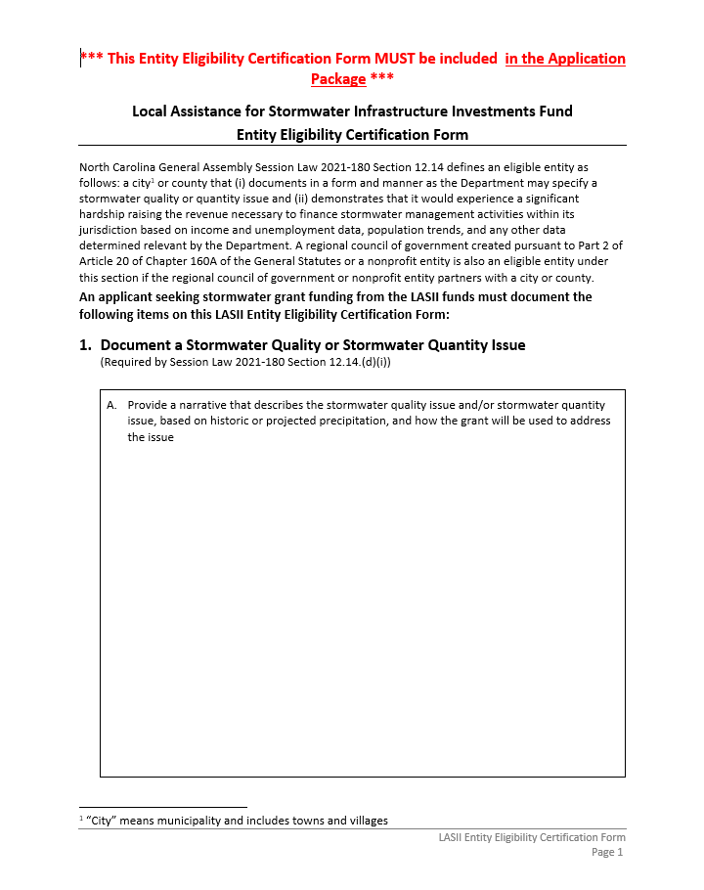
LASII Eligibility Form

Slide 153
LASII Eligibility Form – Section 1
Description of stormwater quantity and/or quality issue
Map and/or narrative identifying location of stormwater quantity and/or quality issue
Photographs of stormwater quantity and/or quality issue (if available)
Rainfall data (if available)
Other information
See guidance & eligibility form

Slide 154
LASII Eligibility Form – Section 2
Demonstration of significant hardship
Check the appropriate item in the Eligibility Certification:
  2.A - LGU Indicators or Benefits to Disadvantage Areas OR
  2.B – Develop and Implement a New Stormwater Utility

Slide 155
LASII Eligibility Form – Item 2.A
Criterion 1 - LGU Indicators
  Significant hardship – At least 1 of 5 LGU indicators worse than state benchmark
  Complete the Eligibility Certification Form LGU Indicator Table to determine eligibility (using the link provided in the Form) OR
Criterion 2 – Disadvantage Areas
  75% project construction cost benefits disadvantage areas using Project Budget
  Portion of City or County identified by Community Mapping System OR
  Narrative must sufficiently describe disadvantage factors including median household income, poverty rates, property valuation per capita, employment rate for targeted area or additional factors that may qualify (see guidance)

Slide 156
LASII Eligibility Form – Item 2.B
City or County does not currently have a stormwater utility with a stormwater enterprise fund
Provide a statement that application is to develop & implement a Stormwater Utility with a Stormwater Enterprise Fund
Provide a resolution to develop and implement a Stormwater Utility with a Stormwater Enterprise Fund

Slide 157
LASII Eligibility Form – Section 3
Applicable to Councils of Government (COG) or nonprofit entity partnering with an eligible City or County
Provide
  Name and address of COG or nonprofit entity
  COG primary contact name, title, and contact information
  City/Count primary contact name, title, and contact information
  Copy of executed instrument used to establish partnership

Slide 158
LASII Stormwater Eligibility Form - Execution
Authorized Representative signs form (original signatures are required)
Include attached exhibits in submittal with form

Slide 159
LASII – Grant Limits
Stormwater Construction Grants
  $5M per applicant / per grant cycle
  $7.5M per LGU collaboration / per grant cycle
Stormwater Planning Grants
  $400K per applicant / per grant cycle
  $500K per LGU collaboration / per grant cycle
Development and Implementation of New Stormwater Utility with Stormwater Enterprise Fund (based on the LGU indicator, Eligibility Certification Table in Item 2.A)
  $400K - if 0, 1, 2 LGU indicators are demonstrated
  $500K – if 3, 4, 5 LGU indicators are demonstrated

Slide 160
Local Assistance for Stormwater Infrastructure Investment
Required Narrative for All Projects

Slide 161
LASII –Narrative for All Projects
Required for all applications
Must address all items discussed in guidance
Read guidance
If required narrative not applicable, state “Not applicable”

Slide 162
LASII –Narrative for All Projects
Describe the source of the water that is causing the stormwater quality and/or quantity "issue"
  Upstream flow problems?
  Rainfall directly falling onto area?
  Is stormwater overflowing streambank an issue?
  Is the streambank being eroded?
Mapping
  Provide maps at a reasonable scale that clearly
  depicts issues

Slide 163
LASII – Narrative for All Projects
Do you have an established Stormwater Utility ?
  Date of utility establishment
Do you have an established Stormwater enterprise fund ?
  When fund created and first fees collected
Revenues
  Estimate of amount collected in past 12 months
  Source of revenue
Funds expended
  Estimate amount in past 12 months
  Source of expenditures

Slide 164
LASII – Narrative for All Projects
Provide NPDES Municipal Separate Storm Sewer System (MS4) permit (if applicable)
    Permit number, issue date, summary of compliance issues
For Stormwater Planning Studies
  Provide detailed description of proposed stormwater planning activity and goals of the proposed planning activity
Public input – Describe any public input sessions or notifications about the project

Slide 165
LASII – Narrative for All Projects
Stormwater planning study only provide:
  Detailed description of proposed stormwater planning activity
  Goals of the proposed planning activity
Public input – Include input focused on residents and / or businesses most directly impacted by project
  Describe any public input sessions
  Provide notifications about public input sessions

Slide 166
Local Assistance for Stormwater Infrastructure Investment
Stormwater
Construction Projects

Slide 167
LASII Priority Rating System for Construction Projects
Categories
  Category 1 – Project Purpose (35 points max)
  Category 2 – Project Benefits (30 points)
  Category 3 – System Management (10 points)
  Category 4 – Affordability (25 points)
Make sure project is eligible
Read the guidance
Submit scoresheet with narrative & supporting documentation

Slide 168
LASII Priority Rating System for Construction Projects
Priority Rating System
Category 1 – Project Purpose
(35 points max)
Notes:
A project probably serves multiple purposes. But it can only receive priority points for one purpose. So choose the highest priority purpose that every part of the project serves. If there is any part of the project that doesn’t support the claimed purpose, then the project will not earn those project purpose points.

Slide 169
1.A – Stormwater Control Measures (SCMs)
> 50% of construction cost used for SCMs to control stormwater quality
Purpose
  Create new stormwater control measures (SCMs)
  Improve, retrofit, repair, rehabilitate, replace existing SCM infrastructure to control stormwater quality
SCMs must adhere to NC Stormwater Design Manual Part C: Minimum Design Criteria (statement required in narrative)

Slide 170
1.A.1 Nature-Based SCMs (35 points)
Must clearly demonstrate how SCM meets definition of a nature-based stormwater solution
Narrative must include
  Description of how SCM meets definition of nature-based solution
  List of potential types of SCMs to be used and key design considerations
  Map showing location of proposed SCMs
  If receiving runoff, % of impervious area tributary to SCM for existing and future development
  Future growth and development – Document how additional runoff will be managed

Slide 171
1.A.2 Non-Nature-Based Solutions (25 points)
IF the proposed SCM is not nature-based, the Application will earn points under Line Item 1.A.2
Narrative must include
  List of potential types of SCMs to be used and key design considerations
  Map showing location of proposed SCMs
  If receiving runoff, % of impervious area tributary to SCM for existing and future development
  Future growth and development – Document how additional runoff will be managed

Slide 172
1.B Restoration of Streams, Wetlands, Buffers, and Estuaries (25 points)
For projects that will restore streams, wetlands, buffers, or estuaries from existing substandard state to a more natural state to control stormwater quality
Narrative must include statement that project is not to satisfy compensatory mitigation credits
Supporting documentation
  Map showing proposed streams, wetlands, buffers, or estuaries to be restored
  Photographs showing current condition
    Taken no longer than 3 months before date of application
    Include date stamp

Slide 173
1.B.1 Restoration of 1st Order Stream (2 points)
For projects that restore first-order stream and includes stormwater infiltration SCMs
Narrative – Discuss key design considerations that support implementation feasibility
Supporting documentation – Map showing
  Name (if named) / location of first-order stream
  Streams / wetlands / buffers to be restored
  Location of stormwater infiltration SCMs

Slide 174
1.B.2 Restoration of Permanent Riparian Buffers (2 points)
Restoration of permanent riparian buffers at least 30 feet on both sides of stream
Narrative must state
  Restoration meets
    Woody vegetation for Zone 1
    Woody or herbaceous vegetation for Zone 2
  Protection for a minimum of 30 feet on each side of stream
  Removal of all stormwater discharges through buffer not associated with natural drainageways if applicable

Slide 175
1.C Stormwater Infrastructure for Quantity Control (25 points)
> 50% of construction costs used to create / improve / retrofit / repair / rehabilitate / replace existing stormwater infrastructure to control stormwater quantity

Slide 176
1.C Stormwater Quantity Improvement (25 points)
Narrative should include
  Statement of primary purpose is not to improve / repair transportation infrastructure
  If receiving runoff from future upstream growth and development
    % of impervious area that will be tributary to infrastructure for both future / existing development
    How additional runoff will not cause new or increased flooding or flood risk or water quality issues
Supporting documentation
  Peak flow reduction expected
  Map showing location of proposed stormwater infrastructure

Slide 177
LASII Priority Rating System for Construction Projects
Priority Rating System
Category 2 – Project Benefits
(30 points max)

Slide 178
2.A Water Quality Improvements
Earn points for only one of sub-categories

Slide 179
2.A.1 Impaired Waters (15 points)
Project will directly benefit impaired waters
Provide:
  Stream name and impairment(s) as documented in the Integrated Report
  Discussion of impairment and connect the dots to show the project will directly benefit the impairment
  Map(s) with project location, stream location and impaired segment
Common errors (from WW experience)
  Project does not address impairment
  Map does not adequately show location of project and impairment
Notes:
Ken takes over.
Points under Line Item 2.O are earned when a project directly benefits an impaired waterway as documented in the most recent Integrated Report by the Division of Water Resources. The narrative must include the stream name and the documented impairment(s), how the project will directly benefit the impairment, and maps showing the location of the project and the impaired stream segment. Common errors are that there is not direct connection between the project and the impairment, or the map does not adequately show the location of the project and impairment.

Slide 180
2.A.2 Special Water Classifications (10 points)
Classifications – HQW, ORW, Tr, SA, UWL, PNA, AFSA, SAV, WS-I, WS-II, WS-III, WS-IV
Project will directly benefit these classified waters
Provide mapping
  Project location
  Location of special waters
See guidance for more information

Slide 181
2.A.3 Achieves 35% reduction in Total Nitrogen and Total Phosphorus in NSW Waters (10 points)
Must achieve ≥ 35% reduction in both TN and TP in Nutrient Sensitive Waters (NSW)
Narrative must include
  River basin name, stream name, index number, stream classification
  Watershed classification
  Statement – Project will adhere to NC SCM Credit Document requirements
  Percentage of reductions achieved
  Letter needed from NC DEQ Stormwater Program if
    Implementing item from NC SCM Credit Document for “possible” credits
    Due to existing site limitations, reasonable expected % pollutant reduction if unable to meet design requirements
  Read guidance

Slide 182
2.A.4 Achieves 35% reduction in Total Nitrogen and Total Phosphorus in Non-NSW Waters (5 points)
Must achieve ≥ 35% reduction in both TN and TP in Non-Nutrient Sensitive Waters (NSW)
Narrative must include
  River basin name, stream name, index number, stream classification
  Watershed classification
  Statement – Project will adhere to NC SCM Credit Document requirements
  Percentage of reductions achieved
  • Letter needed from NC DEQ Stormwater Program if
    Implementing item from NC SCM Credit Document for “possible” credits
    Due to existing site limitations, reasonable expected % pollutant reduction if unable to meet design requirements
  Read guidance

Slide 183
2.A.5 Benefits NC Natural Heritage Program (NCNHP) Natural Area (3 points)
Must identify a direct connection between what project will accomplish and improvement of water quality in a NCNHP Natural Area rated “General” or above
Narrative – Description identifying direct connection
Supporting documentation
  Screenshot / printout of NCNHP natural area
  Identify project location with landmarks to identify project location
See guidance

Slide 184
2.B Flood Reduction
Earn points for only one of sub-categories

Slide 185
2.B.1 Increases Public Safety (15 points)
Will help applicant to access and operate critical infrastructure during flood events
Narrative – Describe
  Why infrastructure is critical
  How project will improve access and operation of critical infrastructure during flood events
Supporting documentation – Map showing location of critical infrastructure or NCDOT evacuation routes
See guidance for NCDOT evacuation route link

Slide 186
2.B.2 Reduces Structural Flooding (8 points)
Will reduce structural flooding of habitable structures
Narrative
  Statement of the nature of flooding (crawl space, finished basement, finished first floor, etc.)
  Statement of cause of flooding
  Total number of structures where flooding will be reduced
Supporting documentation – Map showing location of each qualifying habitable structure
See guidance

Slide 187
2.B.3 Reduces Street Flooding (5 points)
Narrative
  Identify streets to be addressed by project
  Cause of street flooding
  Whether street flooding prevents residents from accessing their home during a flood event
  How project will reduce street flooding
Supporting Documentation – Map showing location / extent of street flooding to be addressed by project
See guidance

Slide 188
2.C Collaboration Efforts (10 points)
2 or more local units of local government will improve stormwater quality or quantity control through collaborative efforts necessary to accomplish project

Slide 189
2.C Collaboration Efforts (10 points)
Narrative
  Goals / outcomes of proposed project and expected benefits
  Why each unit of local government must participate in project
  Previous collaboration
  Status of any previous stormwater quality or quantity work related to project
Supporting documentation
  Resolution or board meeting minutes showing motion to approve collaborative effort participation
  Map showing project location & line of demarcation between participating jurisdictions
See guidance

Slide 190
2.D Local or Regional Resilience Planning (3 points)
Identified through local or regional resilience planning process to address flooding, sea level rise, or other environmental changes
To qualify for points, local or regional plan must address a timeframe of at least 10 years

Slide 191
2.D Local or Regional Resilience Planning (3 points)
Narrative
  Include local / regional resilience plan name, publication date, and organization
  Timeframe addressed by plan
  Concise summary of
    Project connection to the plan
    Future conditions utilized to complete vulnerability assessment
    Long-term strategies for addressing challenges faced (with page references in plan)
Supporting documentation
  List of organizations and / or citizens
    Participating in plan development
    Who approved final plan
  Printout of pages specifically referenced with sections discussed highlighted

Slide 192
2.E. Innovative Projects (5 points)
Innovative projects that address stormwater quantity or as described in the “Innovative Stormwater Program FAQs” section of the current NC Land and Water Fund Innovative Stormwater Program Manual OR the NC DEQ Stormwater Design Manual to address stormwater quality

Slide 193
2.E Innovative Projects (5 points)
Innovative stormwater quantity narrative
  Project description and reason it is innovative
  How it will support utilization of new or different practices
  How project will
    Build on current stormwater experiences and practices
    Advance practices in stormwater quantity management
  How applicant will disseminate findings and results
Innovative stormwater quality narrative
  Documentation of how project meets innovative stormwater quality requirements
  How project will
    Build on current stormwater quality management experiences and practices
    Advance practices in stormwater quality management
  How applicant will disseminate findings and results

Slide 194
2.F Public Education Component (1 point)
Discuss a commitment to provide a public education feature
See guidance for more information

Slide 195
LASII Priority Rating System for Construction Projects
Priority Rating System
Category 3 – System Management
(10 points max)

Slide 196
3.A. Local Planning
Earn points for one of these subcategories

Slide 197
3.A.1 Developed Plans (5 points)
You receive these points if you have adopted or are developing any of the following plans:
  Flood resiliency,
  Watershed,
  Stormwater management,
  Stream restoration, or
  Estuary restoration

Slide 198
3.A.1 Developed Plans (5 points)
Adopt One of the Plans
  Narrative
    Statement that adopted plan includes project (with appropriate page reference)
    Description of how adopted plan demonstrates and supports project
    Link to adopted plan on website
  Supporting documentation – Resolution or board meeting minutes which shows a motion to approve and adopt plan
Developing One of the Plans
  Narrative
    Statement that one of the plans will be developed and includes the project
    Description of the status of the development of the Plan
    Include the anticipated timeline for Plan completion

Slide 199
3.A.2 Operation & Maintenance Plan (3 points)
O&M plan must be active as of date of application and include
  Inspection requirements
  Inspection frequency
  Timeline of scheduling and completing repairs
  Log of completed repairs
  Description of maintenance requirements & activities
  Schedules for routine & emergency maintenance
Narrative
  Date plan was implemented and statement of active use
  Identification of responsible parties
  Estimate of annual O&M expenditures
  Link to website or provision of plan
See guidance

Slide 200
3.B. Stormwater Capital Improvement Plan (2 points)
Narrative
  Statement of years covered by CIP
  Description of project in CIP ⇨ unambiguously same project seeking funding
  Explanation (if needed) of why project has moved ahead in CIP
Supporting documentation
  Resolution or board meeting minutes showing motion to approve and adopt CIP within 2 years of application deadline
  Printout of stormwater CIP Priority list
See guidance

Slide 201
3.C Stormwater Utility
Earn points for one of these subcategories

Slide 202
3.C.1 Stormwater Utility with Enterprise Fund
(5 points)
Applicability
Adopted Stormwater Utility and Stormwater Enterprise Fund
Is developing or implementing a Stormwater Utility with a Stormwater Enterprise Fund

Slide 203
3.C.1 Stormwater Utility with Enterprise Fund
(5 points)
Existing Stormwater Utility & Enterprise Fund
  Narrative
    Statement of when the Utility and Enterprise Fund began operation and when first fees were collected
    Link to Utility and Enterprise Fund, including rates and fees on website or provide information
  Supporting documentation
    Resolution or board meeting minutes which shows motion to approve and adopt Utility and establish Enterprise Fund
Development Stormwater Utility & Enterprise Fund narrative
    Statement that applicant is developing or implement Utility with Enterprise Fund
    Status of development of Utility with Enterprise Fund
    When development & implementation will be complete with an estimate of when fees will be collected

Slide 204
3.C.2 Stormwater Management Program w/o Enterprise Fund (3 points)
Applicability
Applicant has adopted a Stormwater Management Program
Demonstration of development or implementation of Stormwater Management Program

Slide 205
3.C.2 Stormwater Management Program w/o Enterprise Fund (3 points)
Adopted Stormwater Management Program
  Narrative
    Statement of when Stormwater Management Program began operation
    Link to information about Stormwater Management Program or provide information
  Supporting documentation
    Resolution or board meeting minutes which shows a motion to approve and adopt Stormwater Management Program
Development of Stormwater Management Program narrative
  Statement that applicant is developing or implementing Stormwater Management Program
  Description of status of development and implementation
  Statement of when development and implementation will be complete

Slide 206
LASII Priority Rating System for Construction Projects
Priority Rating System
Category 4 – Affordability
(25 points max)

Slide 207
4.A Population
Choose one of the subcategories
4.A.1 Population < 10,000 people (3 points)
4.A.2 Population ≥ 10,000 people (2 points)

Slide 208
4.B Local Government Unit Indicators
Choose one of the subcategories
  4.B.1 – 1 of 5 LGU indicators worse than state benchmark (4 points)
  4.B.2 – 2 of 5 LGU indicators worse than state benchmark (6 points)
  4.B.3 – 3 of 5 LGU indicators worse than state benchmark (8 points)
  4.B.4 – 4 of 5 LGU indicators worse than state benchmark (10 points)
  4.B.5 – 5 of 5 LGU indicators worse than state benchmark (12 points)
LGU Indicators are
  Property Valuation per Capita is less than $125,015
  Percent Population Change is less than 4.48%
  Poverty Rate is greater than 14.0%
  Median Household Income is less than $56,642
  Unemployment rate is greater than 7.1%

Slide 209
4.C Disadvantaged Areas (10 points)
Project benefits disadvantage areas
Qualification: 50% of construction costs
Portion of City or County identified by Community Mapping System or by narrative qualify
“Disadvantaged area” based on
  •Median household income
  •Poverty rates
  •Property valuation per capita
  •Employment rate for targeted area
  •Additional factors (see guidance)

Slide 210
4.C Disadvantaged Areas (10 points)
Narrative
  Map of disadvantage area
  Description of disadvantage factors that qualify the area as disadvantage
  Description of the stormwater quality issue and/or stormwater quantity issue in the disadvantage area
  Description of how the proposed project will directly improve the water quality issue or reduce the severity/frequency of flooding
  Separate narratives must be provided for stormwater quality and stormwater quantity issues
  See guidance

Slide 211
Local Assistance for Stormwater Infrastructure Investment
Stormwater
Planning Grants

Slide 212
LASII Priority Rating System for Planning Grants
Categories
  Category 1 – Project Benefits (20 points)
  Category 2 – System Management (12 points)
  Category 3 – Affordability (20 points)
Make sure project is eligible
Read the guidance
Submit narrative & supporting documentation

Slide 213
Examples of Planning Grant Eligible Uses
Stormwater inventory and asset condition assessment
Stormwater rate or fee development
Planning for stormwater utility
Development & implementation of stormwater enterprise fund
Watershed plan development
Stormwater management plan, CIP & O&M Plan
Plan for stream/wetland/buffer/estuary restoration
Hydrologic and hydraulic modeling
Challenges/benefits of collaboration with other LGUs on watershed and/or stormwater planning and management

Slide 214
LASII Planning Grants – Opening Narrative
Top 3 stormwater-related challenges over next 5 years
Proposed planning study
  Description
  Goals
  Scope of work
  Expected deliverables
Narrative
  Consistent with application form
  Must be complete and concise
  If category not applicable, state as such

Slide 215
LASII Priority Rating System for Planning Grants
Priority Rating System
Category 1 – Project Benefit
(20 points max)

Slide 216
1.A Link Between Challenges & Study (0 to 5 points)
Describe how study will address at least 1 of top 3 challenges
For previous studies, list
  Study goal & intent
  Alternatives evaluated
  Levels of commitment
  Reasons for success or failure
How study will differ from past studies
Map of specific locations of challenges and project location
See guidance

Slide 217
1.B Develop & Prioritize Future Projects (0 to 3 points)
Describe how study will identify solutions
Describe how applicant will use study results to develop & prioritize future projects
Describe how applicant will use study results to prioritize funding
See guidance

Slide 218
1.C Stormwater Minimum Control Measures (2 points)
Must address at least one of the following Minimum Control Measures (MCM) defined in MS4 permit
  Public education and outreach
  Public involvement and participation
  Illicit discharge detection and elimination
  Construction site runoff controls
  Post-construction site runoff controls
  Pollution prevention and good housekeeping for municipal operations
Narrative
  Which MCM(s) have already been implemented & date of implementation
  Which MCM(s) will be the subject of this study
  Anticipated results
See guidance

Slide 219
1.D Collaboration (3 points)
For studies where 2 or more units of local government agree to collaborate
Narrative
  Description of goals, outcomes, and benefits
  Description of necessity for each unit of local government to participate
  Discussion of previous collaboration efforts
  Description of any previous stormwater quantity or quality work directly related to study
Supporting documentation
  Resolution or board meeting minutes from each participating unit of local government
  Map showing project location and jurisdictional boundaries of each unit of local government
See guidance

Slide 220
1.E Benefit to Impaired Waters, Classified Waters, or Sensitive Waters (2 points)
Points ⇨ If project results in identifying methods that will support the protection of impaired, classified or sensitive waters to stormwater quality and/or quantity issues

Slide 221
1.E Benefit to Impaired Waters, Classified Waters, or Sensitive Waters (2 points)
Studies to evaluate projects benefiting impaired subwatershed or Classified Waters
Watershed classification
Map with project & impairment highlighted
Provide river basin name, stream name, 8-digit HUC for subbasin, index number, and stream classification
Discuss impairment and how project will result in plan to resolve impairment
Discuss methods that will be evaluated to benefit specific classified waters
Supporting documentation
See guidance

Slide 222
1.F Nature-Based Solutions (2 points)
Demonstrate how solution will meet definition of a nature-based stormwater solution

Slide 223
1.G Innovative Stormwater Project (2 points)
Investigates applicability of an innovative stormwater project to address stormwater quantity/quality issues
Innovative stormwater quantity narrative
  Study description and reason it is innovative
  How study will support utilization of new or different practices
  How study will
    Build on current stormwater experiences and practices
    Advance practices in stormwater quantity management
  How applicant will disseminate findings and results
Innovative stormwater quality narrative
  Documentation of how study meets innovative stormwater quality requirements
  How study will
    Build on current stormwater quality management experiences and practices
    Advance practices in stormwater quality management
  How applicant will disseminate findings and results

Slide 224
1.H Decrease in Vulnerability (1 point)
Addresses vulnerability related to
  Flooding
  Sea level rise
  Other environmental changes
Narrative
  How projects are evaluated will address these changes
  How projects being evaluating will decrease vulnerability
  Concise statement of future conditions that will be used in vulnerability assessment
See guidance

Slide 225
LASII Priority Rating System for Planning Grants
Priority Rating System
Category 2 – System Management
(12 points max)

Slide 226
2.A Stormwater Personnel (1 point)
At least 0.5 full-time equivalent (FTE) are actively spending their time on stormwater management activities
Narrative
  Identification of FTE(s) designated as responsible for stormwater management
  Description of day-to-day stormwater management responsibilities & activities
  Description of FTE’s stormwater management qualifications, experience, and training
Supporting documentation – If consultant contracted, copy of contract between consultant and applicant
See guidance

Slide 227
2.B Results from Previous Studies (1 point)
Documentation of previous studies undertaken and status of study recommendations
Narrative
  Describe previous planning study(ies) and goals
  List recommendations
  Provide date of study completion
  Provide status of recommendations
See guidance

Slide 228
2.C Staff Involvement (1 point)
Document staff members’ involvement in developing ideas for proposed planning study as well as execution and implementation of study
Narrative
  Title & description of staff member role(s) in developing proposed study
  Describe
    How staff will be involved
    How staff will be involved in implementation of study recommendations
    Role of staff members in future stormwater management activities
See guidance

Slide 229
2.D Adopted Stormwater Management Plan (4 points)
Have already adopted a stormwater management plan
  Provide resolution or board meeting minutes which shows a motion to approve and adopt the stormwater management plan
  Link to adopted stormwater management plan or supporting information
Study will lead to adoption of stormwater management plan
  Statement of plans to adopt a stormwater management plan for study area by completion of study
  Description of status of development of plan and timeline for completion and adoption

Slide 230
2.E Stormwater Utility & Stormwater Enterprise Fund
Choose one subcategory

Slide 231
2.E.1 Existing Stormwater Utility & Stormwater Enterprise Fund (4 points)
Narrative
  State when Stormwater Utility and Stormwater Enterprise Fund began operation and when first fees were collected
  An official record of the amount of revenue collected in the past 12 months
  An official record of the amount funds expended in the past 12 months
  Link to information about Stormwater Utility Enterprise Fund or supporting information
Supporting Information – Resolution or board meeting minutes showing motion to approve and adopt the Stormwater Utility and establish a Stormwater Enterprise Fund
See guidance

Slide 232
2.E.2 Will Develop & Implement a Stormwater Utility & Stormwater Enterprise Fund (5 points)
Provide a resolution to develop and implement a Stormwater Utility with a Stormwater Enterprise Fund
Describe status of this development
See guidance

Slide 233
LASII Priority Rating System for Planning Grants
Priority Rating System
Category 3 – Affordability
(20 points max)

Slide 234
3.A Population
Choose one of the subcategories
3.A.1 Population < 10,000 people (2 points)
3.A.2 Population ≥ 10,000 people (1 point)

Slide 235
3.B Local Government Unit Indicators
Choose one of the subcategories
  3.B.1 – 1 of 5 LGU indicators worse than state benchmark (2 points)
  3.B.2 – 2 of 5 LGU indicators worse than state benchmark (4 points)
  3.B.3 – 3 of 5 LGU indicators worse than state benchmark (6 points)
  3.B.4 – 4 of 5 LGU indicators worse than state benchmark (8 points)
  3.B.5 – 5 of 5 LGU indicators worse than state benchmark (10 points)
LGU Indicators are
  Property Valuation per Capita is less than $125,015
  Percent Population Change is less than 4.48%
  Poverty Rate is greater than 14.0%
  Median Household Income is less than $56,642
  Unemployment rate is greater than 7.1%

Slide 236
3.C Disadvantaged Areas (10 points)
Study benefits disadvantage areas
Qualification: 50% of construction costs
Portion of City or County identified by Community Mapping System or by narrative qualify
“Disadvantaged area” based on
    •Median household income
    •Poverty rates
    •Property valuation per capita
    •Employment rate for targeted area
    •Additional factors (see guidance)

Slide 237
3.C Disadvantaged Areas (10 points)
Narrative
  Map of disadvantage area
  Description of disadvantage factors that qualify the area as disadvantage
  Description of the stormwater quality issue and/or stormwater quantity issue in the disadvantage area
  Description of how the proposed study will directly improve the water quality issue or reduce the severity/frequency of flooding
  Separate narratives must be provided for stormwater quality and stormwater quantity issues
  See guidance

Slide 238
Contact Information
Name | Role | Phone Number | E-mail
Jon Risgaard | SRF Section Chief | 919.707.9175 | jon.risgaard@ncdenr.gov
Ken Pohlig, PE, PhD | WW Unit Supervisor | 919.707.9170 | ken.pohlig@ncdenr.gov
Kavitha Ambikadevi, PE | DW Unit Supervisor | 919.707.9048 | kavitha.ambikadevi@ncdenr.gov
Victor D’Amato, PE | VUU Supervisor | 919.707.9186 | victor.damato@ncdenr.gov
Matthew Rushing | AIA / MRF | 919.707.9060 | matthew.rushing@ncdenr.gov
Colleen Simmons | CDBG-I | 704.235.2022 | colleen.simmons@ncdenr.gov
Tony Evans, PE | Stormwater | 919.707.9168 | tony.evans@ncdenr.gov
Jennifer Haynie | Affordability | 919.707.9173 | jennifer.haynie@ncdenr.gov
Shadi Eskaf | Division Director | 919.707.9177 | shadi.eskaf@ncdenr.gov

