Slide 1
New Stormwater Funding Program & Fall 2022 Application Process:
Local Assistance for Stormwater Infrastructure Investments (LASII)
Department of Environmental Quality
Division of Water Infrastructure
August 16, 2022

Slide 2

North Carolina Department of Environmental Quality
Secretary Elizabeth Biser
2

Slide 3
North Carolina Division of Energy, Mineral, and Land Resources (DEMLR)
Division Director
Brian Wrenn
3

Slide 4
Questions?
Division Director:
Shadi Eskaf shadi.eskaf@ncdenr.gov
Public Information Officer:
Cathy Akroyd cathy.akroyd@ncdenr.gov
LASII Application or Funding questions:
Tony Evans tony.evans@ncdenr.gov
Ken Pohlig ken.pohlig@ncdenr.gov
Notes:
Before we proceed, I should say that we have a lot to cover in this hour, and it is possible, or even likely, that we will not have time to answer questions at the end of this session. However, we have already been receiving questions about stormwater funding applications. We are compiling a Q&A document that we will post on our website in the coming days, which will be a working document as we receive more questions and provide more answers. So, please feel free to use the Chat function today to ask your questions. Even if we don’t have time to answer them in this session, we will read through all your questions and it will help us develop that FAQ document. If you would like a direct follow-up, I also suggest you email the appropriate person you see listed here with your question after this webinar. I will post this slide again towards the end of the webinar.

Slide 5
Agenda
Overview
New LASII Stormwater Funding Program
Fall 2022 Application Process
5

Slide 6



Division of Water Infrastructure
Administers low-interest loans and grant funding programs for:
Drinking water infrastructure
Wastewater infrastructure
Stormwater infrastructure
CWSRF green projects: stormwater, reclaim water, stream restoration, energy efficiency
Pre-construction planning
Asset Inventory and Assessment (AIA) grants
Merger/Regionalization Feasibility (MRF) grants
Stormwater planning
Developing and Implementing a New Stormwater Utility
6

Slide 7
Applications and SWIA
Twice/year applications for funding.
Applications scored based on Priority Rating Systems that are approved by the State Water Infrastructure Authority (SWIA).
Funding decisions made by SWIA.
7

Slide 8
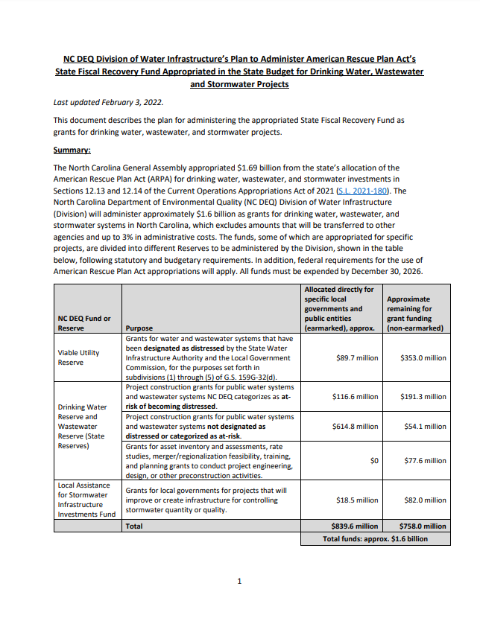
State of North Carolina’s ARPA Funding for Infrastructure – February 2022
SL 2021-180 appropriated $1.69 billion in State’s ARPA funds to water, wastewater, and stormwater infrastructure, to be administered by NC DEQ.
Division of Water Infrastructure posted an ARPA Administration Plan in February 2022 on its website, under “I Need Funding”
https://deq.nc.gov/about/divisions/water-infrastructure/i-need-funding
For new LASII stormwater funding program, Plan specified a timeline to applications by Fall 2022.

Slide 9
Timeline for LASII Stormwater Funding
2022 | Activity
January – June 3 | Developed Draft Priority Rating Systems for stormwater construction and planning and Draft Administration Plan with public input and SWIA; published for public comment
July 14 | SWIA reviewed >130 public comments and approved final Priority Rating Systems
August | Fall 2022 application materials posted; conducted “How to Apply” training (Aug. 2 – 4; Aug. 8 – 10); training recording posted
September 30 | Fall 2022 application deadline (1st round)
2023 | Activity
February | SWIA awards Fall 2022 LASII stormwater grants
May 1 | If LASII funds available, Spring 2023 application deadline for stormwater projects (2nd round)
July | If LASII funds available, Authority awards Spring 2023 stormwater grants
Future application rounds will be used to award remaining funds, if available
9
Notes:
Training recording posted; later slide has link.
Thank the EFC for assistance, DEMLR, SWIA Stormwater Funding Committee, SWANC, NCLM, other resource agency partners, and many people who actively participated in the listening sessions and provided

Slide 10
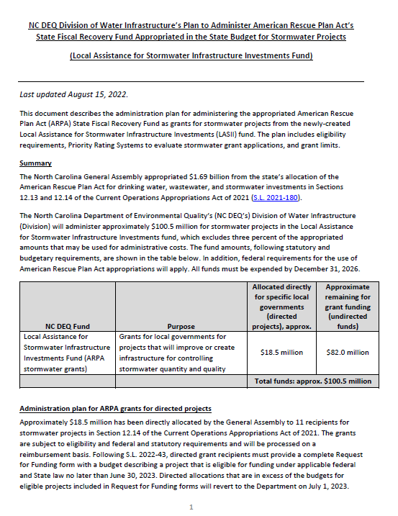
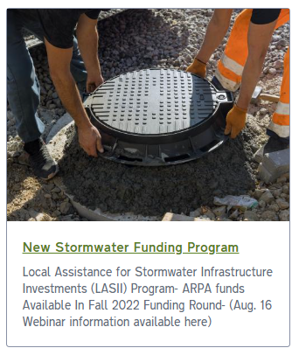
New: Administration Plan for LASII
Supplements ARPA Administration Plan with more details specific to the Local Assistance for Stormwater Infrastructure Investments (LASII) Funding.
Posted August 2022 on Division of Water Infrastructure’s website, on the “Stormwater Funding” page: https://deq.nc.gov/about/divisions/water-infrastructure/stormwater-funding-program
Notes:
If you’d seen the proposed/draft version of the plan prior to this week, please know that the final plan has some changes from the original proposal. So please familiarize yourself with the plan that’s now available on the website.

Slide 11

New LASII Stormwater Funding Program
Eligibility
Types of Grants
Grant Limits
Priority Rating Systems

Slide 12
What is LASII?
Local Assistance for Stormwater Infrastructure Investments
Grants for cities and counties for projects that will improve or create infrastructure for controlling stormwater quantity and quality.
New funding program.
Currently funded by the State’s allocation of American Rescue Plan Act (ARPA) funding:
$103.6 million appropriated to LASII, of which approximately $82 million is available for competitive funding.

Slide 13
Eligibility: Session Law 2021-180 Section 12.14
Who is eligible to apply
Cities (i.e.: municipalities, including towns, villages)
Counties
Councils of Government or non-profit entity if partnering with city or county on LASII stormwater project
Eligibility requirements
Must document a stormwater quality or quantity issue
  Statement of issue, map/narrative identifying location and watershed, and (if available) photos/articles of issue
Must demonstrate significant hardship raising revenue to finance stormwater management activities
  At least 1 out of 5 economic indicators worse than state benchmark, or
  Project almost entirely directly benefits disadvantaged area, or
  Project creates a new stormwater utility with Enterprise Fund
Details in the LASII Administration Plan
Notes:
Stormwater Entity Eligibility Certification Form – will be described later.

Slide 14
Types of LASII Grants
Construction grants
Development and implementation of new stormwater control measures (SCM) or rehabilitation of SCMs
Restoration of streams, wetlands, buffers and estuaries
Retrofitting existing stormwater conveyances to provide for quantity/ quality control
Installation of innovative technologies or nature-based solutions
Development and implementation of a new stormwater utility
Planning grants
Research or investigative studies
Alternatives analyses
Preparation of engineering concept plans or engineering designs
Similar activities to determine best solutions to stormwater quantity or quality issues and to engineer / permit solutions
Nature-based solutions
Notes:
Construction projects include SCMs … etc.
Funds for the development and implementation of a new stormwater utility come out of the Construction grants allocation, although the work is primarily planning and typically doesn’t include actual physical construction work.

Slide 15
What Are “Nature-Based Solutions”?
S.L. 2021-180, Section 12.14.(h)
“Nature-based solutions” are sustainable planning, design, environmental management, and engineering practices that weave natural features or processes into the built environment to store, infiltrate, and treat water by enlisting natural features and processes in efforts to promote resilience, reduce flood risks, improve water quality, protect coastal property, restore and protect wetlands, stabilize shorelines, and add recreational space.

Slide 16
Available LASII Grant Funds
Amount available is approximately $82 million
Approx. $57.4 million for construction
  Grants for development and implementation of a new stormwater utility are paid from LASII construction funds
Approx. $24.6 million for planning
SWIA may award all in the Fall 2022 funding round, or split funding into two rounds

Slide 17
LASII Grant Limits
Construction grant limits $5 million per applicant per cycle $7.5 million per grant per cycle IF two or more units of local government work together on the same project
Planning grant limits $400,000 per applicant per cycle $500,000 per grant per cycle IF two or more units of local government work together on the same project
Develop and Implement New Stormwater Utility grant limits Grant amount dependent upon number of LGU economic indicators worse than the state benchmark If 0, 1, or 2 LGU indicators worse than state benchmarks, maximum is $400,000 If 3, 4, or 5 LGU indicators worse than state benchmarks, maximum is $500,000 LGU indicators: percent poverty, median household income, unemployment, population growth, per-capita appraised property values
17
Notes:
LGU Indicator Calculator for Stormwater Funding available on the applications webpage that can help assess how many LGU indicators are worse than the state benchmark – application process will explained later.

Slide 18
  Stormwater Construction Project Priority Rating System (PRS)
Project Purpose: 35 points
Project Benefits: 30 points
System Management: 10 points
Affordability: 25 points
Maximum points = 100

Slide 19
Construction Project PRS – Project Purpose
Line Item # | Category 1 – Project Purpose Points will be awarded for only one Project Purpose: 1.A or 1.B or 1.C | Points
1.A | More than 50 percent of the construction cost of the project will be used to create new stormwater control measures (SCMs) or to improve, retrofit, repair, rehabilitate or replace existing SCM infrastructure to control stormwater quality
1.A.1 | Proposed SCMs are nature-based stormwater solutions, OR | 35
1.A.2 | Proposed SCMs are not nature-based stormwater solutions | 25
1.B | Restoration of streams, wetlands, buffers, or estuaries to control stormwater quality | 25
1.B.1 | Project includes restoration of a first order stream and includes stormwater infiltration SCMs | 2 (additional points)
1.B.2 | Project includes restoration of permanent riparian buffers to at least 30 feet on both sides of the stream | 2 (additional points)
1.C | More than 50 percent of the construction cost of the project will be used to create or improve, retrofit, repair, rehabilitate or replace existing stormwater infrastructure to control stormwater quantity | 25
Maximum points available for Category 1 – Project Purpose |  | 35
Notes:
I will not go over the Priority Rating System – for that, please watch the recording of the How to Apply training.
Instead, all I will point out here is that there are specific types of project purposes, benefits, system management and affordability criteria that give points to an application. For instance, if a project has more than 50 percent of its construction costs going towards creating new SCMs that are nature-based, the application gains 35 points.
FOLLOW THE GUIDANCE. The Guidance explains each line item, and what the applicant must provide in their Narrative and supporting documentation to claim and gain those points.
Division staff will review the application’s narrative and supporting documentation to determine whether the application gains those points.
The more points an application gets, the greater the chances the application will be selected for funding, since SWIA typically awards funds to highest-scoring applications first.

Slide 20
Construction Project PRS – Project Benefits
Line Item # | Category 2 – Project Benefits | Points
2.A | Water Quality Improvement
2.A.1 | Project directly benefits subwatersheds that are impaired as noted on the most recent final version of the Integrated Report, OR | 15
2.A.2 | Project directly benefits specific classified waters (HQW, ORW, Tr, SA, UWL, PNA, AFSA, SAV, WS I, WS II, WS III, WS IV), OR | 10
2.A.3 | Achieves at least 35% reduction in both Total Nitrogen (TN) and Total Phosphorus (TP) in Nutrient Sensitive Waters, OR | 10
2.A.4 | Achieves at least 35% reduction in both Total Nitrogen (TN) and Total Phosphorus (TP) in Non-Nutrient Sensitive Waters, OR | 5
2.A.5 | Directly benefits a NC Natural Heritage Program natural area | 3
2.B | Flood Reduction
2.B.1 | Increases public safety by improving the applicant’s ability to access and operate critical infrastructure during flood events such as water and/or wastewater treatment infrastructure, schools, hospitals, and/or emergency response facilities, including NC Department of Transportation (NCDOT) Evacuation Routes, OR | 15
2.B.2 | Reduces structural flooding in habitable structures or improves ability to access habitable structures during a flood event, OR | 8
2.B.3 | Reduces street flooding | 5
Notes:
We have slides showing all of the PRS for the construction projects. Here are the Project Benefits. You can get as many of these points as applicable, based on the Guidance.

Slide 21
Construction Project PRS – Project Benefits
Line Item # | Category 2 – Project Benefits | Points
2.C | By working together, two or more units of local government improve stormwater quality and/or quantity control through collaborative efforts that are necessary in order to accomplish the project | 10
2.D | Project has been identified through a local or regional resilience planning process that included a vulnerability assessment for future conditions and long-term strategies for addressing flooding, sea level rise, or other environmental changes | 3
2.E | Includes an innovative stormwater project to address stormwater quantity, or as described in the “Innovative Stormwater Program FAQs” section of the current NC Land and Water Fund Innovative Stormwater Program Manual to address stormwater quality | 5
2.F | Includes a public education component such as signage describing the function of the stormwater quality or quantity infrastructure | 1
Maximum points available for Category 2 – Project Benefits |  | 30
Notes:
Rest of the Project Benefits.

Slide 22
Construction Project PRS – System Management
Line Item # | Category 3 – System Management | Points
3.A | Local Planning
3.A.1 | Applicant has developed or is developing a local flood resiliency plan, watershed plan, stormwater management plan, stream restoration plan, or estuary restoration plan, and the proposed project is included in the plan, as of the date of application, OR | 5
3.A.2 | Applicant has implemented an Operation and Maintenance Plan for stormwater infrastructure which includes inspections, repairs, and maintenance, as of the date of application | 3
3.B | Applicant has a current Stormwater Capital Improvement Plan (CIP) that spans at least 5 years and proposed project is included in the CIP | 2
3.C | Stormwater Utility
3.C.1 | Applicant has established or is developing or implementing a Stormwater Utility with a Stormwater Enterprise Fund, OR | 5
3.C.2 | Applicant has established or is developing or implementing a Stormwater Management Program without a Stormwater Enterprise Fund | 3
Maximum points available for Category 3 – System Management |  | 10
Notes:
Category 3 is for System Management. Here, local governments with good stormwater management practices receive additional points.

Slide 23
Construction Project PRS – Affordability
Line Item # | Category 4 – Affordability | Points
4.A | Population
4.A.1 | Population is less than 10,000, OR | 3
4.A.2 | Population is greater than or equal to 10,000 but less than 20,000 | 2
4.B | Local Government Unit (LGU) Indicators
4.B.1 | 1 out of 5 LGU indicators worse than state benchmark, OR | 4
4.B.2 | 2 out of 5 LGU indicators worse than state benchmark, OR | 6
4.B.3 | 3 out of 5 LGU indicators worse than state benchmark, OR | 8
4.B.4 | 4 out of 5 LGU indicators worse than state benchmark, OR | 10
4.B.5 | 5 out of 5 LGU indicators worse than state benchmark | 12
4.C | Project benefits disadvantaged areas: 50 percent or more of the total project cost will benefit disadvantaged areas | 10
Maximum points available for Category 4 – Affordability |  | 25
Maximum Points Available for All Categories for Stormwater Construction Project | 100 | 100
Notes:
Finally, Category 4 gives additional points to local governments that are smaller, have more economic constraints, and/or projects that primarily benefit disadvantaged areas.

Slide 24
  Stormwater Planning Project Priority Rating System (PRS)
    Project Benefits
    System Management
    Affordability
    Maximum points = 52
Notes:
On the Planning side, there is a separate PRS. Organized similar to Construction PRS, but without a “project purpose” section.

Slide 25
Planning Grant – Example Types of Projects
Purpose may include but is not limited to:
  Develop and implement a stormwater utility
  Stormwater rate or fee development
  Stormwater asset inventory and assessment
  Stormwater modeling (hydrologic and hydraulic)
  Regionalized stormwater planning/management
  Engineering concept plans or designs
  Develop planning documents such as:
    Watershed plan
    Stormwater management plan/program
    Restoration plan for streams, wetlands, buffers or estuaries
    Stormwater infrastructure O&M plan
    Stormwater capital improvement plan (CIP)

Slide 26
Planning Project PRS – Project Benefits
Line Item # | Category 1 – Project Benefits | Points
1.A | Link between challenges and how the study will help address the challenges | Range from 0 – 5
1.B | How the study will be used to develop and prioritize future projects that address the challenges | Range from 0 – 3
1.C | Study will investigate new procedures to implement, add to, or make improvements to at least one (1) of the six (6) Stormwater Minimum Control Measures | 2
1.D | Study is a collaborative effort with other local government units which is necessary to accomplish the goals of the study | 3
1.E | Study will evaluate potential projects that will benefit: a subwatershed that is impaired as noted on the most recent final version of the Integrated Report; specific classified waters (HQW, ORW, Tr, SA, UWL, PNA, AFNA, SAV, WS I, WS II, WS III, WS IV); Nutrient Sensitive Waters such that the project will achieve at least 35% reduction in both Total Nitrogen (TN) and Total Phosphorus (TP); or a NC Natural Heritage Program natural area | 2
1.F | Study will evaluate nature-based solutions to address the identified stormwater quality or stormwater quantity issue | 2
1.G | Study will investigate the applicability of an innovative stormwater project to address stormwater quantity, or as described in the “Innovative Stormwater Program FAQs” section of the current NC Land and Water Fund Innovative Stormwater Program Manual to address stormwater quality | 2
1.H | Study will evaluate potential projects that will address flooding, sea level rise, or other environmental changes with the goal to decrease vulnerability to future conditions | 1
Notes:
Planning PRS – several benefits can points. I will not go over these. See the video of the application training for details about these, and read the Guidance.

Slide 27
Planning Project PRS – System Management
Line Item # | Category 2 – System Management | Points
2.A | At least one person working for or with the applicant is designated as responsible for stormwater management and provides at least 0.5 Full Time Equivalents (FTEs) on stormwater management activities | 1
2.B | Status of implementing results of previous planning study or studies | 1
2.C | Level of applicant’s staff involvement in planning project development and implementation | 1
2.D | Applicant has already adopted a stormwater management plan for the study area or by the completion of this project will have adopted a stormwater management plan for the study area | 4
2.E | Stormwater Utility and Stormwater Enterprise Fund
2.E.1 | Applicant has a Stormwater Utility and a Stormwater Enterprise Fund, OR | 4
2.E.2 | Applicant has a Resolution to develop and implement a Stormwater Utility and a Stormwater Enterprise Fund | 5
Notes:
System Management again provides points for local governments that have or are implementing good stormwater management practices.

Slide 28
Planning Project PRS – Affordability
Line Item # | Category 3 – Affordability | Points
3.A | Population
3.A.1 | Population is less than 10,000, OR | 2
3.A.2 | Population is greater than or equal to 10,000 but less than 20,000 | 1
3.B | Local Government Unit (LGU) Indicators
3.B.1 | 1 out of 5 LGU indicators worse than state benchmark, OR | 2
3.B.2 | 2 out of 5 LGU indicators worse than state benchmark, OR | 4
3.B.3 | 3 out of 5 LGU indicators worse than state benchmark, OR | 6
3.B.4 | 4 out of 5 LGU indicators worse than state benchmark, OR | 8
3.B.5 | 5 out of 5 LGU indicators worse than state benchmark | 10
3.C | Project benefits disadvantaged areas | 8
Maximum Points Available for All Categories for Stormwater Planning Project | Maximum Points Available for All Categories for Stormwater Planning Project | 52
Notes:
Affordability, like the Construction PRS, provides points for local governments that are small, have economic constraints, or projects the primarily benefit disadvantaged areas.

Slide 29
  Fall 2022 Application Process

Slide 30
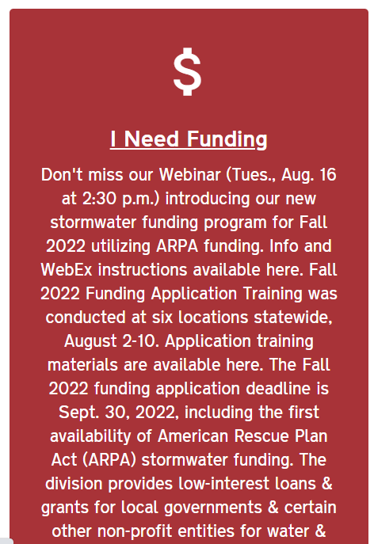
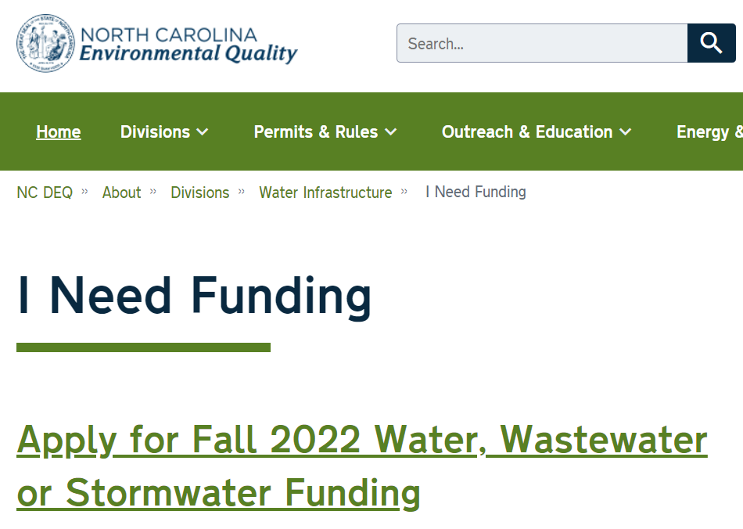
Fall 2022 LASII Stormwater Grant Applications
All application materials can be found on Division’s website http://deq.nc.gov/about/divisions/water-infrastructure under “I Need Funding” → “Application Forms and Additional Resources”: https://deq.nc.gov/about/divisions/water-infrastructure/i-need-funding/application-forms-and-additional-resources
Notes:
All of the Application forms are now online.
Applicants should begin the process of completing their applications very soon now.
ASAP: get familiar with the application instructions and Stormwater PRS and Guidance. Read those! Applications will take time to put together, and requires the governing board to pass a resolution in order to submit an application, so you need to plan ahead!
Applications are due Sept 30, at 5:00pm.
Here’s where to find the applications: On the Division’s main webpage (first link), scroll down to get to the red I Need Funding box. Click it, and then click on the “Apply for Fall 2022 funding link”.

Slide 31
How and By When to Apply
Complete application forms and provide supporting documentation by application deadline.
Slides from and recording of “How to Apply Training” are on “Application Forms and Additional Resources” page. Highly recommend watching the video for all LASII stormwater funding applicants.
How to Complete the Application Forms
LASII Stormwater Funding (Eligibility and Priority Rating Systems
Application submittal deadline – Sept. 30, 2022 at 5 PM
Notes:
Recommend looking at slides and recording of “How to Apply” for much more detail than we can provide in this webinar
It goes through the requirements for each line item of the PRSs

Slide 32
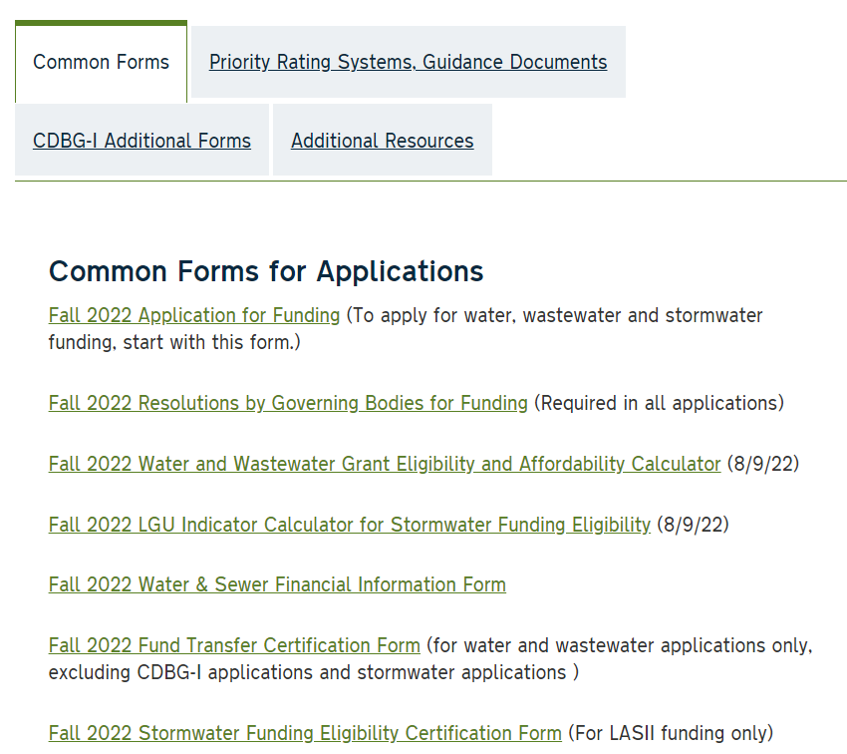
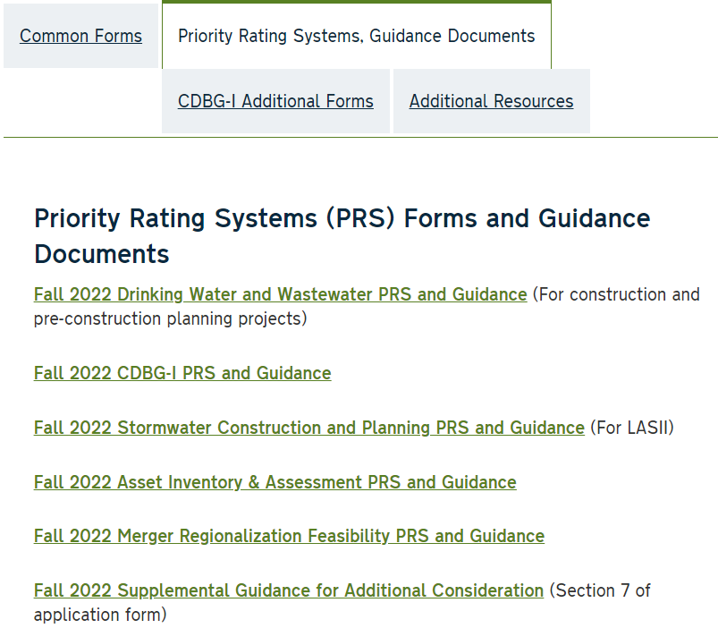
Applicable Forms for LASII Applications
These are the forms relevant to the LASII applications
Notes:
These are the forms that are relevant to the LASII applications – highlighted in yellow on this screen.

Slide 33
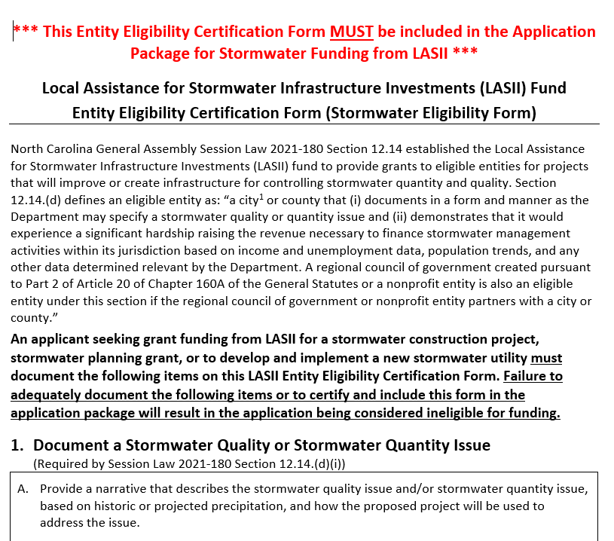
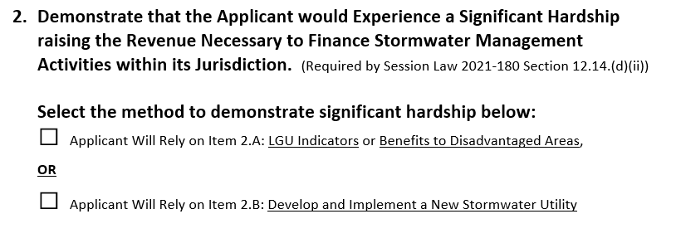
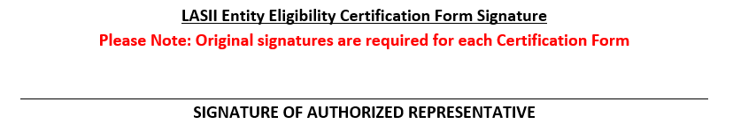
LASII Fund Entity Eligibility Certification Form
Complete this Form First to Determine if Eligible
Required for All LASII Applications – Ineligible for Funding if not Included
See Guidance Document and Entity Eligibility Form for Instructions
Notes:
Complete this form first to see if you are eligible. If not, there is no reason to apply for LASII funds
This form must be included in the application package
Must document SW quality or quantity issue, and document the method by which significant hardship is demonstrated.
Also have a page specifically if the applicant is a COG or nonprofit partnering with a city or county.
Authorized Representative signs form (original signatures are required)

Slide 34
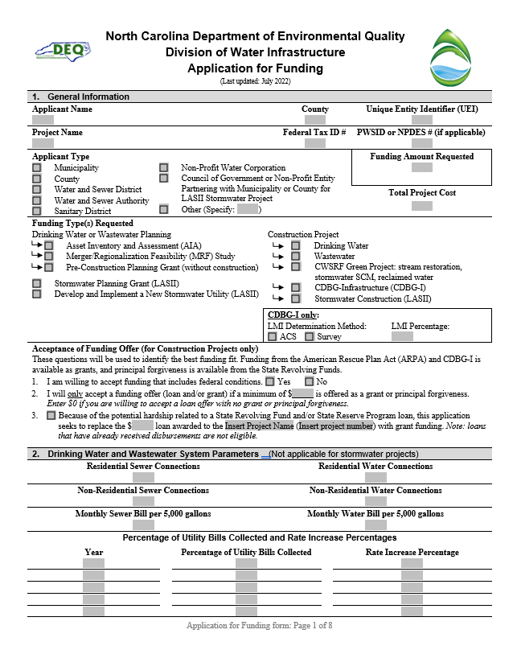
Application for Funding
One application for all Division funding programs
All sections must be completed unless specified otherwise
Follow the attached Instructions
Each application is viewed as stand-alone
If applying for Stormwater Construction and Stormwater Planning, submit separate applications
Notes:
Once you click on the links, you’ll select the one for the application. You should see the application with a header like this.
Make sure that you use this application. We will not consider applications submitted on the old form because there is too much information needed related to that.
Make sure you complete all sections within the application unless specified otherwise. For LASII, look for “LASII” or “stormwater” or “construction projects” or “planning projects”.
Please make sure that you take the time to read through the instructions. If you applied to other funding programs in the past, note that there are some significant changes to this form, so please read the instructions.
There is a checklist at the end of the application to make sure you submit the rest of the required documents.

Slide 35
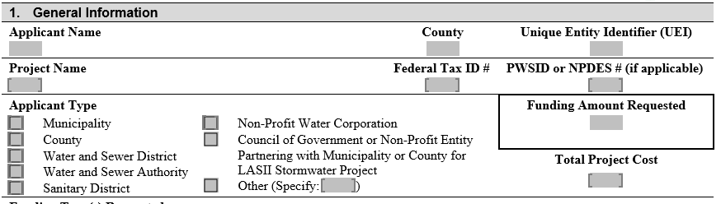
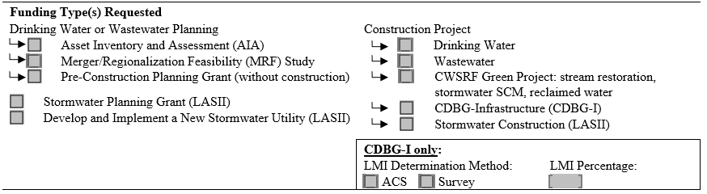
Application for Funding – LASII Funding Types
Notes:
On the Application, specify what type of funding you request. There are three funding types for LASII.

Slide 36
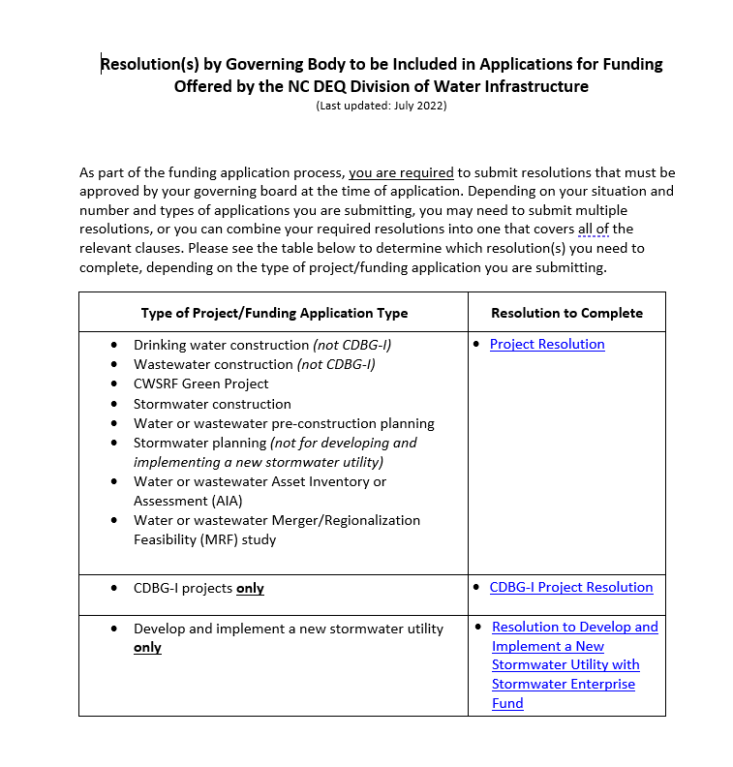
Resolution by Governing Body: Needed with Application
Notes:
Resolutions will now be due at the time of application. If needed, a template is available on the website. You need to submit one of these two resolutions, depending on the funding type. Governing body must convene and pass the resolution ahead of submitting the application. Must be part of the application package. Please plan ahead as the governing body must pass this resolution before you apply! Applications due Sept 30.

Slide 37
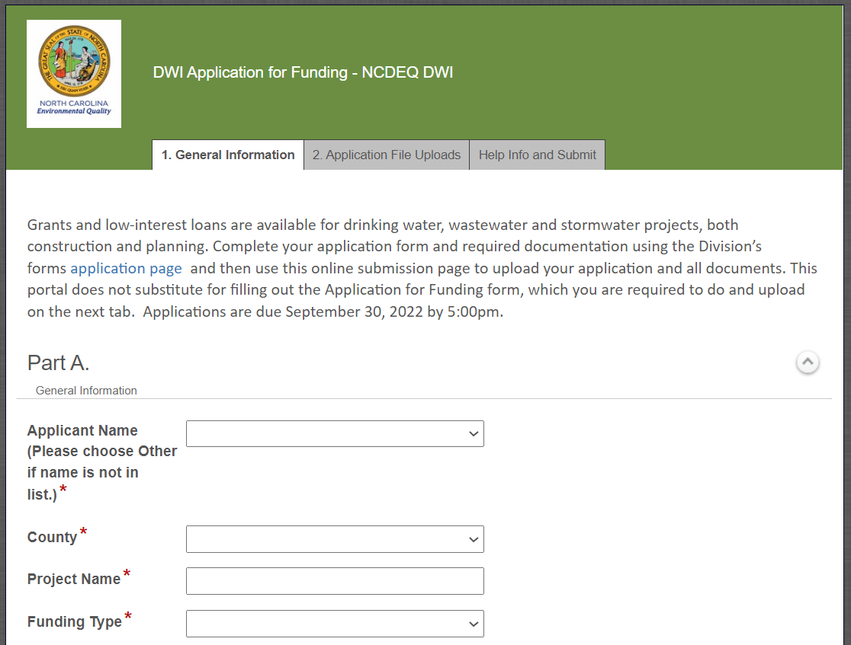
Application Submittal – Electronic (New!)
Upload and submit application documents online: https://edocs.deq.nc.gov/Forms/OPA-ARPA
Electronic submittals only accepted
Upload completed application forms and supporting documents
File size limit: 250 MB/file
Documents uploaded individually
Notes:
Watch the training recording to step through this
You upload all application files to this submittal portal and hit submit.

Slide 38
How to Apply Training
Watch the recorded “How to Apply Training” video on the Application Forms and Additional Resources webpage:
https://deq.nc.gov/about/divisions/water-infrastructure/i-need-funding/application-forms-and-additional-resources
How to Complete the Application Forms
LASII Stormwater Funding (Eligibility and Priority Rating Systems)

Slide 39
Questions?
Division Director:
Shadi Eskaf shadi.eskaf@ncdenr.gov
Public Information Officer:
Cathy Akroyd cathy.akroyd@ncdenr.gov
LASII Application or Funding questions:
Tony Evans tony.evans@ncdenr.gov
Ken Pohlig ken.pohlig@ncdenr.gov
Notes:
If you would like a direct follow-up, I also suggest you email the appropriate person you see listed here with your question after this webinar.

Slide 40
Ken Pohlig, PE
Ken.Pohlig@ncdenr.gov
919-707-9170
Tony Evans, PE
Tony.Evans@ncdenr.gov
919-707-9168
Stormwater Funding Contacts

Slide 41
Division of Water Infrastructure deq.nc.gov/about/divisions/water-infrastructure
State Water Infrastructure Authority deq.nc.gov/about/divisions/water-infrastructure/ state-water-infrastructure-authority

