Slide 1
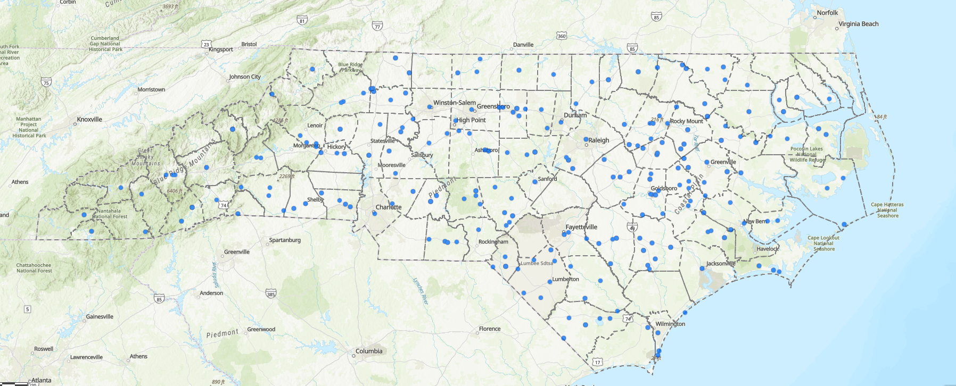
Map of Spring 2022 Funded Projects

