Slide 1
Laboratory Certification Updates
July 2020 Virtual Lab Technology Day
Beth Swanson
Division of Water Resources, Water Sciences Section

Slide 2
Laboratory Certification Staff
 | Title/Role | Region/Oversight
? | Environmental Program Manager | Program Management/Rules Revision
Todd Crawford | Technical Assistance and Compliance Specialist | Mentor/Trainer/Chlorophyll a Round Robin Coordinator
Jason Smith | Auditor | Asheville/Winston-Salem/Mooresville
Tonja Springer | Auditor | Fayetteville/Raleigh/Database Management
Thomas Halvosa | Auditor | Washington/Raleigh
Beth Swanson | Technical Assistance and Compliance Specialist | Mentor/Trainer
Anna Ostendorff | Auditor | Wilmington/Raleigh
Michael Cumbus | Auditor | Winston-Salem/Mooresville
Each auditor manages out-of-state laboratories as well.

Slide 3
Overview
July 2019 Rule Revision
New Policies
Updated Policies
Changes on the Horizon
PT Study Reminders
Answer questions from chat

Slide 4
Rule Revision
Website Links:
https://deq.nc.gov/about/divisions/water-resources/water-resources-data/water-sciences-home-page/laboratory-certification-branch/rules-regulations
https://deq.nc.gov/about/divisions/water-resources/water-resources-data/water-sciences-home-page/laboratory-certification-branch/rules-regulations-0
Key Revisions
Codified many polices
Expanded the list of parameters considered Field Parameters (added Turbidity, Salinity, Sulfite, VAR Options 5, 6 & 12)
Fee change
SOPs required for Field Laboratories
Documented training program for all lab types

Slide 5
Rule Revision
Examples of policies that were codified (not all inclusive)
Matrix spike requirements
Chemical, reagent and standard traceability requirements
Mechanical liquid-dispensing device calibration requirements
Requirements for Continuing Calibration Blank/Continuing Calibration Verification (CCB/CCV), Blank, Second Source Standards, Factory-set Curve verification

Slide 6
Rule Revision

Slide 7
Rule Revision
Field labs are required to have SOPs written and in use for every parameter method by July 1, 2020.
Templates are on our website – (an option, not required to use them)
https://deq.nc.gov/about/divisions/water-resources/water-resources-data/water-sciences-home-page/laboratory-certification-branch/technical-assistance-policies
Not requiring that labs submit to us at this time, but they will be reviewed during any future inspection. Will be reviewed before any new parameter method is added and we could request to see them at any time
[All types of labs] SOP must be reviewed every 2 years. Document the review date and if any revisions are made, document what changed, and the date completed. Any changes to procedure before the 2 years must be added to the SOP in real time.

Slide 8
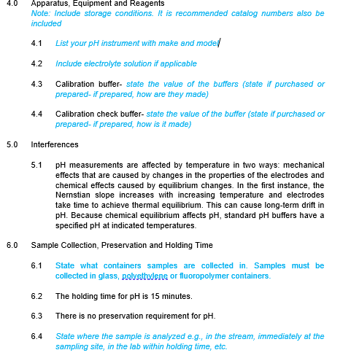

Slide 9
Rule Revision
Documented training program required for all labs (i.e., Field and Non-Field). Required to be in place by August 1, 2020 (1 month after Field Lab SOPs are to be implemented) 15A NCAC 02H .0805 (a) (7) (P) and 15A NCAC 02H .0805 (g) (5)
Required elements include, at a minimum:
staff have the education, training, experience, or demonstrated skills needed to generate quality control results within method-specified limits [defined by each lab] and/or that meet the requirements of these Rules [supervisor requirements, 15A NCAC 02H .0805 (a) (3)];
staff have read the laboratory Quality Assurance Manual and/or applicable Standard Operating Procedures; and
staff have obtained acceptable results on Proficiency Testing samples pursuant to Rule .0803(1) of this Section or other demonstrations of proficiency.
Other demonstrations include things such as training side-by-side with an experienced analyst which both analysts sign off on and analyzing a single blind sample.

Slide 10
New Policies
https://deq.nc.gov/about/divisions/water-resources/water-resources-data/water-sciences-home-page/laboratory-certification-branch/policies
Temperature-Measuring Devices Used for Laboratory Operations
Duplicate Sample Analyses for Field Parameters
Fecal Sludge MPN Analysis Protocol
Dissolved Oxygen Meter Calibration
Free Available Chlorine Hold Time
SW-846 pH Calibration Verification
Department of Environmental Quality

Slide 11
Updated Policies
Documentation Requirements for Sample Collection and Receipt
Chlorophyll a
Matrix Spiking
Electronic Signature and Data Storage Policy
Analytical Balance Weights Verification

Slide 12
On the Horizon
Residues – Drying time study and dry filter blank
Residue is considered a method-defined parameter per the definition in the Code of Federal Regulations, Part 136.6, Section (a) (5). This means that the methods may not be modified per Part 136.6, Section (b) (3).
The drying time study and dry filter blank we have been allowing in lieu of constant weights are modifications and we will no longer be able to accept them as of January 1, 2021.
Inline meter policy being updated– applies to COMPLIANCE only
Working out specifics, but frequency of calibrations or calibration verification will be increased.

Slide 13
On the Horizon
EPA Method Update Rule (??)
From the EPA website: The public comment period closed on December 23, 2019. EPA is preparing a final rule for publication later in 2020.
Also per the EPA website, proposed changes include:
revised EPA methods;
new or revised methods published by voluntary consensus standard bodies, such as ASTM
International and the Standard Methods Committee;
new or updated methods developed by the U.S. Geological Survey;
methods reviewed under the Alternate Test Procedures (ATP) program; and
minor changes to quality assurance and quality control within individual methods.
We will let labs know when the MUR is published, provide guidance on any changes and give an implementation date

Slide 14
Ongoing PT Reminders
Choosing a method description: Look at your Certified Parameters Listing (CPL) and make sure they match
Include your lab Certification #
Include your EPA ID
We will ask for revised reports if these are missing or incorrect
At this time, we are not changing the PT due date of September 30. Please contact us in August if you foresee issues getting your testing completed due to Covid-19 hardships

Slide 15
Questions and Follow-up
Contact information:
Beth Swanson
(919) 733-3908 ext. 259
Beth.Swanson@ncdenr.gov
Website address:
https://deq.nc.gov/about/divisions/water-resources/water-resources-data/water-sciences-home-page/laboratory-certification-branch
Sign up for the listserv!
DENR.DWQ.Lab_Cert-join@lists.ncmail.net

