Slide 1
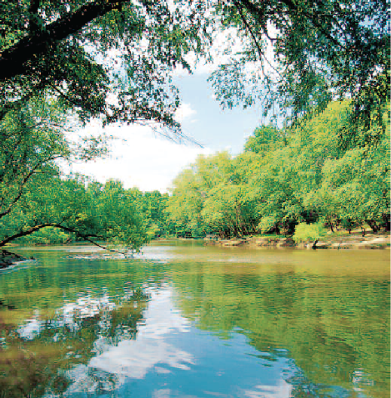
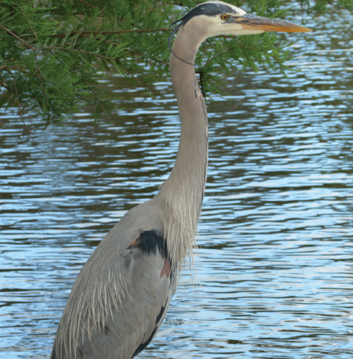
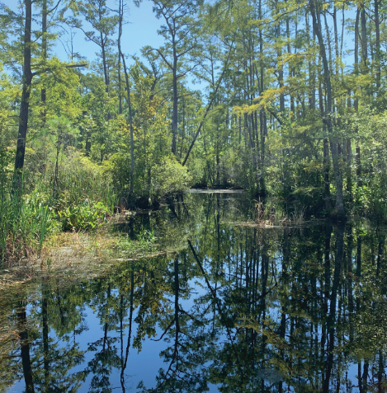
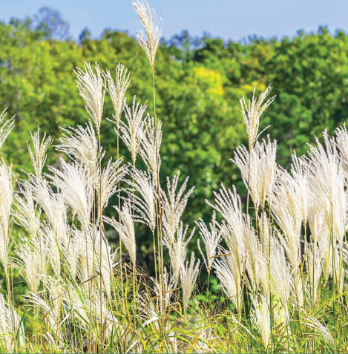
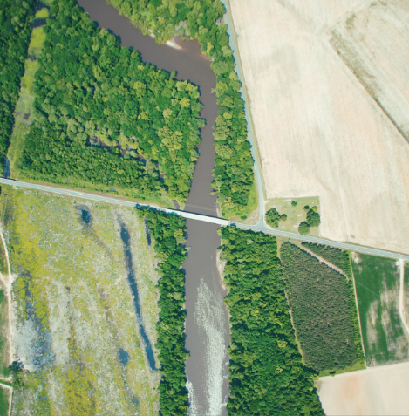
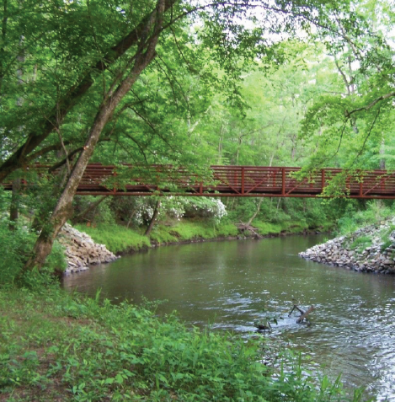
Riparian Buffer Rules 101
Sue Homewood
NCDWR
2021

Slide 2
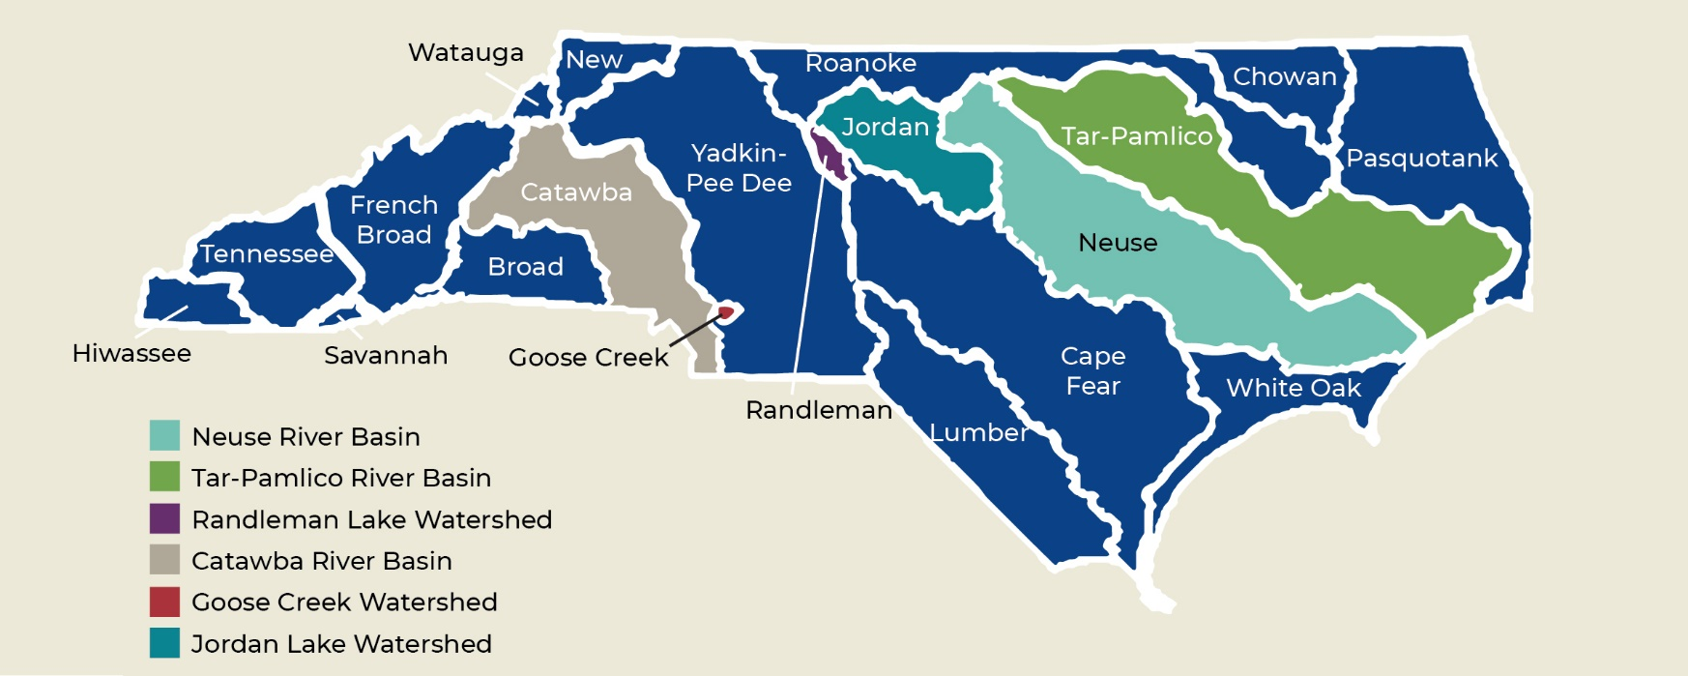
Riparian Buffer Protection Programs

Slide 3
Purpose of Specific Buffer Rules
Nutrient Removal Function to protect estuaries / downstream lakes
Neuse
Tar-Pamlico
Catawba
Protect Water Supply
Randleman Lake (New Water Supply)
Jordan Lake
Sustain and recover federally endangered Carolina Heelsplitter
Goose Creek

Slide 4
Buffer Rule Implementation
Division of Water Resources (DWR)
In some watersheds local governments may request delegation
Local governments- Jordan Lake & Randleman Lake Watersheds
Exceptions for local delegations/designations:
- Forestry
- Multi-jurisdictional/boundary projects
- Government Projects
- Agriculture

Slide 5
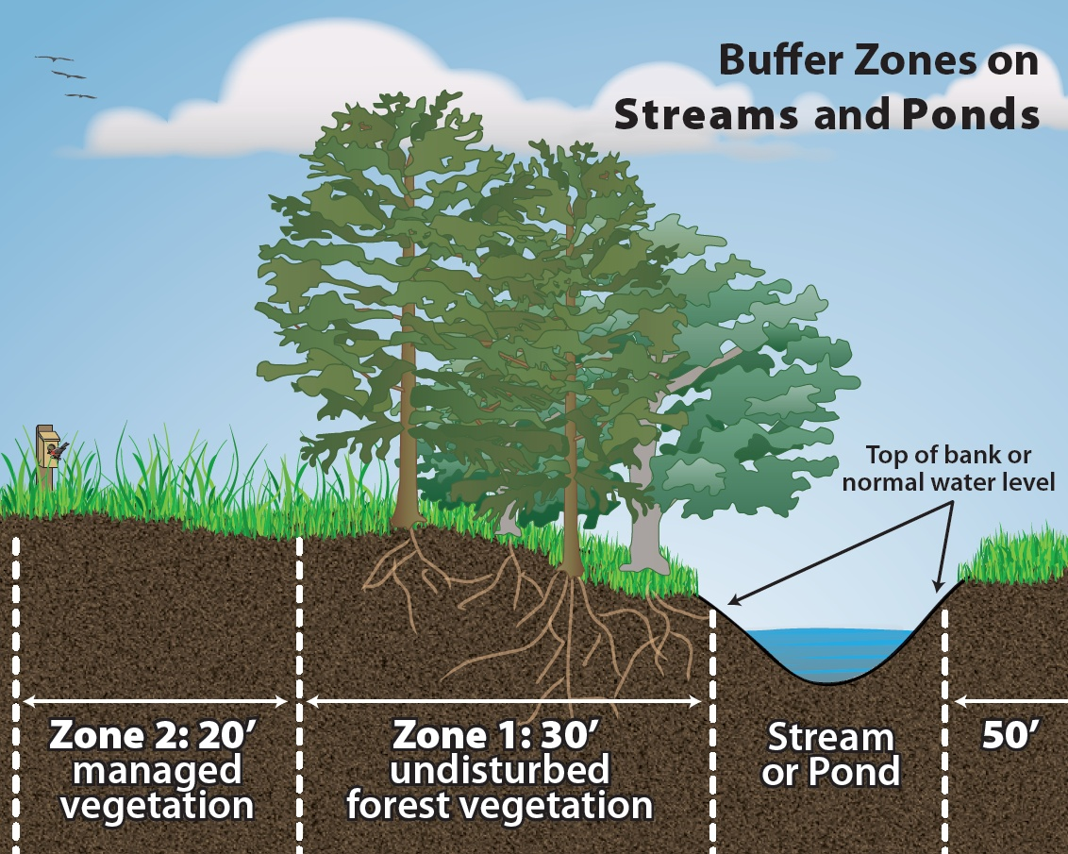
How is buffer measured?
Buffer Zones on Streams, Lakes, Ponds, Coastal Water
Neuse
Tar-Pam
Catawba
Jordan
Randleman

Slide 6
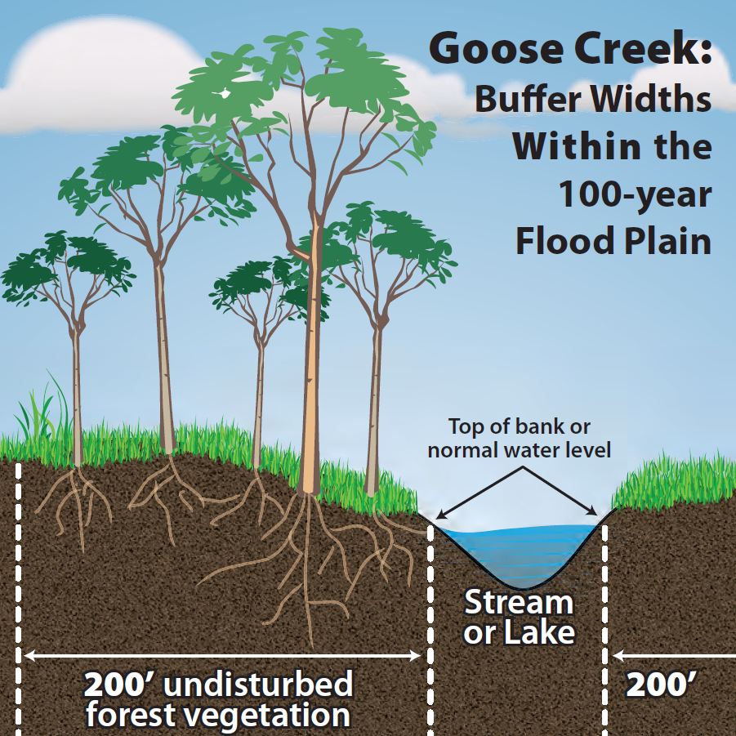
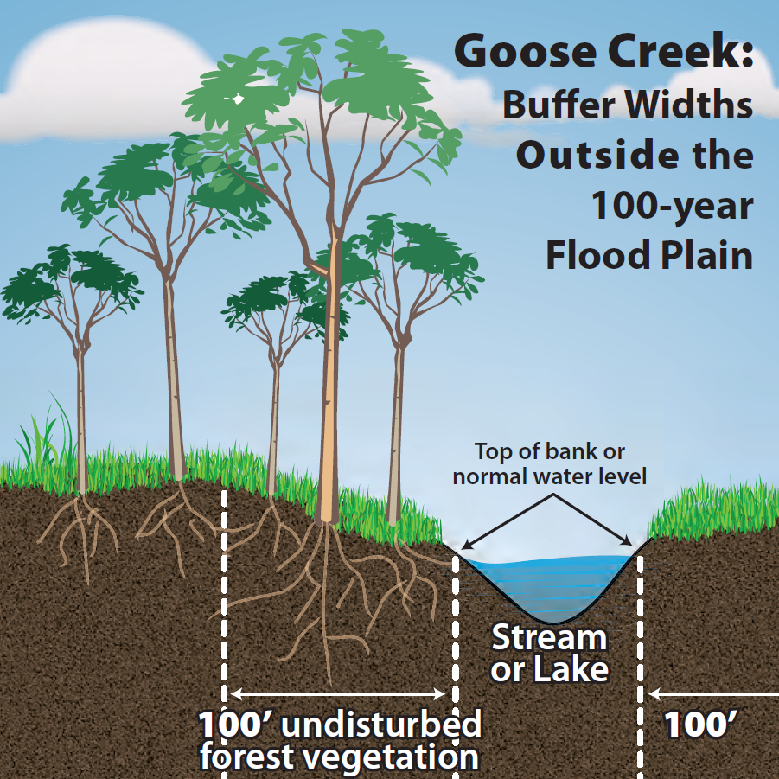
How is buffer measured?

Slide 7
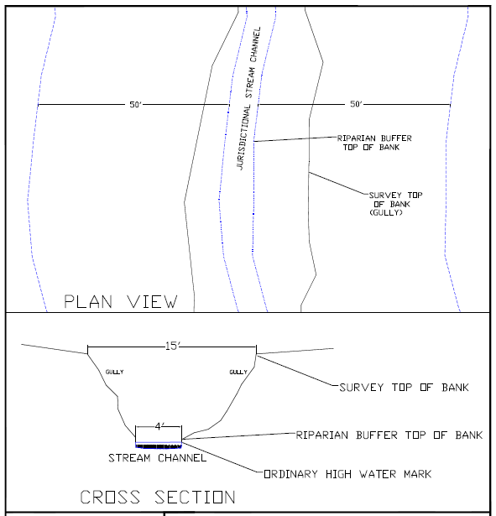
How is buffer measured?
Common questions:
Incised stream
Do you measure the buffer distance horizontally on a plan sheet or topographically with the “lay of the land”?
Where is the “top of bank” to start the buffer distance measurement on an incised stream?
I thought that the buffer started at the edge of the coastal wetlands?
Where do you start measuring the buffer on the edge of a lake/pond? What about a beaver impoundment?

Slide 8
Where does the buffer apply?
Features “approximately shown” on
Latest USGS Topographic 1:24,000 scale
-OR-
Most Recent Published NRCS Soil Survey
Randleman
Also applies if other site specific evidence indicates the presence of waters not shown on either of the two maps
Catawba
Only Main Stem Catawba River/Lakes
Web
Soil
Survey

Slide 9
Where does the buffer apply?
Applies to:
Perennial streams
Intermittent streams
Lakes and reservoirs
Ponds attached to streams
Estuaries
Modified natural streams
Does not apply to:
Ditches & Manmade conveyances*; unless constructed for navigation or boat access
Ephemeral streams
Ponds that are not attached to streams
Wetlands
Agricultural ponds
*Unless in Randleman

Slide 10
What is allowed in the buffer?
Zone 1
“Vegetated area that is to be undisturbed (protected) except as provided for in the Rule”
Zone 2
“Vegetated area that is to be undisturbed (protected) except as provided for in the Rule”
Grading deemed allowed provided existing vegetation in Zone 1 not compromised stormwater runoff is managed in compliance with the rule, and disturbed areas are stabilized and revegetated
What about
“pruning”?

Slide 11
What is allowed in the buffer?
Existing and Ongoing Uses
An activity is considered to be an “existing use” per the buffer rules if it existed (and ongoing) prior to:
July 22, 1997 Neuse River Basin
April 1, 1999* Randleman Lake
January 1, 2000 Tar-Pamlico River Basin
June 30, 2001 Catawba River Basin
February 1, 2009 Goose Creek Watershed
August 11, 2009* Jordan Lake Watershed
Only the portion of the riparian buffer that contains the footprint of the existing use shall be exempt

Slide 12
What is allowed in the buffer?
Table of Uses
Allowable
With
Mitigation*
?
Exempt*
Allowable*
OR
Allowable
With
Mitigation Upon Authorization
Allowable Upon Authorization
?
Deemed Allowable
Prohibited
Notes:
Let’s discuss this when we talk about the 2020 rule revisions in a few more slides.

Slide 13
What is Allowed in the Buffer?
Allowable
With
Mitigation*
Jordan – if the use is not listed, then it is prohibited
Exempt*
Allowable*
Allowable
With
Mitigation Upon Authorization
Deemed Allowable
Allowable Upon Authorization
Neuse, Tar-Pam, Catawba, Randleman, Goose Creek
Prohibited

Slide 14
2020 Buffer Rule Revisions What happened when we weren’t looking?

Slide 15
2020 Rule Updates
The Big Picture
Main goals
Revise outdated requirements
Provide maximum consistency with other NC rules and/or Federal Regulations
Improve and clarify language / address inconsistencies
Incorporate recent legislation, declaratory rulings, clarification memos, interpretations
Provide maximum consistency between individual Riparian Buffer Rules
Reduce/Improve regulatory processes when possible
Provide more flexibility to the regulated community

Slide 16
2020 Rule Updates
What didn’t change?
Jordan Lake Riparian Buffer Rules
Unable to revise rules per legislation
Each Buffer Rule’s original scope, purpose, and applicability
All exemptions and existing uses
What features are subject to the buffer rules
The width or definition of Zone 1 or Zone 2
Table of Uses to identify specific activities within the buffers
Local government delegation/designation authority

Slide 17
2020 Rule Updates
What’s New?
Relocation and subdivision of many Rules (Cross Reference Table available on website)
Previous Rule Citation | Current Citation
15A NCAC 02B .0233 Neuse Buffer Rules | 15A NCAC 02B .0714 Neuse Maintenance of Existing Riparian Buffers 15A NCAC 02B .0610 Definitions 15A NCAC 02B .0611 Authorization Certificates 15A NCAC 02B .0612 Forest Harvesting Requirements
15A NCAC 02B .0241 Neuse Buffer Rules Delegation | 15A NCAC 02B .0715 Neuse Buffer Rule Delegation Authority
15A NCAC 02B .0259 Tar Pam Buffer Rules | 15A NCAC 02B .0734 Tar Pam Maintenance of Existing Riparian Buffers 15A NCAC 02B .0610 Definitions 15A NCAC 02B .0611 Authorization Certificates 15A NCAC 02B .0612 Forest Harvesting Requirements
15A NCAC 02B .0261 Tar Pam Buffer Rules Delegation | 15A NCAC 02B .0735 Tar Pam Buffer Rule Delegation Authority
15A NCAC 02B .0243 Catawba Buffer Rules | 15A NCAC 02B .0614 Catawba Maintenance of Existing Riparian Buffers 15A NCAC 02B .0610 Definitions 15A NCAC 02B .0611 Authorization Certificates 15A NCAC 02B .0612 Forest Harvesting Requirements
Previous Rule Citation | Current Citation
15A NCAC 02B .0250 Randleman Lake Buffer Rules | 15A NCAC 02B .0724 Randleman Lake Maintenance of Existing Riparian Buffers 15A NCAC 02B .0610 Definitions 15A NCAC 02B .0611 Authorization Certificates 15A NCAC 02B .0612 Forest Harvesting Requirements
15A NCAC 02B .0251 Randleman Lake Stormwater Rules | 15A NCAC 02B .0721 Randleman Lake Stormwater Requirements
15A NCAC 02B .0605 Goose Creek Buffer Rules: Buffer Widths | 15A NCAC 02B .0605 Goose Creek Buffer Widths
15A NCAC 02B .0606 Goose Creek Variance Activities | 15A NCAC 02B .0606 Goose Creek Authorization Certificates
15A NCAC 02B .0607 Goose Creek Buffer Rules | 15A NCAC 02B .0607 Goose Creek Buffer Types and Managing Activities in Buffers
15A NCAC 02B .0608 Goose Creek Forest Harvesting Activities | 15A NCAC 02B .0608 Goose Creek Forest Harvesting Activities

Slide 18
2020 Rule Updates
What’s New?
Common Elements for Neuse, Tar-Pam, Catawba Relocated into Separate Rules
15A NCAC 02B .0610 Definitions
15A NCAC 02B .0611 Authorization Certificates
15A NCAC 02B .0612 Forest Harvesting Requirements

Slide 19
2020 Rule Updates
What’s New?
New Categories for better clarity but definitions and approval process have not changed significantly
New category:
Allowable upon Exception
Previous Category | Current Category
Exempt | Deemed Allowable
Allowable | Allowable upon Authorization
Allowable with Mitigation | Allowable with Mitigation upon Authorization
Prohibited | Prohibited

Slide 20
2020 Rule Updates
What’s New?
Allowable upon Exception
For any activities that are not specifically listed within the Table of Uses
Requirements (hardships) retained and updated from previous Variance process
Mitigation specifically required for all activities within this category
Major/Minor exceptions based on total impact acreage rather than Zone location
Minor exceptions less than or equal to 1/3 acre of buffer impacts
Major exceptions greater than 1/3 acre of buffer impacts
All Authorization upon Exceptions approved by implementing Authority
Major exceptions must be noticed to the public on DWR website following DWR notice procedures prior to approvals
Jordan Buffer

Slide 21
2020 Rule Updates
What’s New?
Table of Uses
All footnotes were relocated into appropriate line items
Significant changes to allowances for residential properties/structures
Expanded allowances for stormwater control measures within buffer
Significant update/revisions to Utility Line Uses
Allowable
With
Mitigation Upon Authorization
Allowable Upon Authorization
Deemed Allowable
Prohibited
(gg) Utility Lines – Streambank stabilization for the protection of publicly owned utility lines (not including new line installation):
Less than 150 feet of streambank disturbance
Greater than 150 feet of streambank disturbance
X
X

Slide 22
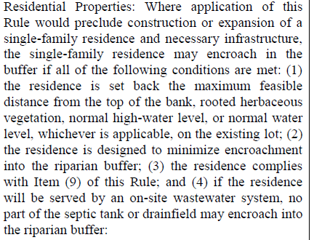
2020 Rule Updates
What’s New?
Table of Uses
Fences: Modified and Simplified
Greenways, trails, sidewalks or linear pedestrian/bicycle transportation system expanded and combined
Residential Properties - Allows residential structures/expansions where no alternatives exist
Combined roads, driveways, railroads for consistency
Modified thresholds from linear foot to buffer impact acreages

Slide 23
2020 Rule Updates
What’s New?
Table of Uses - Utilities
Streambank stabilization for the protection of publicly owned utility lines
Increased allowable maintenance corridor from 10 feet to 30 feet wide
Sanitary Sewer Overflows
Vegetation maintenance activities
Replacement/Rehabilitation of existing sewer lines within, or adjacent to, an existing right of way
New Line Construction Activities

Slide 24
2020 Rule Updates
What’s New?
Diffuse Flow Stormwater Runoff Through Riparian Buffer
Changed diffuse flow to dispersed flow as defined in 15A NCAC 02H .1002
Conveyances through the buffer from approved SCMs now deemed authorized
Added activities/uses to allowable upon authorization
Allow new conveyances when nutrient calculations show achievable rule loading goals
Allow for new conveyances with minimal flow rates to account for small areas that cannot be reasonably directed to SCMs due to topography
Allow for realignment of existing conveyances
Allow for new conveyances for bypass of upslope runoff
Expanded allowances for linear transportation facilities
Provided process for unlisted stormwater runoff control methods to be considered under Allowable with Exception
Jordan Buffer

Slide 25
Questions?

