Slide 1
Town of Typicalville (NPDES #NC0012345) 2013 PAR
February 15, 2013
NC Division of Water Resources
PERCS Unit
1617 Mail Service Center
Raleigh, NC 27699-1617
Enclosed are an original and one copy of the Town of Typicalville’s Pretreatment Annual Report (PAR)
for the period of January 1, 2012 through December 31, 2012.
I certify, under penalty of law, that this document and all attachments were prepared under my
direction or supervision in accordance with a system designed to assure that qualified personnel
properly gather and evaluate the information submitted. Based on my inquiry of the person or
persons who manage the system, or those persons directly responsible for gathering the information,
the information submitted is, to the best of my knowledge and belief, true, accurate, and complete. I
am aware that there are significant penalties for submitting false information, including the possibility
f fines and imprisonment for knowing violations.
If you have any questions concerning this material, please contact John Basin at (555) 123-4576.
Sincerely,
Jane D. Wastewater
Jane D. Wastewater
Director of Public Utilities

Slide 2
Town of Typicalville (NPDES #NC0012345) 2013 PAR Narrative
GENERAL INFORMATION:
GENERAL PROGRAM INFORMATION:
AT, LTMP, HWA, SUO, ERP, IWS and Permits are up to date, except we now have enough Method 1631 mercury data to revise our HWA and resolve our over allocation. Plan to do this in the next 4 months.
All Dates on the Division's Database Program Info Sheet are correct
A copy of our Program Info sheet is enclosed with corrections.

Slide 3
: Town of Typicalville (NPDES #NC0012345) 2013 PAR Narrative
GENERAL INFORMATION (cont.):
GENERAL PERMIT INFORMATION:
No permits lapsed or expired prior to renewal
No new or Name Changes at any SIUs

Slide 4
: Town of Typicalville (NPDES #NC0012345) 2013 PAR Narrative
IU INFORMATION, listed alphabetically
Chicken Pluckers, Inc. ( IUP # 0008, Poultry)
SNC INFORMATION:
This SIU was in SNC for TRC limit violations for BOD during January to June 2012.
This SIU was also in SNC for reporting due to failure to complete all self-monitoring samples during January to June 2012.
Copy of Public Notice is enclosed.

Slide 5
Town of Typicalville (NPDES #NC0012345) 2013 PAR Narrative
IU INFORMATION, listed alphabetically
Chicken Pluckers, Inc. ( IUP # 0008, Poultry)
SNC INFORMATION (cont.):
SNC Situation for BOD has been resolved. The SIU began an investigation into the source of the BOD violations in February, per our first NOV. Their efforts were intensified as the violations continued and more NOVs were issued. In the end they traced the source to problems in the Industry's pretreatment unit. Temporary repairs were completed in August, which enabled the SIU to come back into compliance during the second six-month reporting period (i.e., they still had some violations in July but overall not SNC – see IDSF)
SNC situation for reporting has also been addressed. This Industry has hired new staff and is now properly sampling according to its permit requirements.

Slide 6
Town of Typicalville (NPDES #NC0012345) 2013 PAR Narrative
Chicken Pluckers, Inc. (continued)
ORDERS AND SCHEDULE INFORMATION:
Compliance Schedule added to permit to require installation of new pretreatment equipment.
Copy of the Schedule submitted to the Division with a permit modification with new effective date of 9/30/12 .
As noted above, the repairs to the treatment unit to address the BOD violations were “temporary” and so the SIU must still do more work to get a permanent solution.

Slide 7
Town of Typicalville (NPDES #NC0012345) 2013 PAR Narrative
Chicken Pluckers, Inc. (continued)
A to C and CONSTRUCTION INFORMATION:
An AtoC was issued to the Industry on 10/28/12 .
Industry will install the following: new 100,000 gal EQ tank at head of pretreatment, upgrade chemical feeds and pH adjustment at approx. cost of $75,000
The schedule requires that installation of equipment be completed by June 30, 2013.
MISSED DATA:
SIU missed many BOD samples (see SNC discussion) and missed some other parameters a few times. NOVs issued, resampling required.

Slide 8
Town of Typicalville (NPDES #NC0012345) 2013 PAR Narrative
Chicken Pluckers, Inc. (continued)
ENFORCEMENT ACTIONS by POTW, and Industry responses, for Non-SNC, Non-Order, Non-Construction, Non-"missing" data events:
NOVs and a penalty of $250 for each instance of SNC (a total of $500) were issued.
The penalties were paid promptly. Overall, this Industry has been very cooperative with the Town in resolving all issues.
OTHER MISC. INFORMATION:
This SIU had a couple violations for pH, but these did not constitute SNC (see IDSF for percent violations.) NOVs were issued per our ERP.

Slide 9
Town of Typicalville (NPDES #NC0012345) 2013 PAR Narrative
Slugem Hosiery Mill, Inc. (IUP # 0007, Textile)
SNC INFORMATION:
SIU was not in SNC this PAR Year
Previous SNC situation, see 2011 PAR, was resolved with permit modification effective February 1, 2012. The POTW increased IUP limits for chromium and copper. The cause of the violations and SNC in 2011 was determined to be increased production and flow.
ORDERS AND SCHEDULE INFORMATION: None
A to C and CONSTRUCTION INFORMATION: None
MISSING DATA: Please note there is no monitoring for ammonia, mercury, or MBAS for the first six months as this is only an annual monitoring requirement

Slide 10
Town of Typicalville (NPDES #NC0012345) 2013 PAR Narrative
Slugem Hosiery Mill, Inc. (IUP # 0007, Textile) - Cont.
ENFORCEMENT ACTIONS by POTW, and Industry responses for Non-SNC, Non-Order, Non-Construction, Non-"missing" data events:
The $500 penalty ($250 per SNC) assessed in the last PAR Year (2011) was paid on February 22, 2012.
There were also two reporting violations for late sample reporting (two weeks late for March and 8 days late for October). NOVs were issued and penalties were assessed at ($50 each). Penalties were paid on May 5, and November 30, respectively.
Overall, this Industry has been very cooperative with the Town in resolving all issues.
A couple limit violations occurred in 2012, (see IDSF form, NOVs were issued), but overall the SIU was not in SNC for either six month period in 2012.

Slide 11
Town of Typicalville (NPDES #NC0012345) 2013 PAR Narrative
Terrible Textiles. (IUP # 0009)
As noted in the 2012 PAR, Terrible Textiles burned down on 12/1/2011 and the permit was formally dropped effective 12/31/2011. There was no monitoring, no data, and therefore no IDSF for this industry in this PAR.

Slide 12
Town of Typicalville (NPDES #NC0012345) 2013 PAR Narrative
Will Plateit Metal Finishers, Inc. (IUP # 0006, 40CFR433)
SNC INFORMATION:
This SIU was in SNC for the parameter of Cadmium (Cd) for both the January 1-June 30, 2012, and the July 1-December 31, 2012, reporting periods.
SIU was SNC for two periods in a row for Cadmium.
In general, this Industry cannot identify or resolve the cause of their SNC. They also do not promptly pay the penalties. Several meetings between the Town and the Industry, as well as letters from our attorney have improved the industry’s cooperation, but have still been unable to determine the source or reason for the increased Cadmium levels. Consent Order issued to require resolution, with upfront penalty.
Copy of Public Notice is enclosed.

Slide 13
Town of Typicalville (NPDES #NC0012345) 2006 PAR Narrative
Will Plateit Metal Finishers, Inc. (IUP # 0006, 40CFR433) – Cont.
ORDER/SCHEDULE INFORMATION:
POTW and the SIU entered into a Consent Order (copy enclosed). Effective date of 2013, so not included on the PPS form.
AtoC and CONSTRUCTION INFORMATION: None
MISSING DATA: NONE
OTHER MISC. INFORMATION:
The SIU filed both required semi-annual TTO certifications in lieu of monitoring for organics.

Slide 14
Narrative - Example: Town of Typicalville (NPDES #NC0012345) 2006 PAR Narrative
Will Plateit Metal Finishers, Inc. (IUP # 0006, 40CFR433) – Cont.
ENFORCEMENT ACTIONS by POTW, and Industry responses, for Non-SNC, Non-Order, Non-Construction, Non-"missing" data events:
Several other NOVs were issued throughout the year.
A penalty of $250 was issued for the Jan-Jun 2012 SNC. SIU failed to pay the penalty within the required 30 days. It was paid on September 30, 2012 after a strong letter from the POTW’s attorney indicating failure to pay would result in termination of service.
Another $1000 penalty for the Jul-Dec SNC was incorporated into the Consent Order. It has not been collected, but documentation of collection will be included in our next PAR.

Slide 15
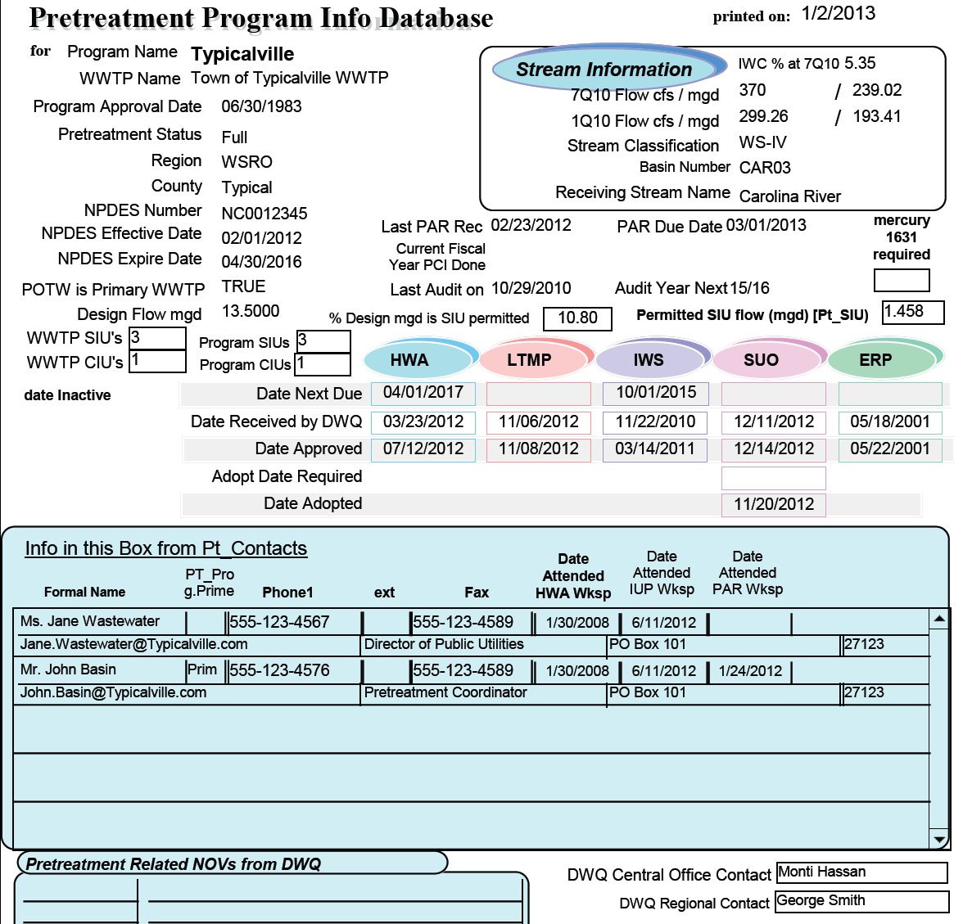
No Corrections Needed.

Slide 18
PUBLIC NOTICE
OF SIGNIFICANT INDUSTRIAL
WASTEWATER PERMIT
VIOLATIONS
The Town of Typicalville, in accordance with Federal and State Regulations is hereby giving Public Notice. Listed below are Significant Industrial Users that were in significant noncompliance (SNC) with national pretreatment regulations, 40 CFR Part 403, and state pretreatment regulations, 15 NCAC 2H .0900, and local pretreatment regulations during the period of January 1 thru June 30, 2012; Will Plateit Metal Finishers, Inc.-Cadmium and Chicken Pluckers, Inc.-BOD, Reporting. And July 1 thru December 31, 2012; Will Plateit Metal Finishers, Inc.-Cadmium
A continuing effort is being made by all the listed industries to achieve compliance, including installation of new equipment and upgrading of existing equipment and continued progress is expected until full compliance can be attained.
Town of Typicalville, Department of Public Utilities, Jane Wastewater, Director.
January 17, 2013
Affidavit of Publication
The Typicalville Herald
Typicalville, N.C.
Personally appeared before me, a Notary Public of the
County of Typical, State of North Carolina, on
this the __17__day of ______January_____2013
_____Suzy Newsy_____
of The Typicalville Herald, who, bring duly sworn, state that
the notice entitled
PUBLIC NOTICE OF SIGNIFICANT
INDUSTRIAL WASTEWATER PERMIT VIOLATIONS
_______________________________________
a true copy of which is attached hereto, appeared in The
Typicalville Herald, a newspaper published in the Town of
Typicalville, County of Typical,
State of North Carolina, _____once____ a week for
_____one____week(s), on the following dates:
January 17___________ ______20___13_
______________________________20______
______________________________20______
______________________________20______
_______________________________________
The Typicalville (N.C.) Herald
of ______January___________2013
____Peter Public___
Notary Public

Slide 19
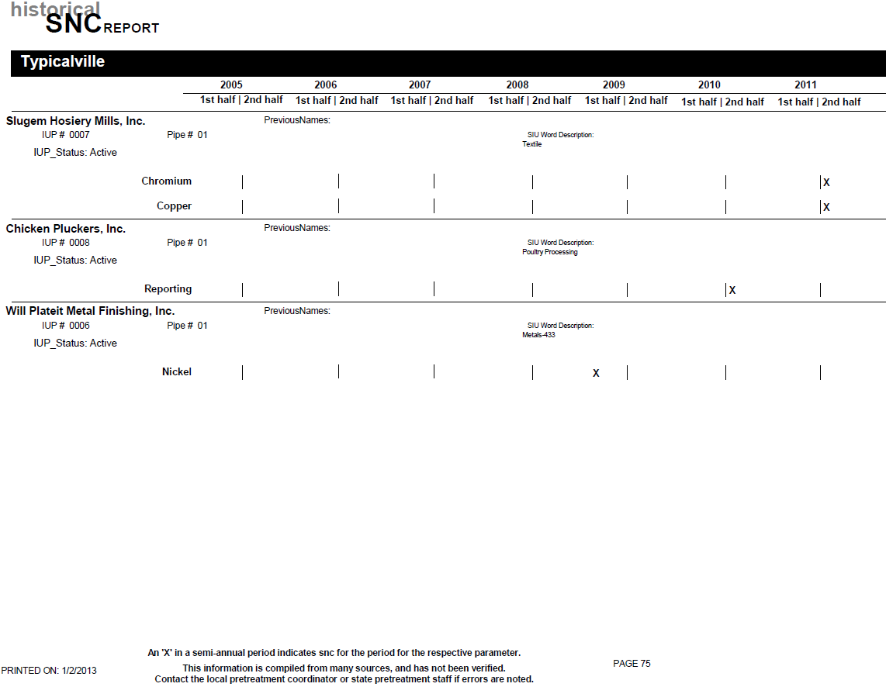

Slide 20
IDSF for SIUs with both daily and average limits

Slide 23
North Carolina
County of Typical
In the matter of Town of Typicalville
Pretreatment Permit No. 0006
held by Will Plateit Metal Finishers, Inc.
CONSENT ORDER AND COMPLIANCE SCHEDULE
Pursuant to provisions of the Sewer User Ordinance of the Town of Typicalville, this Consent Order is made effective the 1st day of February, 2013, between Will Plateit Metal Finishers, Inc. (hereinafter the "User") and the Town of Typicalville (hereinafter the "Town").
The User and Town hereby stipulate and agree as follows:
1. User holds Town of Typicalville Pretreatment Permit No. 0006 (hereinafter the "Permit", which shall refer to User's existing permit and any subsequent renewals or modifications thereof) for the operations of existing pretreatment units and discharges from said treatment works into the Town's sewer system.
2. User has been unable to meet the permit limitations for Cadmium (Cd) set forth in its Permit.
3. Achievement of these limits will require resolution of existing problems in the present treatment train and possibly, development of alternative solutions to alleviate noncompliance, including but not limited to the construction of additional pretreatment facilities as well as the preparation of plans and specifications as necessary.
4. User hereby agrees to do and perform all of the following:

Slide 24
Meet and comply with all terms and conditions of the Permit (except as modified by the Order) provided, however, subject to the terms and conditions of the Consent Order, the following shall apply:
Parameter Daily Max (mg/L) Monitoring Frequency Detection Limit
Cadmium (Cd) 0.13 Weekly 0.002 mg/L
Unless and until Compliance is achieved, the User will undertake activities necessary to bring the User into Compliance in accordance with the following schedule:
COMPLIANCE SCHEDULE
Activities
Prepare an Engineering Report of process alternatives and/or pollution prevention/waste minimization alternative designed to achieve Compliance
Complete Pilot Studies or waste minimization studies and identify alternatives chosen to achieve Compliance
If required, submit necessary drawings and information to obtain any necessary permits and/or authorization to construct from the Town of Typicalville
Begin construction and/or implement identified process alternative(s), pollution prevention, and waste minimization alternatives.
Complete identified construction/pollution prevention/ waste minimization alternatives and/or process alternatives.
Complete analysis of implemented changes, including daily monitoring from April 1st to May 1st and make necessary modifications to optimize and obtain full operational status.
Achieve compliance with final (IUP) limit 0.07 mg/L.
Deadline for Completion
April 1, 2013
July 1, 2013
September 1, 2013
December 1, 2013
March 1, 2014
June 1, 2014
July 1, 2014

Slide 25
c. User shall perform each of the activities set forth in subparagraph (b) on or before the dates established thereby unless such dates are extended by agreement of User and the Town. The User may request such extensions for good cause, and the Town will not unreasonably withhold its consent to such extension.
d. User shall submit a comprehensive written report within five (5) days following each milestone date specified in subparagraph (b). Each such report shall be in narrative form, shall state in detail the activities undertaken since the last report to achieve Compliance, and shall indicate whether User has met the due date for the relevant milestone established in this Consent Order. If any report contains notice of failure to meet a milestone date, the report shall also include a statement explaining the cause of the failure, any remedial actions taken, and the probability of meeting the next milestone.
During any period of construction, User shall submit on or before the 10th day of each month, detailed construction progress reports stating therein in narrative form the work performed during the month and the percentage of completion of the project.
All reports required by the Consent Order shall be submitted to the Town by Certified Mail, Return Receipt Requested, addressed to:
Director of Public Utilities
Town of Typicalville
PO Box 123
Typcialville, NC 12345
e. The User shall pay the Town $1,000, no later than February 27, 2013, for the Significant Non-Compliance during the July through December 2012 reporting period.

Slide 26
e. Any violation of the terms of this Consent Order shall subject the User to the enforcement authority outlined in the Ordinance. Such action may include, but is not limited to such fines, penalties and assessments as may be set forth in the Code of Ordinance of the Town of Typicalville, as amended from time to time.
f. In lieu of other penalties, the following stipulated penalties shall apply for violations of the User's limits or failure to meet a milestone date under this Consent Order, or failure to achieve full compliance with Consent Order.
Violation of limits | $200 per day, per violation
Failure to collected required samples, meet compliance schedule deadlines, required reports, or other milestone dates contained herein | $200 per day, per violation
Failure to achieve full compliance with Final IUP limit at expiration of Order | $1,000 per day

Slide 27
g. Once Compliance is achieved, this Consent Order shall terminate and all obligations hereunder except any obligation to pay identified moneys to the Town shall expire. Upon termination of this Order, the User shall be subject to all terms of the Permit.
h. In the performance of activities under this Consent Order, User must otherwise follow the procedures, rules, regulations, ordinances, and statutes of the Town, State, and Federal governments as they may apply to User. Nothing contained herein shall be construed as a waiver thereof by the Town.
Signed on this 26th day of January 2013.
USER: Will Plateit Metal Finishers, Inc.
BY: William B Plateit
TITLE: President
TOWN: Town of Typicalville
BY: Jane Wastewater
TITLE: Director of Public Utilities
This Order expires July 11, 2014.

Slide 28
Allocation Tables (ATs)

Slide 29
Allocation Tables (ATs) (cont.)

Slide 30
Allocation Tables (ATs) (cont.)

Slide 31
Allocation Tables (ATs) (cont.)

