Slide 1
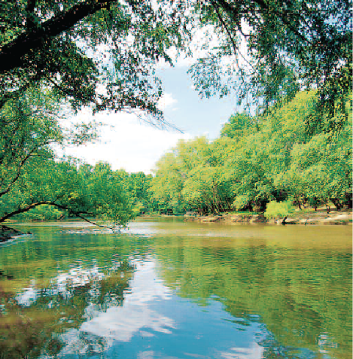
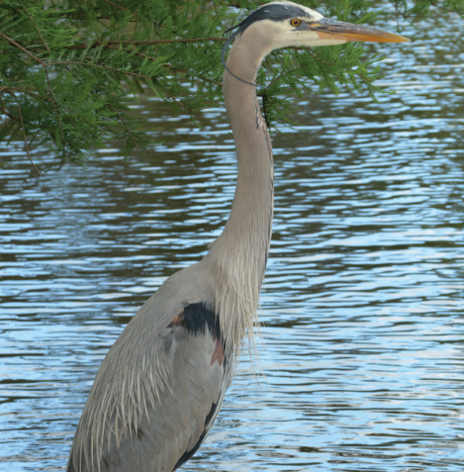
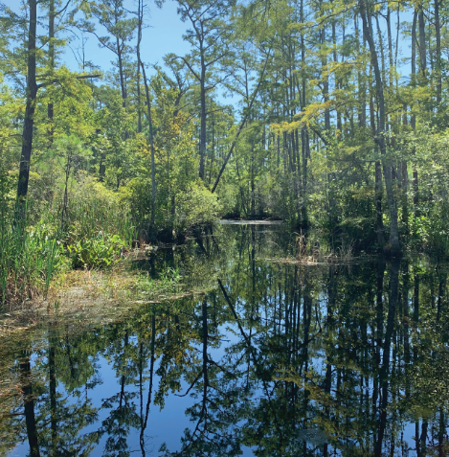
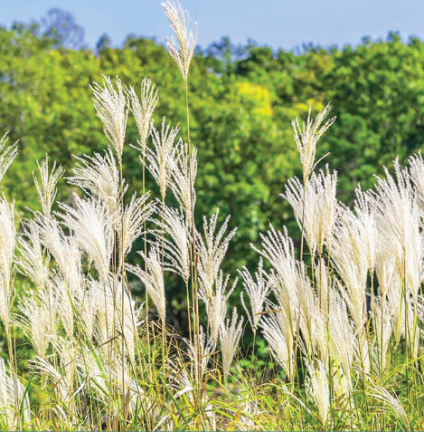
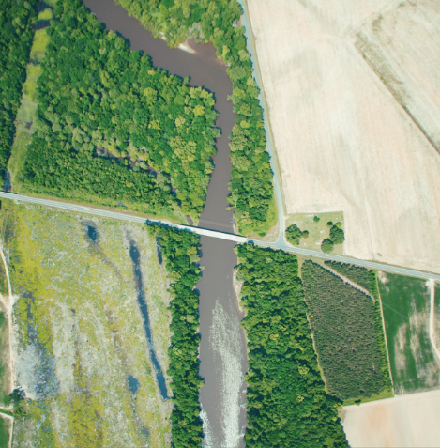
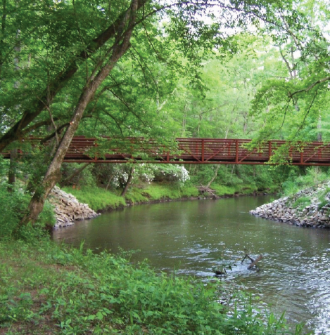
Buffer Authorizations
Paul Wojoski
NCDWR
2021

Slide 2
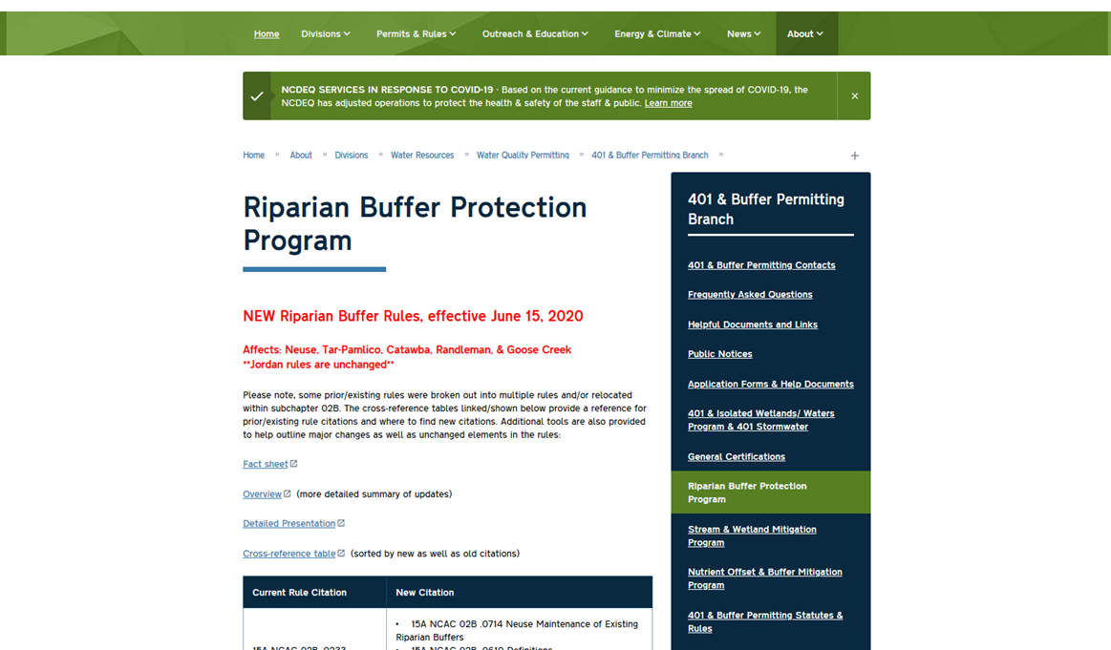
Buffer Protection Program Website

Slide 3
Applying for a Buffer Authorization from DWR
DWR or Local Authority?
Are subject water features present?
Check TOU Category for the project
May be allowable with Exception per 15A NCAC 02B .0611
Is the project in a Buffered Basin?
Not in TOU?
Yes
DWR
Yes
Variance /Exception Application
No
Local
No
Include Mitigation Proposal
Deemed Allowable
Allowable Upon Authorization
Allowable with Mitigation Upon Authorization
Prohibited
You Don’t need a Buffer Authorization from DWR
Does the project also require a 401 Certification?
Check for local requirements
Yes
No
Include Mitigation Proposal if required
Submit online today!
Pre-Construction Notification
Buffer Section!
Buffer Authorization Application

Slide 4
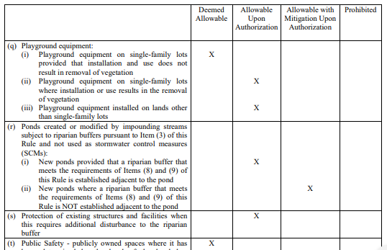
Table of Uses - Categories
Deemed Allowable
Allowable
Upon
Authorization
Allowable with Mitigation
Upon
Authorization
Prohibited

Slide 5
Table of Uses - Categories
Allowable Upon Authorization: may proceed with activity within the buffer provided that there are no practical alternatives. Require written authorization from Authority.
Allowable with Mitigation Upon Authorization: may proceed with activity within the buffer provided that there are no practical alternatives & a mitigation strategy has been approved. Requires written authorization from Authority.
Allowable with Exception: activities not listed within the Table of Uses. Requires written authorization from Authority. Must meet very specific criteria for hardship.
Deemed Allowable: allowed within the buffer =“exempt” (still must use BMPs to minimized disturbance and protect water quality)
Allowable Upon Authorization: may proceed with activity within the buffer provided that there are no practical alternatives. Require written authorization from Authority.
Allowable with Mitigation Upon Authorization: may proceed with activity within the buffer provided that there are no practical alternatives & a mitigation strategy has been approved. Requires written authorization from Authority.
Allowable with Exception: activities not listed within the Table of Uses. Requires written authorization from Authority. Must meet very specific criteria for hardship.
Prohibited: may not proceed within the riparian buffer unless a variance is granted. Mitigation is required as part of the variance.
Notes:
Deemed Allowable
shall be designed, constructed and maintained to minimize vegetation and soil disturbance and to provide the maximum water quality protection practicable, including construction, monitoring, and maintenance activities
Allowable with Exception
not any of the other listed activities
require a written Authorization Certificate with Exception from the Authority for impacts within the riparian buffer and an appropriate mitigation strategy that has received written approval

Slide 6
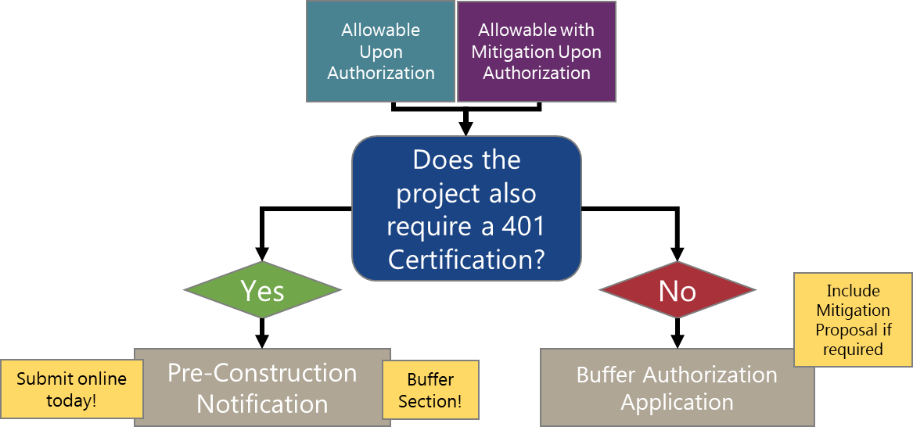
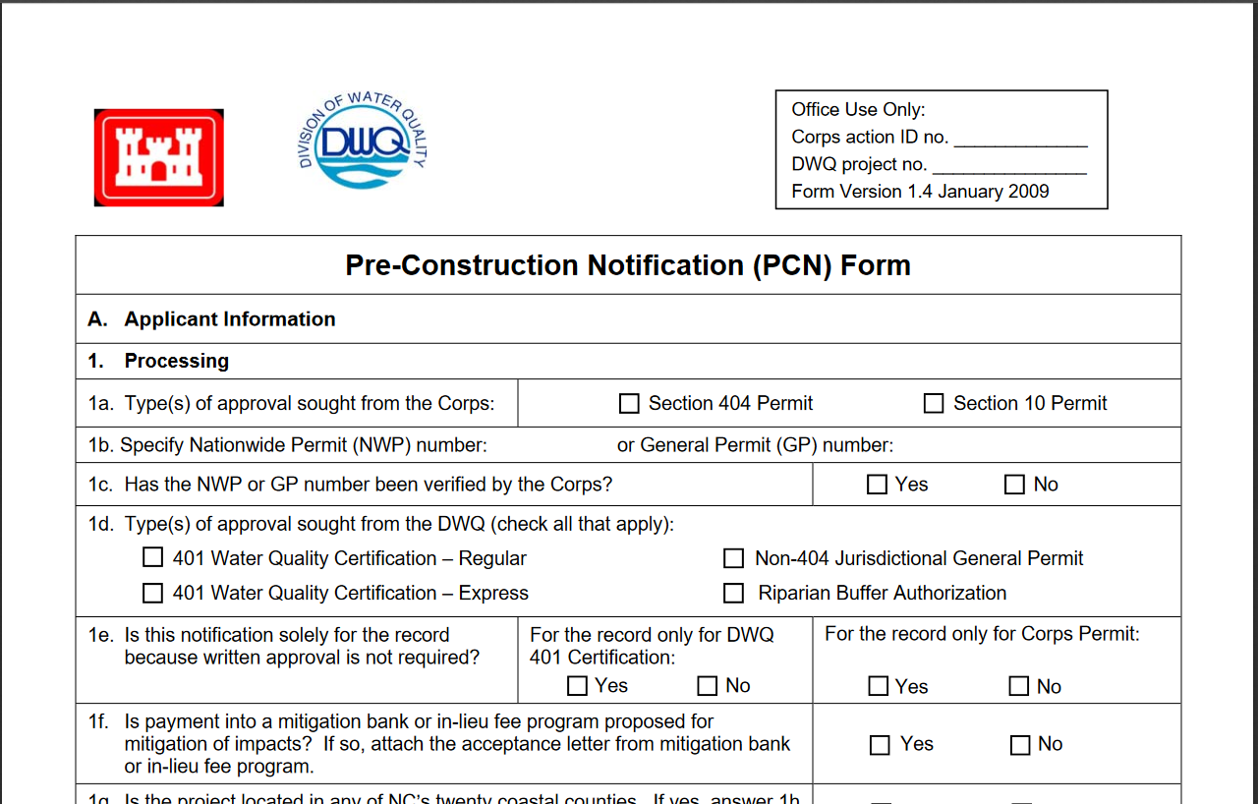
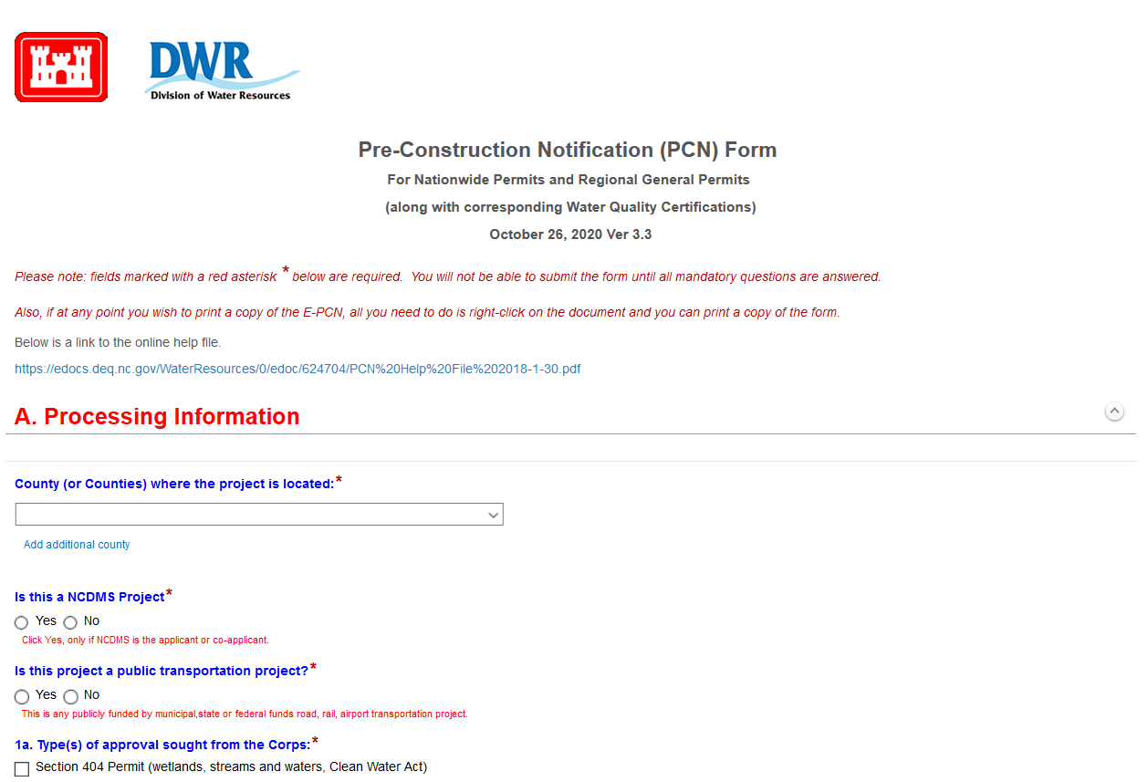
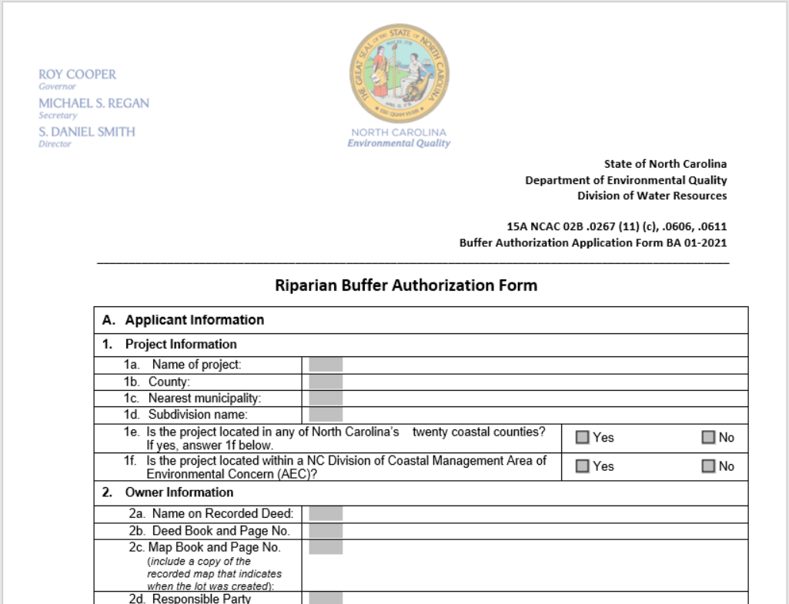
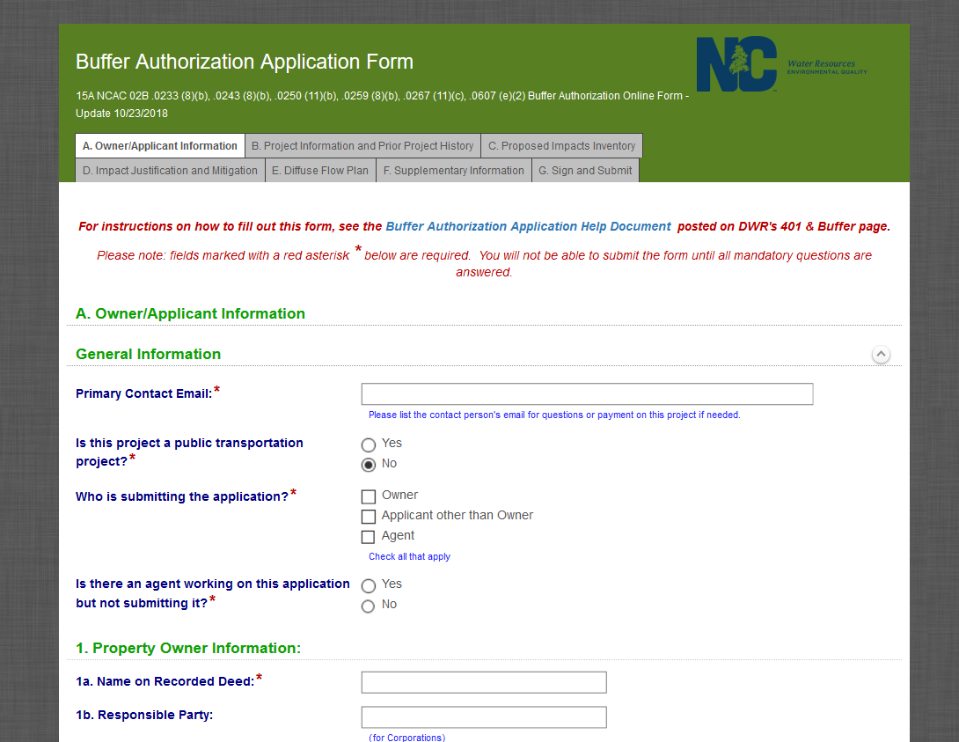
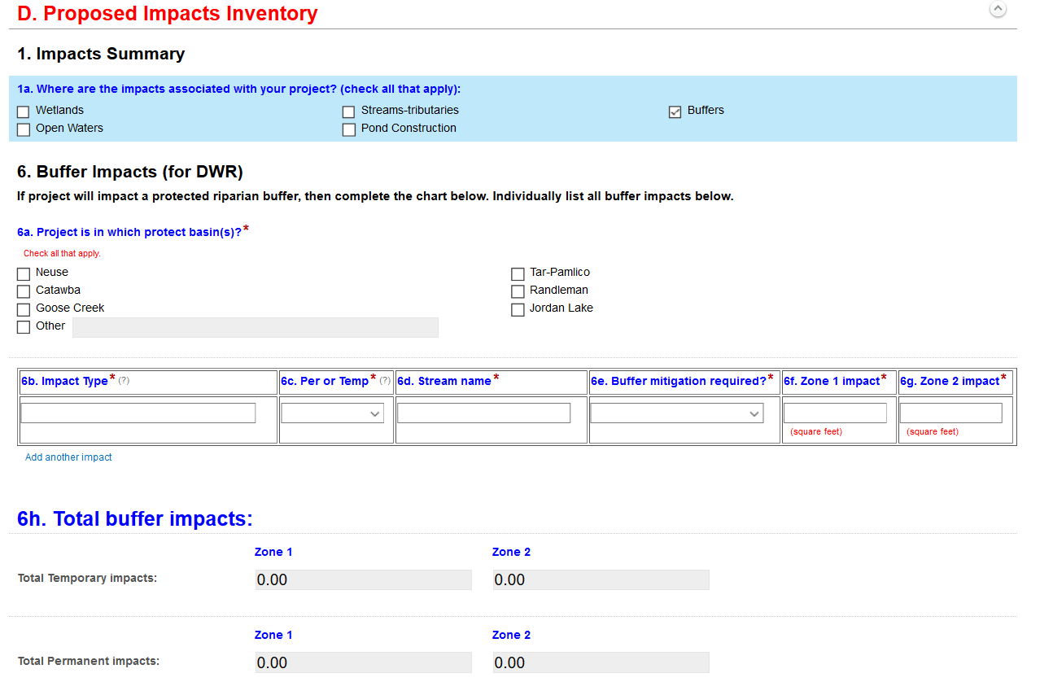
Submitting projects that Require a Buffer Authorization
Paper Form
Online Form
Paper Form
Online Form

Slide 7
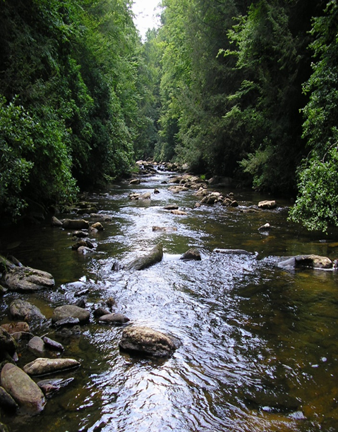
Buffer Authorization – Application Components in 15A NCAC 02B .0611(b)(1)
Contact and legal Information
The nature of the activity to be conducted
The location of the activity
A map and detail sheets
A detailed avoidance and minimization discussion
Plans for Best Management Practices
Mitigation Proposal (if applicable)
Notes:
Contact/Legal – property deed info, agent authorization, etc.
The nature of the activity to be conducted by the applicant;
The location of the activity, including the jurisdiction;
A map that is legible to the reviewer and of sufficient detail to delineate the boundaries of the land to be utilized in carrying out the activity, the location and dimensions of any disturbance in riparian buffers associated with the activity, and the extent of riparian buffers on the land;
An explanation of why this plan for the activity cannot be practically accomplished, reduced, relocated, or reconfigured to avoid or better minimize disturbance to the riparian buffer, preserve aquatic life and habitat, and protect water quality;
Plans for any best management practices proposed to be used to control the impacts associated with the activity; and
For uses designated as allowable with mitigation upon authorization or allowable with exception, a mitigation proposal in accordance with Rule .0295

Slide 8
Buffer Authorization – Review: Main Focus
Review procedures in state Rule at 15A NCAC 02B .0611
In submittal, applicant shall demonstrate:
The basic project purpose cannot be practically accomplished in a manner that would better minimize disturbance, preserve aquatic life and habitat, and protect water quality.
The use cannot practically be reduced in size or density, reconfigured or redesigned to better minimize disturbance, preserve aquatic life and habitat, and protect water quality.
Best management practices shall be used if necessary to minimize disturbance, preserve aquatic life and habitat, and protect water quality
DWR/Local government shall review to demine these criteria are met

Slide 9
Buffer Authorization - Timeline
DWR/Local Governments have 60 days to review application and take action
Issue an Authorization in writing
Notify Applicant of incomplete application and request more information
Deny request
Failure to take any action within 60 days is considered automatic approval unless one of the following:
Applicant agrees to an extended timeline in writing
Applicant fails to furnish necessary information
Applicant refuses to provide Authority staff access to records or site
Necessary information is unavailable
Notes:
Issue authorization in writing
Add Info – Additional Information request letter

Slide 10
Buffer Authorization – Review What to look for
Are all streams shown?
Compare to USGS and Soil Survey maps or Stream or Buffer determinations
Are streams shown as straight lines?
Do crossings occur at fairly straight stream segments?
Are provisions shown to ensure that stormwater runoff through the buffer meets one of the criteria of the rule?
Are all buffer impacts/uses accounted for?
Utility impacts
Sediment and Erosion control impacts
Temporary impacts
Allowances for SMP outlets
Are provisions for Mitigation included if applicable?

Slide 11
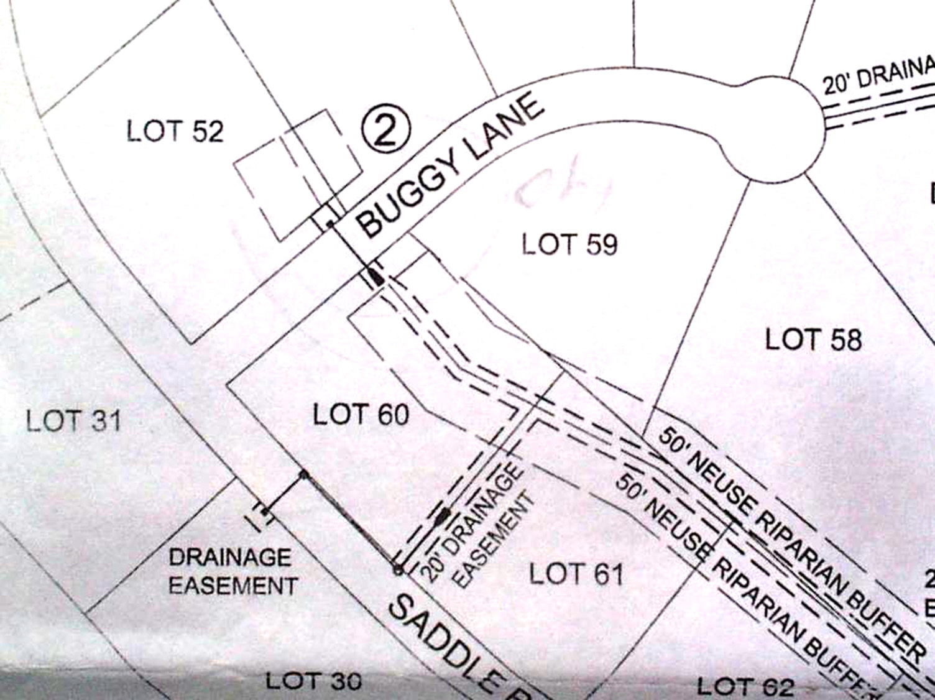
Buffer Authorization – Review Exhibit Details

Slide 12
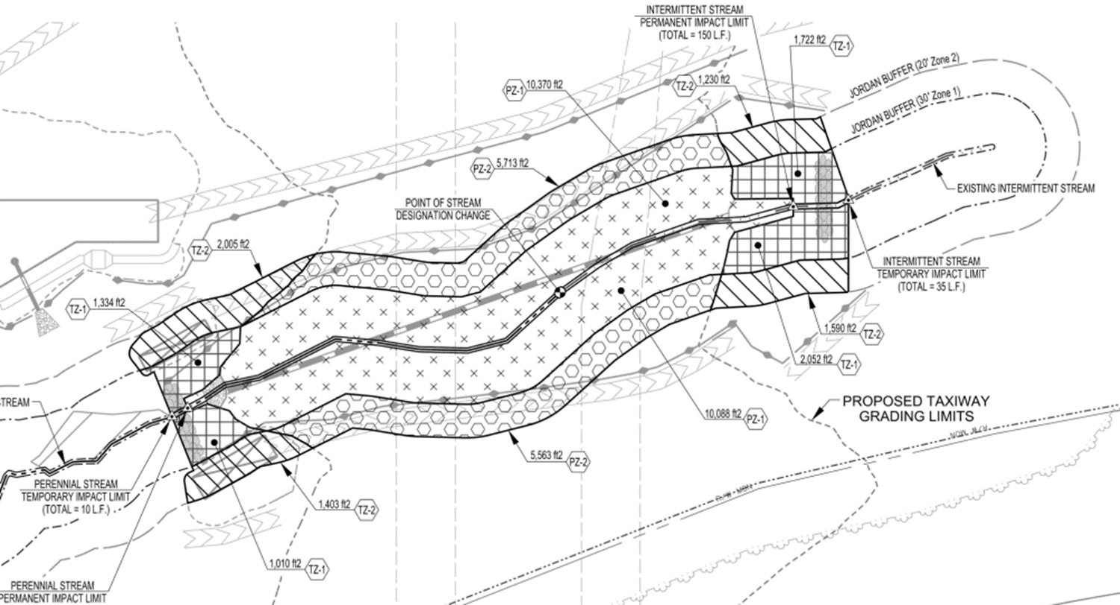
Buffer Authorization – Review Exhibit Details

Slide 13
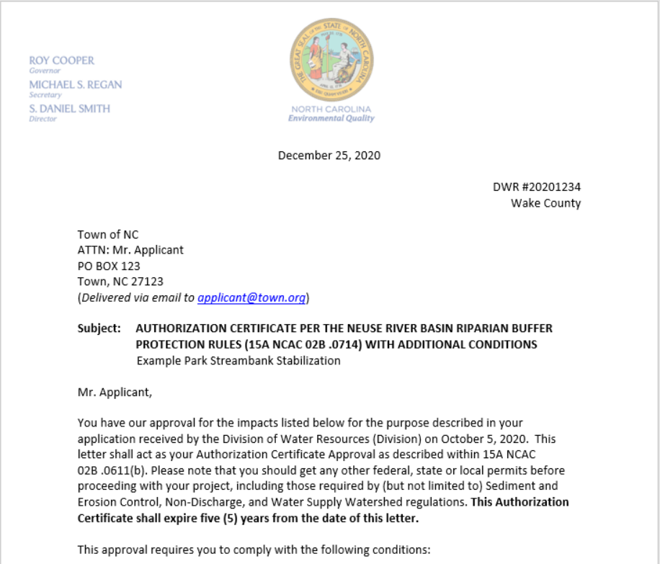
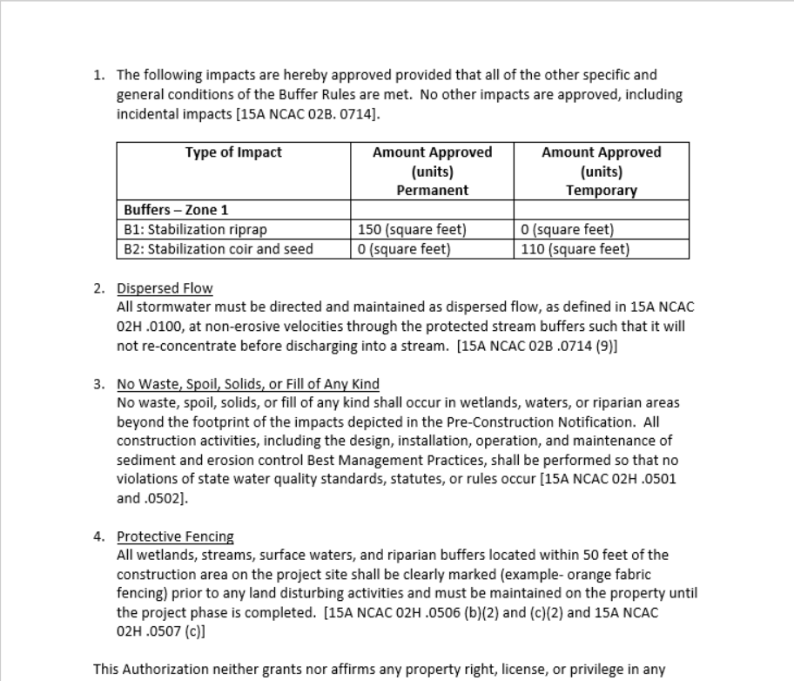
Buffer Authorization - Issuance
DWR/Local government shall issue an Authorization in writing.
DWR/Local government may attach additional conditions to the approval that support the purpose and intent of the buffer protection program
Measures to ensure dispersed flow or stormwater BMP
Mitigation requirements
Restoration of temporarily disturbed area

Slide 14
Appeals of Authorizations / Denials
Appeals of DWR issued Authorizations go to the Office of Administrative Hearing (OAH)
Appeals of Local government issued Authorizations go to the Director of DWR
Director’s decision can be appealed through OAH
Notes:
Appeals must be filed within 60 days. Requirements for filing a Petition are set forth in Chapter 150B of the North Carolina General Statutes and Title 26 of the North Carolina Administrative Code.

Slide 15
Allowable Upon Exception
Applicants may consider applying for an exception for activities that are not listed in the Table of Uses
Exceptions are meant to be for unique and rare situations where there are no other reasonable options
Must meet specific criteria (hardships) that are more stringent than for buffer authorizations
Major Exception > 1/3 acre of buffer impacts
Requires 30-day public notice by DWR
Minor Exception <= 1/3 acre of buffer impacts
Reviewed/approved by Authority
Notes:
Still using major variance form

Slide 16
Criteria / Findings of Fact
Practical difficulties or unnecessary hardships that prevent compliance with the rule
Can secure no reasonable return from, nor make reasonable use of their property. Greater profit not considered adequate justification. Must minimal deviation from rule.
Hardship is due to the physical nature of the property
Applicant did not cause the hardship by violating this Rule
Authorization would be consistent with general spirit, purpose and intent of the rules, will protect water quality, will secure public safety and will preserve substantial justice
Notes:
Authority required to determine if Must minimal deviation from rule that makes reasonable use of the property
Physical nature of property such as SIZE, SHAPE, TOPOGRAPHY
Applicant did not cause the hardship by knowingly or unknowingly violating this Rule

Slide 17
Variances
For Prohibited Activities
Variances issued by the Environmental Management Commission
Very stringent procedure

Slide 18
Buffer Rules Comparisons Table
 | Neuse and Tar-Pam | Randleman | Jordan | Goose Creek | Catawba
Purpose | Protect and Preserve existing riparian buffers to maintain nutrient removal functions | Protect and Preserve existing riparian buffers to protect water supply use of Randleman Lake and other designated water supplies in Randleman watershed | Protect and Preserve existing riparian buffers to maintain nutrient removal functions Protect water supply of Jordan Reservoir | Sustain and recover Federally endangered Carolina Heelsplitter | Protect and preserve existing riparian buffers to maintain nutrient removal functions by protecting water quality of lakes and connecting river segments
Implementation | DWR Voluntarily delegated local governments | Local governments except for specific activates in rule | Local governments DWR throughout rest of watershed and specific activates in rule | DWR Voluntarily delegated local governments | DWR Voluntarily delegated local governments
Applicability | Intermittent and Perennial streams as shown on USGS Topo or Printed Soil Survey Map | Intermittent and Perennial streams as shown on USGS Topo or Printed Soil Survey Map Or as found by site specific evidence Ditches that deliver untreated runoff and are directly connected to intermittent or perineal streams | Intermittent and Perennial streams as shown on USGS Topo or Printed Soil Survey Map | Intermittent and Perennial streams as shown on USGS Topo or Printed Soil Survey Map | Catawaba River mainstem below Lake James and along mainstem lakes in Catawba River Basin

Slide 19
Buffer Rules Comparisons Table (continued)
 | Neuse and Tar-Pam | Randleman | Jordan | Goose Creek | Catawba
Zones | Zone 1 = 30 feet Zone 2 = 20 feet | Zone 1 = 30 feet Zone 2 = 20 feet | Zone 1 = 30 feet Zone 2 = 20 feet | Within 100-year Flood Plain = 200 feet Outside of 100 year Flood Plain = 100 feet | Zone 1 = 30 feet Zone 2 = 20 feet
Mitigation | Zone 1 = 3:1 Zone 2 = 1.5:1 | Zone 1 = 3:1 Zone 2 = 1.5:1 | Zone 1 = 3:1 Zone 2 = 1.5:1 | 3:1 for entire buffer | Zone 1 = 2:1 Zone 2 = 1.5:1

