Slide 1
Buffer Ordinance Compliance and Issues
Niki Maher
401 & Buffer Permitting Branch
Division of Water Resources
2021

Slide 2
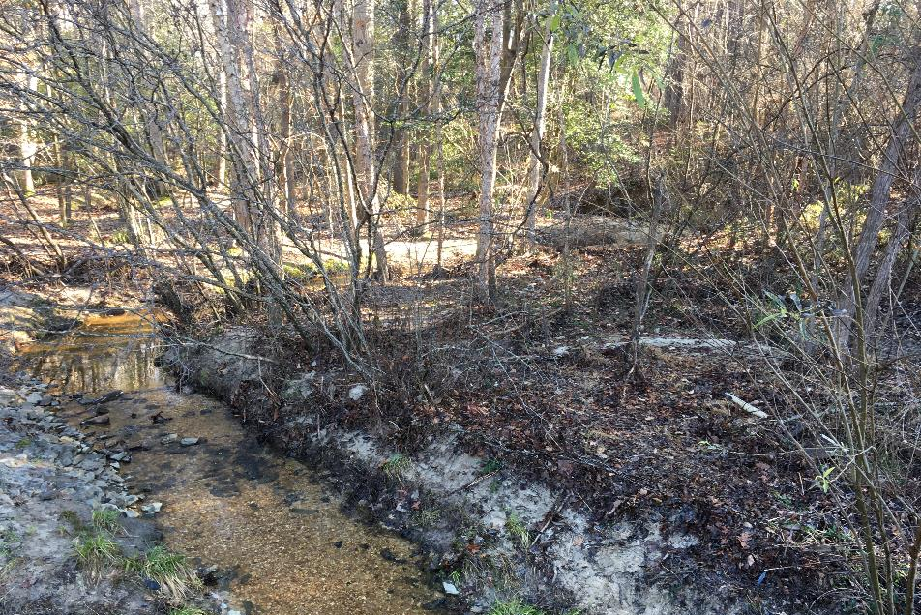
Presentation Outline
Buffer Program Authorities
Ordinance Review Requirements
Common Issues
Violation Examples

Slide 3
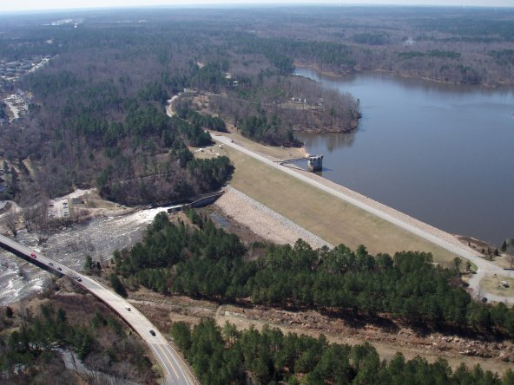
Buffer Program Authorities
Delegated Local Government
  Delegation required information and procedures are listed within each rule
  Local Government (LG) requests the Delegation from the EMC
  LG requests presented to EMC by DWR staff with recommendation
  EMC issues or denies the delegation
Designated by Rule
  Randleman – LGs implement within Water Supply Watersheds
  Jordan Lake Watershed – LGs implement within Watershed
Notes:
Division shall implement applicable requirements to the exclusion of local governments:
(a) Activities conducted under the authority of the State.
(b) Activities conducted under the authority of the United States.
(c) Activities conducted under the authority of multiple jurisdictions.
(d) Activities conducted under the authority of local units of government.
(e) Forest harvesting activities described in Item (14) of this Rule.
(f) Agricultural activities.
(g) Activities conducted in a location where there is no local government program implementing NPDES stormwater requirements, Water Supply Watershed requirements, or a voluntary local stormwater or buffer initiative at the time of the activity.

Slide 4
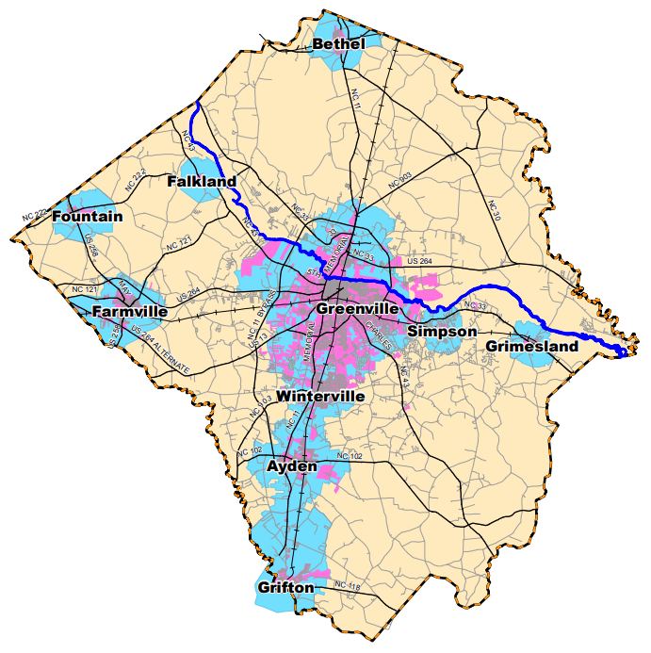
Buffer Program Authorities
DWR still has jurisdiction in certain areas or with certain activities
  State, Federal projects
  Multiple jurisdictions
  LG owned projects
  Forestry or Agriculture
  Areas beyond Local Program jurisdiction
Notes:
Division shall implement applicable requirements to the exclusion of local governments:
(a) Activities conducted under the authority of the State.
(b) Activities conducted under the authority of the United States.
(c) Activities conducted under the authority of multiple jurisdictions.
(d) Activities conducted under the authority of local units of government.
(e) Forest harvesting activities described in Item (14) of this Rule.
(f) Agricultural activities.
(g) Activities conducted in a location where there is no local government program implementing NPDES stormwater requirements, Water Supply Watershed requirements, or a voluntary local stormwater or buffer initiative at the time of the activity.

Slide 5

Ordinance Development and Updates
Buffer Program Ordinance
  Model Ordinance examples on website
    Outdated, but can use structure, format
  Where does the Buffer Ordinance Live?
    Within Unified Development Ord?
    Within Stormwater Ord?
    Within Water Supply Ord?
    Separate Buffer Ord?
    Up to you, as long as the Buffer Rule requirements are met

Slide 6
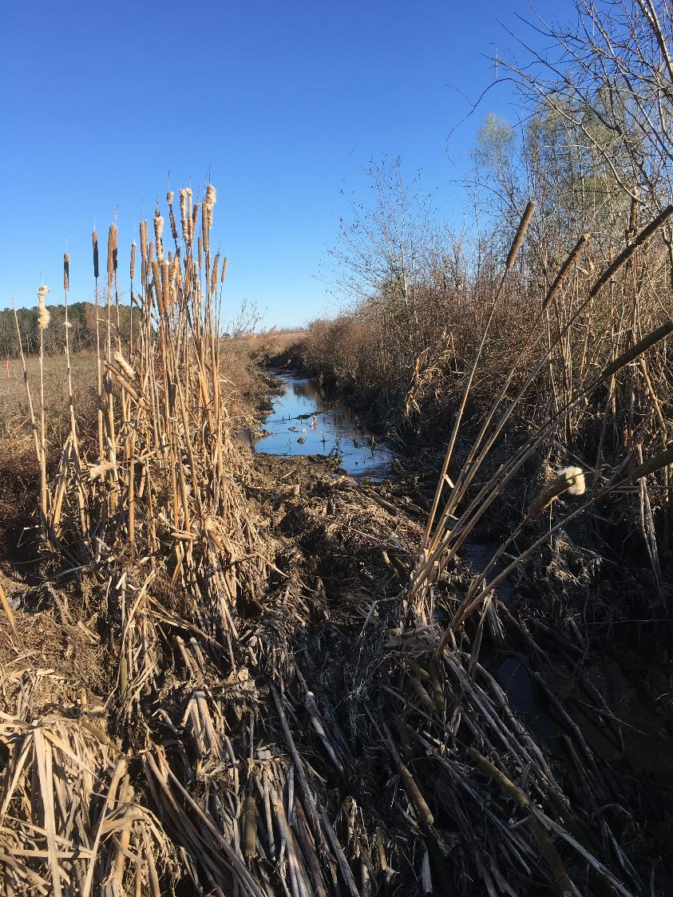
Ordinance Development and Updates
Updated Ordinances must be submitted to DWR for approval
  (Updated Buffer Rules!)
  Suggest that you submit to DWR before Local approval in case changes are needed
May also need approval from DEMLR (Division of Mineral & Land Resources)
  If included within Stormwater or Water Supply Ordinance

Slide 7
Buffer Program Audits
DWR is required to conduct audits of the Delegated/Designated Buffer programs - *some things we look for*
*Riparian Buffer Administrator | *Trained Staff | *Ordinance must at least meet the buffer rule requirement
*Buffer applicability, buffer widths, maps used | *Buffer Determinations and Letters – records | *Buffer Authorizations, exceptions, variances – Records
*Complaints, inspections, resolutions | *Notice of violations and Penalties issued | *How are buffer requirements incorporated in the development approval workflow
Inter-local agreements | Education & Outreach programs | Site Inspection if applicable
Notes:
(c) APPOINTMENT OF A RIPARIAN BUFFER PROTECTION ADMINISTRATOR. Upon receiving delegation, local governments shall appoint a Riparian Buffer Protection Administrator(s) who shall coordinate the implementation and enforcement of the program. The Administrator(s) shall attend an initial training session by the Division and be certified to make on-site determinations pursuant to G.S. 143-214.25A. The Administrator(s) shall ensure that local government staff working directly with the program receive training to understand, implement, and enforce the program and are certified to make on-site determinations pursuant to G.S. 143-214.25A. At any time that a local government does not have anyone on staff certified to make on-site determinations pursuant to G.S. 143-214.25A, it shall notify the Division within 30 calendar days and provide a proposed schedule to secure a certified staff member. The local government shall coordinate with the Division to provide on-site determinations until a new certified staff member is secured by the local government.

Slide 8
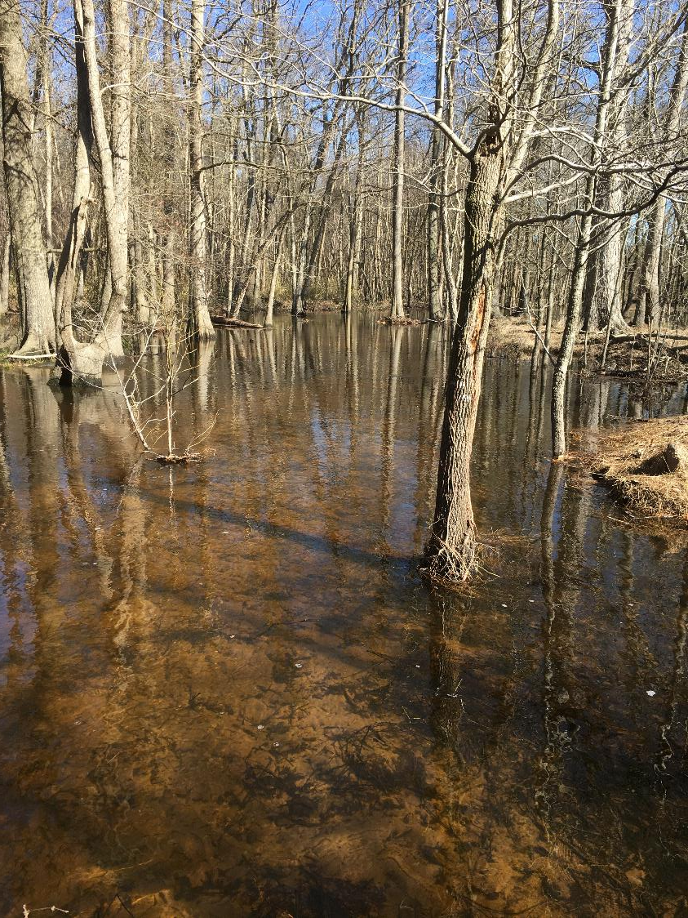
Common Issues and Violation Examples
Buffer Determinations
Buffer Authorizations
Mitigation requirements
Utility Easements
Road Construction
Shoreline Stabilization
Including buffers within lot boundaries
Agriculture, Forestry conversion
Common Violation Examples

Slide 9
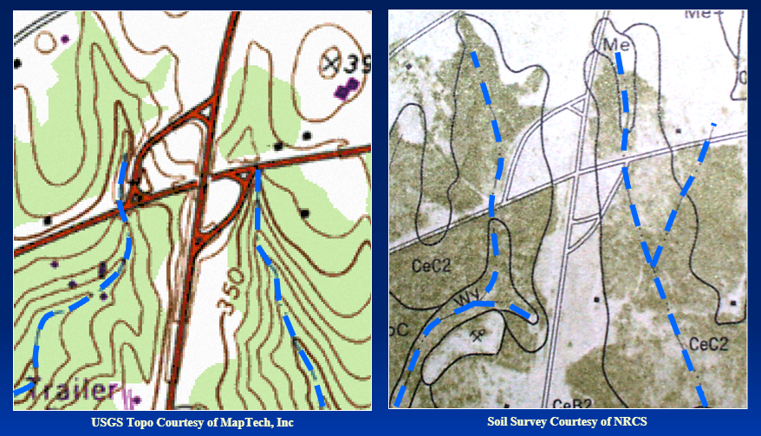
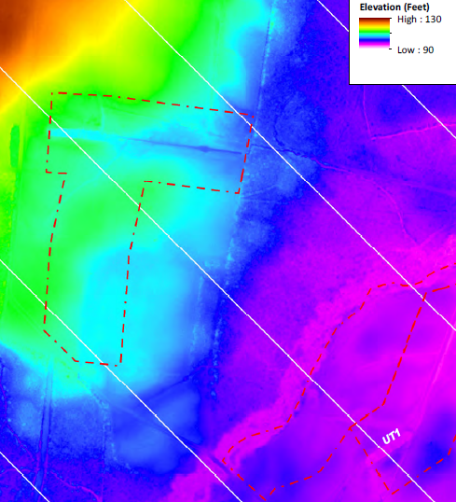
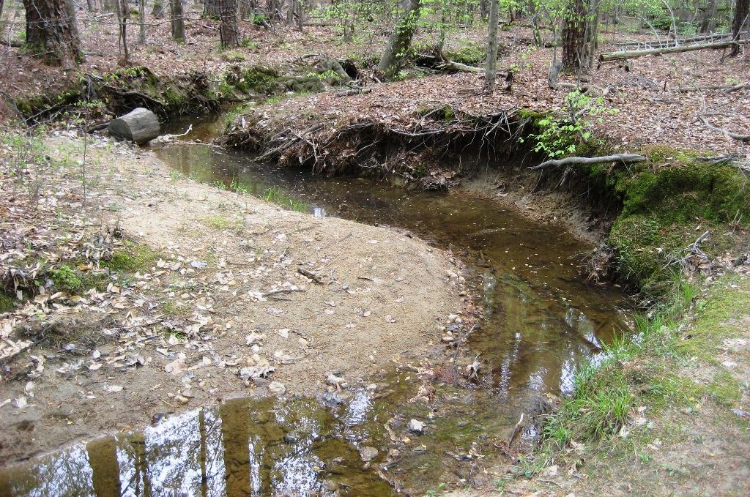
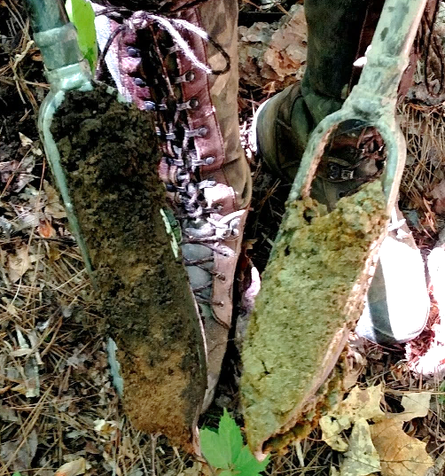
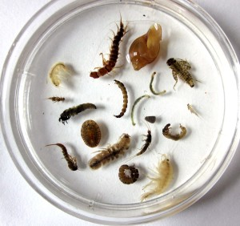
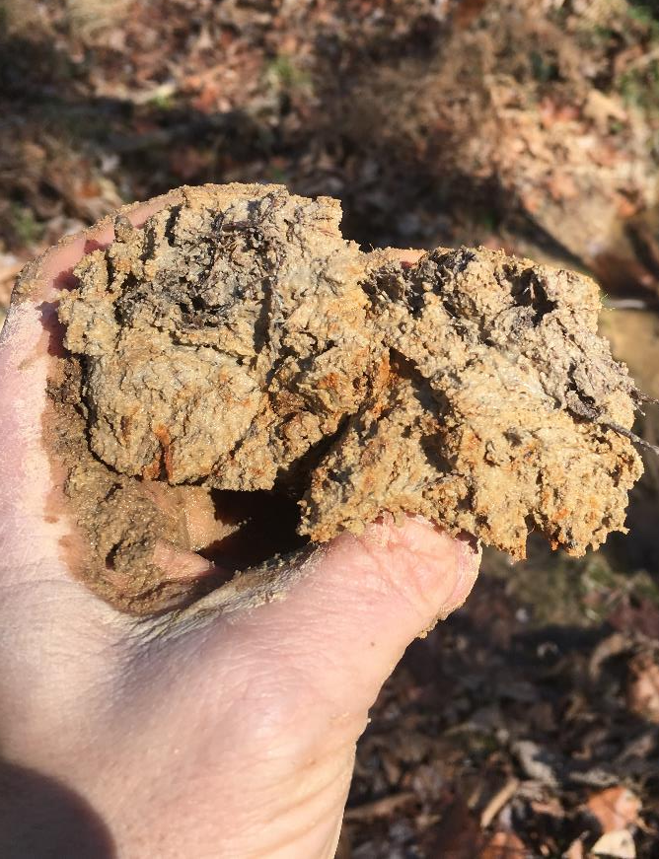
Buffer Determinations
  Only by Certified Staff
    (DWR, LGs, Forest Service-forestry only)
  Use the correct reference maps
  Conduct onsite determination
  Use the approved DWR Method for Identification of Intermittent & Perennial Streams v 4.11
Geomorphology
Hydrology
Biology
Photo: ©2007-2014 Community Science Institute

Slide 10
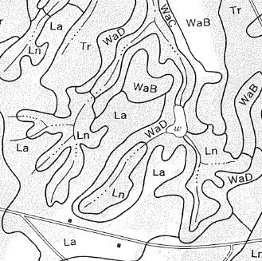
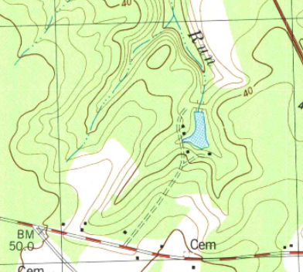
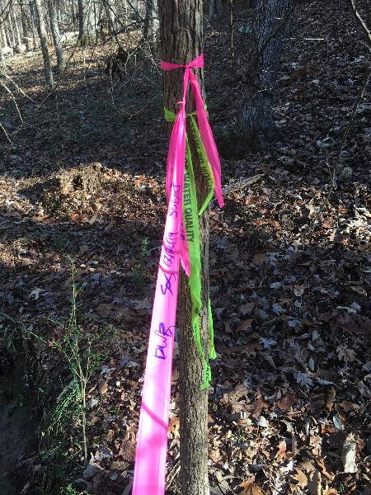
Buffer Determinations
  Make determination on all the mapped features on the property
  If mapped, its buffered unless field inspection determines otherwise
Notes:
Make determination on all the mapped features on the property
If mapped, its buffered unless field inspection determines otherwise
Indicate all mapped and observed features in letter
Include applicable maps
A recent aerial map is good reference for landowner

Slide 11
Buffer Determinations Letters
Should communicate this information
This determination only addresses the applicability to the buffer rules and does not approve any activity within buffers or within waters of the state.
There may be other streams or features located on the property that do not appear on the maps referenced above.
Any of the features on the site may be considered jurisdictional according to the US Army Corps of Engineers and subject to Section 404 and 401 of the Clean Water Act.
This determination shall expire five (5) years from the date of this letter.
Landowners or affected parties may appeal the determination, request must be made within sixty (60) calendar days of the date of this letter to the Director DWR in writing.
Send appeal to:
DWR 401 & Buffer Permitting Branch Supervisor 1617 Mail Service Center Raleigh, NC 27699-1617 | DWR 401 & Buffer Permitting Branch - Supervisor 512 N Salisbury St. Raleigh, NC 27604

Slide 12
Buffer Authorizations
Refer to the Table of Uses for categories and threshold requirements
  (deemed/exempt : allowable with authorization : mitigation required : prohibited)
  15A NCAC 02B .0614 Catawba River Basin Buffer Rule
  15A NCAC 02B .0714 Neuse River Basin Buffer Rule
  15A NCAC 02B .0734 Tar-Pamlico River Basin Buffer Rule
  15A NCAC 02B .0724 Randleman Lake Water Supply Watershed Buffer Rule
  15A NCAC 02B .0267 Jordan Lake Water Supply Watershed Buffer Rule
  15A NCAC 02B .0607 Goose Creek Watershed: Buffer Types & Managing Activities

Slide 13
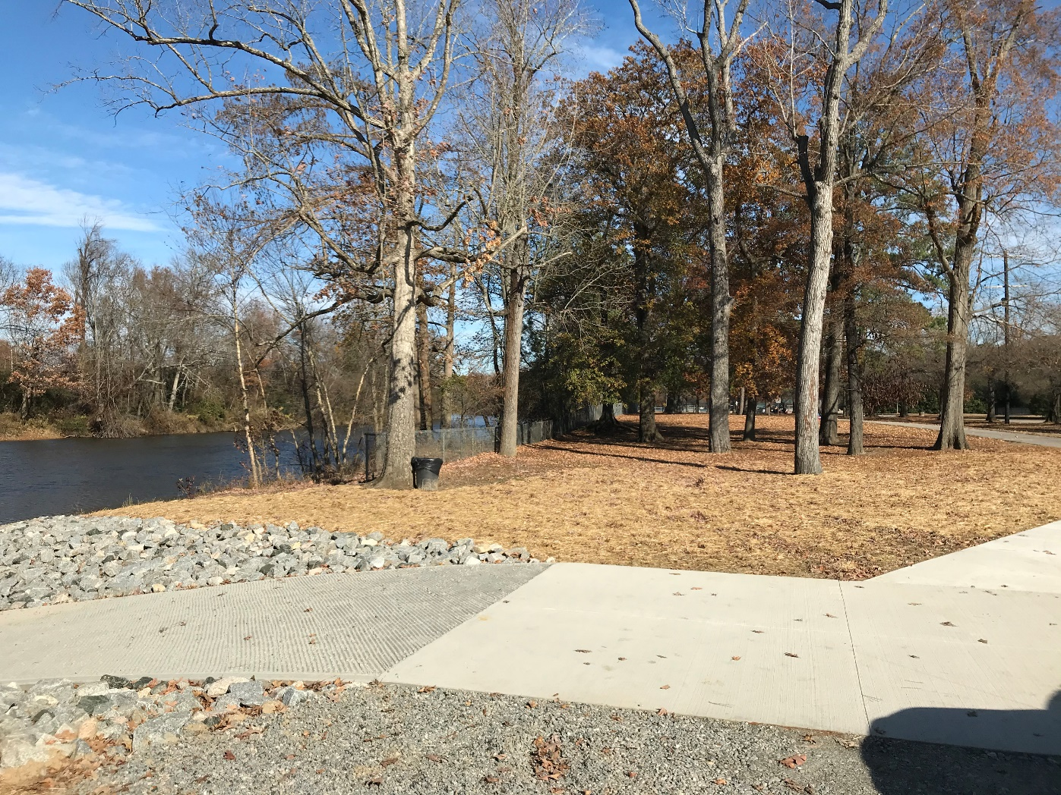
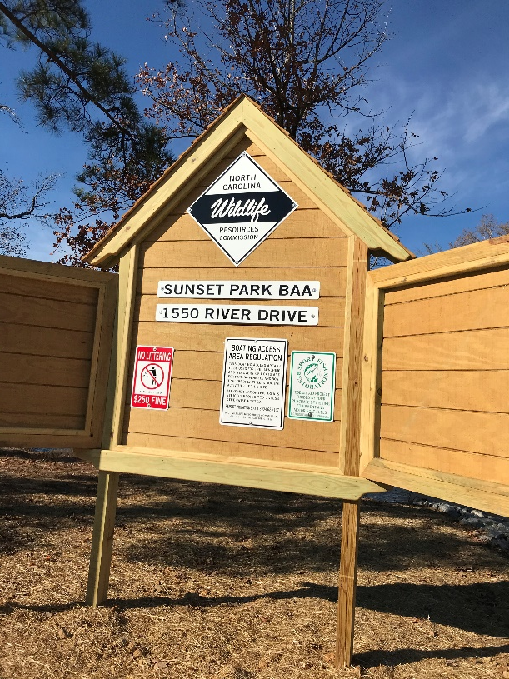
Buffer Authorizations
  Written Application may be needed, reviewed, issued
    15A NCAC 02B .0611 Buffers: Authorization Certificates
    15A NCAC 02B .0267 Jordan Lake Buffer Authorizations
  Review process includes:
    Purpose and Need
    Avoidance and Minimization
    Mitigation?
    Etc.
    Example: boat ramps

Slide 14
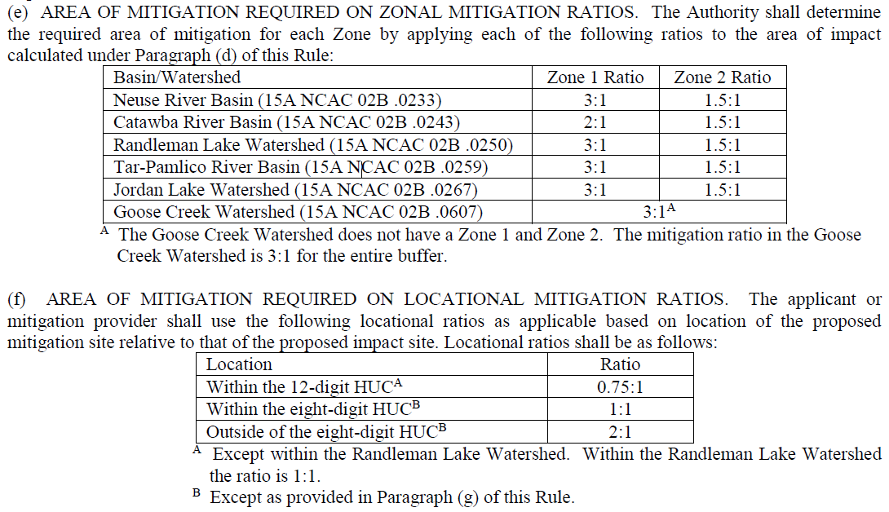
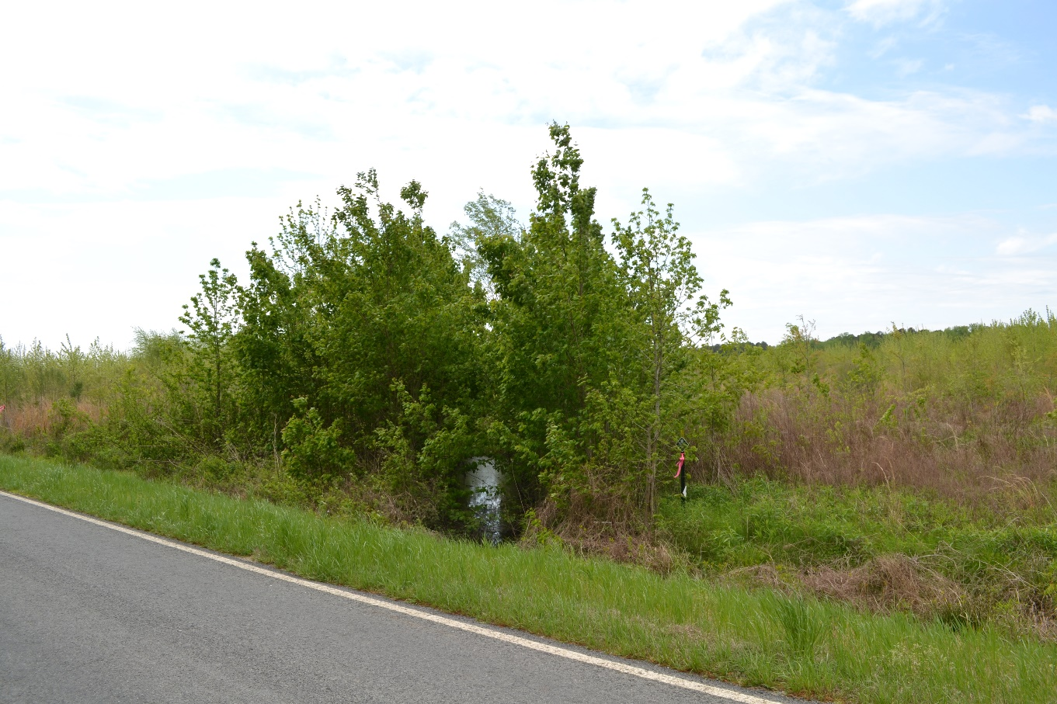
Mitigation
  If Mitigation is Triggered
  Refer to Consolidated Buffer Mitigation Rule 15A NCAC 02B .0295

Slide 15
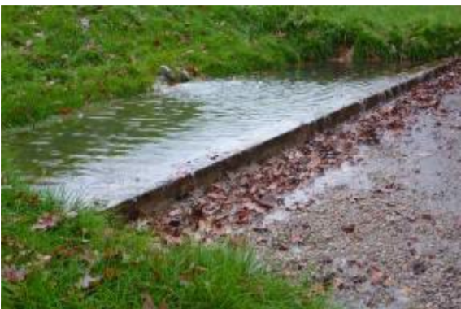
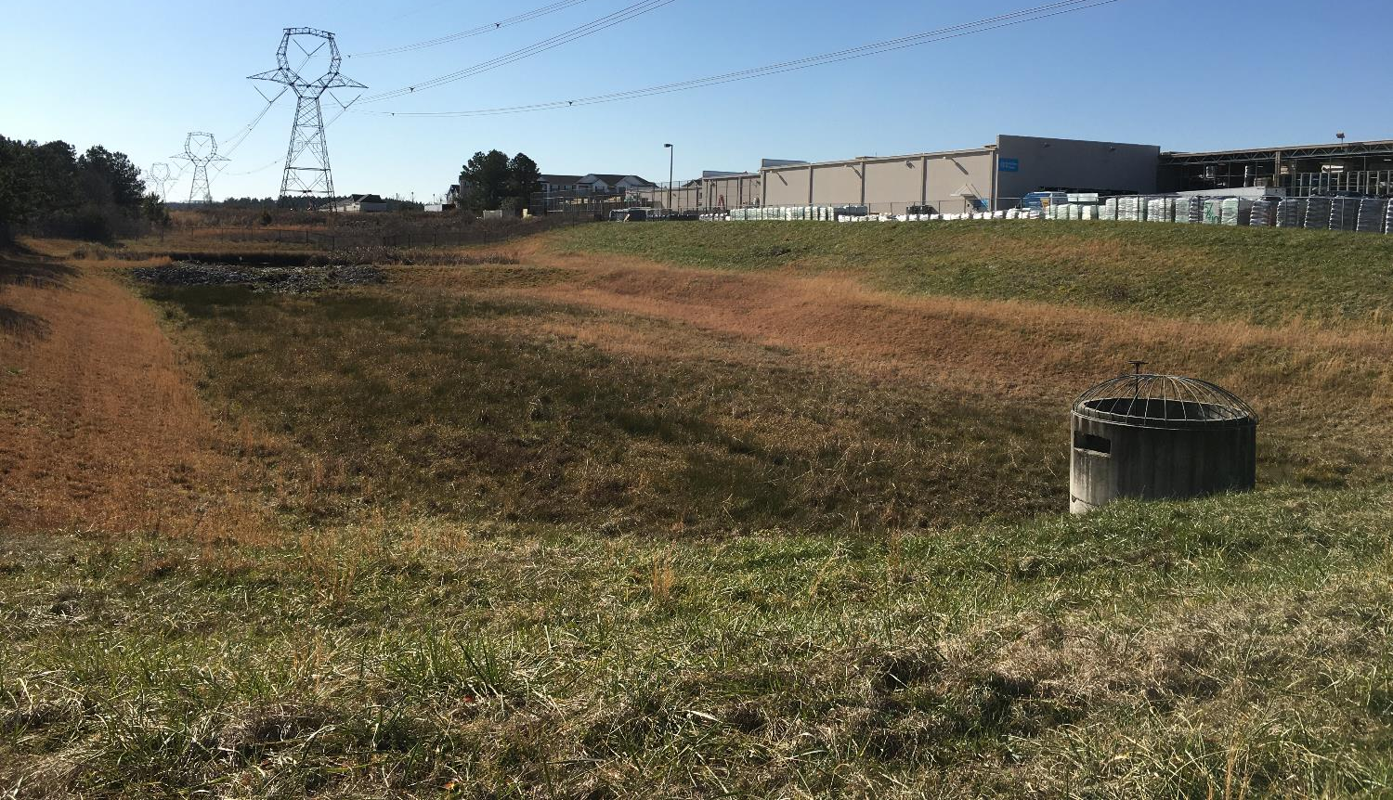
Dispersed or Diffuse Flow
  DISPERSED FLOW (15A NCAC 02B .0607, .0614, .0714, .0724, .0734)
    Stormwater runoff into the riparian buffer shall meet dispersed flow as defined in 15A NCAC 02H .1002. “Dispersed flow" means uniform shallow flow that is conveyed to a vegetated filter strip as defined in Rule .1059 of this Section, another vegetated area, or stormwater control measure (SCM). The purpose of "dispersed flow" is to remove pollutants through infiltration and settling, as well as to reduce erosion prior to stormwater reaching surface waters.
  DIFFUSE FLOW (15A NCAC 02B .0267 Jordan Buffer Only)
    Diffuse flow of runoff shall be maintained in the riparian buffer by dispersing concentrated flow prior to its entry into the buffer and reestablishing vegetation.

Slide 16
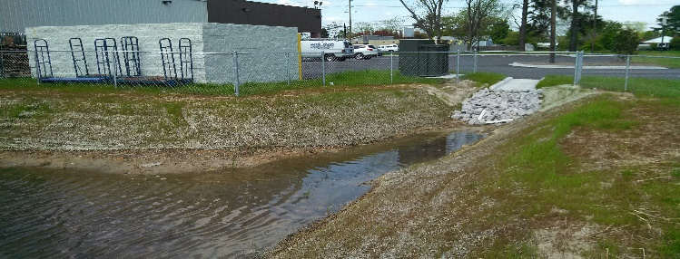
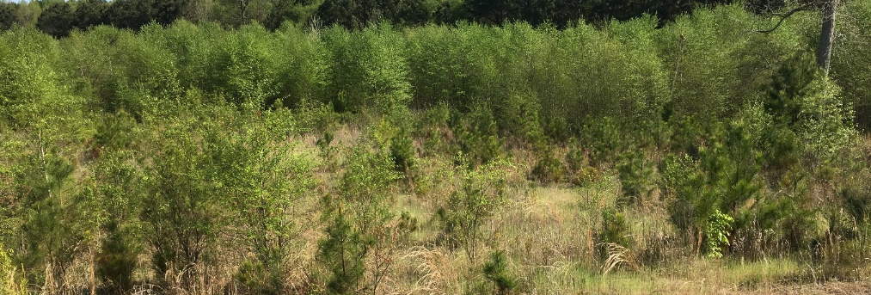
Stormwater Control Measures
SCMs can be used to obtain Dispersed Flow Requirements
SCMs are also used to reduce Pollutants or Nutrient Loading Rates (if required)
  If Nutrient Reduction cannot be fully met:
    Option to Purchase Nutrient Offset Credit pursuant 15A NCAC 02B .0703
    Shall provide proof of purchase to the LG prior to approval of the development plan

Slide 17
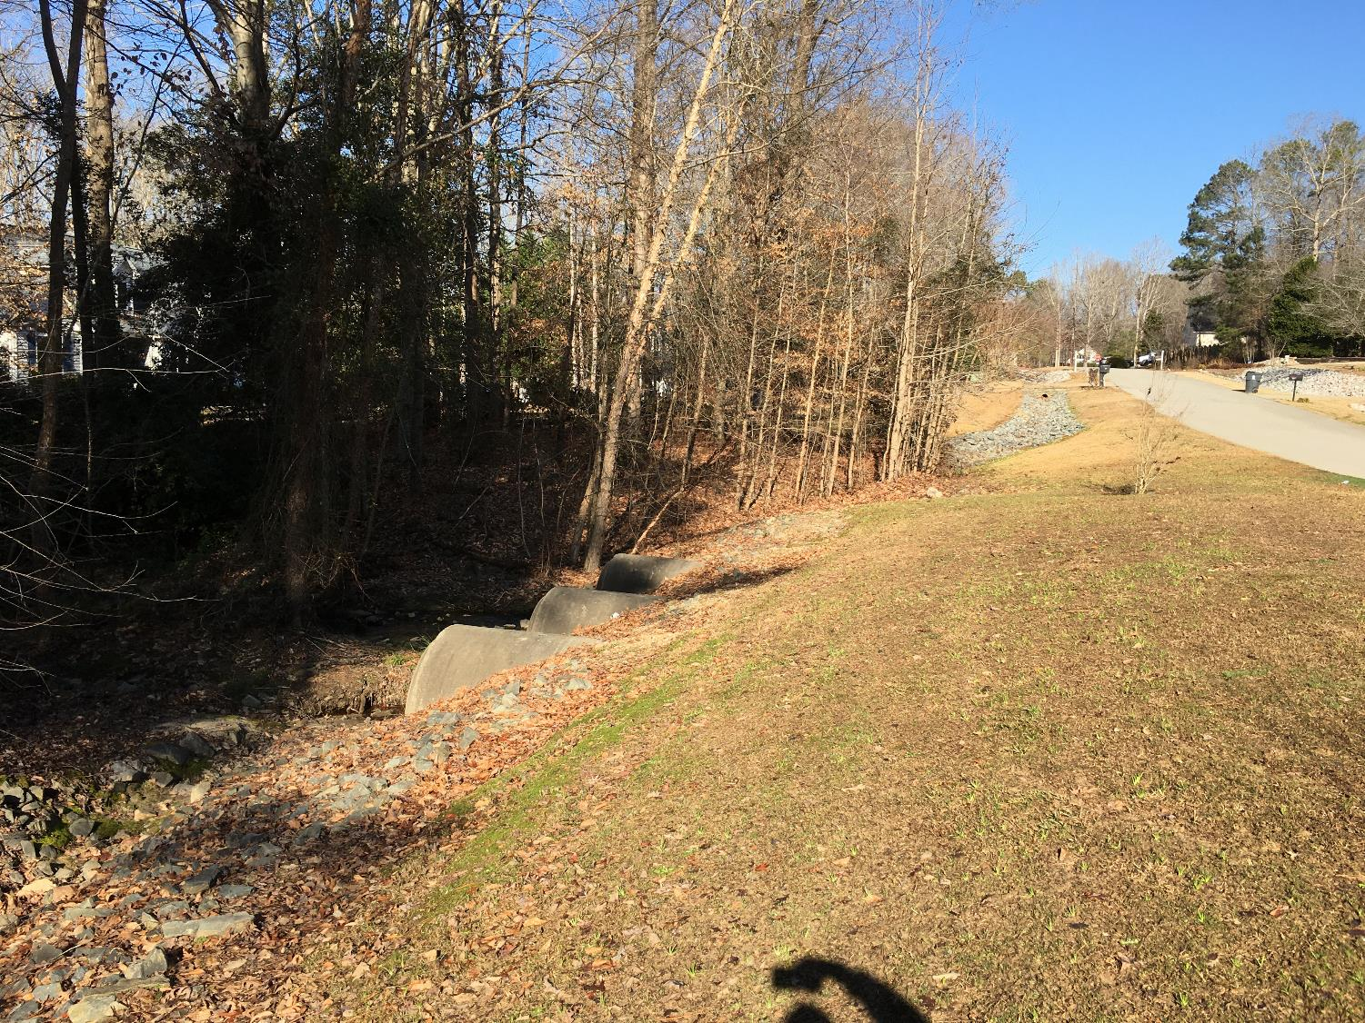
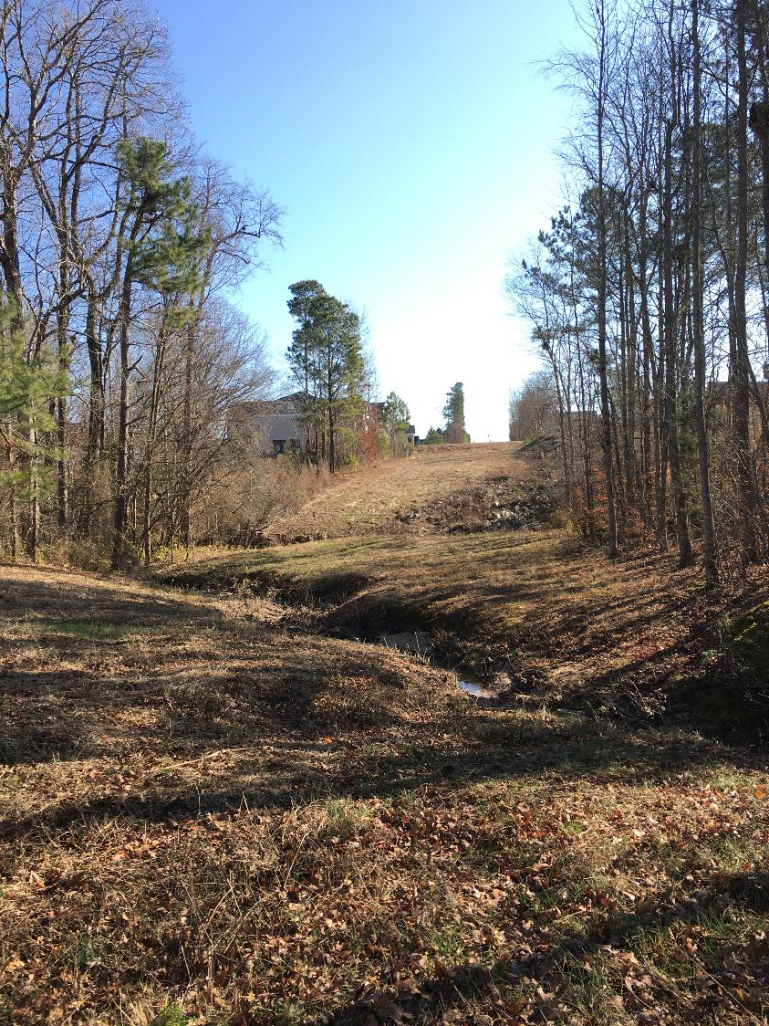
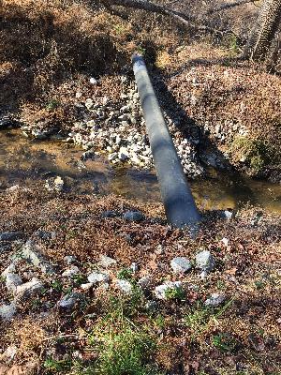
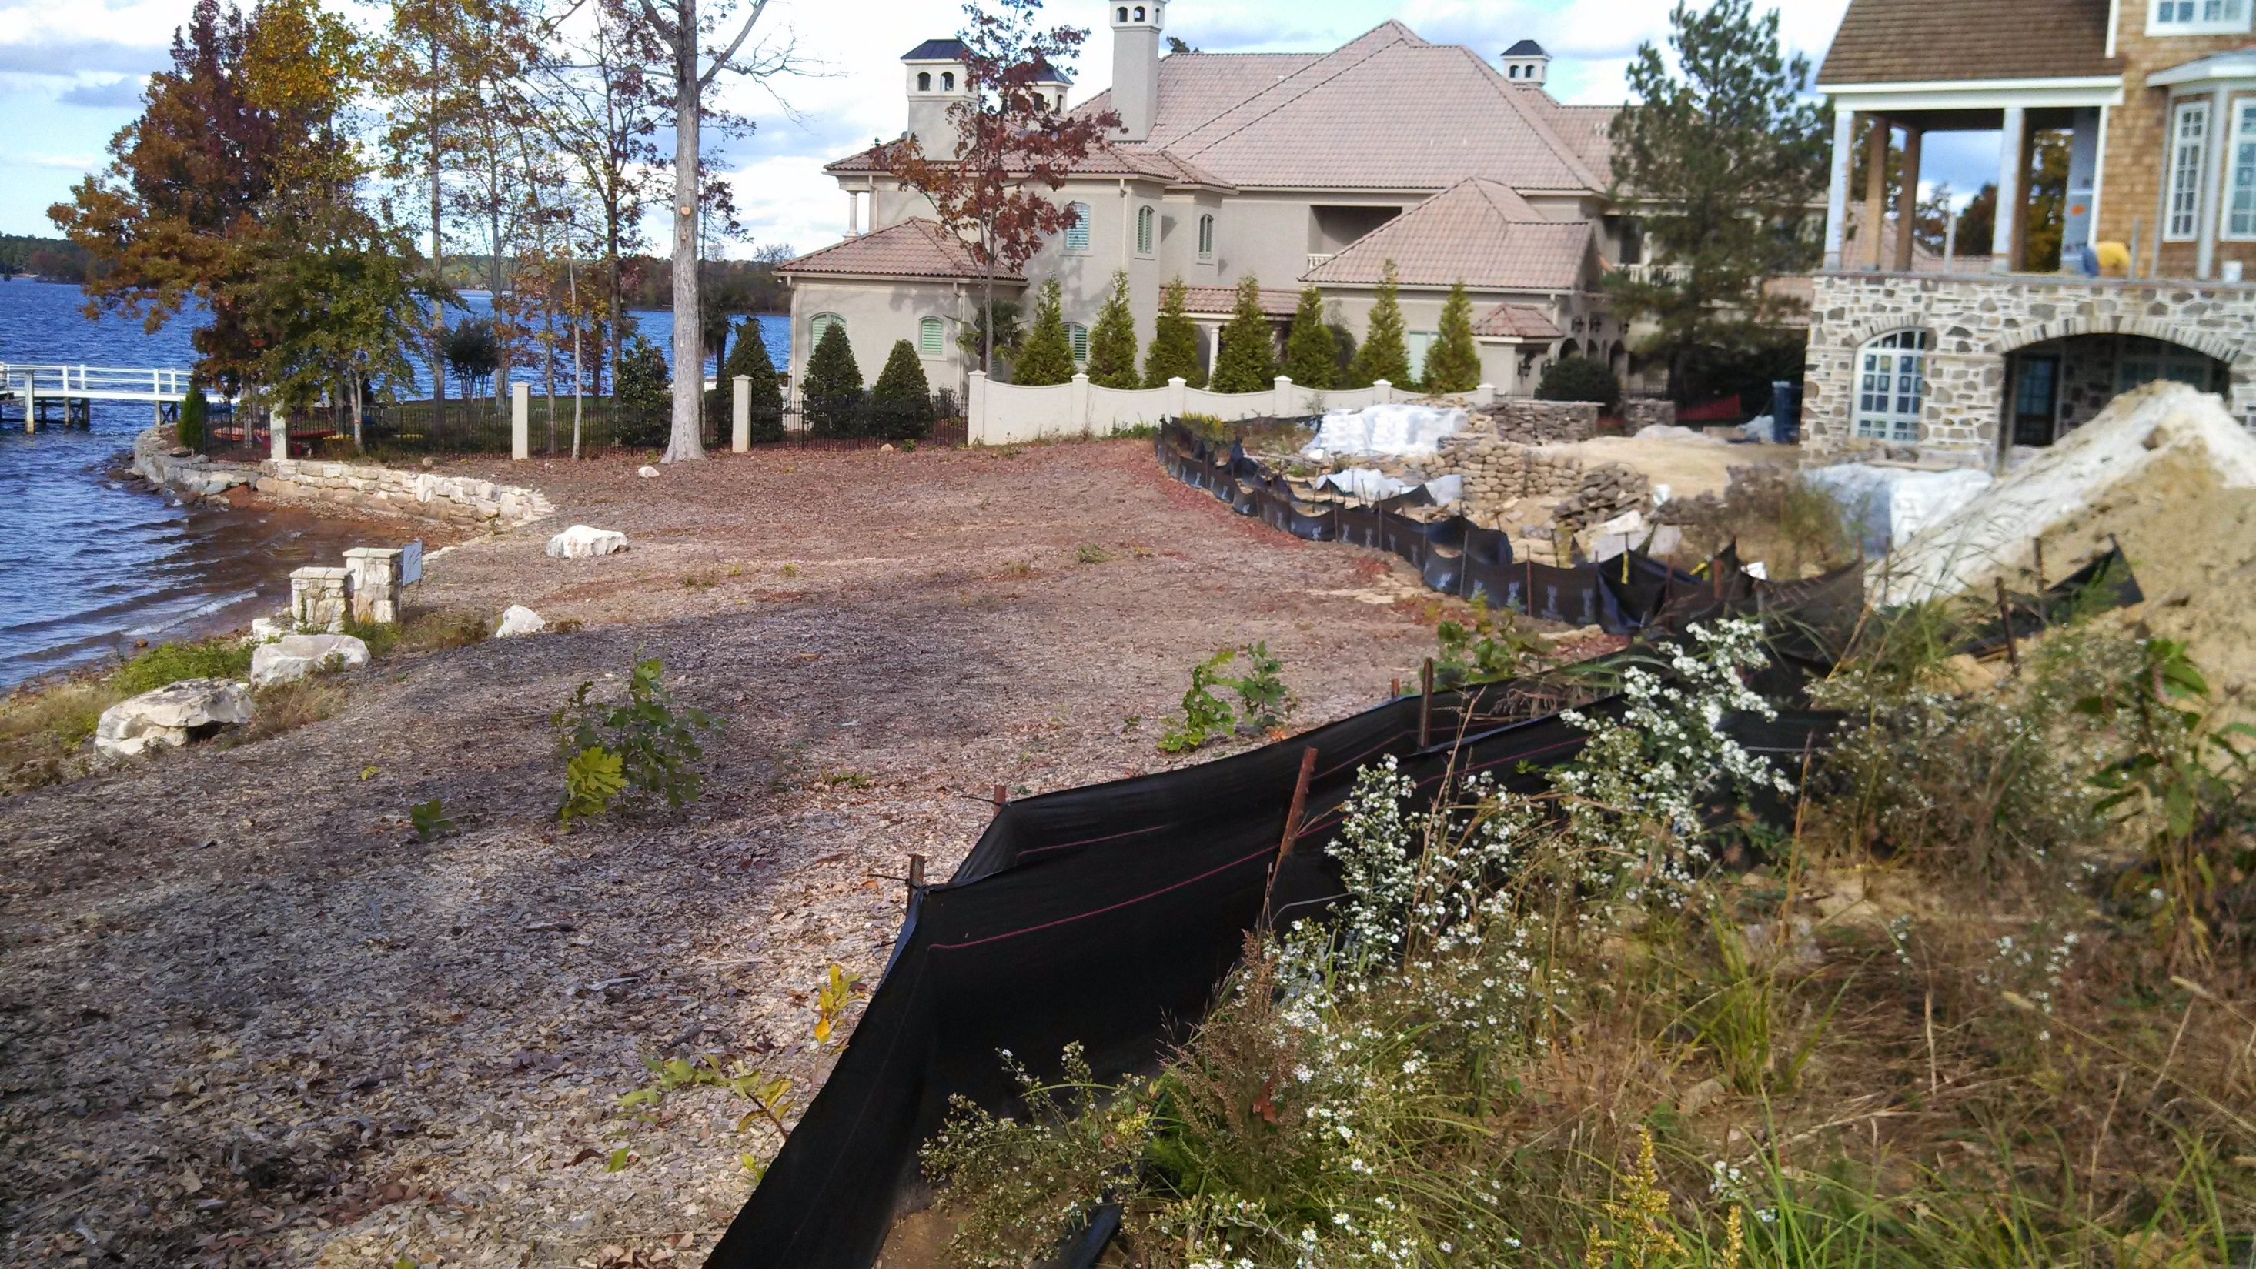
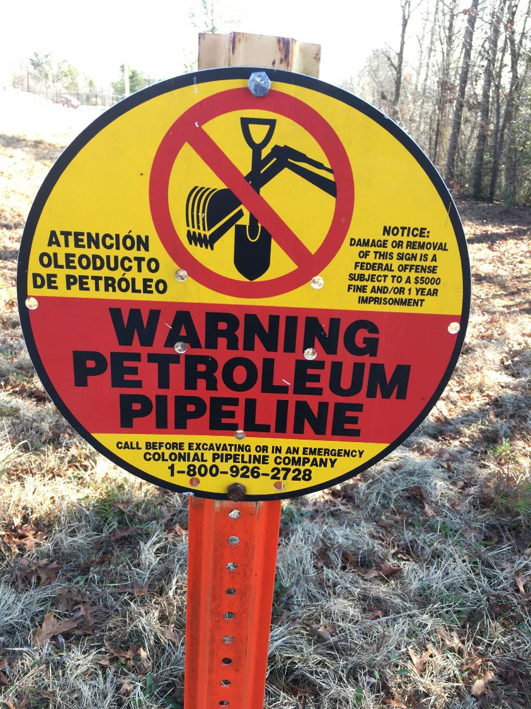
Common Site Issues

Slide 18
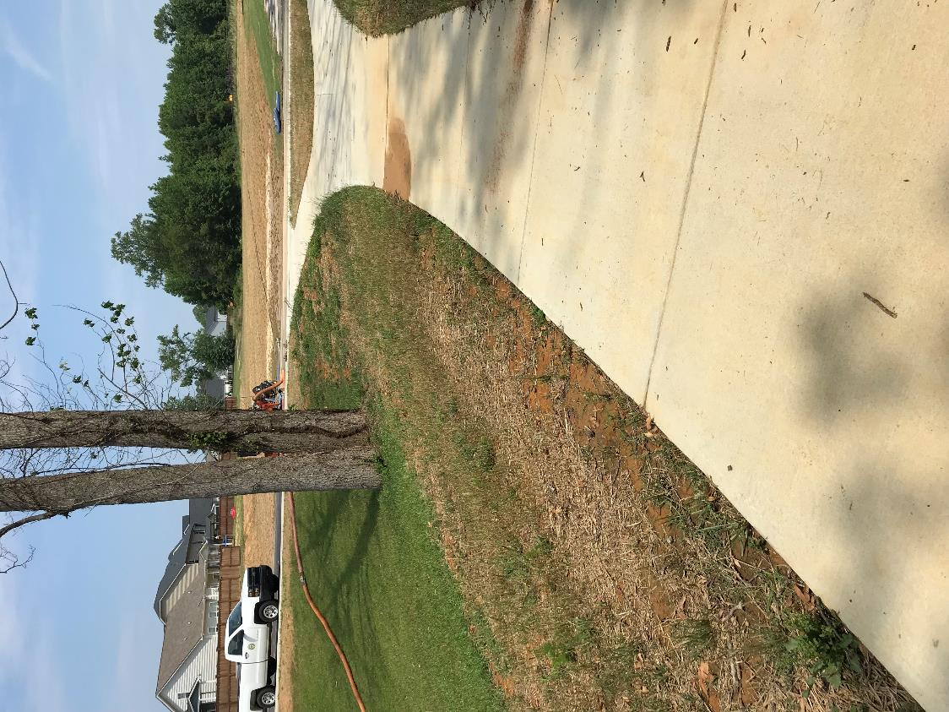
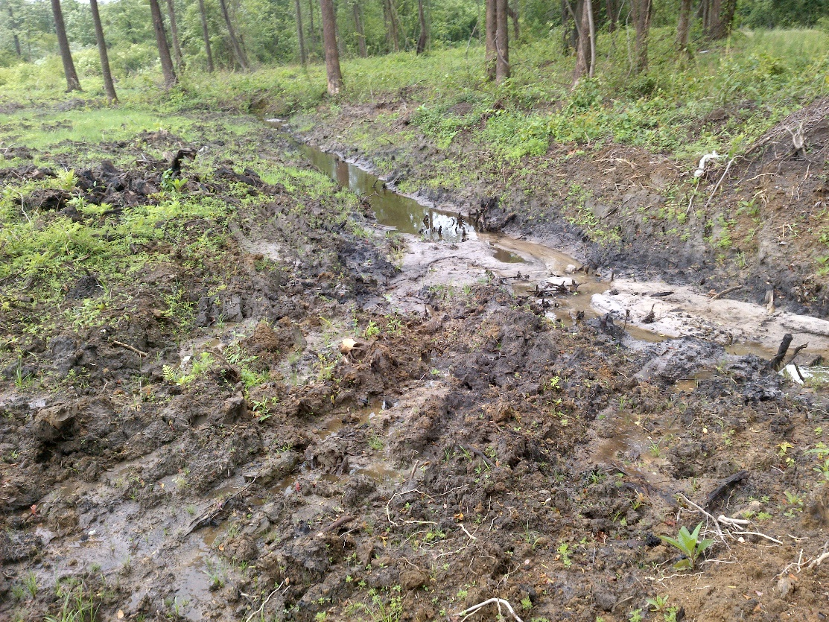
Common Issues
Zone 2 sidewalk

Slide 19
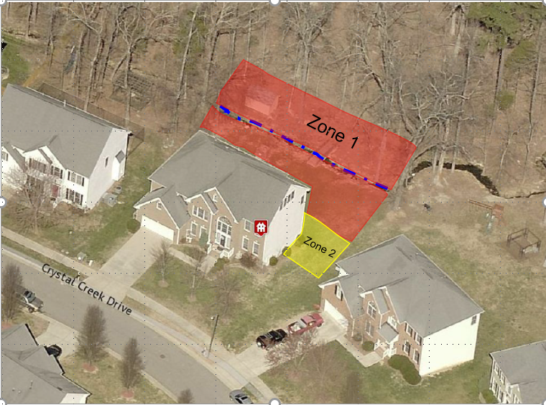
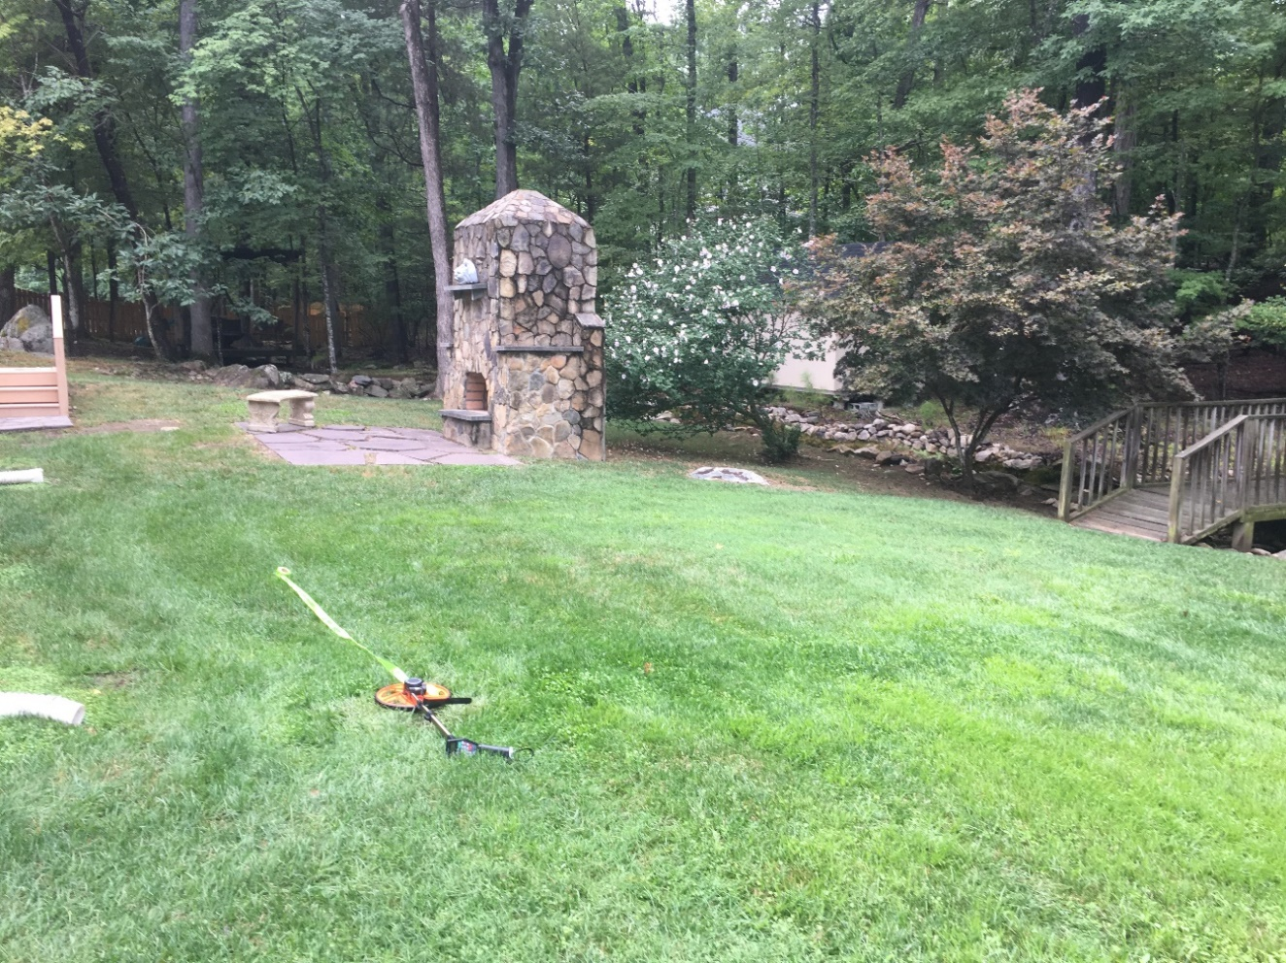
Buffers within lot boundaries
§ 143-214.23A. (f) states that when riparian buffer requirements are included within a lot, cities and counties shall require that the riparian buffer area be shown on the recorded plat
If not platted, potential for noncompliance with the Buffer Rules

Slide 20
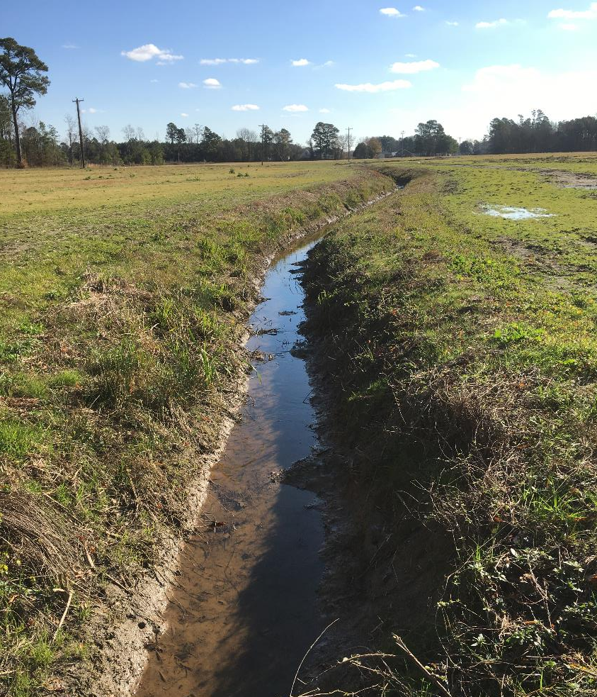
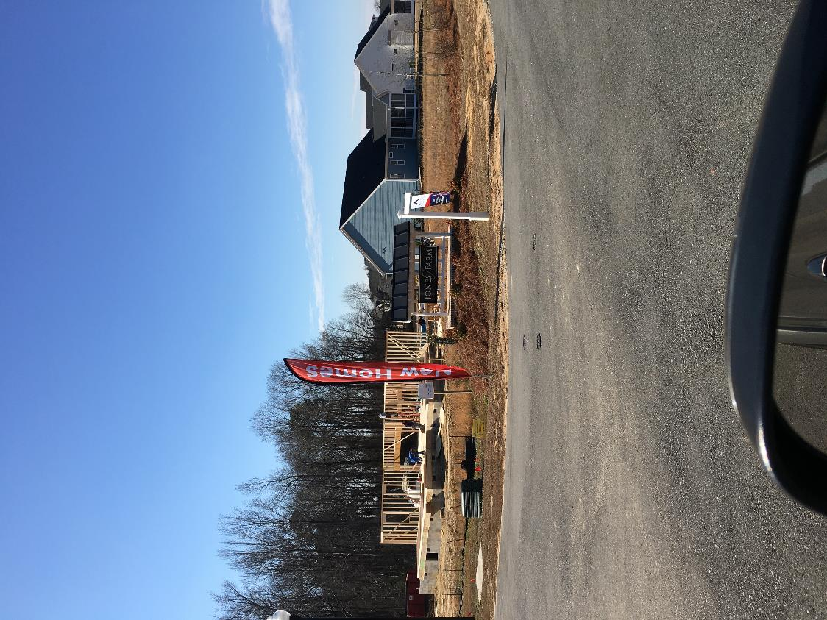
Agriculture “converting to residential”
  Educating and communicating the requirements to current and future owners

Slide 21

We are happy that LGs implement the buffer programs!
Questions?
Shelton Sullivan, DWR 401 & Buffer Permitting Branch
email: shelton.sullivan@ncdenr.gov phone: 919-707-3636

