Slide 1

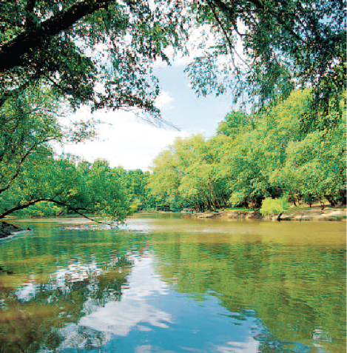

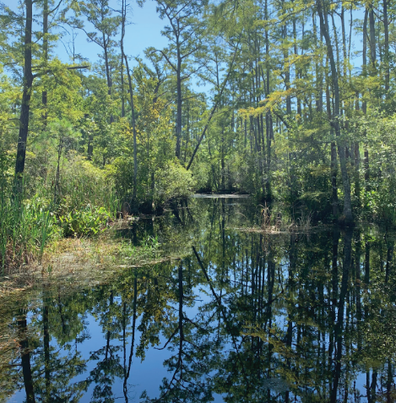

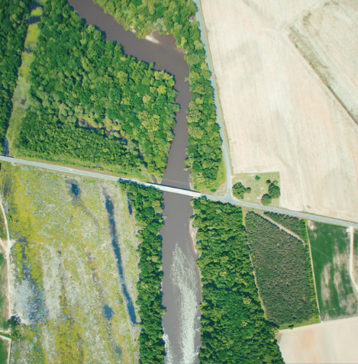
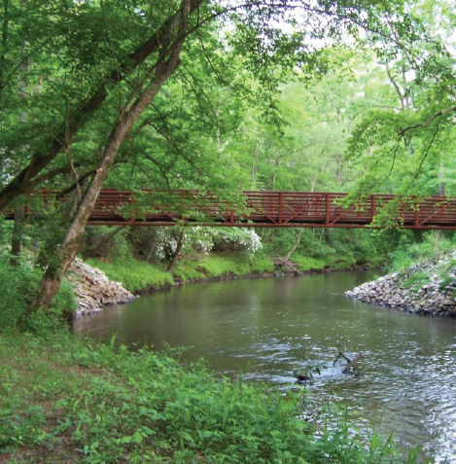




Forestry & Buffer Rules: --A Brief Overview for Local Governments--
Tom Gerow, Jr. RF, CESSWI
Water Resources Staff Forester
North Carolina Forest Service
N.C. Department of Agriculture and Consumer Services

Slide 2
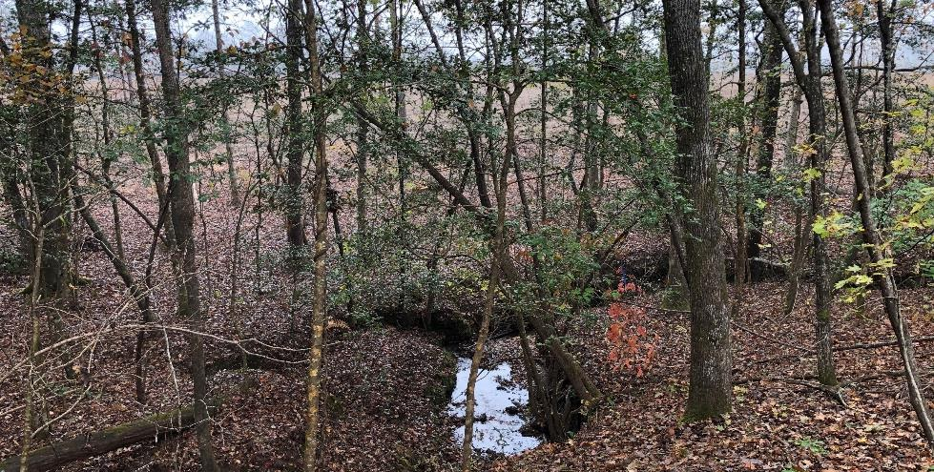
Forestry & Buffer Rules 101
Step 1: Handled at the State-level: NCFS + DWR.
Step 2: Is not delegated down to local programs.
Step 3: If see a logging job and have questions, contact the County Forest Ranger:
www.ncforestservice.gov >> “Contact Us”.
Notes:
Impacts on natural resources
Algal over production
Environmental, Social, and Economic Issues

Slide 3

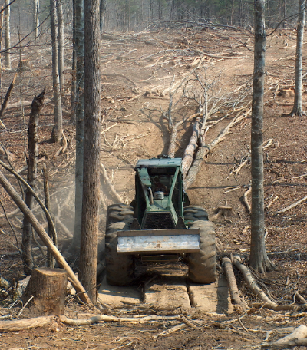
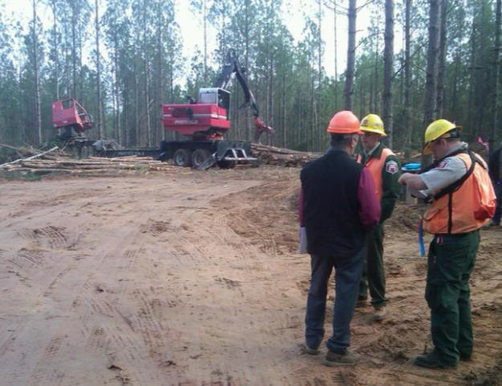
Roles of NCFS in Water Quality
Education… Prevention… Consultation…
FPG compliance inspections
Forestry BMP monitoring and assistance
Training, education, outreach
Interdisciplinary collaboration
Notes:
We are literally the ‘boots on the ground’ when it comes to forestry and logging in North Carolina.

Slide 4




Forestry & WQ Governance
NC Sedimentation Pollution Control Act >> FPGs:
Forest Practice Guidelines Related to Water Quality
State Laws prohibiting waterway obstruction
Riverbasin/Watershed Riparian Buffer Rules
Federally-required BMPs in wetlands & waters of US.
+ State-adopted Forestry BMPs
+ Private-sector, market-based, consumer-driven 3rd-party audited forest certification programs
Notes:
Forestry is governed by several laws and rules, when it comes to water quality protection. Sometimes we have to address the criticism that “forestry is exempted from all the permits and can do whatever y’all want to”. While it is true that forestry (silviculture) is exempted from most (but not all) federal and state permitting, there are strings attached -- conditions that must be met , in order to maintain those exemptions. Basically, forestry jobs have to meet many of the same requirements spelled-out by the 401 or 404 permits; but there’s no requirement to submit a plan to make notifications.
Forest certification programs are not government-sponsored; they are private sector programs, but play an important role in raising the bar for the entire industry, when it comes to BMP performance and overall attention to water quality and other important resource concerns.

Slide 5
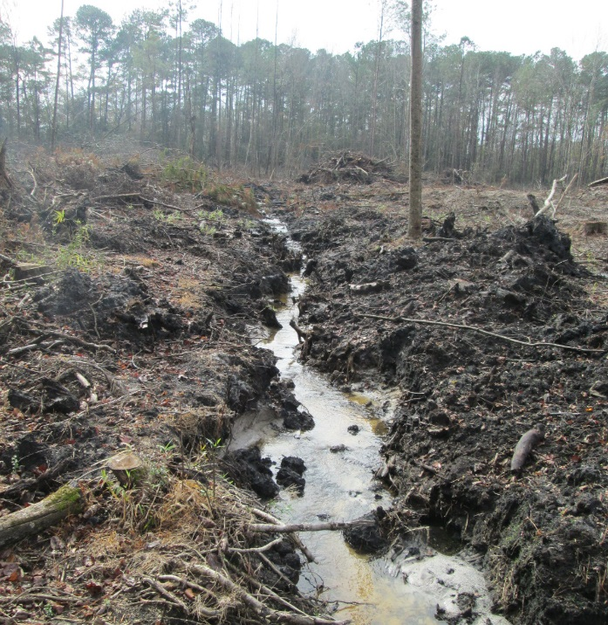
Forestry in the Buffer Rules
Role of NC Forest Service
Do stream determinations:
Upon Request…,
…Only on forestry sites,
…Must be a Registered Forester and pass SWITC.
On routine forest water quality inspections, we observe the Buffer Rule Zone.
Not Forestry

Slide 6
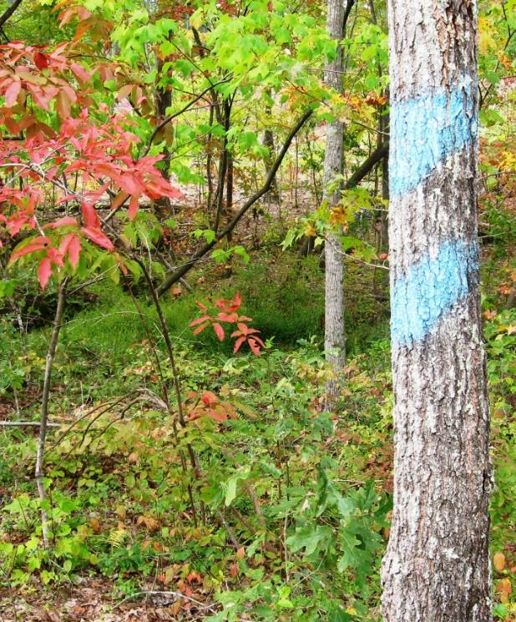
Forestry in the Buffer Rules
How Forestry is Handled:
Not a grandfathered “Existing Use”.
No prior-approval needed.
No mitigation required.
“Forest Harvest Requirements” in each Buffer Rule.
Tract must be eligible.
Selective Harvesting and limited forest management practices allowed in the Buffer Rule Zone.
This is Forestry

Slide 7
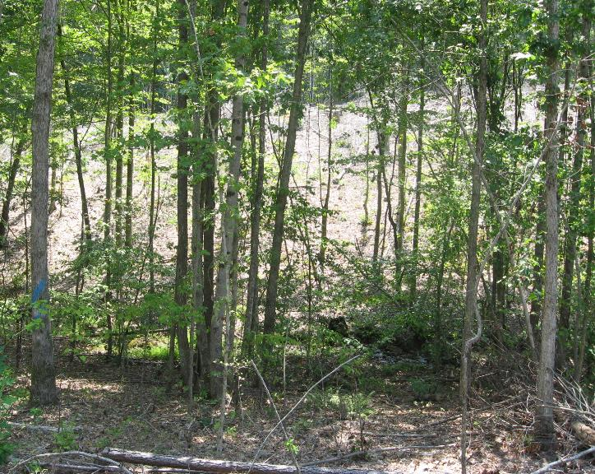
Forestry in the Buffer Rules
<<<< Neuse Buffer Rule Zone, Durham Co.
Notes:
I’m not going to get into the Forest Harvesting Requirements of each & every Buffer Rule, because they are very detailed, and are slightly different between different River Basins or Watersheds -- But they are spelled out in the Forestry Leaflets provided in your notebook, and can be printed from our website.
((Photo shows a well-implemented, Neuse River Basin Riparian Buffer Rule zone on a logging job in Durham County.))

Slide 8
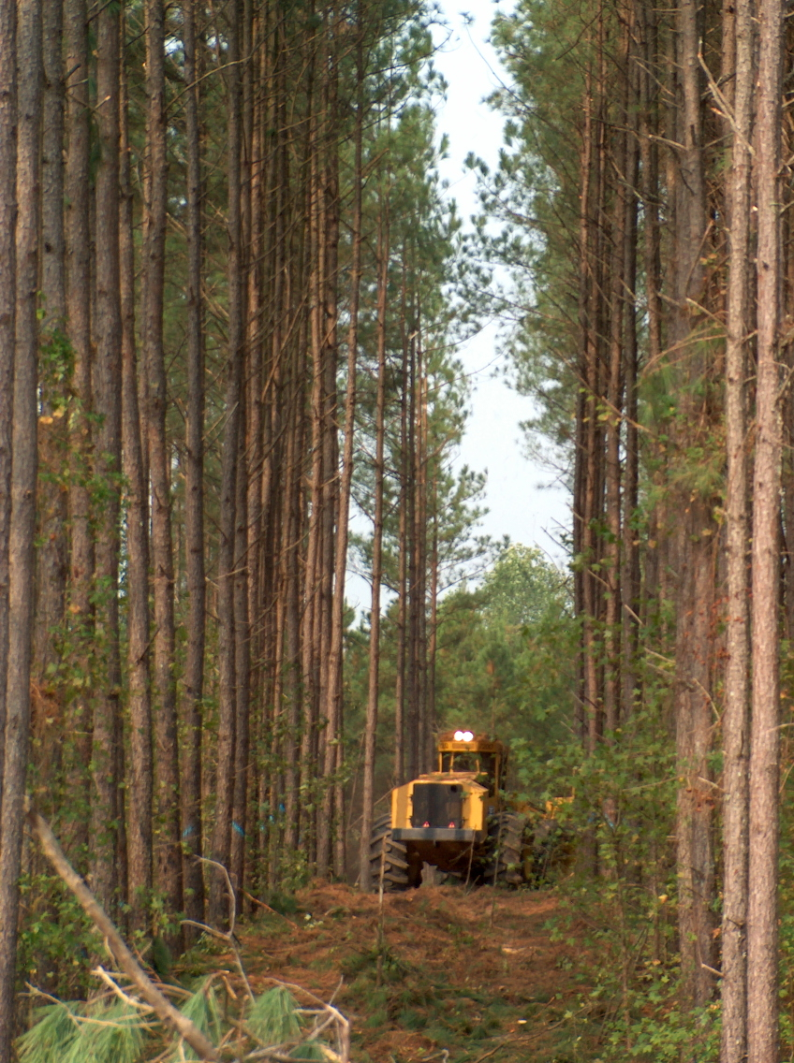
Forestry & WQ Governance: FPGs
NC Sedimentation Pollution Control Act (SPCA) >>>
  Forest Practices Guidelines Related to Water Quality (FPGs)
State Laws prohibiting waterway obstruction
Riverbasin/Watershed Riparian Buffer Rules
Federally-required BMPs in wetlands & waters of US
FPGs:
Statewide regulations, 9 narrative standards (02 NCAC 60C).
Applicable on all forestry-related, land-disturbing activities.
Applicable on all* lands: NC has 18MM acres of the forest, ~65% private....
  Exception: Qualla Boundary, Cherokee Nation treaty lands
NCFS is lead agency: administer FPGs & inspect for compliance.
Enforcement remains vested with DEQ (or NCDA for pesticide).

Slide 9
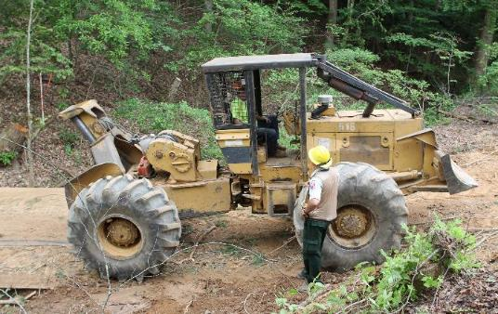
Topics in Statewide FPG Standards
.0201 Streamside Management Zone (SMZ)
.0202 Prohibition of Debris Entering Streams and Waterbodies
.0203 Access Road and Skid Trail Stream Crossings
.0204 Access Road Entrances
.0205 Prohibition / Waste Entering Streams, Waterbodies, Groundwater
.0206 Pesticide Application
.0207 Fertilizer Application
.0208 Perennial Stream Temperature
.0209 Rehabilitation of Project Site
The FPGs were enacted in 1990; re-adopted in 2018.
NCFS conducts 3,000 - 4,000 inspections annually (+2,000 to 3,000 re-inspections).
Over last 10+ years, final compliance at completion exceeds 95%.
Notes:
Note, 2 of the highlighted FPG rules closely mirror requirements described in the Riparian Buffer Rules.

Slide 10
Comparing FPGs & Buffer Rules
FPGs | Buffer Rules
Requires a SMZ. | Requires a specific Buffer Rule Zone(s)
Any Intermittent Stream, Any Perennial stream, Any Perennial Waterbody. | ‘Blueline’ stream approximately shown on topo or soil map. (with caveat, in Randleman)
No fixed width of SMZ. But must restrain sedimentation. Must provide/maintain groundcover. | Prescribed 50-feet width, separated into multiple Zones. Groundcover required. Must provide for diffuse flow.
No explicit harvest restrictions. Must retain shade on Perennial Stream. | Specific tree diameter limits, by species. No harvesting of streambank edge trees.
No SMZ required on beaver ponds. But must restrain sedimentation. | Buffer Rule Zone must be applied along water’s edge of beaver impoundments.
NCFS is lead agency. NC-DEQ handles most enforcement. | DWR is lead agency and handles enforcement.
Get to know your County Forest Ranger.

