Slide 1
Department of Environmental Quality
High Rock Lake
Nutrient Management
Strategy: Agriculture
March 10, 2023

Slide 2
High Rock Lake NMS Rulemaking
Action Items from Meeting #2
Joe Hudyncia update on NCDACS litter waste records
NRCS update on BMP implementation:
$38.4 million spent in HRL counties (not limited to HRL watershed)
22,600 new acres of tillage management
6,900 new acres of cover crops
167 waste storage facilities
870,900 feet of fencing (76 stream crossings, 579 acres of access control)
4,400 acres of prescribed grazing
3,900 acres of nutrient management
Taylor Darnell to upload litter waste analysis report
Department of Environmental Quality

Slide 3
HRL Ag TAG Initial Report
Highlights for Steering Committee
Many farmers are already using precision nutrient management
Smaller producers generally cannot afford the time/resources/energy required
Poultry industry has undergone significant changes
Slight overall increase in production (trend in point-in-time inventory unclear)
Litter being applied across the watershed
Local conservation staffing capacity is an ongoing limitation
TAG members highlight need for better education, outreach, and training

Slide 4
Report Points of Discussion
Phosphorus over-application via waste/residuals
Litter testing
Inspection and enforcement of waste utilization plans
Education
Application setbacks
Livestock exclusion
Education
Technical assistance
Regulate stream access
Allow flash grazing
Funding
Tax credits
Fines
Drinking water fee assessment

Slide 5
Break

Slide 6
Collective Compliance
How does it work?
Overall N loss reduction mandate applies in Neuse, Tar-Pamlico, Falls Lake, and Jordan Lake
Crop acres + fertilization rates + BMPs + yield expectations + NUE + soil groups N loss estimate
All fields in watershed combined
Measured at “edge of management unit” (i.e. field boundary)
Loss at field, not loading to stream
Measured against baseline
Includes major crops, but not all
P loss tracking requirement applies in Tar-Pamlico, Falls Lake, Jordan Lake
Qualitative, not quantitative
Risk up or down
Pasture N loss reduction mandate applies in Falls Lake and Jordan Lake

Slide 7
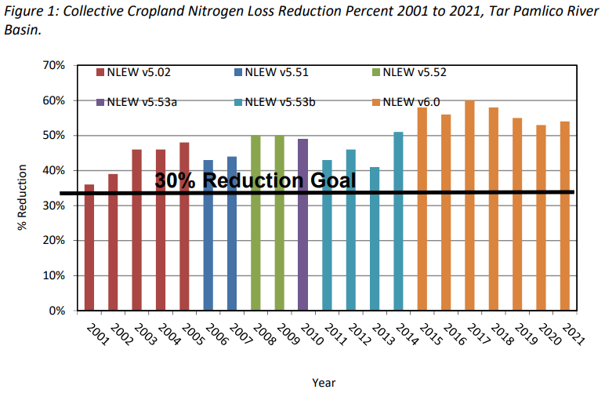
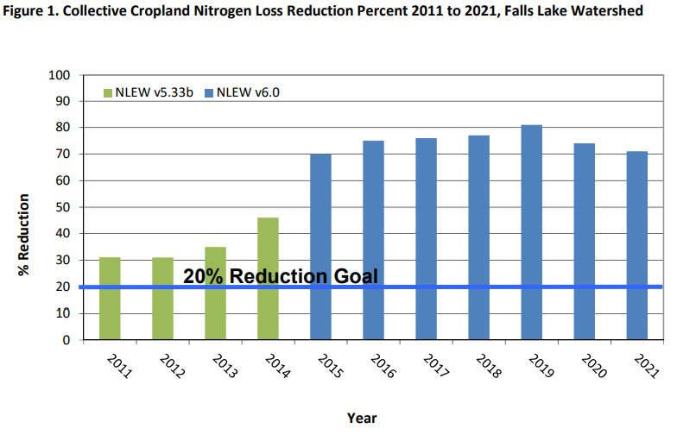
Ag Reduction Progress

Slide 8
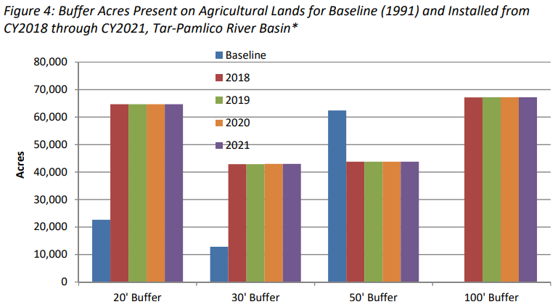
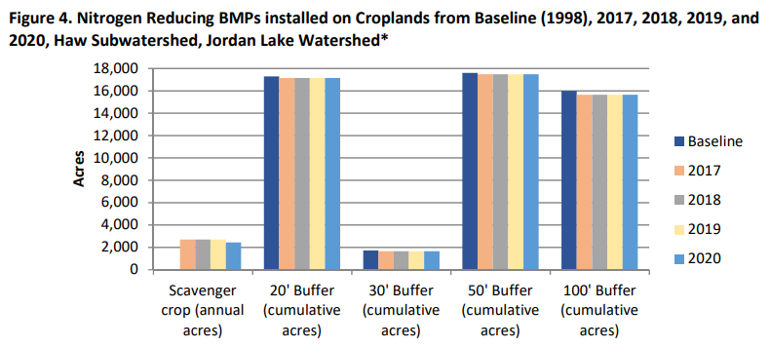
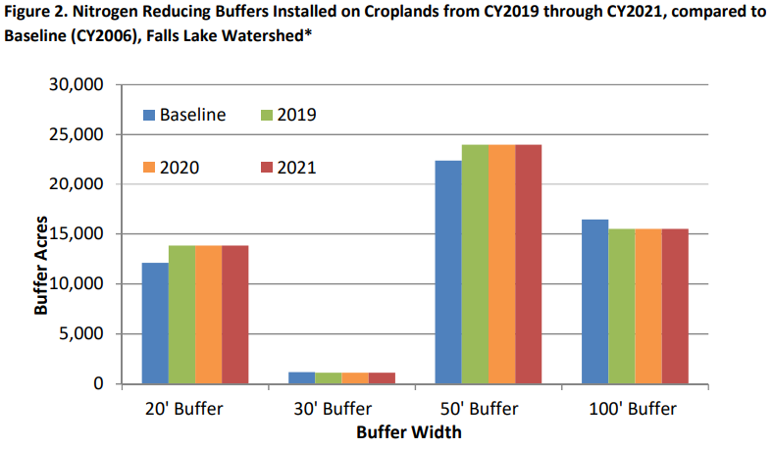
Buffer Implementation

Slide 9
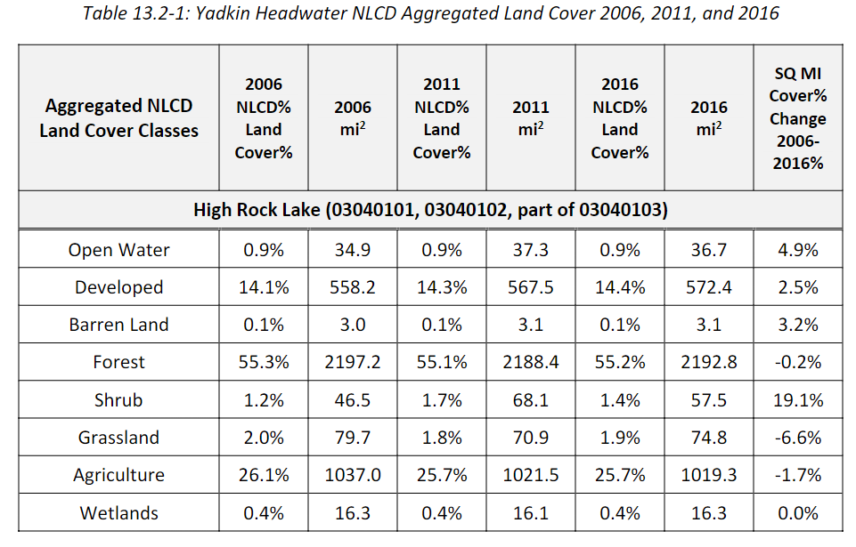
Land Cover
(Baseline)

Slide 10
Where to go from here?
Most TAG recommendations have been non-regulatory
Funding = implementation
No capacity to expand and re-design NLEW
Pasture > Cropland
Phosphorus is key
We don’t intend to apply a numerical reduction target to agriculture
In lieu of NLEW modeling, track and report on progress
What should the report include?

Slide 11
Questions?
Joey Hester
Joey.hester@ncdenr.gov
O: 919-707-3675
C: 919-418-5712
Department of Environmental Quality

