Slide 1
High Rock Lake Nutrient Rules Engagement Process All Stakeholders Meeting #3
May 31, 2023
Salisbury Civic Center
Salisbury, NC

Slide 2
Welcome!
Please introduce yourself to your table members
Share your name, location and connection to High Rock Lake and its watershed

Slide 3
Meeting goals for todayGoals
For anyone interested in High Rock Lake and its watershed to…
Inform stakeholders about updates regarding the High Rock Lake Nutrient Rules process, including hearing from the four Technical Advisory Groups, as well as the Steering Committee.
Collect and address questions from the stakeholders.
Solicit input from stakeholders about rules coverage and content, and process from here.

Slide 4
Today’s Agenda
Welcome & purpose of the meeting
Introductions at your table
Review of agenda & ground rules
Recap & overview
Hearing from Steering Committee
Focus on TAGs
TAG progress reports
Learn more about TAGs – breakouts
Reporting out
Next steps & survey
Closing

Slide 5
GROUND RULES
Stick to the tasks and topics on the agenda and keep discussion focused; one subject at a time.
Discuss all relevant information and issues, even difficult ones.
Keep discussion open and balanced.
Participate, show up, share your thinking as much as you can.
Strive to make decisions by consensus.
Look beyond positions to interests.
Disagree openly and respectfully.
Put personal differences aside in the interests of a successful team.
Jointly design ways of testing disagreements and look for mutually beneficial solutions.
Follow through on commitments.
Share information discussed in team meetings with your organization and reflect its position back to the team.
While participants are free to discuss the process outside of official meetings, decisions will be made during meetings themselves.

Slide 7
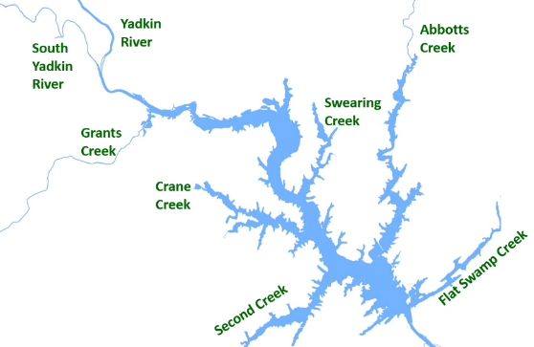
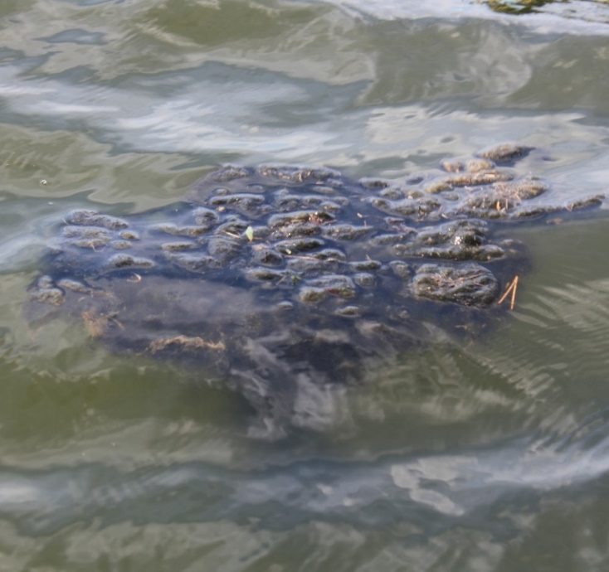
High Rock Lake Nutrient Management Strategy Rulemaking
Excessive algal production
Elevated risk to human health from algal toxins
Seeking stakeholder input on means of reducing nitrogen and phosphorus, which feed algae
Drafting regulations (called “rules”) to reduce loading of N and P to HRL
Department of Environmental Quality

Slide 8
Progress Since September
Wastewater treatment facilities
Permitted nutrient limits
Septic systems
Residuals/Biosolids
Stormwater
Wastewater
Agriculture
Riparian Buffers
Animal feeding operations
Manure/waste distribution
Fertilization management
Livestock stream exclusion systems
Conservation planning
Cost share funding
Construction sites
Urban, residential, commercial development
Roadway/highway runoff
Local government ordinances
Flood management
Vegetation protection
Erosion control
Nutrient management

Slide 9
Rulemaking Timeline

Slide 10
Steering Committee Update
Grace Messinger, Piedmont Triad Regional Council
Role | Member | Alternate | Organization
Voting | Ann Marie Clark | Jim Crawford | High Rock Lake Association
Voting | Dr. Bill Davis | Rob Baldwin | Wilkes SWCD
Voting | Allie Dinwiddie | Julie Henshaw | NC Division of Soil & Water Conservation
Voting | Rich Gannon |  | NC Division of Water Resources
Voting | Joey Hester |  | NC Division of Water Resources
Voting | Keith Huff | Andy Allen | City of Winston-Salem
Voting | Bill Kreutzberger |  | Independent Consultant
Voting | Keith Larick |  | NC Farm Bureau
Voting | Grady McCallie |  | NC Conservation Network
Voting | Andy McDaniel |  | NC Department of Transportation
Voting | Grace Messinger | Danica Heflin | Piedmont Triad Regional Council
Voting | Edgar Miller | Grace Fuchs | Yadkin Riverkeeper
Voting | Chris Millis |  | NC Homebuilders Association
Voting | David Saunders |  | Yadkin Pee Dee River Basin Association
Voting | Justin Somers |  | Perdue Farms, Yadkin SWCD
Voting | Judy Stalder | Jon Lowder | Triad Real Estate and Building Industry Coalition
Voting | Jonathan Williams |  | Town of Spencer
Non Voting | Helen Simonson |  | Downstream Interests

Slide 11
Technical Advisory Group Updates
Agriculture TAG
Keith Larick, NC Farm Bureau
Allie Dinwiddie, NCDACS Division of Soil & Water Conservation
Edgar Miller, Yadkin Riverkeeper
Stormwater TAG
Brent Cockrum, FEI Consulting
Wastewater TAG
Bill Kreutzberger, Independent Consultant
Riparian Buffer TAG
Rich Gannon, DWR NPS Planning
Robby Abou-Rizk, Blue Ridge Trout Unlimited
Siham Muntasser, Wild Ones Central North Carolina

Slide 12
Learning more about TAGs – 4 corners
You'll have about 30 minutes to interact with TAG members in informal breakouts around the room & share on the posters:
+ What you like about what’s coming out of the work of the TAG
Delta What would you change?
? Questions
If you're a TAG member, please spend some time at your TAG and also visit other TAGs as you would like.
Post-it notes are at your table for leaving comments on charts or you can write directly on the charts themselves.

Slide 13
Closing & Survey
Questions? Want to get more involved? Fill out the sign-up sheet at your table and/or email Joey!
Please complete the anonymous meeting rating survey - QR code on agenda
THANK YOU for joining us today!

