Slide 1
Department of Environmental Quality
High Rock Lake
Nutrient Management
Buffer Technical
Advisory Group
August 25, 2023

Slide 2
Meeting Objectives
Approve Buffer TAG Report
Members sign onto majority and minority opinions

Slide 3
Decision-Making Process re: consensus
From High Rock Stakeholder Engagement Process Charter, p. 11
“Consensus requires the active participation of everyone in the group and an atmosphere where disagreements are respected. When someone disagrees, the goal of the group shall be to discover the reason for the objection and to find a way to work toward meeting that need in a revised agreement. Consensus is being defined as at a minimum, “I can live with and support the decision.”
“Consensus agreements reached in one team meeting should not be reconsidered in a subsequent meeting without the consent of all participants in attendance.”

Slide 4
Important Reminders
Buffer TAG makes recommendations to the Steering Committee, who then reviews and offers a formal consensus proposal to DWR, who then drafts rules that incorporate as much of the proposal as possible. Then draft rules are shared with the stakeholder community for further comment (phase II), and DWR amends the rules based on feedback if necessary. This is the first step in this process, but it will not be the last.
Members can continue to offer opinions and contribute to the discussion via stakeholder meetings and in phase II of draft rule review, which is expected sometime in 2024.

Slide 5
TAG Responsibility Clarification
The Riparian Buffer TAG is charged with developing recommendations for a riparian buffer protection rule.
This protection rule is intended to protect existing streams and rivers from further degradation, not to reduce nutrient loading to the watershed.
Other TAGs are charged with identifying possible strategies for reducing nutrient loading within their respective sectors, and the Steering Committee is charged with turning TAG proposals into a formal rulemaking recommendation.
Buffer rules cannot legally require new vegetation where none already exists.
Buffer rules are only part of the overall nutrient management strategy.

Slide 6
Poll Question 1

Slide 7
Report Feedback
Robby’s Document:
  We have been advised that amendments 1, 2, 3, 5, and 6 violate the 5th Amendment to the US Constitution, and so DWR believes moving forward with those recommendations will be problematic. Furthermore, while increasing funds for compliance monitoring would certainly be helpful, we do not have the authority to appropriate funding in agency rulemaking.
  The 25% impervious cover metric (amendment 4) is a valuable indicator of hydrologic disruption but is not a widely agreed upon threshold. Therefore, DWR does not believe that it offers a meaningful benchmark for regulatory enforcement. Additionally, DWR acknowledges the importance of aligning rule proposals with limited staff capacity and recognizes the importance of prioritizing reports and metrics that are actionable by DEQ and will ensure better implementation of buffer programs.
  The regulatory status of airports is quite complicated and depends on ownership of each facility. DWR will investigate this issue during rule drafting and identify ways that rule language can be strengthened to avoid ambiguity.
  Is there anything included in the document that

Slide 8
Is there anything else in Robby’s document that TAG members would like to discuss?

Slide 9
Majoriy/Minority Sign-on
Is everyone comfortable with their name being written on the report under their endorsed opinion?
Poll Question 2

Slide 10
Next Steps

Slide 11
Buffer Width Proposal
DWR:
Zone 1: 30ft
Zone 2: 20ft
Perennial and intermittent streams everywhere in watershed
  Includes wetlands within 50ft of surface waters
  Includes hydrologically connected impoundments that are fed by an intermittent or perennial stream or that discharge directly to an intermittent or perennial stream
  Excludes disconnected ponds

Slide 12
Allowable Uses
Ongoing and existing uses – protected by the US Constitution
Disconnected agricultural ponds exempted – WOTUS
Forest harvest (next slide)

Slide 13
Buffer Proposal
Alternative Proposal from TAG members:
Zone 1: 50ft
  0 - 10ft - No tracked vehicles
  0 - 20ft - Removal of individual trees allowed except with exposed roots on streambank, unless diseased or dangerous
  21 - 50ft - 50% of trees > 5” DBH, every 15 years except every 5 years for plantations
Zone 2: 20ft
  Forest harvest allowed w/ ground cover reestablishment
  Grading w/ revegetation allowed as long as vegetation in zone 1 is not compromised
Within protected buffer (all 70ft):
  No soil disturbing site preparation
  No logging decks or sawmills
  Removal of invasive exotics allowed
  One-time fertilizer at agronomic rate allowed to establish replanted vegetation

Slide 14
Buffer Mitigation
Unavoidable buffer impacts require “variances”
Variances are granted by EMC along with quantified buffer “credits” that must be acquired
Mitigation system is statewide (15A NCAC 02B .0295) and applies to all buffer rules, so fundamental changes to mitigation rules are not being proposed by DWR

Slide 15
Buffer Mitigation
15A NCAC 02B .0295
(e) AREA OF MITIGATION REQUIRED ON ZONAL MITIGATION RATIOS. The Authority shall determine the required area of mitigation for each Zone by applying each of the following ratios to the area of impact calculated under Paragraph (d) of this Rule:
Basin/Watershed | Zone 1 Ratio | Zone 2 Ratio
Neuse | 3:1 | 1.5:1
Catawba | 2:1 | 1.5:1
Randleman Lake | 3:1 | 1.5:1
Tar-Pamlico | 3:1 | 1.5:1
Jordan Lake | 3:1 | 1.5:1
Goose Creek | 3:1

Slide 16
(f) AREA OF MITIGATION REQUIRED ON LOCATIONAL MITIGATION RATIOS. The applicant or mitigation provider shall use the following locational ratios as applicable based on location of the proposed mitigation site relative to that of the proposed impact site. Locational ratios shall be as follows:
Randleman ratio is 1:1
Mitigation not allowed outside of same watershed in Falls, Goose Creek, Randleman, Jordan Lake Subwatersheds
Location | Ratio
Within the HUC-12 | 0.75:1
Within the HUC-8 | 1:1
Outside of the HUC-8 | 2:1

Slide 17
Buffer Proposal
DWR:
Zone 1: 30ft
  Inner 10ft - No tracked vehicles
  Inner 10ft - Removal of individual trees allowed except with exposed roots on streambank, unless diseased or dangerous
  Outer 20ft - 50% of trees > 5” DBH, every 15 years except every 5 years for plantations
Zone 2: 20ft
  Forest harvest allowed w/ ground cover reestablishment
  Grading w/ revegetation allowed as long as vegetation in zone 1 is not compromised
Within protected buffer (all 50ft):
  No soil disturbing site preparation
  No logging decks or sawmills
  Removal of invasive exotics allowed
  One-time fertilizer at agronomic rate allowed to establish replanted vegetation

Slide 18
What’s missing?
Are there any rule provisions we have not addressed which need discussion?

Slide 19
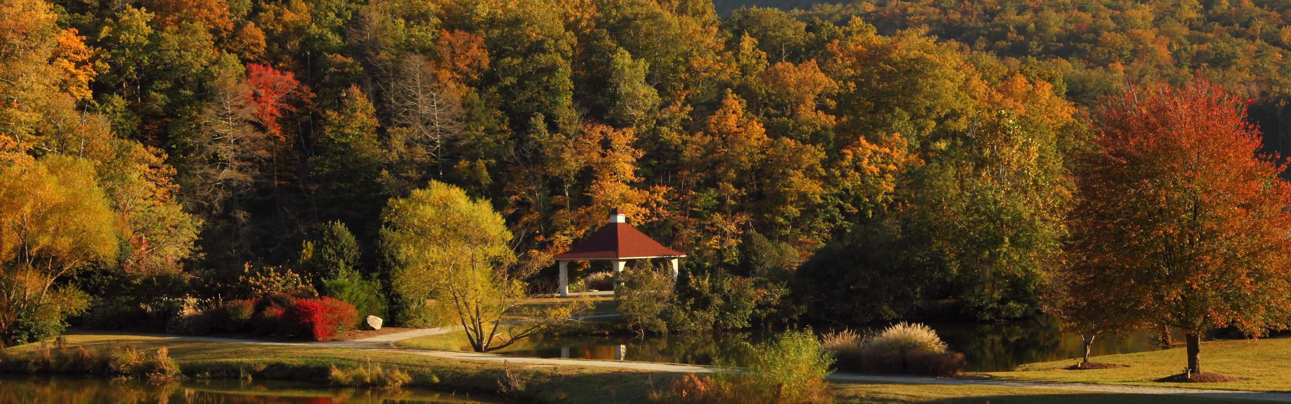
Questions?
Joey Hester
Joey.hester@ncdenr.gov
O: 919-707-3675
C: 919-418-5712
Department of Environmental Quality

