Slide 1

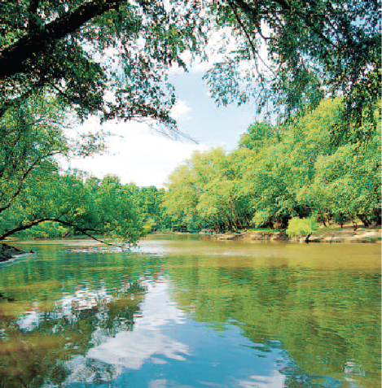
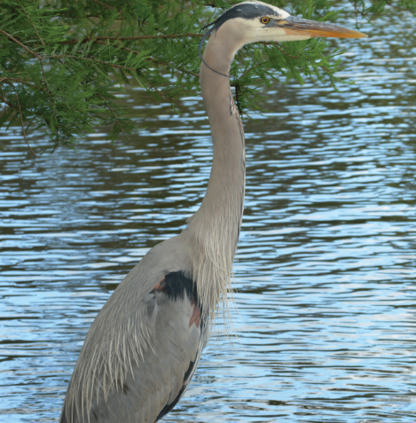
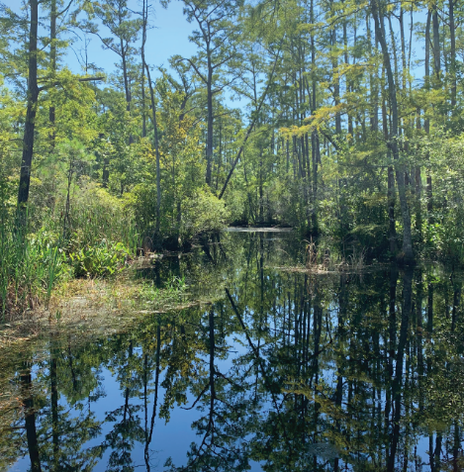
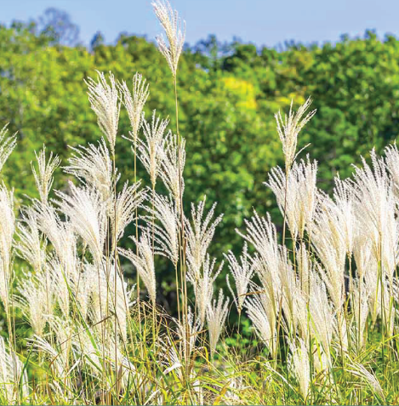
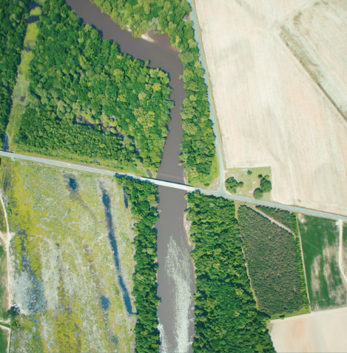
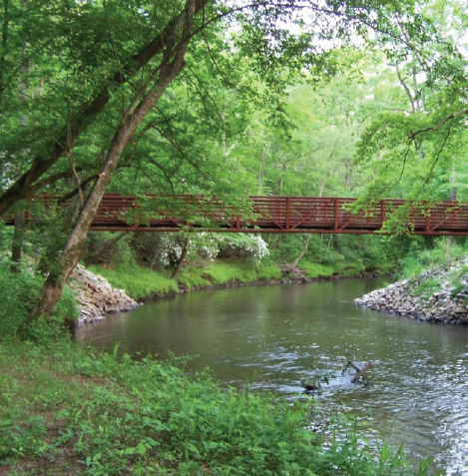

Riparian Buffer Rules 101
Sue Homewood
NCDWR
2023

Slide 2
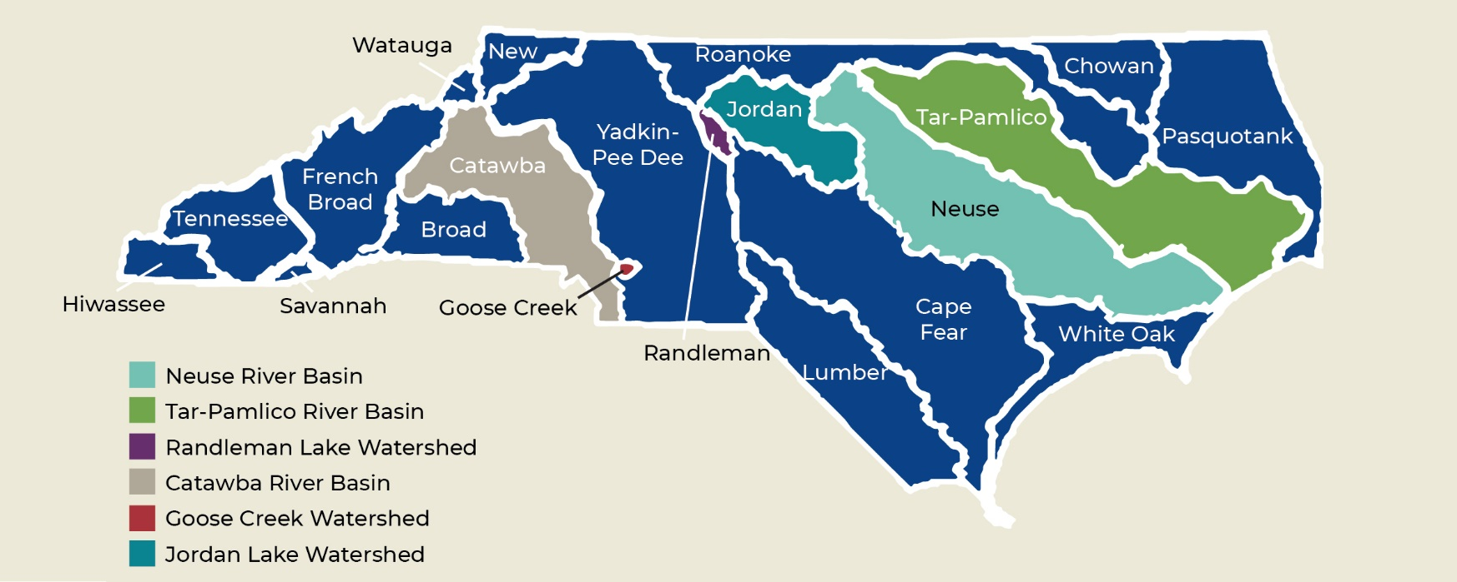
Riparian Buffer Protection Programs

Slide 3
Purpose of Specific Buffer Rules
Nutrient Removal Function to protect estuaries / downstream lakes
  Neuse
  Tar-Pamlico
  Catawba
Protect Water Supply
  Randleman Lake (New Water Supply)
  Jordan Lake
Sustain and recover federally endangered Carolina Heelsplitter
  Goose Creek

Slide 4
Buffer Rule Implementation
Division of Water Resources (DWR)
  In some watersheds local governments may request delegation
Local governments- Jordan Lake & Randleman Lake Watersheds
  Exceptions for local delegations/designations:
  - Forestry
  - Multi-jurisdictional/boundary projects
  - Government Projects
  - Agriculture

Slide 5
Buffer Rules Development
Common rules for consistency whenever possible
  Definitions
  Forest Harvesting Requirements
  Review & Approval Process
  Local Government Delegation Process
Individual Rules specific to each watershed
  Purpose & Applicability
  Table of Uses

Slide 6
Where does the buffer apply?
Features “approximately shown” on
  Latest USGS Topographic 1:24,000 scale
  -OR-
  Most Recent Published NRCS Soil Survey
Randleman
  Also applies if other site specific evidence indicates the presence of waters not shown on either of the two maps
Catawba
  Only Main Stem Catawba River/Lakes

Slide 7
Where does the buffer apply?
Applies to:
  Perennial streams
  Intermittent streams
  Lakes and reservoirs
  Ponds attached to streams
  Estuaries
  Modified natural streams
Does not apply to:
  Ditches & Manmade conveyances; unless constructed for navigation or boat access
  Ephemeral streams
  Ponds that are not attached to streams
  Wetlands
  Agricultural ponds

Slide 8
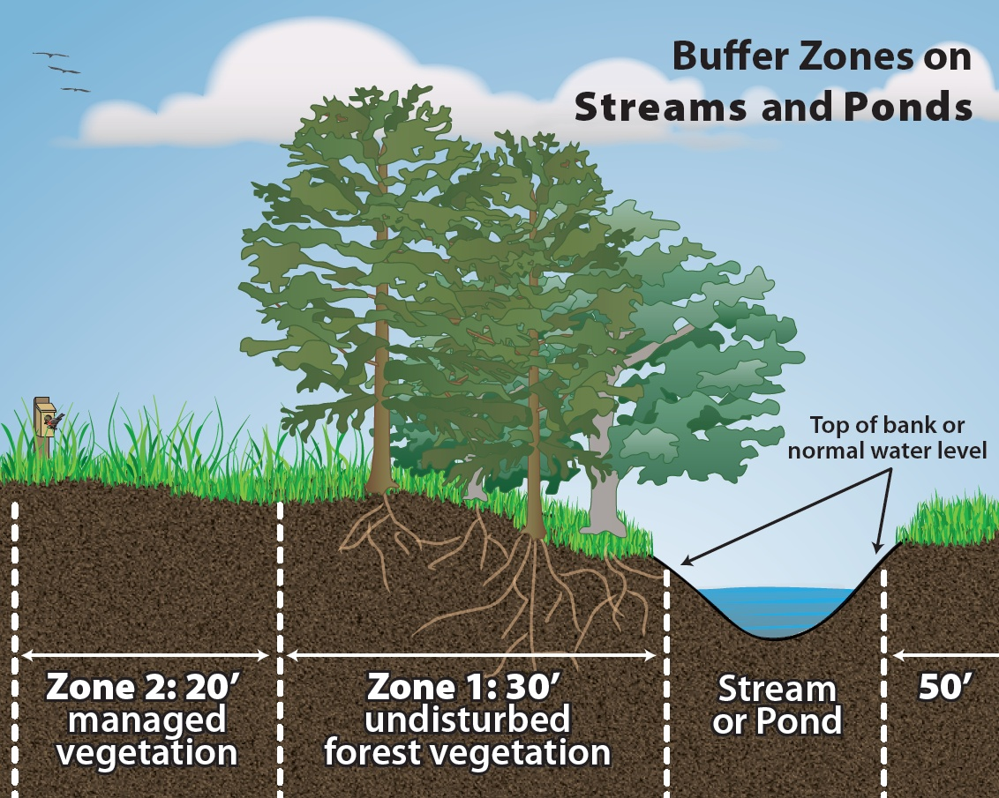
How is buffer measured?
Buffer Zones on Streams, Lakes, Ponds, Coastal Water
Neuse
Tar-Pam
Catawba
Jordan
Randleman

Slide 9
What is allowed in the buffer?
Zone 1
“Vegetated area that is to be undisturbed (protected) except as provided for in the Rule”
Zone 2
“Vegetated area that is to be undisturbed (protected) except as provided for in the Rule”
Grading is deemed allowed provided the existing vegetation in Zone 1 is not compromised and stormwater runoff is managed in compliance with the rule, and disturbed areas are stabilized and revegetated
Notes:
Pruning: the removal of dead tree or shrub branches or live tree or shrub branches with a diameter of less than four inches. Pruning for deciduous trees – once per year during dormant season or following act of God situation. Coniferous – any time of year. Shrubs – pruned by selectively removing branches will maintaining natural shape of plant (does not include cutting all branches down to main trunk).

Slide 10
What is allowed in the buffer?
Existing and Ongoing Uses
An activity is considered to be an “existing use” per the buffer rules if it existed (and ongoing) prior to effective date of the rule (or local ordinance)
Only the portion of the riparian buffer that contains the footprint of the existing use shall be exempt

Slide 11
What is Allowed in the Buffer?
Table of Uses
Allowable
With
Mitigation Upon Authorization
Deemed Allowable
Allowable Upon Authorization
Prohibited
Roads
Utilities
Residential properties
Protection of Existing Structures
Water Dependent Activities
Management of dead/diseased vegetation, invasive vegetation, nuisance vegetation
And more

Slide 12
What is Allowed in the Buffer? – Forest Harvesting
Forest harvest activities
  on lands that have a deferment for use value under G.S. 05-277.2 through 277.6
  on lands that have a forest management plan prepared or approved by a registered professional forester
  Measures taken to minimize soil disturbance
  No decks or sawmills within buffer
  Zone 2
  Harvesting allowed provided ground cover is re-established
  Zone 1
  Selective timber harvesting of 50% of trees greater than 5 inch DBH every 15 years
  In the first 10 feet adjacent to the stream, only high value trees provided they don’t have any exposed primary roots in the streambank
  Minimal use of tracked/wheeled vehicles

Slide 13
Stormwater Management in the buffer rules
Diffuse Flow Stormwater Runoff Through Riparian Buffer
  Allows for conveyances through the buffer from approved Stormwater Control Measures (SCMs)
  Also provides options for:
    Allow new conveyances when nutrient calculations show achievable rule loading goals
    Allow for new conveyances with minimal flow rates to account for small areas that cannot be reasonably directed to SCMs due to topography
    Allow for realignment of existing conveyances
    Allow for new conveyances for bypass of upslope runoff
    Expanded allowances for linear transportation facilities
  Provides a process for stormwater runoff control methods that are not specifically listed in the rule to be considered for approval through an “exception” process

Slide 14
Current setbacks applicable in HRL watershed
NPDES MS4 (14 in HRL)
  Construction site and post-construction stormwater controls
    All projects: 30’ setback
    Low density: dispersed flow, vegetated conveyances
    High density (> 24% BUA): treat 1” BUA runoff w/primary SCM; or annual runoff volume match
  Public education
  Illicit discharge elimination
  Pollution prevention & “good housekeeping”
HQW/ORW/WSW
  30’ vegetated setback
  Low density = dispersed flow, vegetated conveyances
  High density (varies from 6% to 24% BUA): treat 1” BUA runoff w/primary SCM; or annual runoff volume match, 100’ vegetated setback

Slide 15
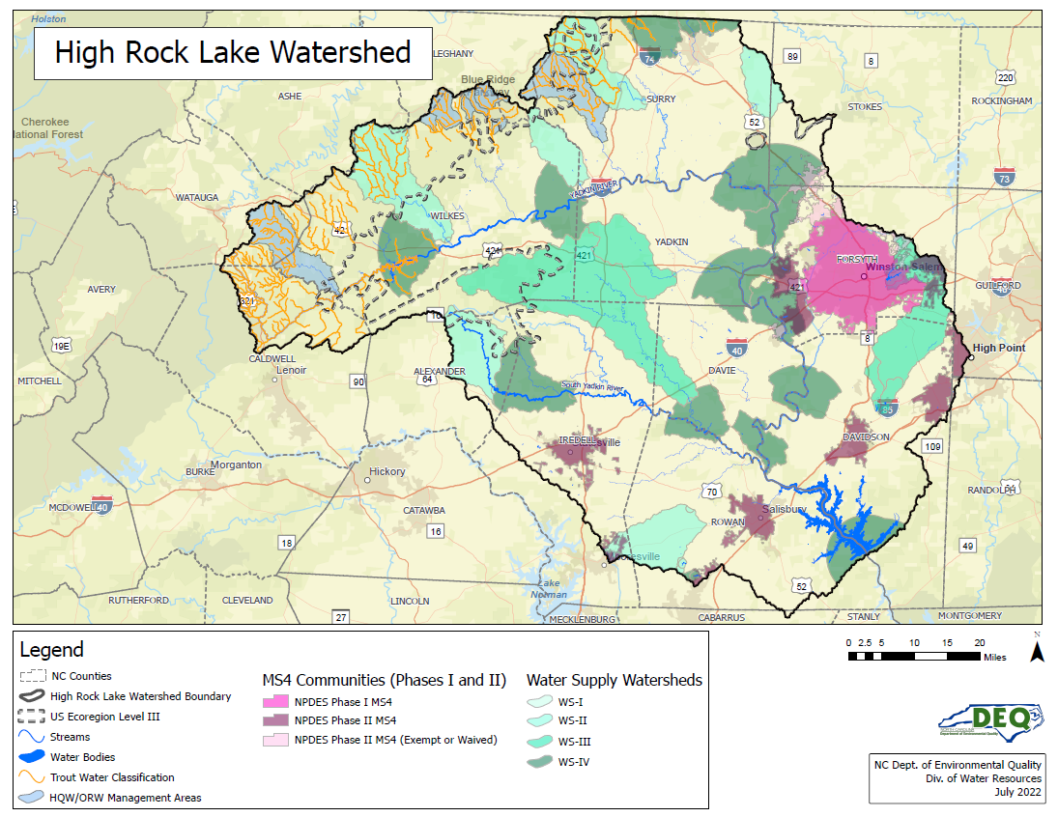

Slide 16
Questions?

