Slide 1
Department of Environmental Quality
High Rock Lake
Nutrient Management
Steering Committee
April 26, 2023

Slide 2
Decision-Making Process re: consensus
From High Rock Stakeholder Engagement Process Charter, p. 11
“Consensus requires the active participation of everyone in the group and an atmosphere where disagreements are respected. When someone disagrees, the goal of the group shall be to discover the reason for the objection and to find a way to work toward meeting that need in a revised agreement. Consensus is being defined as at a minimum, “I can live with and support the decision.”
“Consensus agreements reached in one team meeting should not be reconsidered in a subsequent meeting without the consent of all participants in attendance.”

Slide 3
Questions for Steering Committee
Is the agriculture proposal sound? What implementation metrics should be tracked?
Is the proposed buffer protection framework acceptable?
Are you comfortable with not proposing new regulations for septic systems, forests (excepting buffer protection), and any other excluded categories?

Slide 4
Agriculture TAG
Preliminarily, the Agriculture TAG appears positively inclined toward the following Agriculture Rule Proposal:
  Overall NMS percentage reduction goals will be applied
  Agriculture representatives will submit an annual report that gauges progress toward achieving the overall goals
  The report will track production and implementation metrics that have been determined through consultation from the Steering Committee and other stakeholders
  No nutrient loss/loading model (i.e. NLEW) will be required to demonstrate collective compliance with the overall NMS reduction goals
  The need for local agricultural committees to assist data collection will be determined by the TAG
  Other potential regulatory concepts under consideration but which have not coalesced around a central recommendation include:
    Controlling livestock access to streams
    Phosphorus-based waste application limits

Slide 5
Wastewater TAG
Proposed changes
The Wastewater TAG has preliminarily reviewed the following Wastewater Rule Proposal:
Overall NMS percentage and corresponding load reduction goals will be required
Implementation toward achieving NMS goals will be staged
Early stages will require phosphorus reductions, later stages will require nitrogen reductions
Individual nutrient load allocations will be added to NPDES permits
A collective watershed loading cap will be optional

Slide 6
Riparian Buffer TAG
DWR has offered the following Buffer Rule proposal, and the Riparian Buffer TAG has raised certain concerns:
General DWR intent is to carry forward the same overall buffer rule design currently in place in other major nutrient watersheds, including:
  A 50ft vegetated riparian area will be protected in Zone 1 (inner 30ft) and Zone 2 (outer 20ft)
  Riparian areas will be protected throughout the entire watershed
  Existing uses in the 50’ can continue, but a change of use invokes buffer protections
The TAG is investigating possible modifications to the forest harvesting provisions for each zone
The TAG is reviewing the Table of Uses for watershed-specific concerns

Slide 7
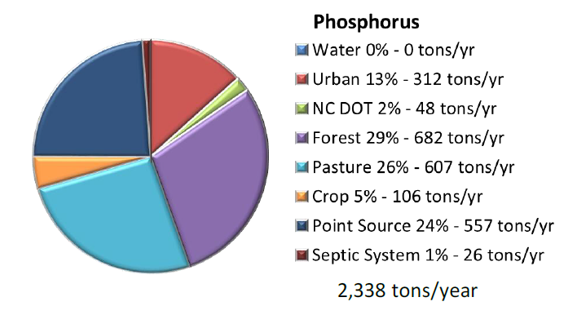
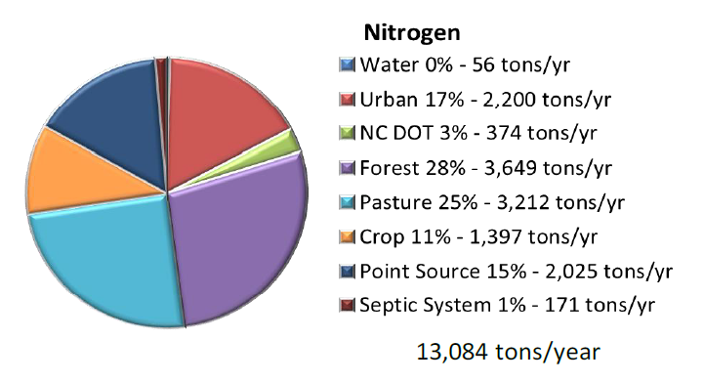
Source Categories
Point Source
  Large POTW
  Small POTW
  Industrial
Septic Systems
Urban
  New Residential/Commercial Development
  Redevelopment
  Existing Development
  Transportation
  State and Federal Entities
Pasture (Falls/Jordan)
Crop
  Animal Feeding Operations
Forest
  Managed
  Unmanaged
NC DOT
Buffer Protection

Slide 8
Source Categories
Point Source
  Large POTW
  Small POTW
  Industrial
Septic Systems
Urban
  New Residential/Commercial Development
  Redevelopment
  Existing Development
  Transportation
  State and Federal Entities
Pasture (Falls/Jordan)
Crop
  Animal Feeding Operations
Forest
  Managed (within buffer)
  Unmanaged
NC DOT
Buffer Protection
Regulated by NMS rules

Slide 9
Source Categories
Point Source
  Large POTW
  Small POTW
  Industrial
Septic Systems
Urban
  New Residential/Commercial Development
  Redevelopment
  Existing Development
  Transportation
  State and Federal Entities
Pasture (Falls/Jordan)
Crop
  Animal Feeding Operations
Forest
  Managed (within buffer)
  Unmanaged
NC DOT
Buffer Protection
Regulated by NMS rules
Regulated by Statute

Slide 10
Septic Systems
Total HRL Septic System Loading (DEH, 2021)
 | TP Load (lb/day) | TKN(mgN/L) (lb/day) | NO3(mgN/L) (lb/day)
Mean | 0.85 | 2.36 | 3.18
Median | 0.66 | 1.82 | 2.45
Daily Total | 123.25 | 341.77 | 461.29
Annual Total (lb/yr) | 44,985 | 124,747 | 168,371
Combined N Loading (lb/yr) |  | 293,117
Baseline Loading (lb/yr) (Tetra Tech, 2012) | 52,000 | 342,000
2021 Reduction from Baseline | -13% | -14%

Slide 11
Point Source Discharger Size
Annual N
Loading

Slide 12
Forestry Operations
On forestry-related, land-disturbing activities in North Carolina, state rules require a protective Streamside Management Zone (SMZ) along any intermittent stream, any perennial stream, and any perennial waterbody
Streamside Management Zone: An area along both sides of intermittent streams and perennial streams and along the margins of perennial waterbodies where extra precaution is used in carrying out forestry-related, land disturbing activities in order to protect water quality.
Regulated by buffer rules:
  No tracked or wheeled vehicles except at stream crossings
  Individual high value trees may be removed in inner 10 feet of zone 1
  Selective harvest (up to 50% of trees greater than 5” dbh) allowable in outer 20 feet of zone 1
  Harvesting allowable with reestablished ground cover in zone 2

Slide 13
Others
What else are we missing?

Slide 14
Questions for Steering Committee
Is the agriculture proposal sound? What implementation metrics should be tracked?
Is the proposed buffer protection framework acceptable?
Are you comfortable with not proposing new regulations for septic systems, forests (excepting buffer protection), and any other excluded categories?

Slide 15

Mark your calendars!
All Stakeholder gathering, May 31 from 2 – 5 pm in person in Salisbury
Steering Committee, Wed, June 14 from 1 – 330 pm in person in Winston Salem
Steering Committee, Fri, July 28 from 10 am - 12:30 pm virtual meeting

