Slide 1
Department of Environmental Quality
High Rock Lake Nutrient Strategy: Stormwater TAG
March 1, 2023

Slide 2
Action Items from Meeting #1
Andy McDaniel report out
Davidson County
  Established a watershed district along Yadkin River which protects 90% of Yadkin’s tributaries (state required 50%)
  DEM audit in 2015, elevated floodplain management to higher priority during permitting
  All flood prone areas are required to meet regulations (which ones?)
  In 2022, County Commissioners raised minimum density to 40k sq. ft per lot (roughly doubled 2015 allowance) to slow growth and restrict mass grading
Others?

Slide 3
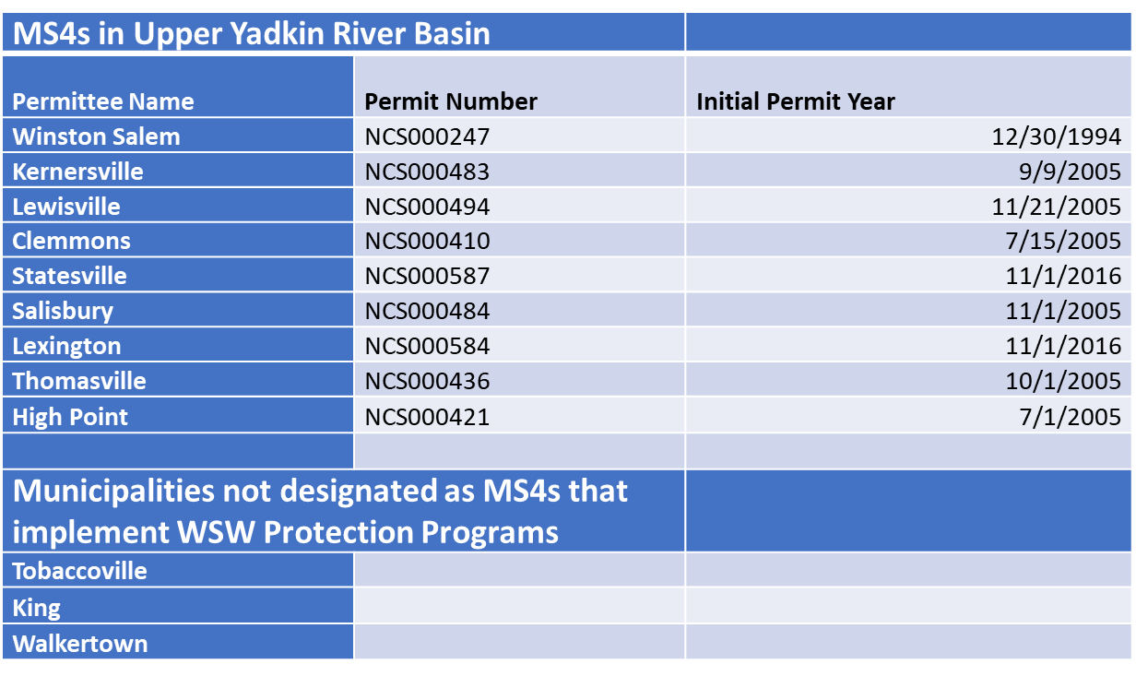
MS4 Local Program History

Slide 4
How do Stormwater Nutrient Requirements Relate to Other State Stormwater Programs’ Post-Construction Requirements?
Background – Other State Programs
High Density Threshold (% BUA):
  WSW - 6% to 24% =>
  ORW/HQW – 12%
  Coastal:
    HQW/ORW – 12%;
    Other – 24%
  NPDES Stormwater - 24%
High Density Ceiling: WSW - 24% to 70% BUA =>
Storm Depth = 1” except:
  1” for NPDES, ORW/HQW, WSW
  1.5” or 1 yr/ 24 hr storm volume difference
  Option, all programs - annual runoff volume match

Slide 5
Nutrient Stormwater Rules – New Dev’t
Post-Construction Requirements by Watershed
Neuse: 3.6 lb N/ac/yr loading rate target (or volume match);
Tar-Pamlico: 4.0 lb N/ac/yr, 0.4 lb P/ac/yr (or volume match);
Both Neuse and Tar (readopted):
  > 24% BUA 1º SCM; offset remainder
  Disturbance thresholds: 1 ac residential; ½ ac commercial/industrial/multi-family
  Exemption for individual SF lots NPOLCPDOS w/ <5% BUA
Falls:
    Disturbance thresholds: ½ acre residential; 12,000 ft2 commercial/industrial/multi-family
    2.2 lb N/ac/yr, 0.33 lb P/ac/yr (or volume match)
    Meet 30-50% of load reduction need onsite; offset remainder
Jordan:
  Nitrogen: UNH 2.2; LNH 4.4; Haw 3.8 lb/ac/yr
  Phosphorus: UNH 0.82; LNH 0.78; Haw 1.43 lb/ac/yr
  All projects above targets > 1 BMP, 85% TSS.
  Offset remainder where < 10 lb N/ac comm./ind. or < 6 lb N/ac SF residential
    Delivery factors apply, offset based on lake-delivered loads
  Quantity: peak rate match, 1 yr/ 24 hr storm

Slide 6
How do Nutrient Loading Rates Compare to % BUA?
Per SNAP Tool (Schueler’s Simple Method w/NC EMC’s)

Slide 7
How are N and P Loads Calculated?
Stormwater Nitrogen and Phosphorus Tool - SNAP
Site-scale spreadsheet calculation - annual TN and TP runoff loads from project (lb/ac/yr) and SCM load reductions
  ∑ Land Cover Type (Annual runoff volume * nutrient concentration)
  Annual runoff volume – Schueler’s Simple Method
  Nutrient concentrations – NCSU research last ~20 yrs
  Result = aggregate site untreated annual runoff loads, N and P (lb/ac/yr)
Nutrient load reductions by Stormwater Control Measures (SCMs)
  Inflow = catchment land covers runoff-weighted aggregate concentration
  Inflow partitioned through SCM to hydrologic “fates”
  Treated portion - fixed event mean concentrations, SCM-specific (vs simple efficiencies)
  Site loads reduced per SCM results
Currently used in Falls (Neuse, Tar-Pamlico begin using May 2023)
Designed for usability statewide

Slide 8
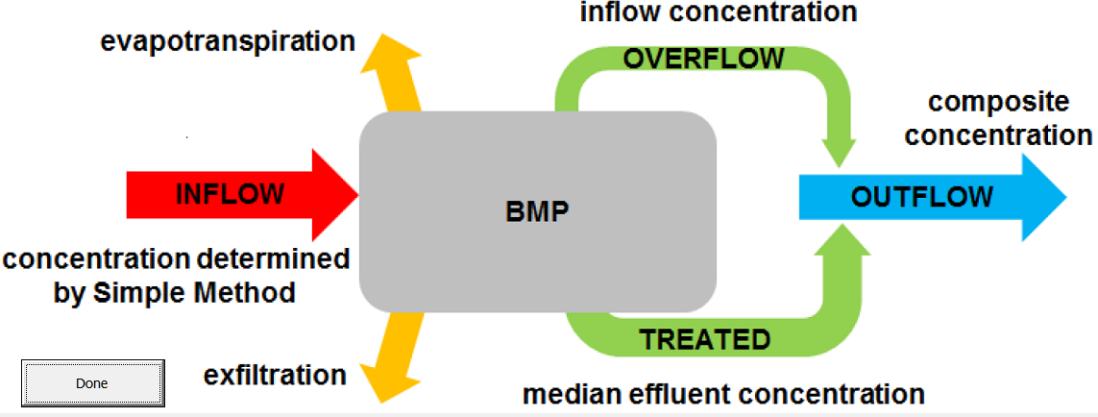
Hydrologic Partitioning by SCMs
(a.k.a. Stormwater ‘Fates’)
Department of Environmental Quality

Slide 9
Runoff Nutrient Concentrations in SNAP
Simple Method Aggregates Annual Catchment Flow, Load to SCM
Clipped from SNAP Tool
 | PROJECT AREA LAND COVERS |  | TN EMC (mg/L) | TP EMC (mg/L) | Pre- Project Area (ft²) | Post- Project Area (ft²)
 | Roof |  | 1.18 | 0.11
 | Roadway |  | 1.64 | 0.34
 | Parking/Driveway/Sidewalk |  | 1.42 | 0.18
 | Protected Forest |  | 0.97 | 0.03
 | Other Pervious/Landscaping |  | 2.48 | 1.07
 | CUSTOM LAND COVER 1
 | CUSTOM LAND COVER 2
 | CUSTOM LAND COVER 3
 | LAND TAKEN UP BY SCM |  | 1.18 | 0.11

Slide 10
Table A.2. SCM Credit Table, NC DEQ Stormwater Control Measure Credit Document, 3/3/2023
SCM | Role |  | % of Annual Runoff |  |  | EMC_{effluent} (mg/L)
 |  | HSG | Untreated Overflow | ET&I | Treated Effluent | TN | TP
Bioretention per MDC | Primary | A | 6 | 85 | 9 | 0.68 | 0.08
 |  | B | 6 | 67 | 27
 |  | C | 6 | 34 | 60
 |  | D | 6 | 13 | 81
Bioretention per MDC but without IWS | Depends on use case | A | 6 | 48 | 46 | 1.33 | 0.11
 |  | B | 6 | 19 | 75
 |  | C | 6 | 10 | 84
 |  | D | 6 | 8 | 86
Bioretention with design variants per Hyper Tool | Depends on design |  | Tool Output |  |  | 0.68 / 1.33 | 0.11
Infiltration per MDC | Primary | A | 16 | 84 | 0 | 0 * | 0 *
 |  | B | 16 | 84 | 0
 |  | C | 16 | 84 | 0
 |  | D | 16 | 84 | 0
Permeable pavement (infiltration) per MDC | Primary | A | 16 | 84 | 0 | 0 ** | 0 **
 |  | B | 16 | 84 | 0
 |  | C | 16 | 84 | 0
 |  | D | 16 | 84 | 0
Permeable pavement (detention, unlined) per MDC | Primary | A | 16 | 8 | 76 | 0.87 | 0.06
 |  | B | 16 | 4 | 80
 |  | C | 16 | 0 | 84
 |  | D | 16 | 0 | 84
Permeable pavement (detention, lined) per MDC | Primary | A | 16 | 0 | 84 | 0.87 | 0.06
 |  | B | 16 | 0 | 84
 |  | C | 16 | 0 | 84
 |  | D | 16 | 0 | 84
Permeable pavement with design variants per the Hyper Tool | Primary |  | Tool Output |  |  | 0.87 | 0.06
Wet Pond per MDC | Primary | A | 16 | 21 | 63 | 0.86 | 0.13
 |  | B | 16 | 16 | 68
 |  | C | 16 | 12 | 72
 |  | D | 16 | 8 | 76
Stormwater wetland per MDC | Primary | A | 16 | 34 | 51 | 0.94 | 0.15
 |  | B | 16 | 29 | 55
 |  | C | 16 | 25 | 59
 |  | D | 16 | 21 | 63
Sand Filter (open) per MDC | Primary | A | 10 | 9 | 81 | 1.09 | 0.08
 |  | B | 10 | 5 | 85
 |  | C | 10 | 0 | 90
 |  | D | 10 | 0 | 90
* EMCs of 0.001mg/L TN and TP are used in the SNAP v4 tool for infiltration to avoid divide-by-zero errors. ** EMCs of 1.08mg/L TN and 0.05 mg/L TP are used in the SNAP v4 tool for infiltrating permeable pavement in cases where the user selects HSG D.
SCM | Role |  | % of Annual Runoff |  |  | EMC_{effluent} (mg/L)
 |  | HSG | Untreated Over-flow | ET&I | Treated Effluent | TN | TP
Sand Filter (closed) per MDC | Primary | A | 10 | 0 | 90 | 1.09 | 0.08
 |  | B | 10 | 0 | 90
 |  | C | 10 | 0 | 90
 |  | D | 10 | 0 | 90
Rainwater Harvesting per MDC | Primary | A | 15 max | Custom based on Tool output |  | 1.73 | 0.08
 |  | B | 15 max
 |  | C | 15 max
 |  | D | 15 max
Green Roof per MDC | Secondary | N/A | 0 | 60 | 40 | 2.44 | 0.76
DIS per MDC | Secondary | A | 10 | 58 | 32 | 2.44 | 0.76
 |  | B | 10 | 45 | 45
 |  | C | 10 | 36 | 54
 |  | D | 10 | 27 | 63
LS-FS per MDC | Secondary | A | 10 | 54 | 36 | 1.03 | 0.17
 |  | B | 10 | 36 | 54
 |  | C | 10 | 22 | 68
 |  | D | 10 | 13 | 77
LS-FS with Virophos sand added to the filter strip | Secondary | A | 10 | 54 | 36 | 1.03 | 0.17
 |  | B | 10 | 36 | 54
 |  | C | 10 | 22 | 68
 |  | D | 10 | 13 | 77
Treatment swale with dry conditions | Secondary | A | 10 | 22 | 68 | 1.07 | 0.13
 |  | B | 10 | 13 | 77
 |  | C | 10 | 4 | 86
 |  | D | 10 | 0 | 90
Treatment swale with wet conditions | Secondary | A | 10 | 36 | 54 | 1.05 | 0.11
 |  | B | 10 | 27 | 63
 |  | C | 10 | 18 | 72
 |  | D | 10 | 9 | 81
Dry Pond per MDC | Secondary | A | 16 | 8 | 76 | 1.33 | 0.22
 |  | B | 16 | 4 | 80
 |  | C | 16 | 0 | 84
 |  | D | 16 | 0 | 84
StormFilter per MDC with PhosphoSorb mediaTM | Primary | A | 10 | 0 | 90 | 0.80 | 0.06
 |  | B | 10 | 0 | 90
 |  | C | 10 | 0 | 90
 |  | D | 10 | 0 | 90
Silva Cell per MDC | Primary | A | 6 | 85 | 9 | 1.23 | 0.23
 |  | B | 6 | 67 | 27
 |  | C | 6 | 34 | 60
 |  | D | 6 | 13 | 81
Filterra | Primary | A | 10 | 0 | 90 | 0.95 | 0.08
 |  | B | 10 | 0 | 90
 |  | C | 10 | 0 | 90
 |  | D | 10 | 0 | 90
BayFilter | Primary | A | 10 | 0 | 90 | TBD*** | TBD***
 |  | B | 10 | 0 | 90
 |  | C | 10 | 0 | 90
 |  | D | 10 | 0 | 90
*** The current data are not sufficient to assess these SCMs for nutrient EMCs.

Slide 11
How Much Do 1º SCMs Reduce Nutrient Loads?

Slide 12
Water Quality Drivers
Lake impairment, load reduction needs
Developed lands loading contribution to lake
Ongoing population growth – development additions - and associated impacts
  Studies find stream degradation begins ~10% watershed BUA.
  Streambeds and banks become nutrient source
  Evidence indicates control of runoff from 1” not protective of streams

Slide 13
Nutrient Load Reduction Needs
Curve determines overall % load reduction needed
% load reduction applied to nutrient export rate which determines SCM type & size

Slide 14
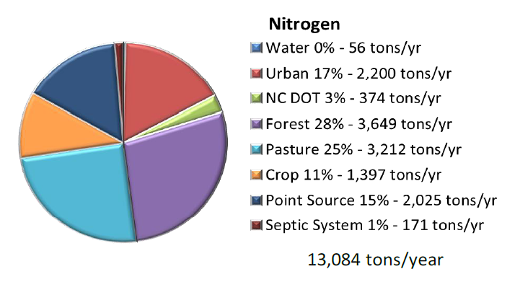
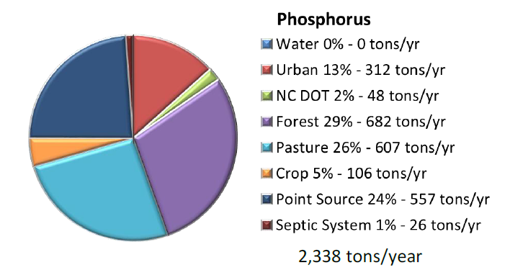
N and P Loading to High Rock Lake by Source
(2005-2010)
Total annual loading to HRL by land cover type (includes ALL acres)

Slide 15
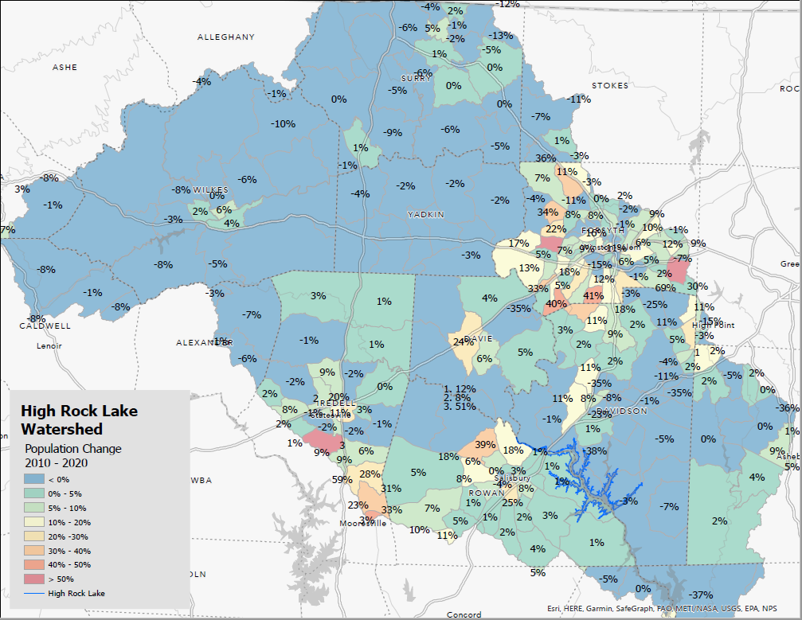

Slide 16
TAG Charge & Next Steps
New Development
What further nutrient reduction management steps can you take that would make sense? Consider both examples of more easily attainable and effective opportunities, as well as more long-term or challenging opportunities for your sector.
  Are ordinance revisions needed in areas with existing protections? What kind?
    Adding quality controls to flood-oriented ordinances?
    Adding nutrient controls?
    Control > 1” for stream protection?
  Are new ordinances needed in areas without?
    Do these communities have the capacity to implement/enforce, or would they need help?

Slide 17

Questions?
Joey Hester
Joey.hester@ncdenr.gov
O: 919-707-3675
C: 919-418-5712
Department of Environmental Quality

Slide 19
Lessons Learned
New Development
  Avoidance
    Development “leaks” outside of regulated areas
    Local governments zone to avoid high density, or developers build to 23.9% BUA
    Whereas studies find stream degradation begins ~10% watershed BUA. Streambanks become nutrient source
  Standardization of req’s across watershed preferable to minimize sprawl, leakage
    However, recognize local administrative capacity is variable; need assistance options
  Lower density thresholds are appropriate
  Evidence suggests streams degrade under runoff from 1” treatment regime
Existing Development
  Reduction opportunities on existing developed lands challenging, costly; need to expand options
  Nutrient credit not yet established for many useful practices; need to loosen constraints
  Load reduction needs estimation challenging, draws over-focus, value/effort questionable; need to de-emphasize as compliance metric
  Progress clearly a long-haul proposition; needs to be built into recurring admin responsibilities

Slide 20
Overview
New Development Nutrient Stormwater Rules
Model program approved by EMC, local programs required
2 approaches to local governments included - N/T = “Swiss cheese”; J/F = all LGs
Programs include post-construction control, AND some or all of:
  ensure compliance, SCM maintenance for life of development;
  public education;
  mapping stormwater system;
  illegal discharges detection/elimination program.
Post-construction stormwater requirements:
  All use nutrient loading rate targets (lb/ac/yr); meet strategy goals project by project
  Onsite-offsite practices combine to meet targets
  Onsite
    Quality: Treatment minimums vary by rule; 30-50% of reduction need (Falls) or one primary SCM (others)
    Quantity: peak rate match, 1 yr/ 24 hr storm (Falls only)
  Offsite – buy credit for remaining load reduction per Nutrient Offset Rule 15A NCAC 2B .0703
    Private offset bank via DWR - https://deq.nc.gov/about/divisions/water-resources/water-quality-permitting/401-buffer-permitting/nutrient-offset-buffer-mitigation-program
    No bank credits available? DMS - https://deq.nc.gov/about/divisions/mitigation-services/customers/nutrient-offset-ilf-program-information

Slide 21
Overview (cont’d) – Jordan, Falls
Existing Development Stormwater Rules
Regulated parties = all local governments
Jordan:
  Stage 1: Education, mapping, IDDE, Retrofits ID
  Stage 2 @ 5, 7 years: Lake monitoring trigger – Impaired? -> Programs required
Jordan, Falls: Nutrient load reduction programs
  Reduction targets = strategy goals applied to pre-New D developed lands w/in jurisdiction
    Falls Stage 1 target = offset post-baseline difference
  Propose pace of implementation – negotiable
    except Falls Stage 1 = 10 ~16 yrs
    Falls – Association alternative plan, “IAIA” = spending-based pace
  Broad latitude on load-reducing practices
    Main focus = existing developed lands w/in jurisdiction; challenging
    May also obtain reductions from other sources
    Joint compliance, combined (rules) compliance options
    (Initially) Only practices with approved nutrient crediting
    (Later) Falls IAIA: Explicit list – includes nutrient-friendly practices lacking accounting

