Slide 1
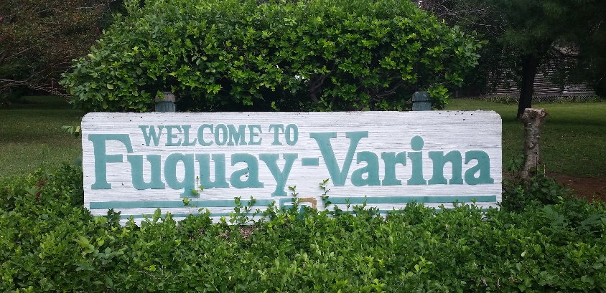
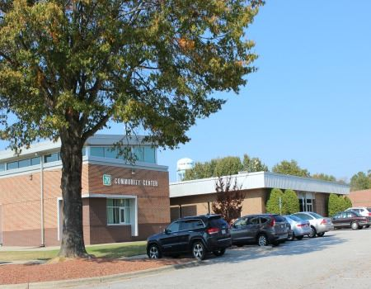
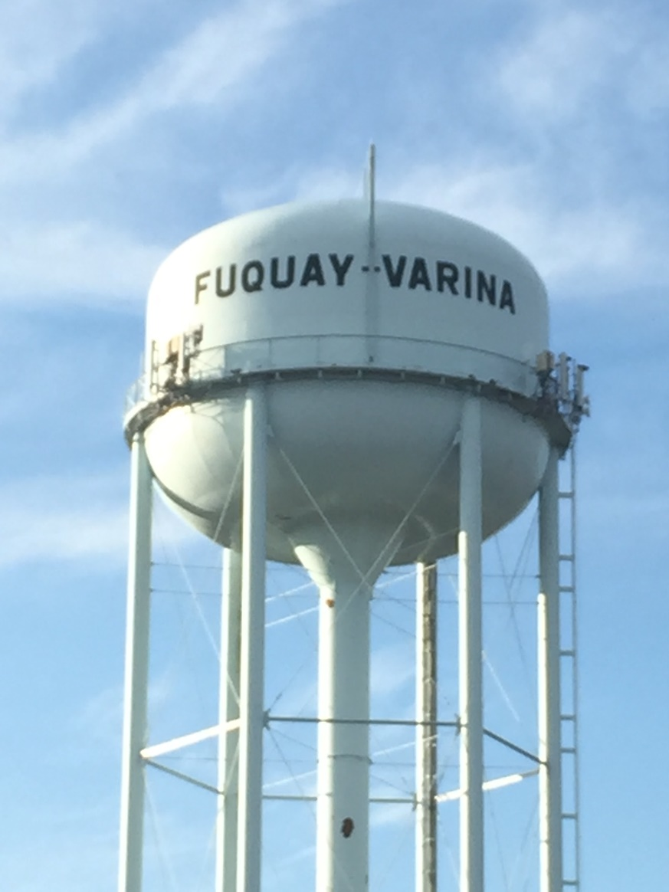
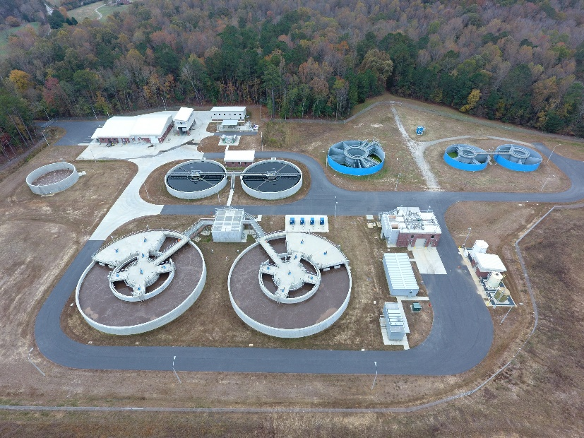
Scoping Phase (Public Meetings), October 2020
Fuquay-Varina Water Supply and Interbasin Transfer Project

Slide 2
Presentation Outline
Who
…is the Town of Fuquay-Varina, NC?
Why
…does the Town need water?
What
…is the process?
Where
…can we find a solution?
When
…will the Town need the water?
How
…can you participate?

Slide 3
Who is the Town of Fuquay-Varina?

Slide 4
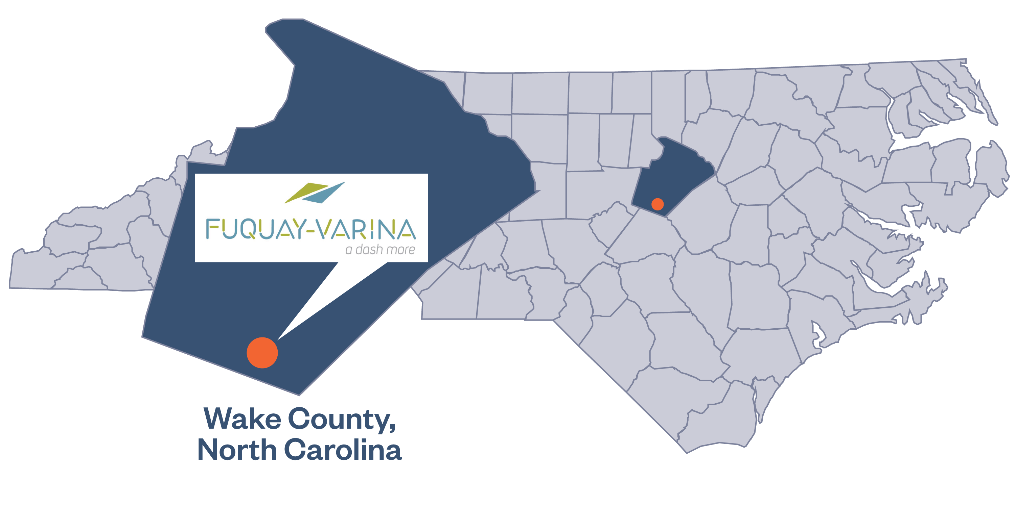
We Are Located in Southern Wake County

Slide 5
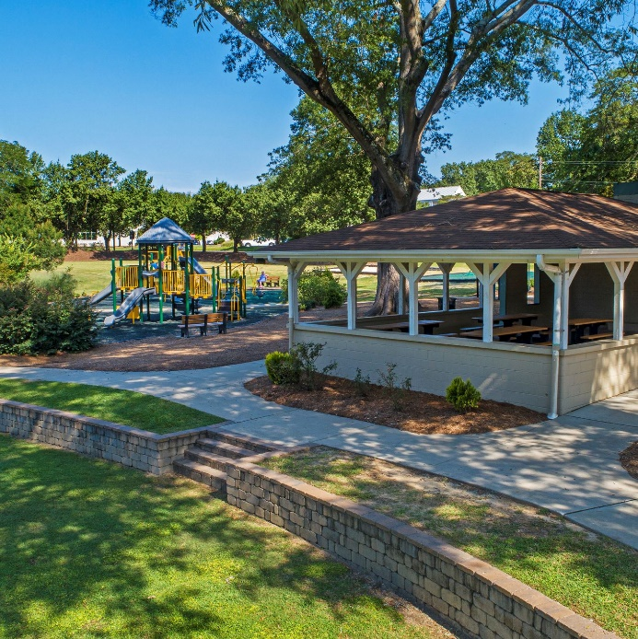
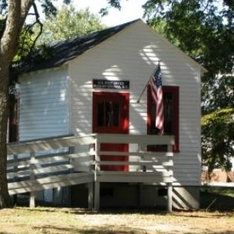
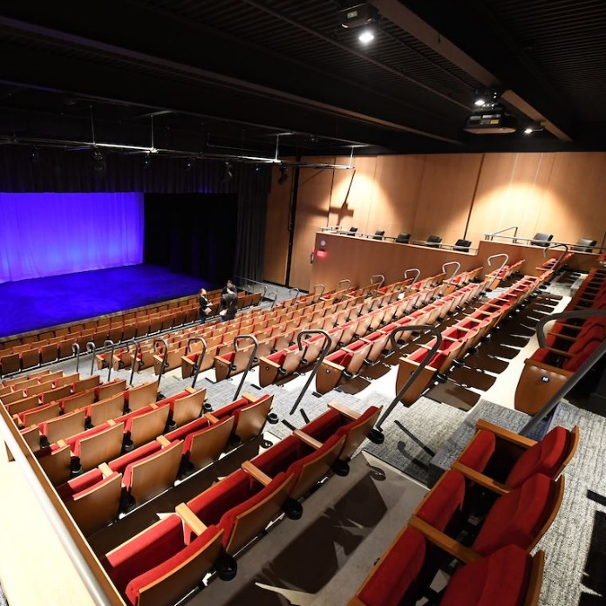
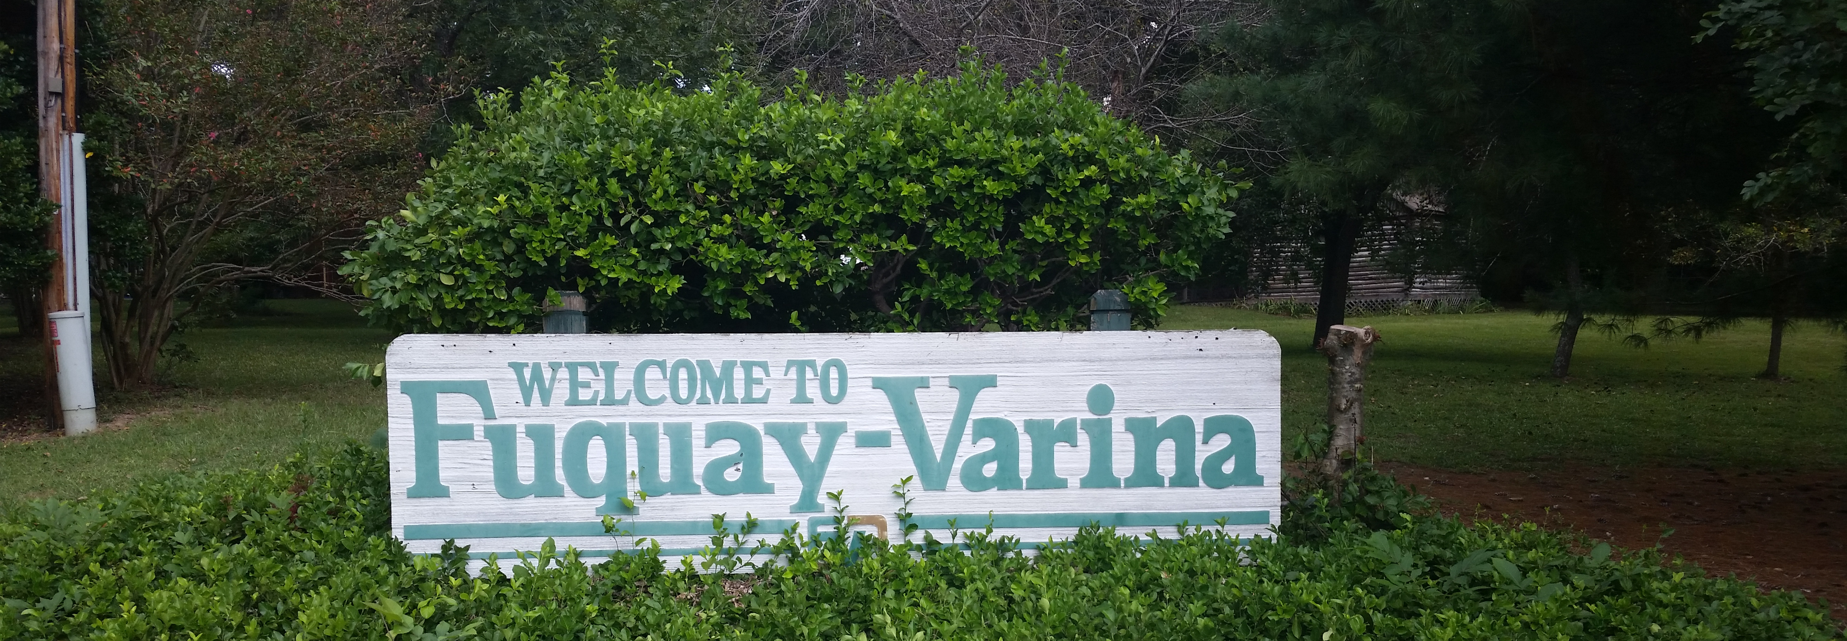
32,000
2020 population
90%
Residential
4% per year
Growing service area
Commercial
10%

Slide 6
Why does the Town need water?

Slide 7
Purpose and Need
Town does not own water supply capacity
Finished water is currently purchased on a wholesale basis via contract:
Harnett County
Johnston County
City of Raleigh
Long-term water supply solution from current water purveyors is not feasible
Town partnering with the City of Sanford for water supply capacity

Slide 8
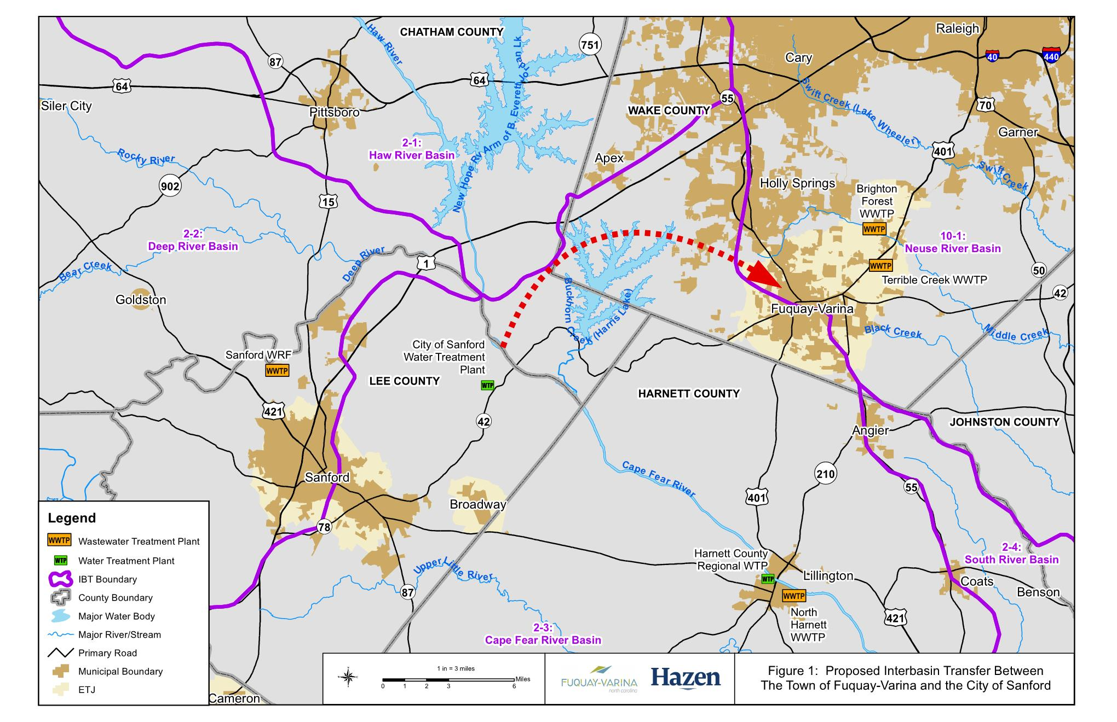
IBT Project Area
Notes:
City’s WTP located in CF
Town’s service area in CF and NR
Approximately 18 miles of finished water transmission main.

Slide 9
What is the process?

Slide 10
IBT Certification Process
I. Applicant submits Notice of Intent to File a Petition (6 months)
30 days notice for scoping meetings
Public meetings within 90 days of NOI submittal
Comments accepted 30 days after last meeting
II. Applicant submits Draft Environmental Document (1 – 3 years)
30 days notice of public hearing
EMC holds public hearing
Comments accepted 30 days after last meeting
EMC prepares written response to comments
Settlement discussions, if requested
EMC determines adequacy of document
III. Applicant submits IBT Petition to EMC (6 months – 1 year)
EMC issues draft determination within 90 days
Public notice draft determination, 30‑day notice of hearings
2+ public hearings within 60 days of draft determination
Comments accepted 30 days after last hearing
EMC prepares written response to comments
EMC issues final determination

Slide 11
Key IBT Tasks
Notice of Intent, Public Notification, Scoping
Water Demand & IBT Projections
Hydrologic Modeling to support IBT
Draft EIS Preparation
Draft EIS Submittal to EMC
IBT Petition
Draft to Final EIS, Record of Decision, Finding of Fact

Slide 12
Preliminary IBT Schedule
Submit IBT Petition to EMC
NOI / Public Notification / Scoping
EMC Meeting (Draft EIS)
ROD and Finding of Fact
EIS
Development
Final EMC Determination
July- Sept 2020
July 2020 – Feb 2021
May 2021
Feb 2022
Jan 2023
Summer 2023
Acronyms:
NOI – Notice of Intent
EIS – Environmental Impact Statement
IBT – Interbasin Transfer
EMC – Environmental Management Commission
ROD – Record of Decision

Slide 13
Where can we find a solution?

Slide 14
Development of Alternatives
Surface water supply alternatives
Draft list of alternatives prepared for scoping
Alternatives grouped into three categories
Surface water supply
Interbasin transfer minimization
Other (e.g., no-action)
Additional alternatives may be developed as a result of scoping and/or further analysis
Interbasin transfer minimization alternatives
Other

Slide 15
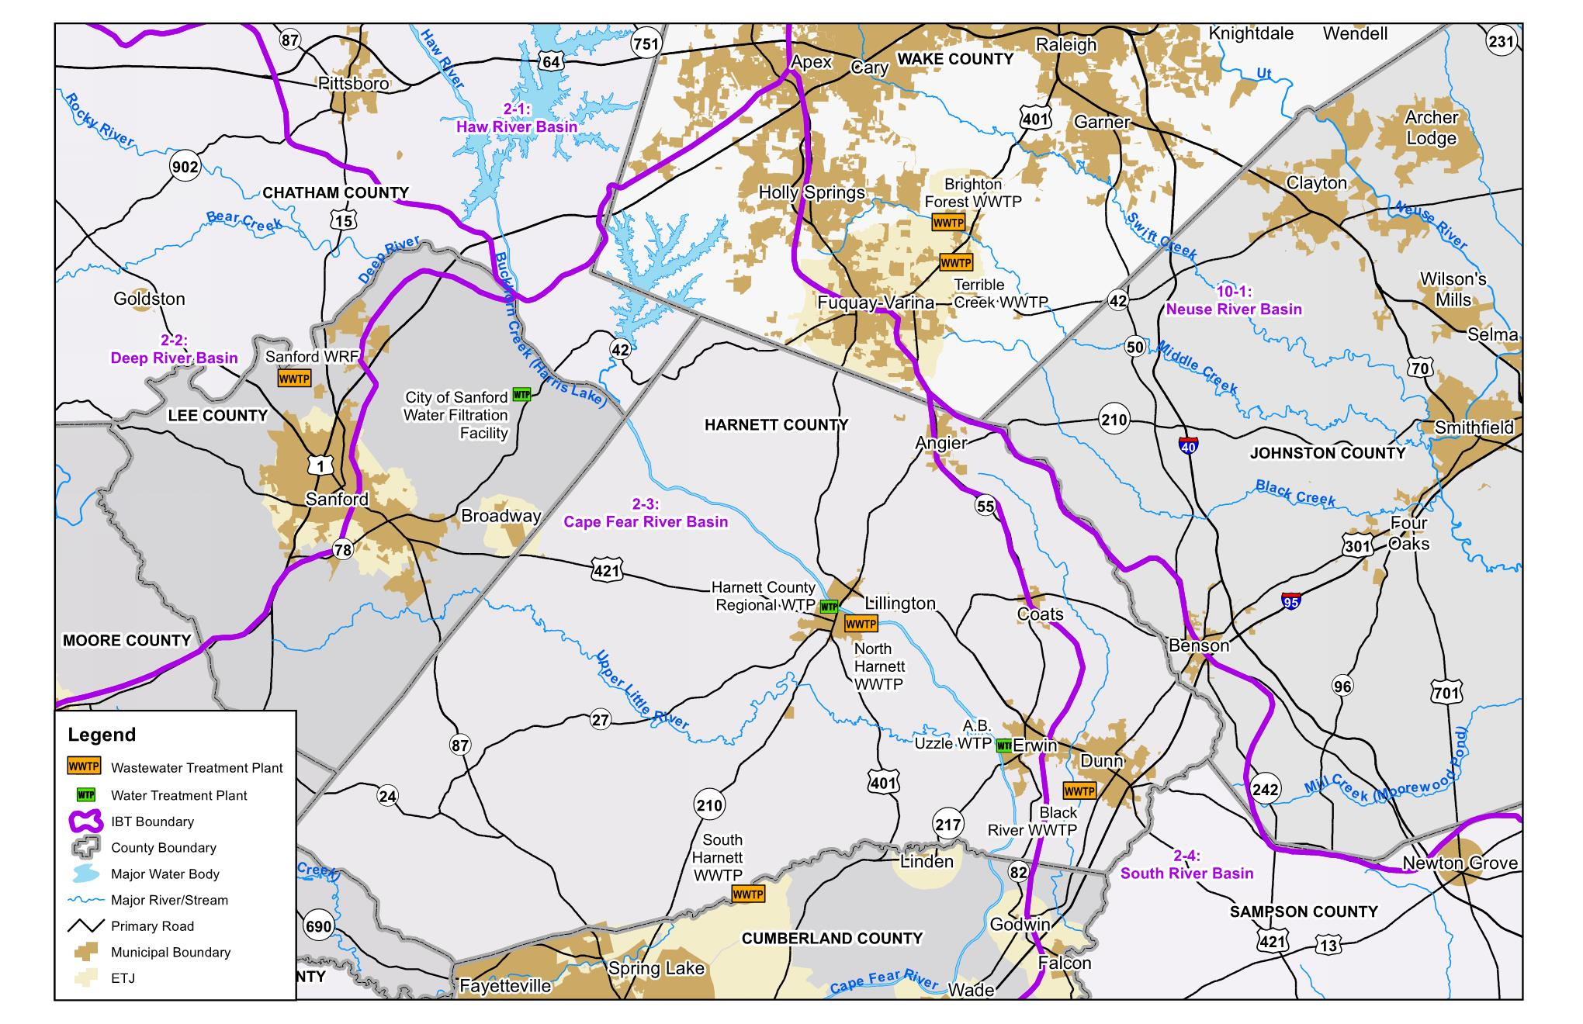
Alternatives Analysis
Purchase capacity from Raleigh
Indirect / direct potable reuse
Jordan Lake allocation
Combination of Alternatives
Purchase capacity from Johnston County
No-action
Town of Fuquay-Varina independent water supply
Purchase capacity from City of Sanford
Additional conservation measures
Purchase capacity from Harnett County
Purchase capacity from City of Dunn
Wastewater return to the Cape Fear
Groundwater
Reuse

Slide 16
When will the Town need the water?

Slide 17
Water Demand Projections
Requesting an IBT certificate for:
Average day transfer of approximately 4 million gallons per day (mgd) (*)
Maximum day transfer of 8 mgd
Transfer from the Cape Fear River basin to the Neuse River basin
Request IBT amount is based on 2055 water demand projections of approximately 7 mgd (*)
Town is partnering with the City of Sanford
Town serves customers in the Cape Fear and Neuse River basins
* Preliminary estimates and will be refined with further study.

Slide 18
How can you participate?

Slide 19
Opportunity to Comment During Scoping
Public Meeting #1
October 14, 2020 at 6:30 P.M.
Chatham County Agriculture and Conference Center
Public Meeting #2
October 20, 2020 at 6:30 P.M.
Cary Town Center Mall
Public Meeting #3
October 21, 2020 at 6:30 P.M.
Cross Creek Mall, Fayetteville
Comment Deadline
Postmarked by November 20, 2020

Slide 20
Opportunity to Comment During Scoping
Written comments should be mailed to:
Town of Fuquay-Varina – IBT Comments
Hazen and Sawyer
Attn: Mary Sadler, PE
4011 WestChase Blvd., Suite 500
Raleigh, NC 27607
Comments may also be submitted electronically to:
msadler@hazenandsawyer.com

Slide 21
Opportunity to Comment During Scoping
Comments will be noted during this phase of virtual public meetings
Mailed and emailed comments will be given equal consideration
Public comment period for this phase of the project closes on November 20, 2020
Future opportunities to provide input during the overall IBT certificate request process

Slide 22
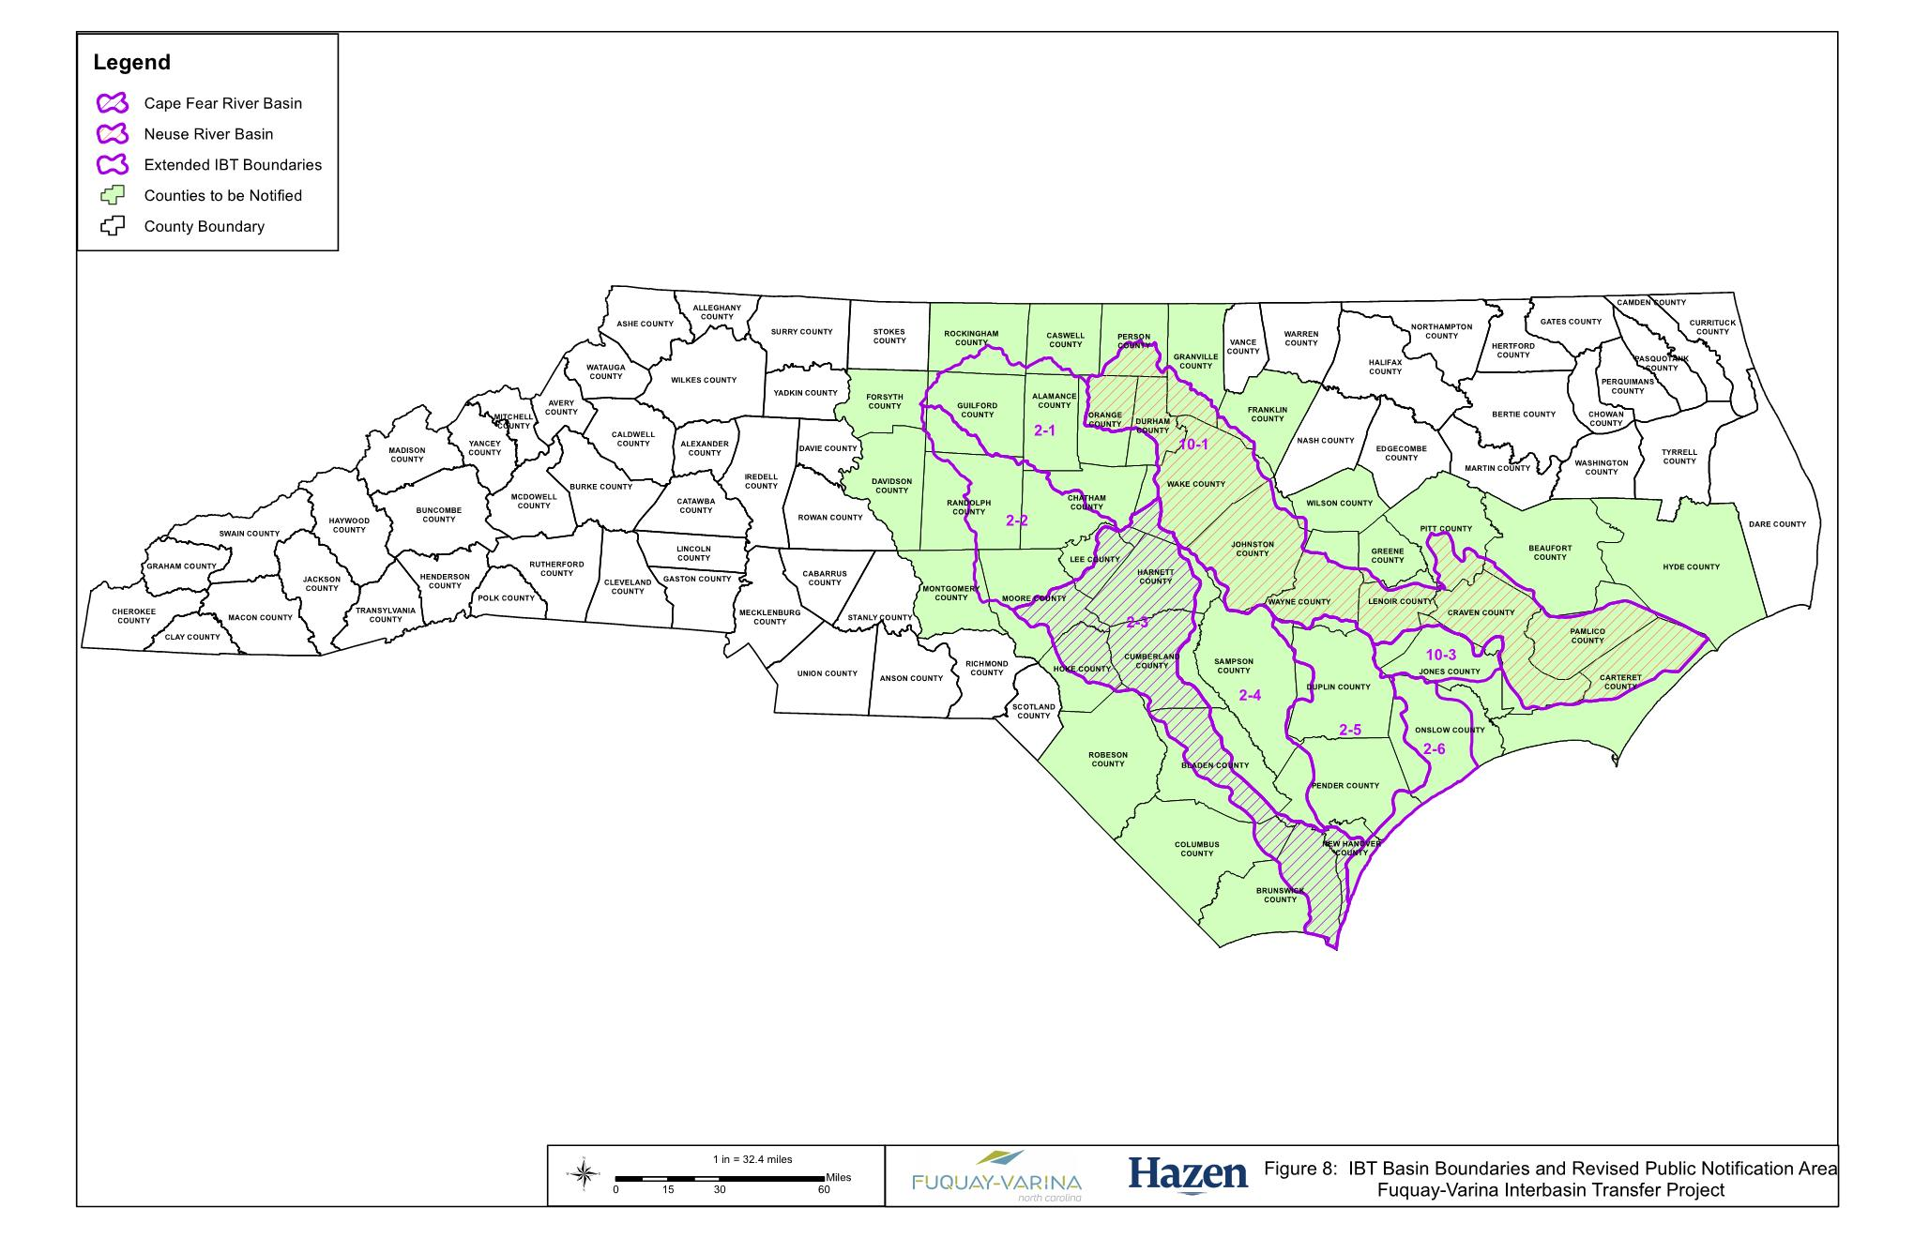
Other Notification Requirements per GS§143-215.22L
Notification Requirements:
Counties
Politically independent cities and towns
Newspapers of general circulation
Public water supply systems, water management agencies
NPDES permit holders
Registered water withdrawals
IBT certificate holders
Any interested person (e.g., Water Allocation Committee list-serve)
IBT Notification Area

Slide 23
Comments / Questions

