Slide 1

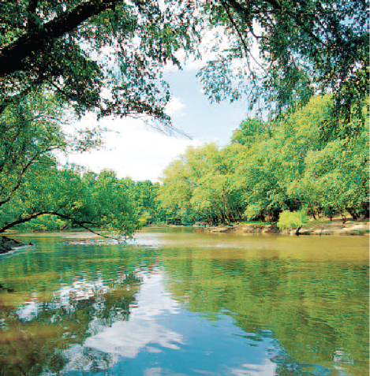

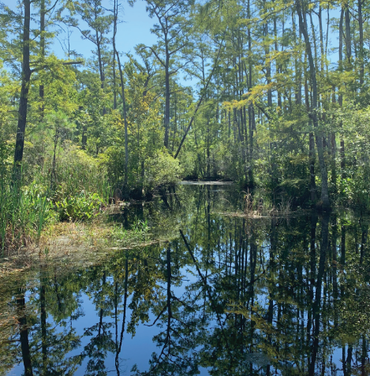
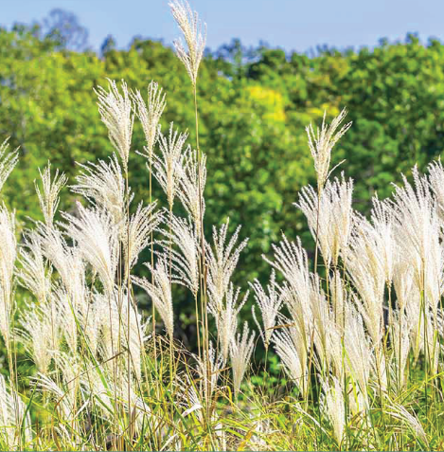
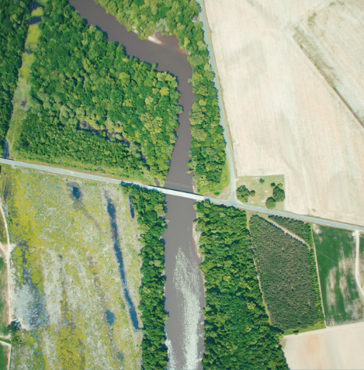
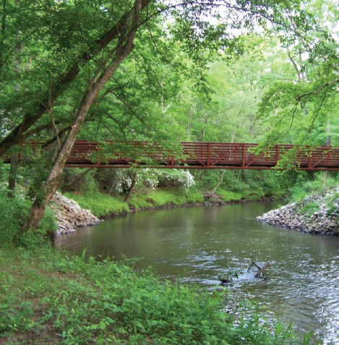




Riparian Buffers for Water Resource Protection
Michael R. Burchell II
Professor and Extension Specialist
Department of Biological and Agricultural Engineering
NC State University

Slide 2
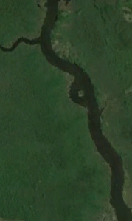
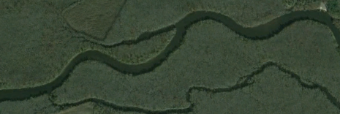
Riparian Areas
From Latin ripa – area adjacent to a watercourse
In NC most of the floodplains were well vegetated – mostly forested
Considered an ecotone
  Transitional area from upland to aquatic
  Like a cell membrane controlling how materials enter the stream
Notes:
Impacts on natural resources
Algal over production
Environmental, Social, and Economic Issues

Slide 3
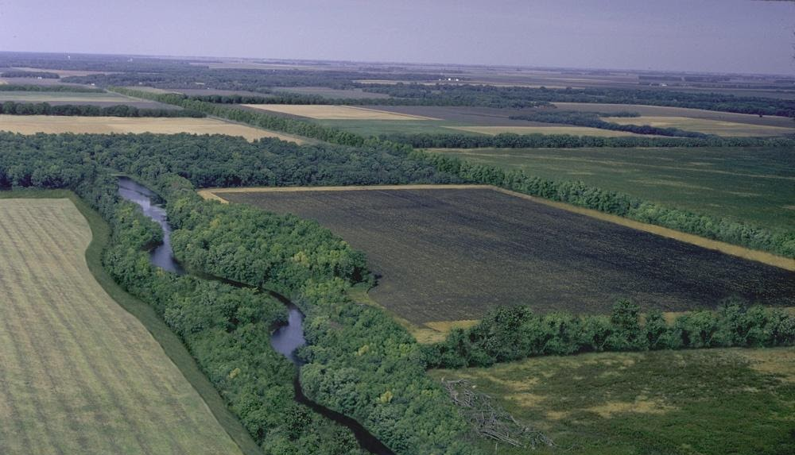
Riparian Buffers
Vegetated streamside corridors (either protected or restored) meant to protect stream ecological functions and downstream water quality
Example mid-western buffer
Notes:
Impacts on natural resources
Algal over production
Environmental, Social, and Economic Issues

Slide 4
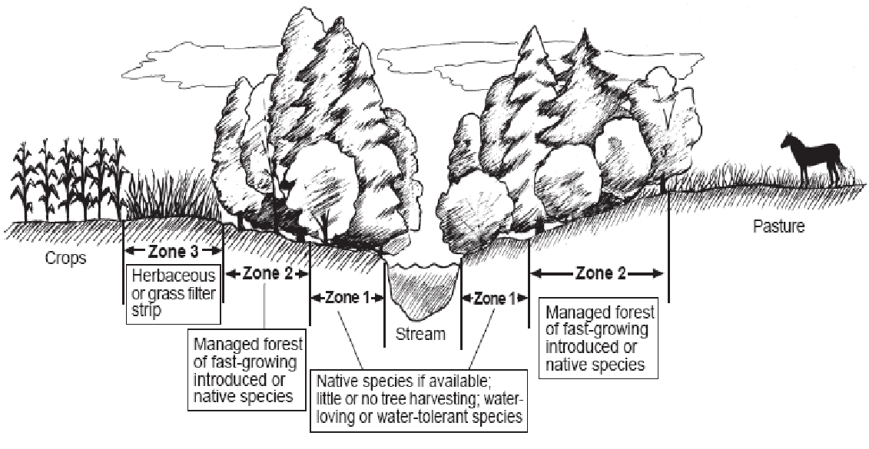
Riparian Buffers
25 years ago, buffer experts (national and NC State) plus state officials joined to determine realistic buffer width to minimize land to put into buffers
Result = minimum 50 feet, two zone buffer (grass + trees)
Floodplain
NRCS ideal buffer design to achieve multiple functions
Notes:
Impacts on natural resources
Algal over production
Environmental, Social, and Economic Issues

Slide 5
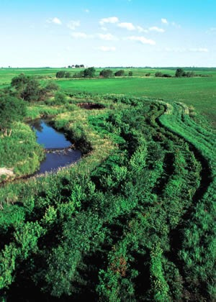
Riparian Buffers
Research has shown buffers can provide 4 functions
http://www.mda.state.mn.us/protecting/conservation/practices/bufferforested.aspx
Notes:
Impacts on natural resources
Algal over production
Environmental, Social, and Economic Issues

Slide 6
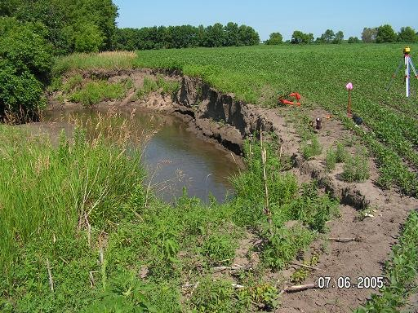
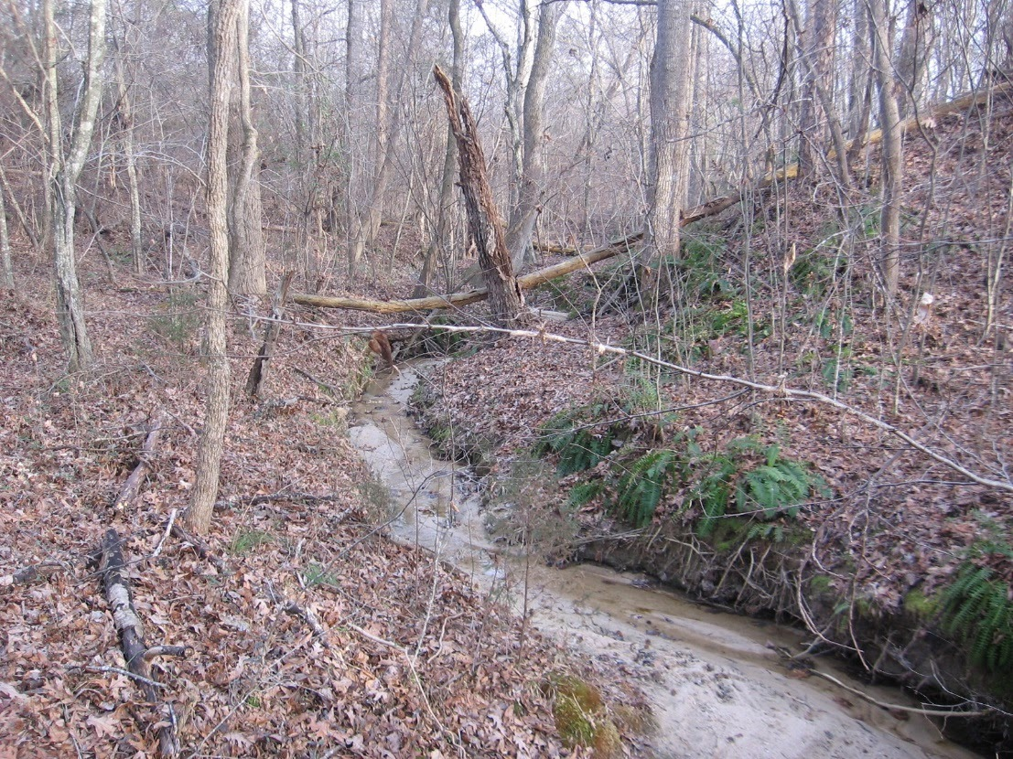
1. Protect Stream Structure
Vegetation within the buffer slows surface water down
Roots near stream stabilize banks (particularly in bends)
Slower runoff + reinforced streambanks = less erosion
Less streambank erosion = less sediment loss downstream
Notes:
Impacts on natural resources
Algal over production
Environmental, Social, and Economic Issues

Slide 7
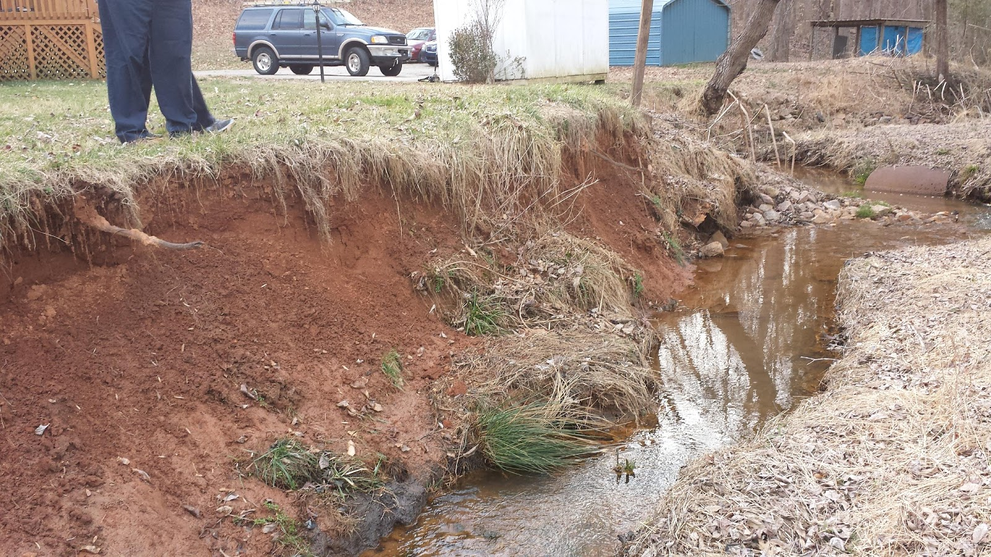
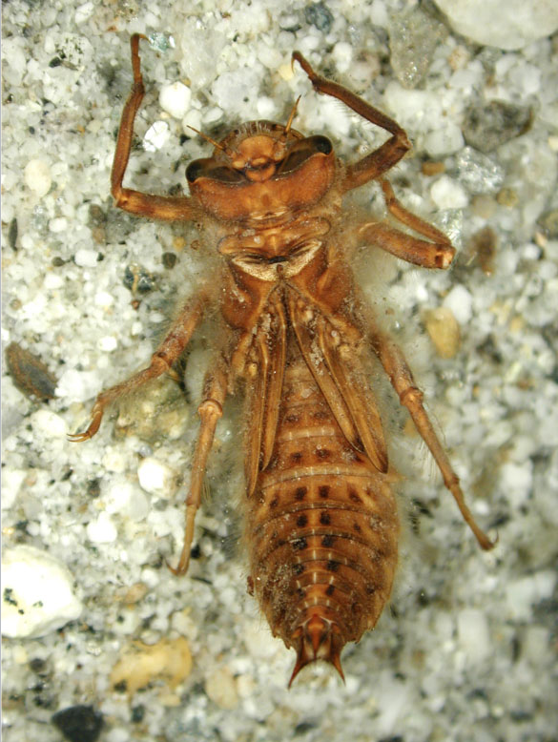
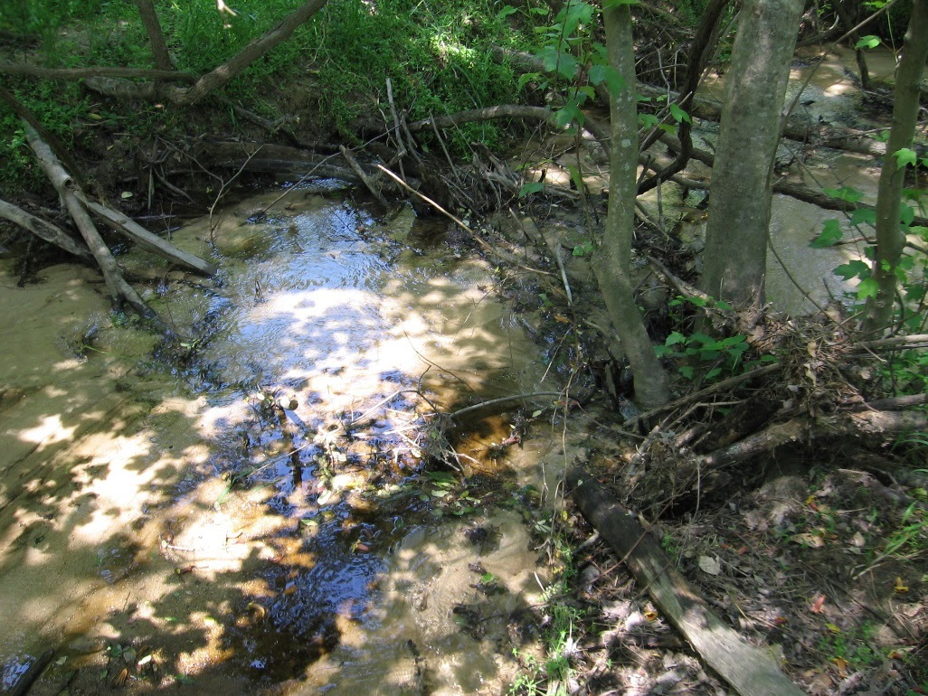
2. Enhance Aquatic Environment
Tree canopy provides shade
  Temperature control
  Higher oxygen
  Controls algae
Leaf litter
  Carbon and organic nutrients (energy for food web)
  Habitat
Coarse woody debris
  Habitat
Notes:
Impacts on natural resources
Algal over production
Environmental, Social, and Economic Issues

Slide 8
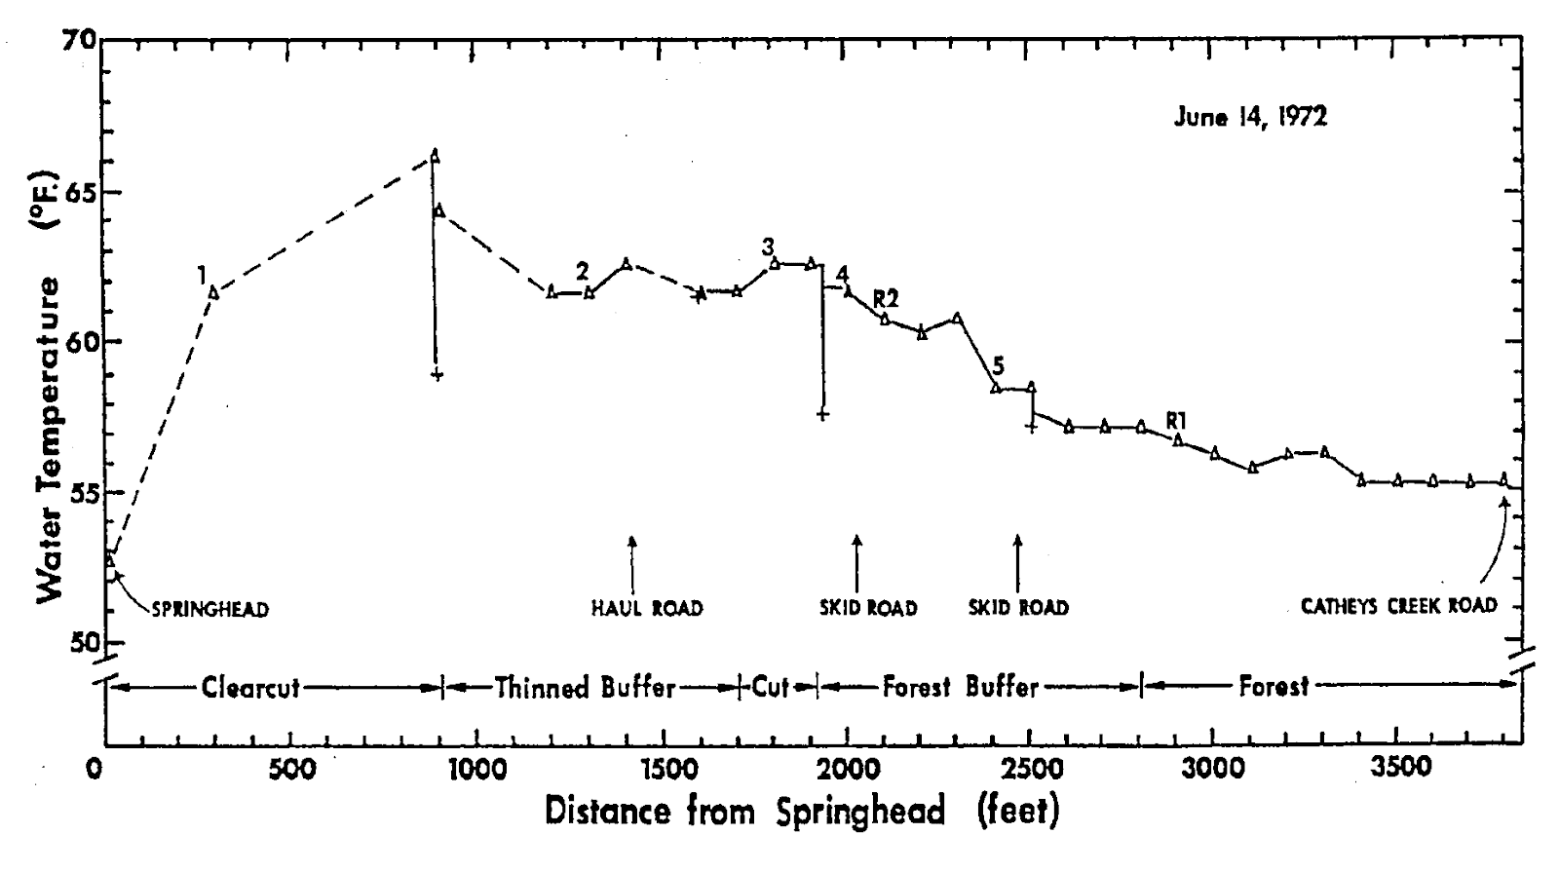
Temperature – Forested Riparian Areas
Effects of Clearcut Timber Harvesting on stream temperature
Lloyd Swift, US Forest Service Coweeta Hydrologic Laboratory – 135 ac clearcut in mixed hardwood forest, 40 ft wide riparian buffer, N-S oriented first order stream, Pisgah National Forest near Brevard, NC
Notes:
Impacts on natural resources
Algal over production
Environmental, Social, and Economic Issues

Slide 9
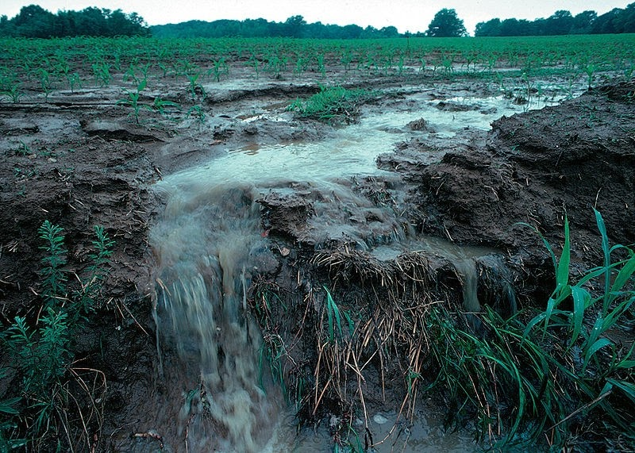
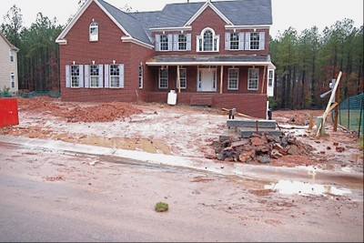
3. Reduce Sediment and Phosphorus from Surface Runoff
Notes:
Impacts on natural resources
Algal over production
Environmental, Social, and Economic Issues

Slide 10
3. Reduce Sediment and Phosphorus from Surface Runoff
Surface runoff
Grass filter slows water
Encourages diffuse flow (critical component)
Sediment and sediment –bound P is deposited
Sediment can be trapped, P uptake by vegetation possible
Notes:
Impacts on natural resources
Algal over production
Environmental, Social, and Economic Issues

Slide 11
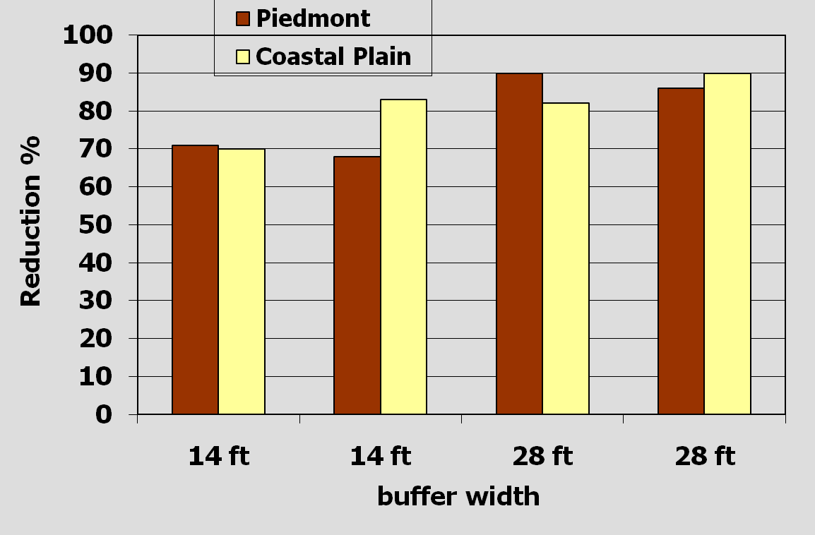
3. Reduce Sediment and Phosphorus from Surface Runoff
Sediment reduction can be high
From: NCSU Technical Bulletin 318 - Riparian Buffers and Controlled Drainage to Reduce Agricultural NPS Pollution. From D. Osmond with permission.
Notes:
Impacts on natural resources
Algal over production
Environmental, Social, and Economic Issues

Slide 12
3. Reduce Sediment and Phosphorus from Surface Runoff
Other analysis on sediment - Predictive Models
Other Analysis on Sediment
Liu et al. (2008) at 85 sites
  30 ft buffer – 85% removal
  50 ft buffer – 94% removal
  100 ft buffer – 100% removal
  Possible over-prediction due to experimental setup?
Sweeny and Newbold (2014) at 22 sites
  30 ft buffer – 64% removal
  50 ft buffer – 74% removal
  100 ft buffer – 80% removal
Note – sediment that is lost has more fine particles and will be more easily transported downstream
Notes:
Impacts on natural resources
Algal over production
Environmental, Social, and Economic Issues

Slide 13
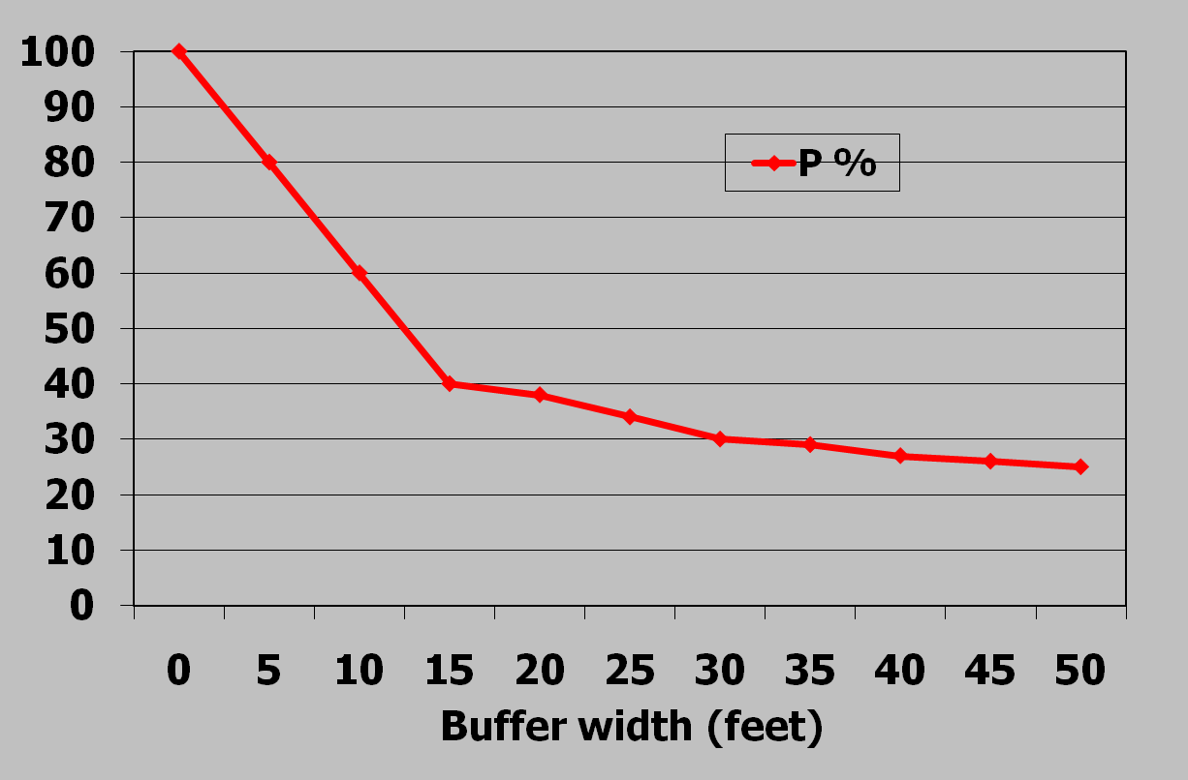
3. Reduce Sediment and Phosphorus from Surface Runoff
Sediment-attached Phosphorus removal can follow similar trends
% P remaining
From: NCSU Technical Bulletin 323 – North Carolina Phosphorus Loss Assessment. From D. Osmond with permission
Notes:
Impacts on natural resources
Algal over production
Environmental, Social, and Economic Issues

Slide 14
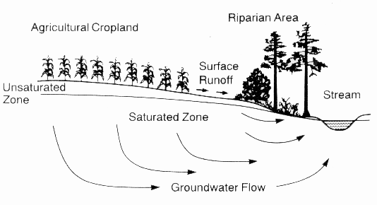
4. Reduce Nitrate-Nitrogen from Groundwater before it Discharges to the Stream
Notes:
Impacts on natural resources
Algal over production
Environmental, Social, and Economic Issues

Slide 15

Riparian Buffers – Nitrogen removal
Buffers can be effective sinks of NO₃ through
Microbial denitrification
Plant uptake
Aerobic Soil
NH₄ NO₃
NO₃
Anaerobic or Hydric soils
NO₃
NO₃
NO₃
NO₃
NO₃
Shallow Ground Water Flow
Restrictive Layer (Aquitard)
Notes:
Impacts on natural resources
Algal over production
Environmental, Social, and Economic Issues

Slide 16
Riparian Buffers – Nitrogen removal
Areas in the floodplain have:
High plant productivity
High soil carbon
Groundwater close to the surface
Low soil oxygen
Aerobic Soil
NH₄ NO₃
NO₃
Anaerobic or Hydric soils
NO₃
NO₃
NO₃
NO₃
NO₃
Shallow Ground Water Flow
Restrictive Layer (Aquitard)
Notes:
Impacts on natural resources
Algal over production
Environmental, Social, and Economic Issues

Slide 17
Riparian Buffers – Nitrogen removal
Groundwater Flow
This leads to higher plant uptake of NO₃
In the absence of oxygen, soil microbes use NO₃ instead (denitrification) and release N₂ to the atmosphere
Both processes combine for significant potential removal of N
NO₃
N₂
Denitrification
“hot spot”
Notes:
Impacts on natural resources
Algal over production
Environmental, Social, and Economic Issues

Slide 18
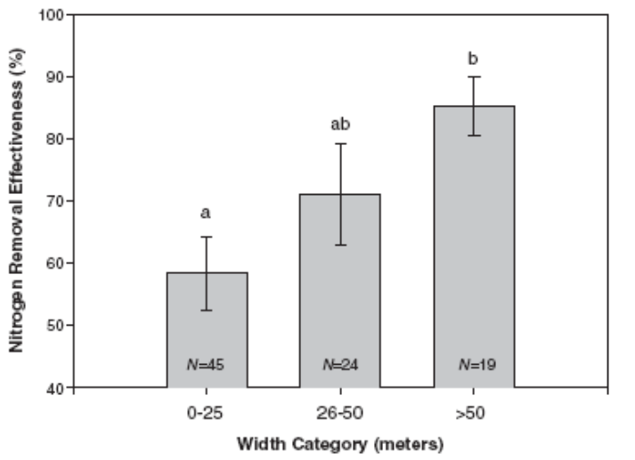
Other Analysis on Nitrogen Removal
Mayer et al. 2007 at 88 sites
Note: Surface + subsurface contributions
<80
<80-160
160+
Buffer width in feet
Notes:
Impacts on natural resources
Algal over production
Environmental, Social, and Economic Issues

Slide 19

Riparian Buffers
Grass Pines Hardwoods
Aerobic Soil
Wells
Anaerobic or Hydric soils
NC studies on buffers enrolled in the NC CREP Program
Tar-Pamlico Basin
2-5 years data
54-72 groundwater wells per site across experimental blocks
Typical experimental setup
Notes:
Impacts on natural resources
Algal over production
Environmental, Social, and Economic Issues

Slide 20
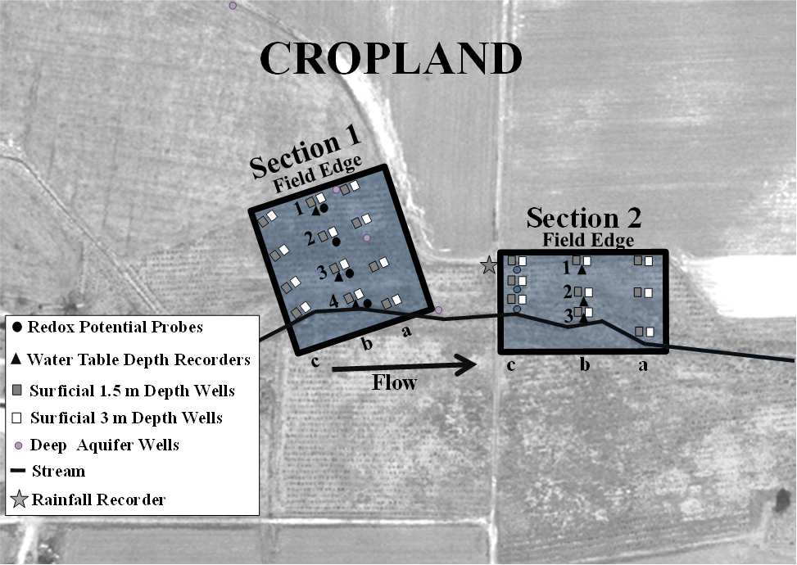
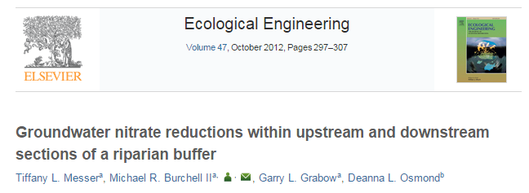
Site 1
NO₃ -N Source - Cropland
Section 1 (200 ft width)
- Groundwater at Field Edge
4 mg/L NO₃-N
- Higher Elevation
Section 2 (150 ft width)
- Groundwater at Field Edge
12 mg/L NO₃-N
- Lower Elevation
- Wetland indicators
Shallow– 63% reduction
Deep – 15% reduction
Shallow– 89% reduction
Deep – 54% reduction
Notes:
Impacts on natural resources
Algal over production
Environmental, Social, and Economic Issues

Slide 21
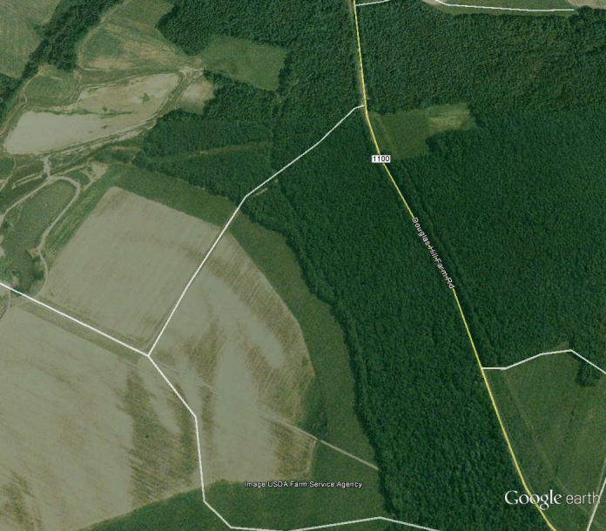
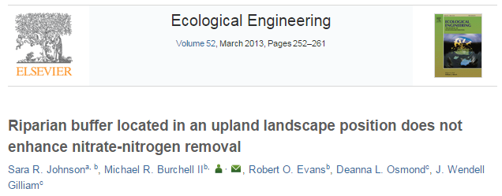
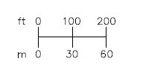
Site 2
NO₃ -N Source – Cropland
3 Blocks (390 ft width)
Zone 2-Pine Conservation Buffer)
Zone 1
Existing Hardwood Buffer
Zone 3 (Grassed)
Stream Flow
Cropland
Water Table Well
Water Quality Well: Shallow and Deep
Redox Probe Nest: Shallow and Deep
Groundwater Flow Direction
– “A misunderstood paper”
Zone 1 Existing Hardwood Buffer
Notes:
Impacts on natural resources
Algal over production
Environmental, Social, and Economic Issues

Slide 22
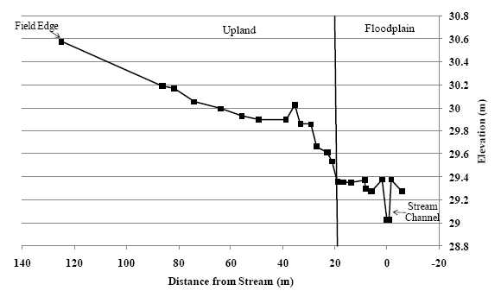
Site 2 – Elevation Cross Section
New pines
Floodplain
Approx. 4 ft elevation drop
390 328 263 197 131 65 0 -65
Distance from stream (ft)
Limited Nitrate
removal
20-80% removal
in floodplain
  Treatment DID OCCUR in the existing hardwood forest within the floodplain within the last 65-75 feet to the stream
Notes:
Impacts on natural resources
Algal over production
Environmental, Social, and Economic Issues

Slide 23
Conclusions
Riparian Buffers can:
  Protect stream structure
  Enhance the aquatic environment
  Reduce sediment and phosphorus form surface runoff
  Reduce nitrate-nitrogen from groundwater before it discharges to the stream
Often, riparian buffers will provide most of these important functions at all sites
Research strongly supports the fact that buffers are a critical component of successful water quality protection strategy in NC watersheds
Notes:
Impacts on natural resources
Algal over production
Environmental, Social, and Economic Issues

Slide 24
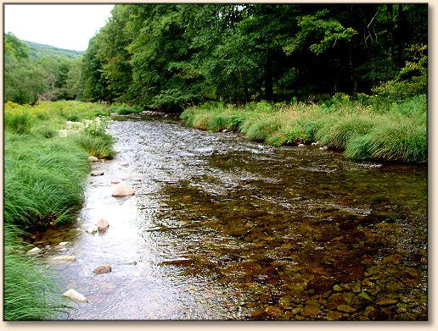
Conclusions
Overall, research indicates most buffer functions approach a maximum at or above 100 feet and start to diminish at different rates as buffers widths get more narrow
Buffers less than the 50 ft width requirement could significantly reduce the effectiveness in N removal (less treatment area) and sediment removal (particularly on lands with higher slopes).
Notes:
Impacts on natural resources
Algal over production
Environmental, Social, and Economic Issues

Slide 25
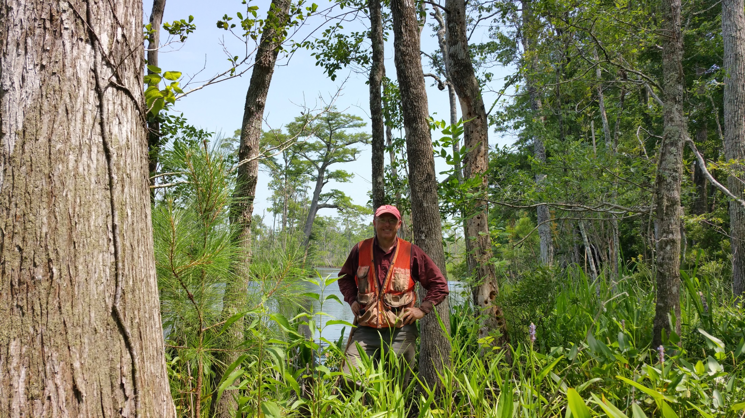
Thank you!
mike_burchell@ncsu.edu
Notes:
Impacts on natural resources
Algal over production
Environmental, Social, and Economic Issues

