Slide 1
Department of Environmental Quality
High Rock Lake
Nutrient Management
Strategy: Stormwater
January 26, 2023

Slide 2
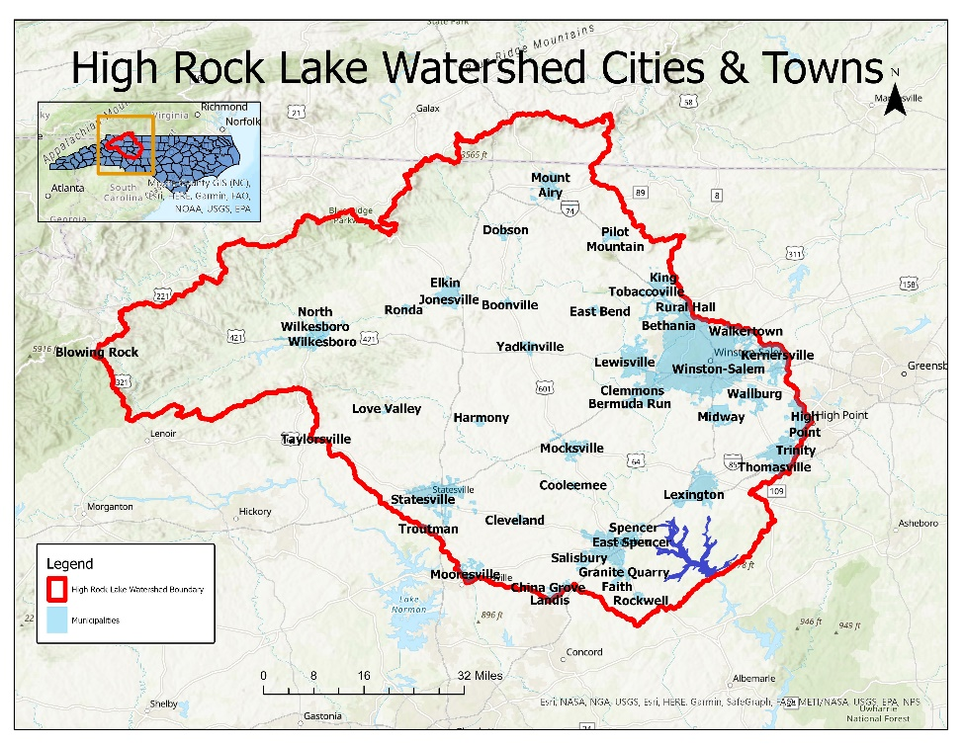
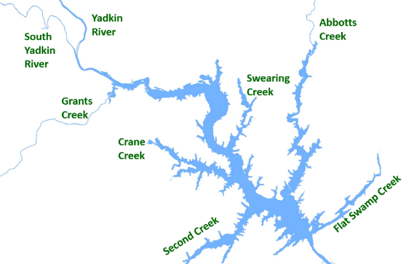
NMS Rulemaking
Implementation Outcomes
Engage stakeholders in watershed planning
Prioritize and enable creative and innovative solutions that meet the needs of residents
Eliminate chlorophyll-a impairment and restore full uses of the Lake (fishing, swimming, recreation)
Protect drinking water supplies along the Yadkin River and around High Rock Lake
Department of Environmental Quality

Slide 3
Stakeholder Engagement
Process Goals
Engage stakeholders in watershed planning
Prioritize and enable creative and innovative solutions that meet the needs of residents
Document existing stormwater management regulatory landscape in HRL
Draft conceptual proposals for
  Reducing nitrogen and phosphorus loading from developed lands
  Implementation timelines
  Adaptive management
Identify regulatory and administrative barriers to implementation
Combine conceptual proposals into a formal recommendation for DWR staff

Slide 4
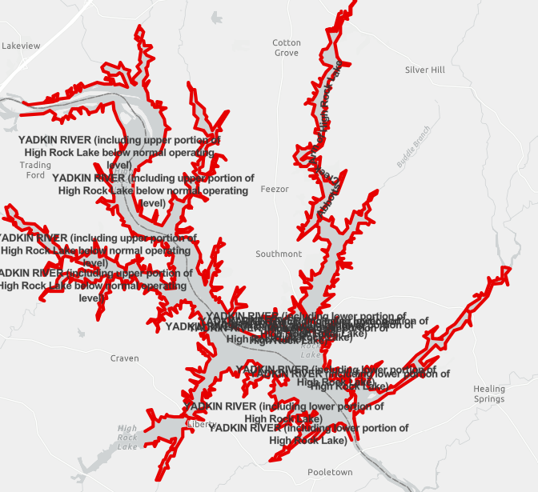
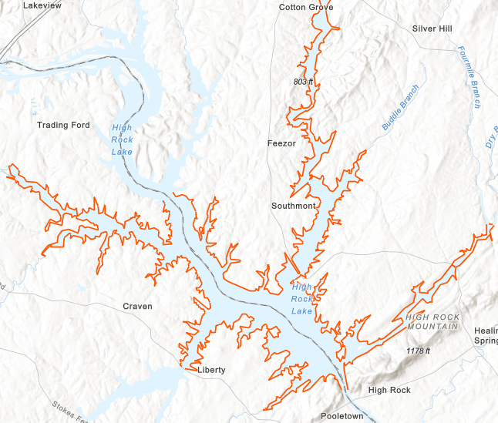
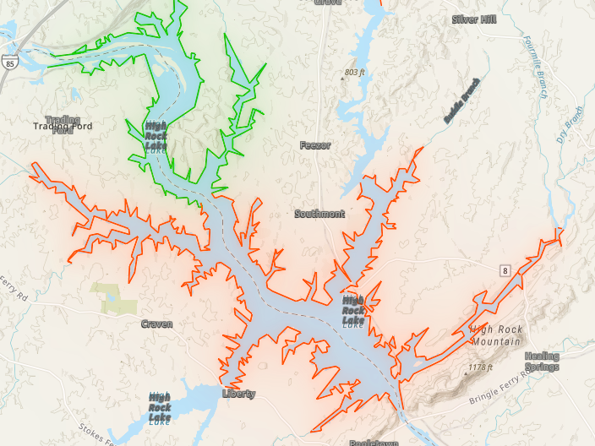
HRL Chlorophyll-a Impairments
2018 2020 2022

Slide 5
State and Federal Statutes
Regulatory Obligations
Clean Water Act
  Set water quality parameter standards to protect “uses” (recreation, drinking water, fishing, etc.)
  When WQ parameters are exceeded, designate a water body “impaired”
  Develop a restoration/remediation plan to reduce inputs to comply with WQ standards
  Monitor implementation until WQ standards are met
  Eliminate the impairment and recover full uses of water body
§ 143-215.8B
  Regulate point and nonpoint sources of pollutants
  Establish nutrient reduction goals
§ 143B-282
  EMC adopts rules to assure water quality standards are met
  Address point and nonpoint sources of pollutants
15A NCAC 02B .0211
  Sets chlorophyll-a standard and requires EMC to regulate contributing sources

Slide 6
Rulemaking Timeline

Slide 7
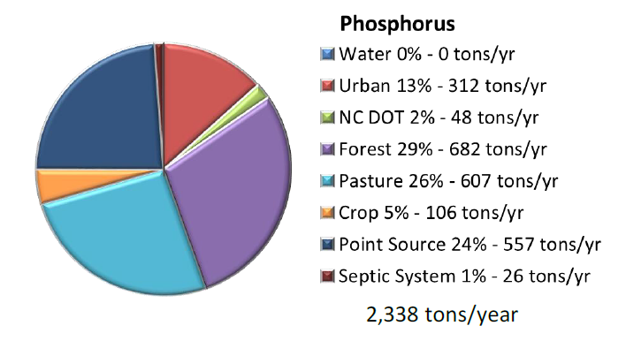
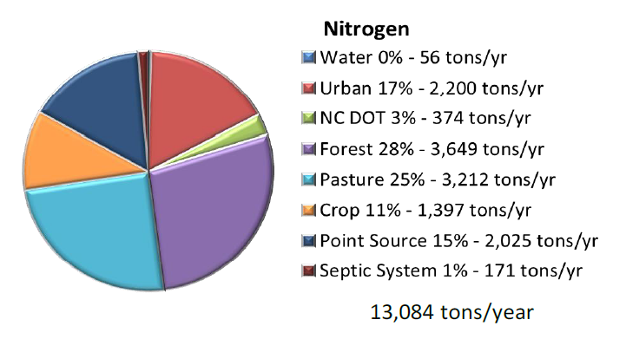
High Rock Lake Watershed Annual Nutrient Loading
Source: Tetra Tech 2012
Department of Environmental Quality

Slide 8
Nutrient Load “Reductions”
Source: Tetra Tech 2012
Department of Environmental Quality

Slide 9
Department of Environmental Quality
High Rock Lake
Nutrient Management
Strategy: Baseline Data
January 26, 2023

Slide 10
High Rock Lake Watershed Annual Nutrient Loading (tons/yr)
Urban: CGIA “developed” outside of MS4 boundaries
Department of Environmental Quality

Slide 11
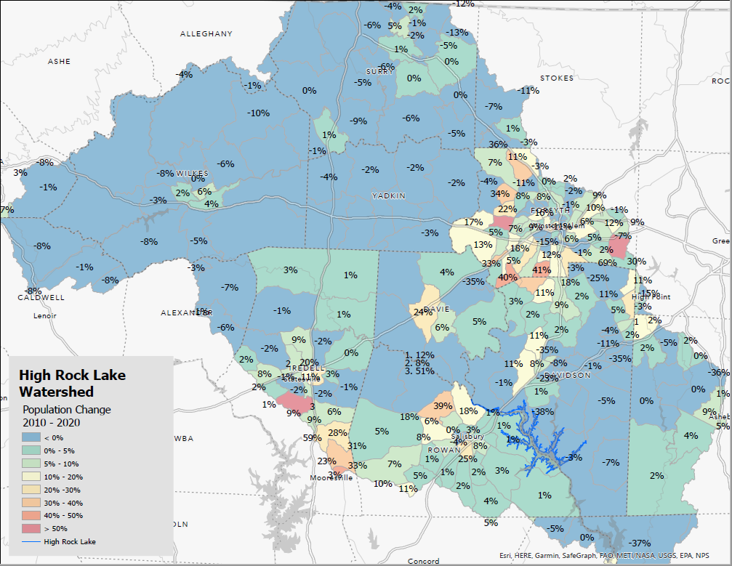

Slide 12
Nutrient Load Reductions
Curve determines overall % load reduction needed
% load reduction applied to nutrient export rate which determines SCM type & size

Slide 13
Current NC Stormwater Regulations in HRL
NPDES MS4 (14 in HRL)
  Construction site and post-construction stormwater controls
    All projects: 30’ setback
    Low density: dispersed flow, vegetated conveyances
    High density (> 24% BUA): treat 1” BUA runoff w/primary SCM; or annual runoff volume match
  Public education
  Illicit discharge elimination
  Pollution prevention & “good housekeeping”
HQW/ORW/WSW
  30’ vegetated setback
  Low density = dispersed flow, vegetated conveyances
  High density (varies from 6% to 24% BUA): treat 1” BUA runoff w/primary SCM; or annual runoff volume match, 100’ vegetated setback

Slide 14
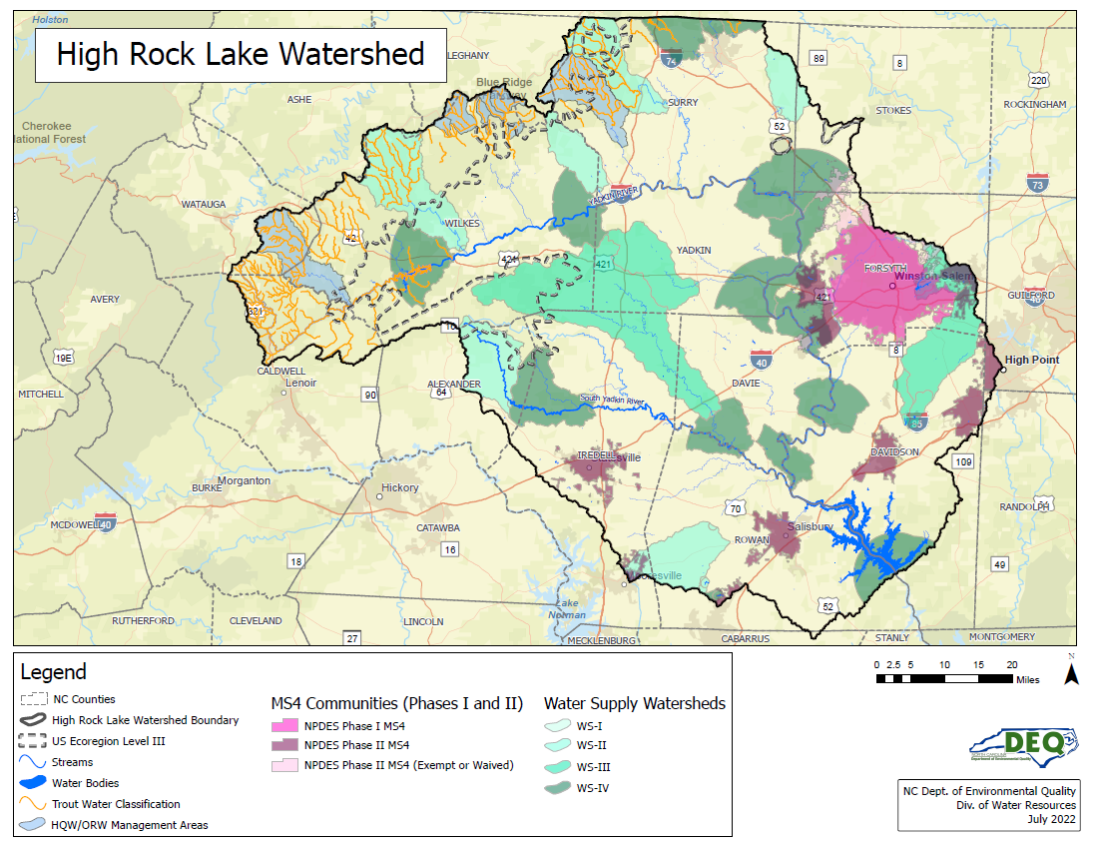

Slide 15
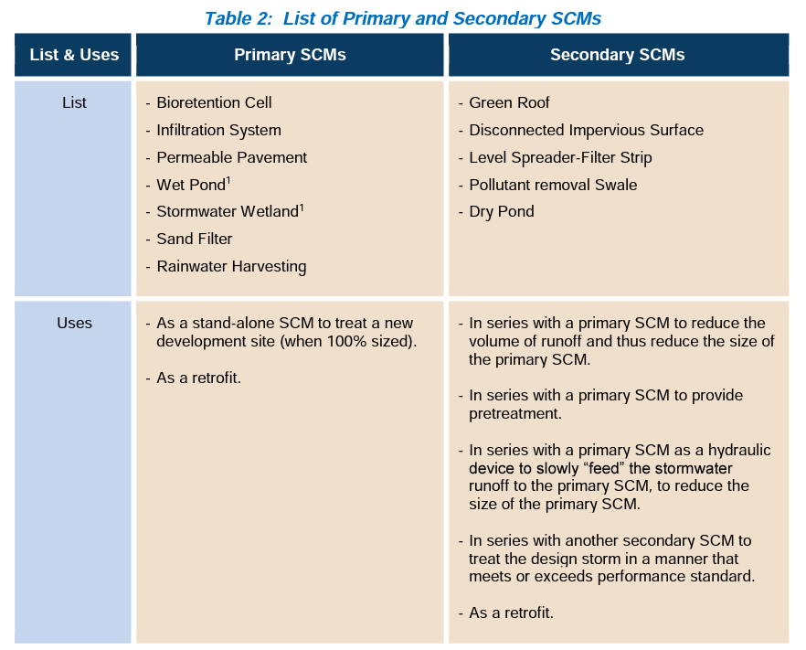

Slide 16
Overview
New Development Nutrient Stormwater Rules
Model program approved by EMC, local programs required
2 approaches to local governments included - N/T = “Swiss cheese”; J/F = all LGs
Programs include post-construction control, AND some or all of:
  ensure compliance, SCM maintenance for life of development;
  public education;
  mapping stormwater system;
  illegal discharges detection/elimination program.
Post-construction stormwater requirements:
  All use nutrient loading rate targets (lb/ac/yr); meet strategy goals project by project
  Onsite-offsite practices combine to meet targets
  Onsite
    Quality: Treatment minimums vary by rule; 30-50% of reduction need (Falls) or one primary SCM (others)
    Quantity: peak rate match, 1 yr/ 24 hr storm (Falls only)
  Offsite – buy credit for remaining load reduction per Nutrient Offset Rule 15A NCAC 2B .0703
    Private offset bank via DWR - https://deq.nc.gov/about/divisions/water-resources/water-quality-permitting/401-buffer-permitting/nutrient-offset-buffer-mitigation-program
    No bank credits available? DMS - https://deq.nc.gov/about/divisions/mitigation-services/customers/nutrient-offset-ilf-program-information

Slide 17
Details
New Development Nutrient Stormwater Rules
Neuse: 3.6 lb N/ac/yr loading rate target (or volume match);
Tar-Pamlico: 4.0 lb N/ac/yr, 0.4 lb P/ac/yr (or volume match);
Both Neuse and Tar (readopted):
  > 24% BUA 1º SCM; offset remainder
  Disturbance thresholds: 1 ac residential; ½ ac commercial/industrial/multi-family
  Exemption for individual SF lots NPOLCPDOS w/ <5% BUA
Falls:
    Disturbance thresholds: ½ acre residential; 12,000 ft2 commercial/industrial/multi-family
    2.2 lb N/ac/yr, 0.33 lb P/ac/yr (or volume match)
    Meet 30-50% of load reduction need onsite; offset remainder
Jordan:
  Nitrogen: UNH 2.2; LNH 4.4; Haw 3.8 lb/ac/yr
  Phosphorus: UNH 0.82; LNH 0.78; Haw 1.43 lb/ac/yr
  All projects above targets > 1 BMP, 85% TSS.
  Offset remainder where < 10 lb N/ac comm./ind. or < 6 lb N/ac SF residential
    Delivery factors apply, offset based on lake-delivered loads
  Quantity: peak rate match, 1 yr/ 24 hr storm

Slide 18
Stormwater Nitrogen and Phosphorus (SNAP) Accounting Tool
Currently used in Falls (Neuse, Tar-Pamlico begin using 2023)
Designed for usability across the State
Spreadsheet calculation, annual nitrogen and phosphorus runoff export from a development site with or w/o treatment (lb/ac/yr)
  Annual runoff volume * landcover-specific nutrient concentrations
  Annual runoff volume calculated with Simple Method
  Models nutrient reductions by Stormwater Control Measures (SCMs)
SCM nutrient treatment
  Inflow = catchment land covers area-weighted aggregate concentration
  Inflow partitioned through SCM to hydrologic fates
  Effluent - fixed event mean concentrations, SCM-specific
Site aggregated into annual runoff load N and P (lb/ac/yr)

Slide 19
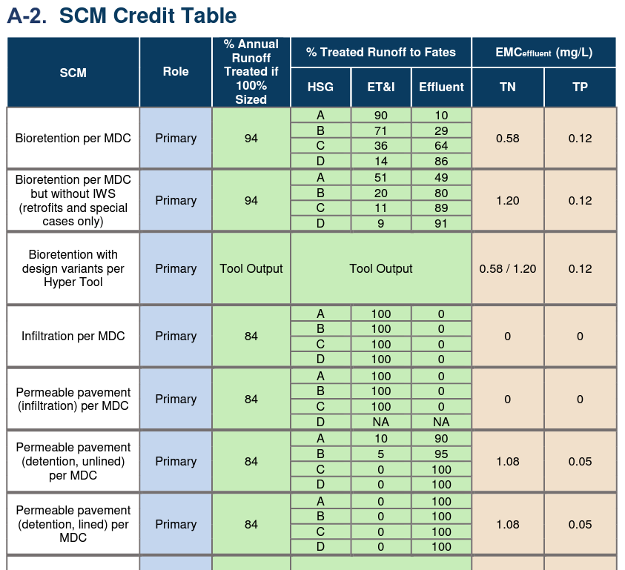
From DEMLR
SCM Credit Doc

Slide 20
Overview (cont’d) – Jordan, Falls
Existing Development Stormwater Rules
Regulated parties = all local governments
Jordan:
  Stage 1: Education, mapping, IDDE, Retrofits ID
  Stage 2 @ 5, 7 years: Lake monitoring trigger – Impaired? -> Programs required
Jordan, Falls: Nutrient load reduction programs
  Reduction targets = strategy goals applied to pre-New D developed lands w/in jurisdiction
    Falls Stage 1 target = offset post-baseline difference
  Propose pace of implementation – negotiable
    except Falls Stage 1 = 10 ~16 yrs
    Falls – Association alternative plan, “IAIA” = spending-based pace
  Broad latitude on load-reducing practices
    Main focus = existing developed lands w/in jurisdiction; challenging
    May also obtain reductions from other sources
    Joint compliance, combined (rules) compliance options
    (Initially) Only practices with approved nutrient crediting
    (Later) Falls IAIA: Explicit list – includes nutrient-friendly practices lacking accounting

Slide 21
Lessons Learned
New Development
  Avoidance
    Development “leaks” outside of regulated areas
    Local governments zone to avoid high density, or developers build to 23.9% BUA
    Whereas studies find stream degradation begins ~10% watershed BUA. Streambanks become nutrient source
  Standardization of req’s across watershed preferable to minimize sprawl, leakage
    However, recognize local administrative capacity is variable; need assistance options
  Lower density thresholds are appropriate
  Evidence suggests streams degrade under runoff from 1” treatment regime
Existing Development
  Reduction opportunities on existing developed lands challenging, costly; need to expand options
  Nutrient credit not yet established for many useful practices; need to loosen constraints
  Load reduction needs estimation challenging, draws over-focus, value/effort questionable; need to de-emphasize as compliance metric
  Progress clearly a long-haul proposition; needs to be built into recurring admin responsibilities

Slide 22

Questions?
Joey Hester
Joey.hester@ncdenr.gov
O: 919-707-3675
C: 919-418-5712
Department of Environmental Quality

Slide 23
New Development Rule Considerations
Nutrient export rate calculations, credits
Density thresholds
Primary vs Secondary SCMs
Hydrologic soil groups

