Slide 1
Watershed Improvements Project Tracker (WIPS)
NC WIPS2
20200714

Slide 2
WIPS Overview
Easily document watershed improvement projects
Captures restoration, protection and education projects
Easy to use with the Survey123 App or with a browser
Standardize improvement accountability statewide

Slide 3
WIPS Links
If links do not work on click- cut and paste into browser.
Open Survey in S123 app or browser- main link for collecting WIPS information
https://arcg.is/0yuGrC
Service URL- Can be added to any online map
https://services2.arcgis.com/kCu40SDxsCGcuUWO/arcgis/rest/services/survey123_47eceeb31f9a4fab8c4413bac5cb4cbb_stakeholder/FeatureServer
Link to main map for viewing data-This application is also embedded in Watershed Action Plan Story Maps
https://ncdenr.maps.arcgis.com/apps/webappviewer/index.html?id=83bb0bde319944c2ab055fec9de9e18d
DEQ Staff Contact
Cam.mcnutt@ncdenr.gov

Slide 4
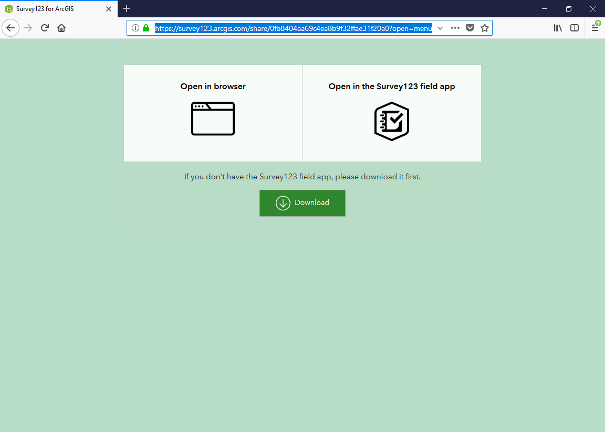
https://arcg.is/0yuGrC
The link above will get you to this page
Open the survey directly in a browser
Open in S123 desktop application or
Download the desktop application
Or install S123 App on phone or tablet –best option

Slide 5
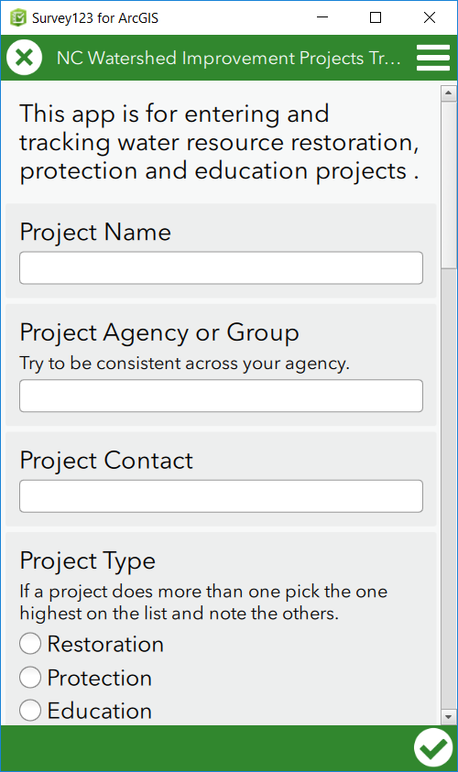
Project Name- Common local name of the project- Like Mud Creek Stream Restoration or 8th street rain garden project.
Project Agency or Group
If implementing multiple projects over time and space try to use the same name or acronym so that summary information and reporting will be easy.
Project Contact
Main point of contact for the project

Slide 6
Project Type- Depending on the type of project you will be asked to answer different questions and identify specific improvement activities. If there are different project types in the same area capture them separately.
Project Type=Restoration
Projects that reduce loading of pollutants or pollution (including stormwater volumes) to surface waters directly or indirectly or improve aquatic ecosystem functions (instream habitat or riparian).
Project Type=Protection
Projects that maintain current loading of pollutants or pollution (including stormwater volumes) to surface waters directly or indirectly or maintain current aquatic ecosystem functions (instream habitat or riparian). Ideally these would be in areas of low loading and high function.
Project Type=Education
Projects inform stakeholders about ways to restore, protect and understand aquatic ecosystems so they can participate in these activities and encourage others to as well.

Slide 7
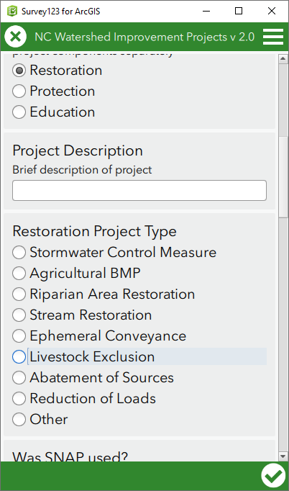
Project Type=Restoration
Projects that reduce loading of pollutants or pollution (including stormwater volumes) to surface waters directly or indirectly or improve aquatic ecosystem functions (instream habitat or riparian).
Depending on what you select you will be asked to enter an area treated or linear feet as well.

Slide 8
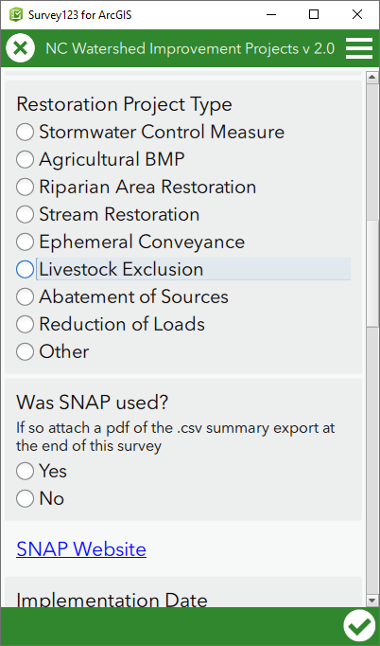
Project Type=Restoration
Indicate if the SNAP tool was used in design of restoration project
More information on SNAP here
https://deq.nc.gov/about/divisions/water-resources/planning/nonpoint-source-management/nutrient-offset-information#stormwater-nutrient-accounting-tools

Slide 9
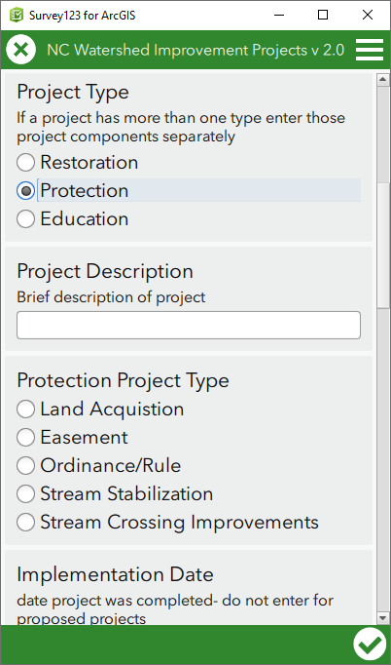
Project Type=Protection
Projects that maintain current loading of pollutants or pollution (including stormwater volumes) to surface waters directly or indirectly or maintain current aquatic ecosystem functions (instream habitat or riparian). Ideally these would be in areas of low loading and high function.
Depending on what you select you will be asked to enter an area protected or link to an ordinance or rule.
More information can be added about the project in the description and notes fields above

Slide 10
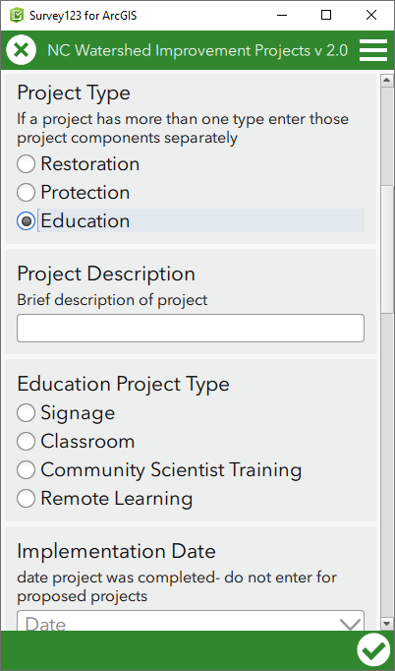
Project Type=Education
Projects inform stakeholders about ways to restore, protect and understand aquatic ecosystems so they can participate in these activities and encourage others to as well.
Depending on what you select you will be asked to enter the number of participants or a photo of the signage later in the survey
More information can be added about the project in the description and notes fields above

Slide 11
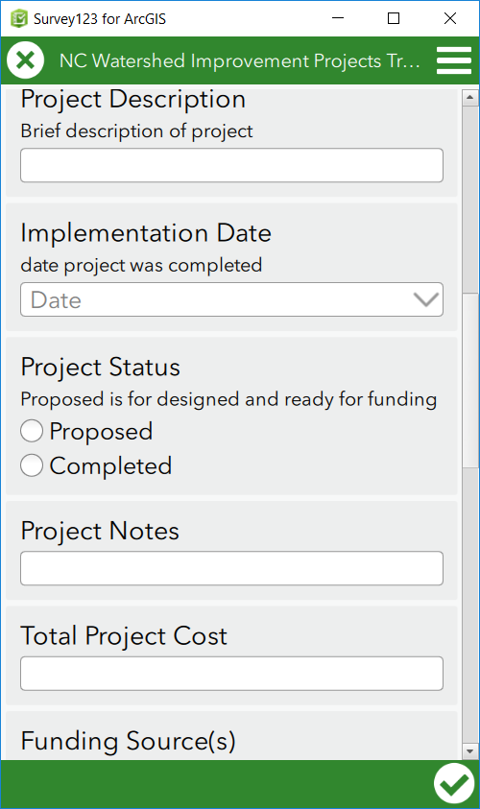
Project Description
Very brief like- 1,200 feet of stream restoration or 15 rain gardens installed in high priority areas along 8th street.
Implementation Date
Date project completed- projects can be entered from previous years
Project Status- This will be used along with project type for map symbolizing
Project Status=Proposed
Project is planned, has a conceptual plan and is in the process of finding funding. Do not complete implementation date for proposed projects. These will be replaced once a project is completed. Note- some projects may be proposed for a long time
Project Status=Completed
Project has been completed and in the monitoring phase
Project Notes- Any notes on project
Total Project Cost- Enter a number with no symbols

Slide 12
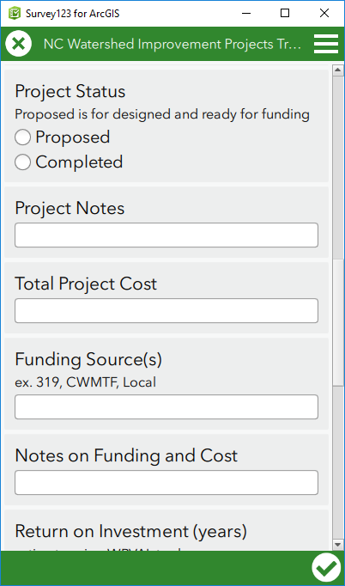
Funding Sources- Text indicating funding sources for project
Notes on Funding Sources and Cost- If applicable

Slide 13
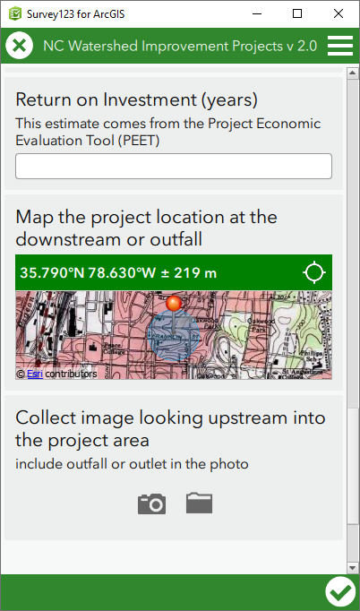
Return on Investment- PEET
The tool will help determine dollar values added by the project and the estimated Return on Investment in years. (coming soon)
Map the point- on phone or tablet the location should be where you are standing. Tap the map to make it larger. Zoom in to confirm location at outfall or downstream point of area of interest. Click check circle in bottom right of screen to save this location- this will also take you back to the survey.
Collect Image- use your phone camera or upload a picture. For proposed plan a small pdf of the conceptual plan maybe useful.
Click the check circle to complete the survey-bottom right

Slide 14
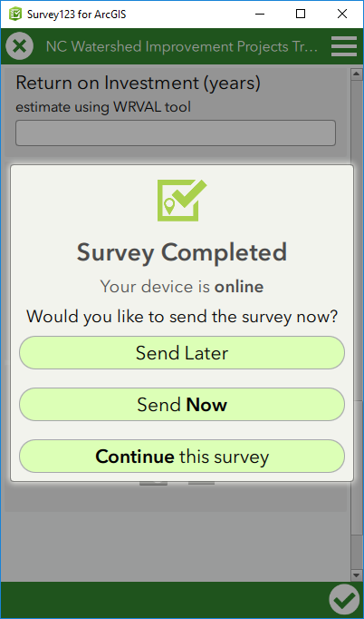
Survey Completed- Continue if you want to review your answers otherwise it is recommended to send now.

